Slide 1
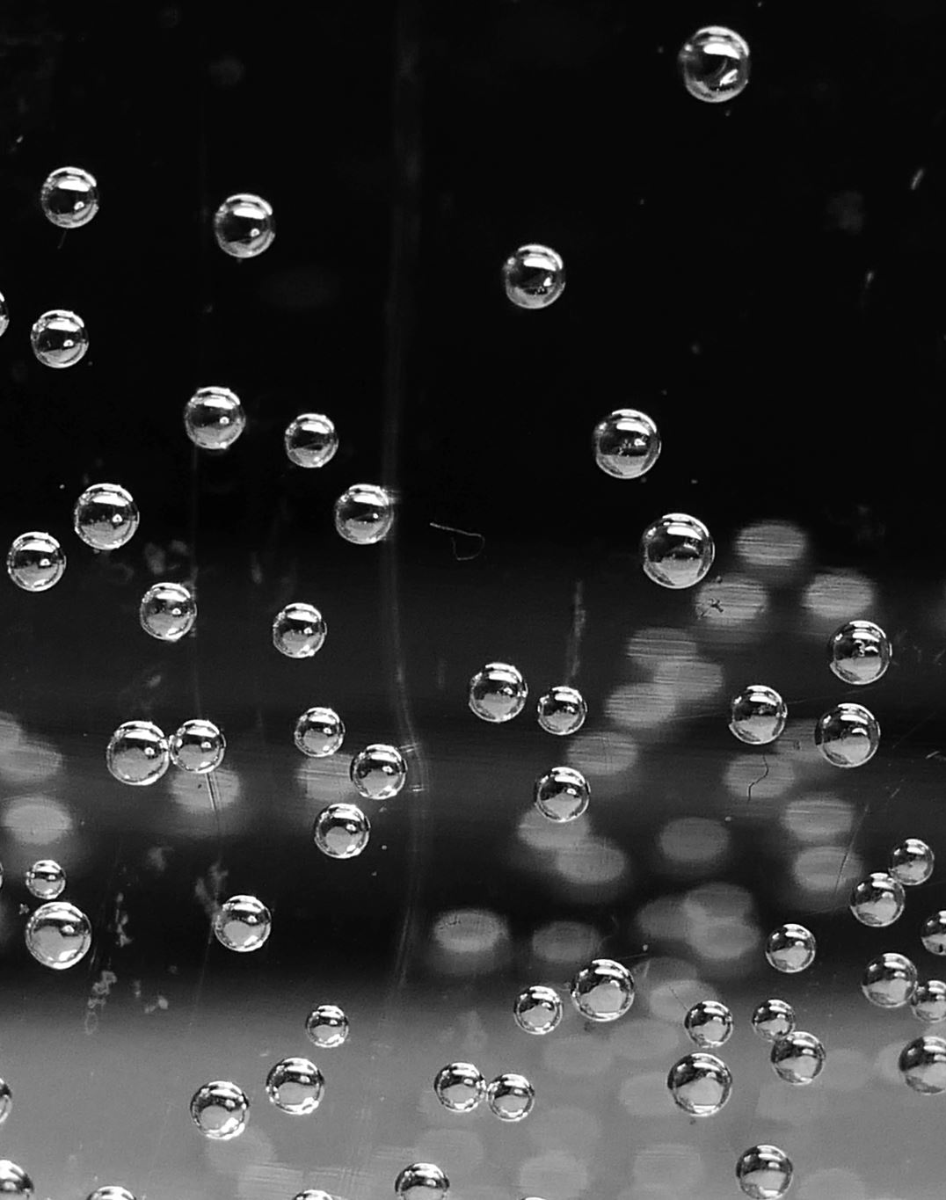
Fizzy Drinks vs Water
Healthy Eating- session 10

Slide 2
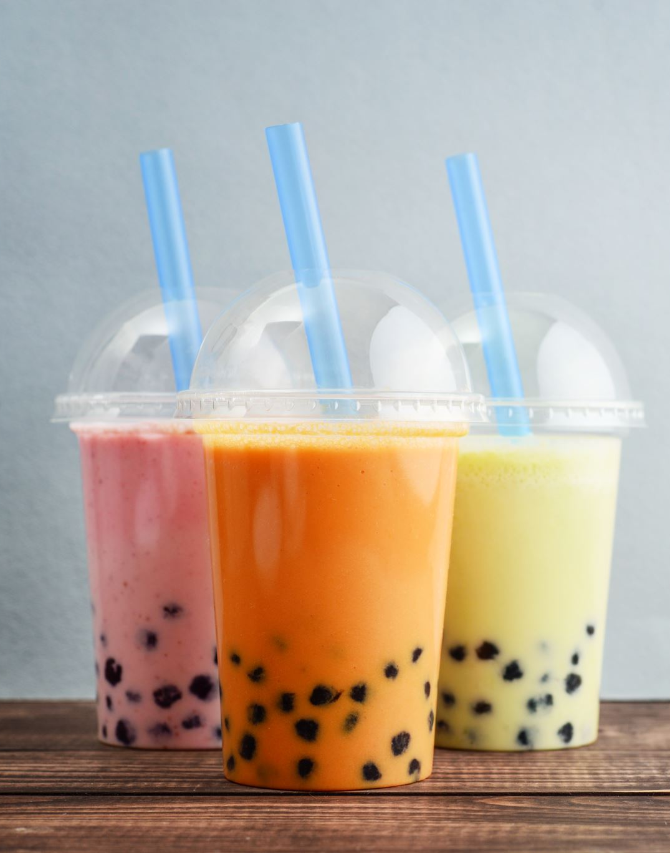
Introduction
Establishing context
What are your favourite beverages to drink?
Which ones are healthy? Why?
How many sugary drinks have you drank today?

Slide 3
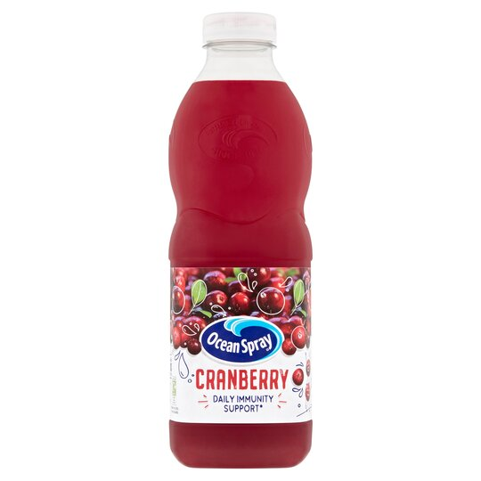

Slide 4
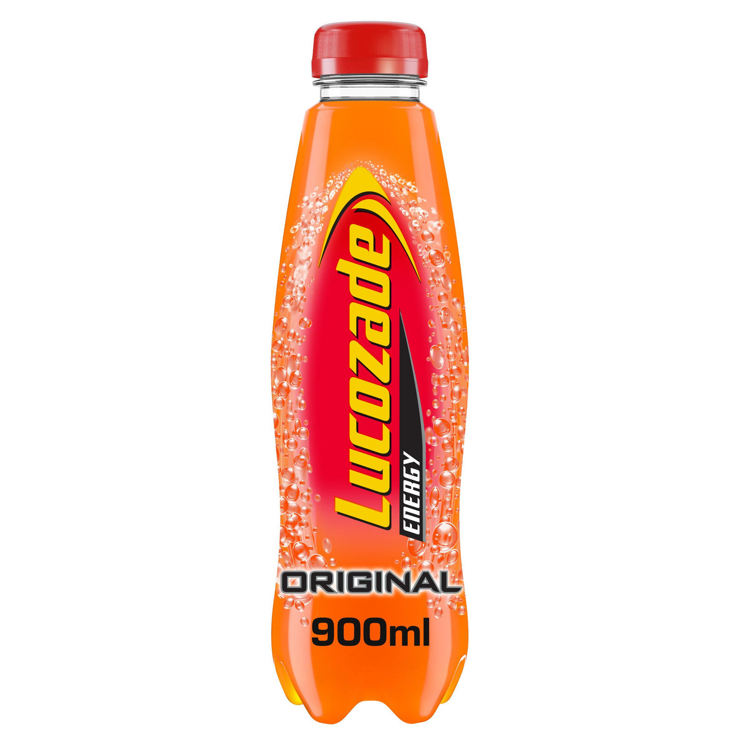
Lucozade original has 11.2g per 100 of sugar- each bottle will contain 56g of sugar per bottle which is 14 sugar cubes per bottle.
Mountain Dew has 12.3g of sugar pre 100ml – each bottle typically contains 500ml = 61.5g of sugar in each bottle which is 15.4 cubes of sugar per bottle.

Slide 5
Recommended guidelines
Recommended intake for young people aged 10 is 24g
Aged 11 - adults is 30g.
One of these drinks per day is almost double your recommended intake.
Have you had days where you have drank more than 2 of these?

Slide 6
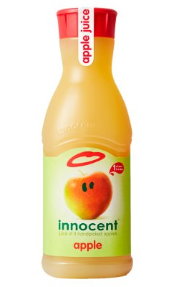
Both healthy? If so, why? If not, why?
Water has 0 sugar
Apple juice has 9.5g per 100ml.

Slide 7
Activity
Working as a team, using the sugar cubes in front of you, place the amount of sugar you think is in each bottle of juice.
Explain why you have chosen to put that amount in.
Revisit the choices that participants put on the board and ask would they still consume the same amount knowing about sugar levels?

Slide 8
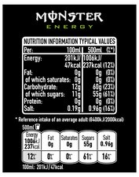
Reading the label
When buying a fizzy drink, always read the back of the label;
There is a box called ‘Nutrition Information Typical Values’
Have a look at the section reading ‘Carbohydrate: of which sugars’.
In this tin of Monster energy drink there are 55grams of sugar.
The NHS advises that
Adults should have no more than 30g of free sugars a day, (roughly equivalent to 7 sugar cubes). Children aged 7 to 10 should have no more than 24g of free sugars a day (6 sugar cubes).
Notes:
By drinking just one of those you are drinking more than your daily amount. Is it worth it?
What else do you eat/drink in a day that contains sugar?

Slide 9
Traffic Lights
Using the bottles in front of you, label them
Green – if you can drink them all the time
Amber – if you can drink them sometimes throughout the week.
Red – if you should not be drinking them at all

Slide 10
Why drinking water is important
Without water, your body cannot function correctly.
Going without water for even short periods of time can cause dehydration.
Children should be drinking about six to eight glasses of fluid a day to avoid dehydration. Adults need to drink a bit more.
However, if you participate in sport or go outside during warm weather, you may need to drink more than this as you lose fluid faster through increased sweating.
How much water have you drank today?
What stops you drinking enough?

Slide 11
Benefits of drinking water
Aids digestion
Flushes bacteria from your bladder
Normalises blood pressure
Helps muscle and joint function
Protects and helps vital organs to function
Regulates body temperate.

Slide 12
Activity
Activity In groups, fill a pint glass with water to demonstrate how much water should be drank each day and see what group can get closest to the recommended intake.
In the same groups, discuss how the group can drink more water each day and keep track of this. Use slides 16-18 to help you).

Slide 13
How to know if you are dehydrated
Babies, toddlers and children are most at risk of dehydration.
You may be dehydrated if you have any of the following symptoms:
Thirst is an early sign and your body’s signal that you should drink something!
Headaches
Lack of concentration
Dry mouth
Constipation
Tiredness
Dark-coloured urine

Slide 14
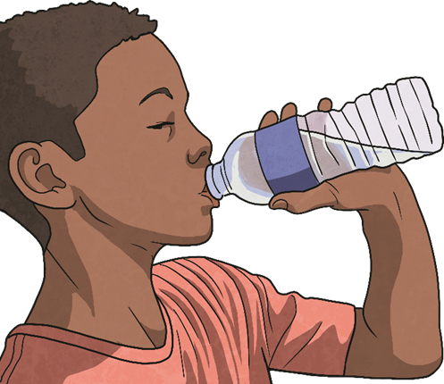
Ways to prevent dehydration
Bring a water bottle to school. If it's a warm day, try a frozen water bottle.
Always drink before, during and after physical activity.
Drink during meals and with your snack.
Try adding fresh fruit to your water.
Experiment with the temperature; some people like iced cold water and some prefer it warmer.
Water is best but milk and juice also keep you hydrated. Just watch out for added sugar!
What other tips can you think of?

