Slide 1
Sleep deprivation
Physical health
Session 3

Slide 2
Sleep deprivation
Sleep is a time of rest during which consciousness of the world is suspended.
Sleep is an essential component of health. Quality sleep promotes and maintains good health and physical performance. Sleep deprivation causes ill health and can lead to detrimental medical conditions.

Slide 3
How much sleep should we be getting?
Most of us need around eight hours of good-quality sleep a night to function properly – but some need more and some less.
What matters is that you find out how much sleep you need and then try to achieve it.
Good-quality sleep is more important than the amount of sleep that you get, and it helps to keep you feeling healthy.
How many hours each night do you sleep? Gauge the group medium and keep this number to compare with recommended guidelines.

Slide 4
Sleep deprivation (Cont.)
According to studies, 73% of young people do not achieve their recommended sleep (AASM, 2018).
Main contributors to this are:
Excessive screentime reduces the amount of melatonin (hormone that controls sleep) released.
Anxiety
Stress
Lack of routine (no set structure)
What does the group think? Agree or disagree?

Slide 5
Activity: differences in sleep
Lets have a bit of fun while finding out how different sleep is to each person. So, take a piece of paper and find someone somebody to fit each of the different sleeping habits.
Had 8 hours sleep last night
Had 6 hours sleep last night
Sleeps with the window open
Sleeps on one pillow
Sleeps on 2 pillows
Takes a glass of water to bed
Sleeps with one leg in and one leg out of the blanket
Needs absolute silence to sleep
Listens to music to help them fall asleep
Sleeps with their pet
Snores
How many did you get?

Slide 6
Factors that influence sleep
Diet- caffeine (contained in coffee, tea, cola and chocolate) is a stimulant and can prevent you from getting to sleep. Spicy and acidic foods or eating a big meal before you go to bed can cause heart burn and indigestion. Sugar can also contribute to negative sleeping patterns.
Tobacco- nicotine is a stimulant and can prevent you from getting to sleep. Nicotine is also addictive and smokers tend to wake up after 2-3 hours of sleep due to nicotine withdrawal.

Slide 7
Additional factors that impact sleep
Environmental factors such as noise, light, extreme temperatures or changes in your environment.
Exercise: during the day can help you sleep but exercise just before you go to bed can prevent you from getting to sleep.
Drugs: many herbal supplements over the counter or prescription medication activate the brain and cause sleep disruption.
Alcohol: induces light sleep but impairs the deeper and more restorative stages of sleep.

Slide 8
What is a good night sleep?
Discuss as a group what you think a good night’s sleep is and what it feels like when you have had one. For example, do you concentrate better at school with a good night’s sleep, or do you enjoy being active more when you have more energy?
When you have had a good sleep, what are the benefits you have experienced?
Notes:
Encourage them to think about the type of bed they have for example, a single or double bed. How dark or quiet the room is and what they do before bedtime.

Slide 9
What happens when we sleep
Growth and repair
Improved physical wellbeing
Boosts mental wellbeing
Boosts the immune system
Improved concentration for learning and memory

Slide 10
Growth and repair
Human growth hormone is released under conditions of sleep. Sleep deprivation or poor-quality sleep can interfere with this and impact growth in the long term.

Slide 11
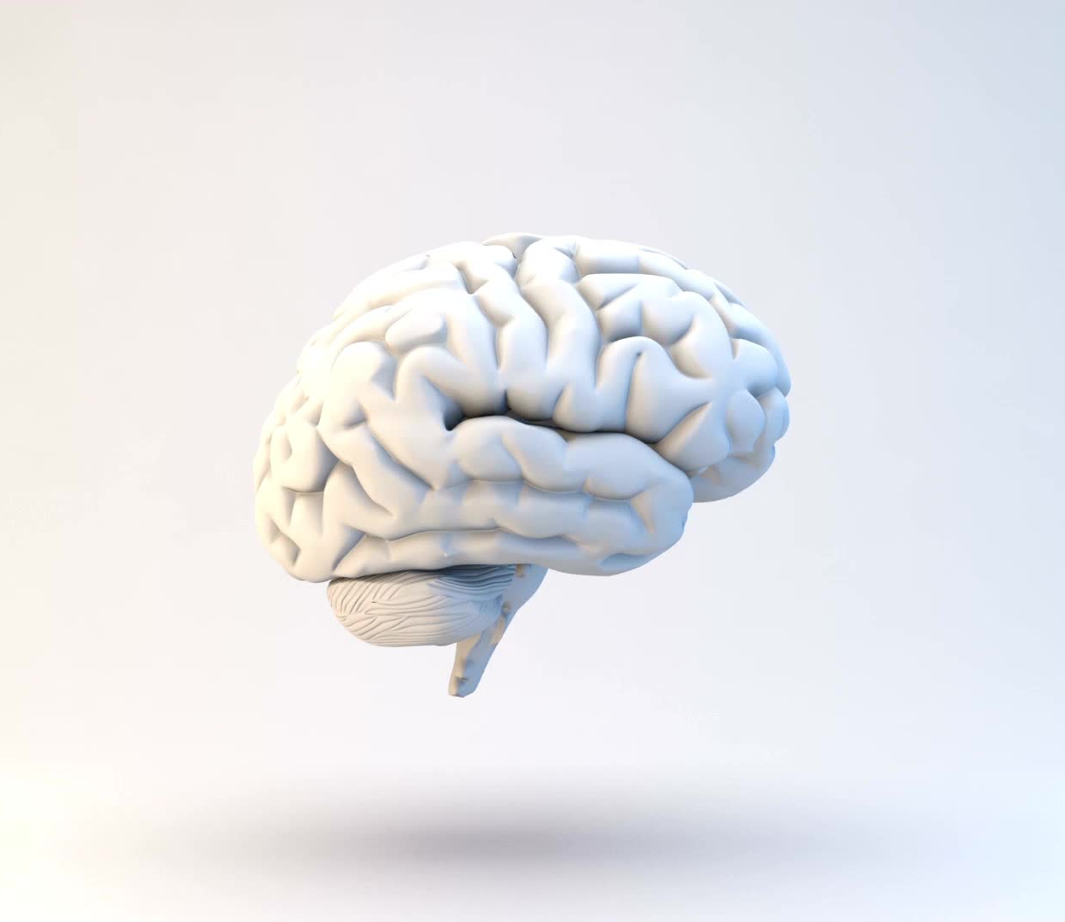
Improved concentration, learning and memory
Sleep facilitates memory, learning and social processes. Sleep enables the brain to encode new information and store it properly.
The parts of the brain that control emotions, decision-making and social interactions slow down during sleep, allowing optimal performance when awake.

Slide 12
Boosts mental well-being
Sleep allows the brain to recharge.
Motivation is highest when mental alertness is highest.
Sleep deprivation or poor-quality sleep can affect alertness and motivation, causing issues with being able to carry out daily tasks.

Slide 13
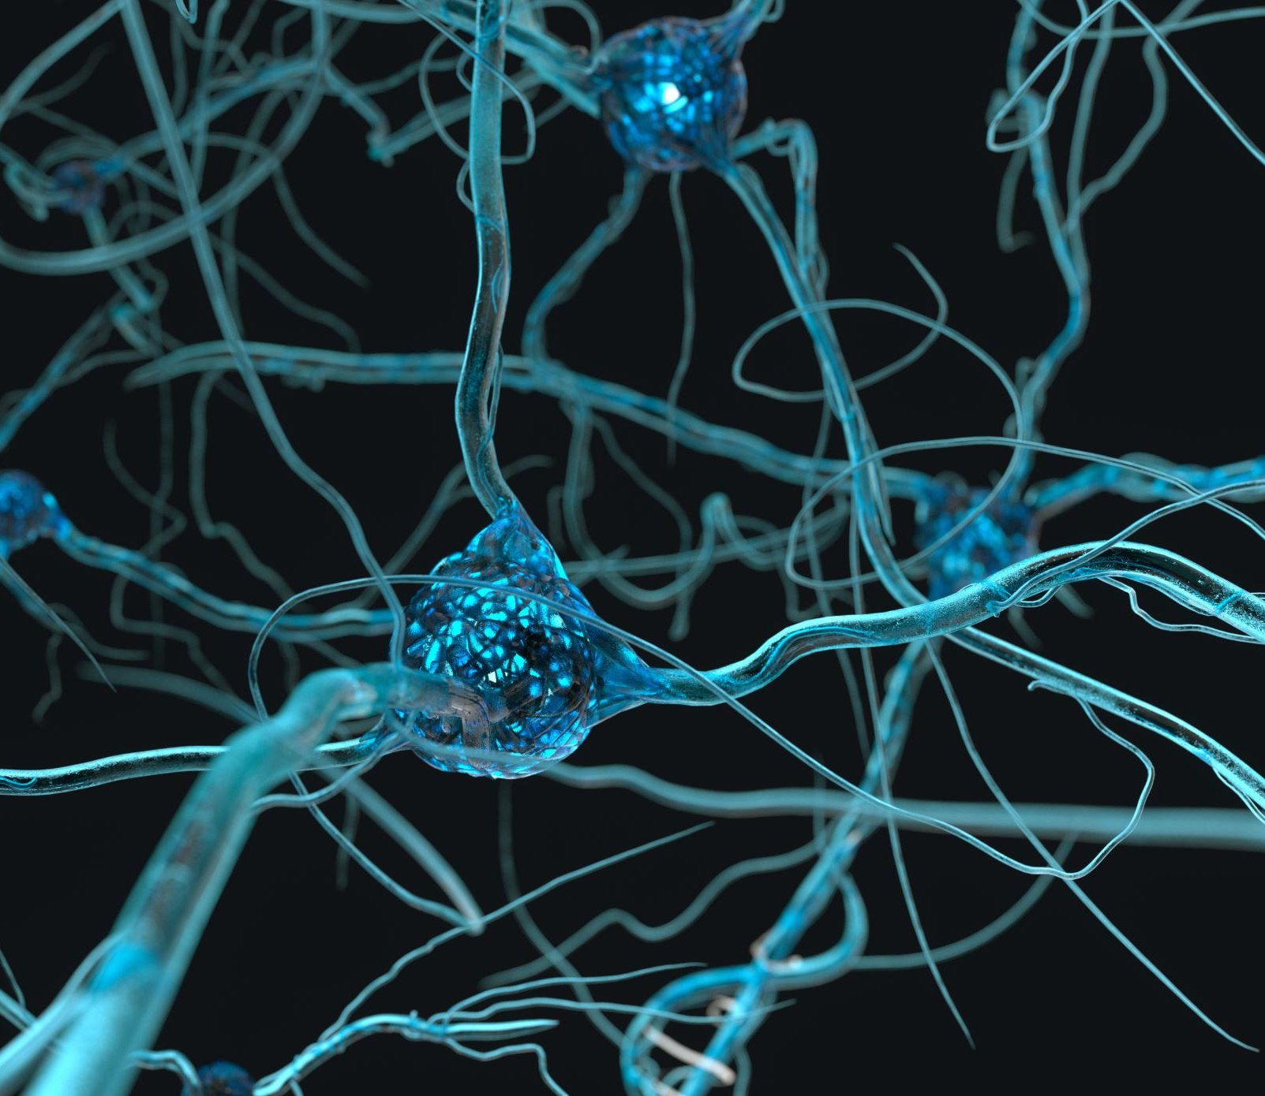
Boosts the immune system
Sleep allows the repairing of muscles, neurons in the nervous system and other tissues, and the replenishing of immune cells.
This repairing is maximal during sleep as energy consumption is lowered and is directed towards the healing or recovery process. Sleep deprivation or poor-quality sleep can interfere with this, the repair and recovery will not be as effective. When you are experiencing periods of illness, your body wants to sleep to recover.

Slide 14
Improved physical state
Sleep follows a pattern and has several stages.
To fully recover, your brain must experience each stage.
If sleep deprivation or poor-quality sleep prevents this, you will not be at your peak and therefore physical performances will suffer.

Slide 15
Notes:
Everyone stands in the middle of the room – one wall = true, other wall = false. Pose each statement to the young people – depending on if they think the statement is true or false, move to that wall.

Slide 16
You should eat a huge meal before you go to sleep…

Slide 17
False: when you consume food your body starts the digestion process which can be unsettling and impair sleep. Light meals a while before bed time is better.

Slide 18
You must have a comfy bed…

Slide 19
True: a structured bed helps supports your body when your muscles relax during deep sleep. It should not be too soft or too firm and should be big enough.

Slide 20
We should have lots of blankets and keep the heating on all night…

Slide 21
False: We sleep better in a cooler environment – think hibernation. Ideally room temperature should be between 16-24°C (20°C for babies and young children, who find it harder to regulate body temperature). Bed clothes also need adjusting.

Slide 22
We all sleep differently…

Slide 23
True: We are all different. Some will need less sleep; some more. Some will be larks, some will be owls i.e. some prefer early to bed, some early to rise.

Slide 24
We should go to bed and get up at the same time every day…

Slide 25
True: Keep regular hours. Going to bed and getting up at roughly the same time will programme your body to sleep better.

Slide 26
Exercise just before bedtime will help you sleep…

Slide 27
False: Regular, moderate exercise can help relieve the day’s stresses and strains. But not too close to bedtime or it may keep you awake due to adrenaline.

Slide 28
The size of your bed is important to a good night’s sleep…

Slide 29
True: The bed should be a minimum of 6 inches longer than you when you are lying down. The right length is really important so you have enough room while you are asleep

Slide 30
If you can’t sleep, stay in bed anyway…

Slide 31
False: If you can’t sleep, don’t lie there worrying about it. Get up after 20 minutes and do something you find relaxing until you feel sleepy again - then go back to bed.

Slide 32
Having TVs, computers and fun gadgets in your room helps you sleep...

Slide 33
False: Having lots of gadgets in your bedroom can be very distracting and even make you stay up later. A bedroom, or the area where your bed is, should be for sleeping and be a calm place. Switch off all gadgets when it is sleep time.

Slide 34
An old bed is as good as a new one...

Slide 35
False: Just like mattresses, beds do wear out. After seven years it is worth checking if you need to replace your bed for better sleep. An old mattress does not provide the optimum sleep environment for support, comfort, hygiene etc.

Slide 36
Your room should be dark when you sleep…

Slide 37
True: Your room needs to be dark to have a good night’s sleep, curtains should block out light and bedside lamps should be switched off.

Slide 38
Strategies for better sleep
Stick to a schedule. This means resisting daytime sleep.
Pay attention to what you consume each day and watch for sugary content before bed.
Create conditions that will give you the best sleep.
Limit screentime before bed.
Avoid large meals before bedtime.
Exercise during the day.
Practice breathing techniques to reduce stress.
Interesting to see that healthy eating, emotional wellbeing, social wellbeing and physical activity is all related to how you sleep. Do you all agree and if so, how?

Slide 39
Individually or with a partner, design a poster promoting the benefits of a good night’s sleep for younger participants at your youth club.

