Slide 1
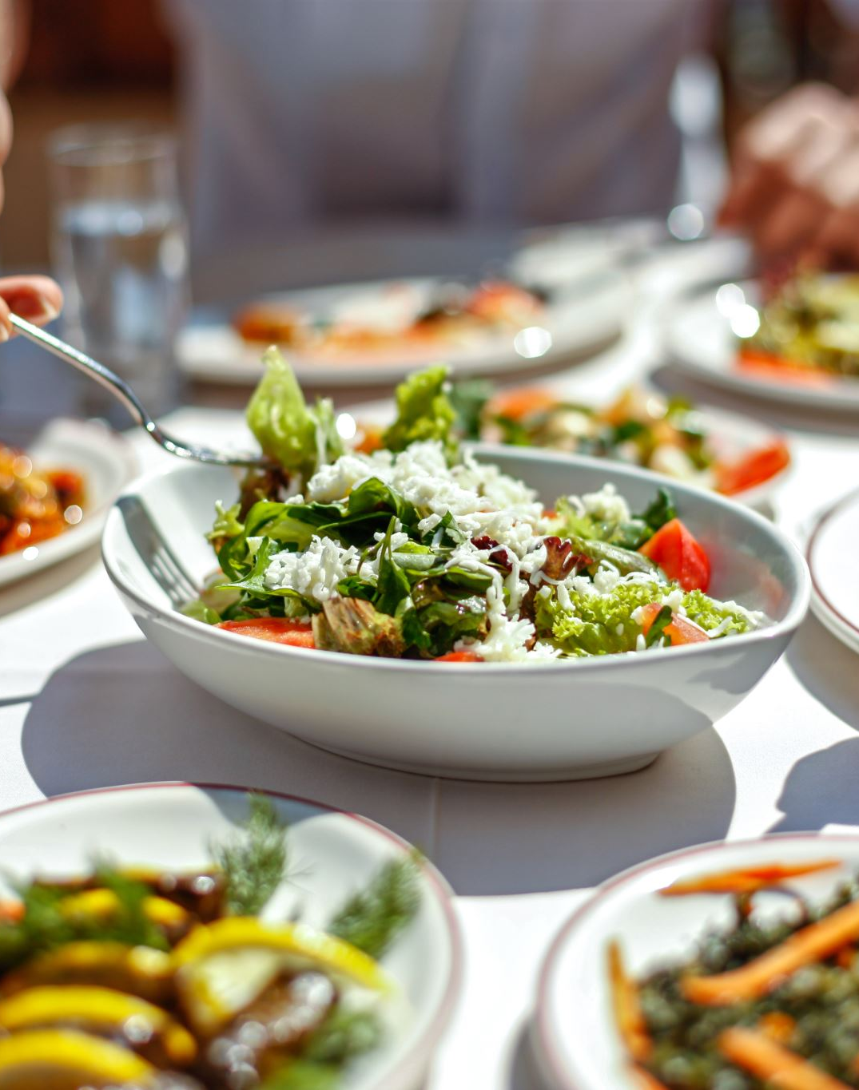
The Eat Well Guide
Theme: Healthy Eating- session 9

Slide 2
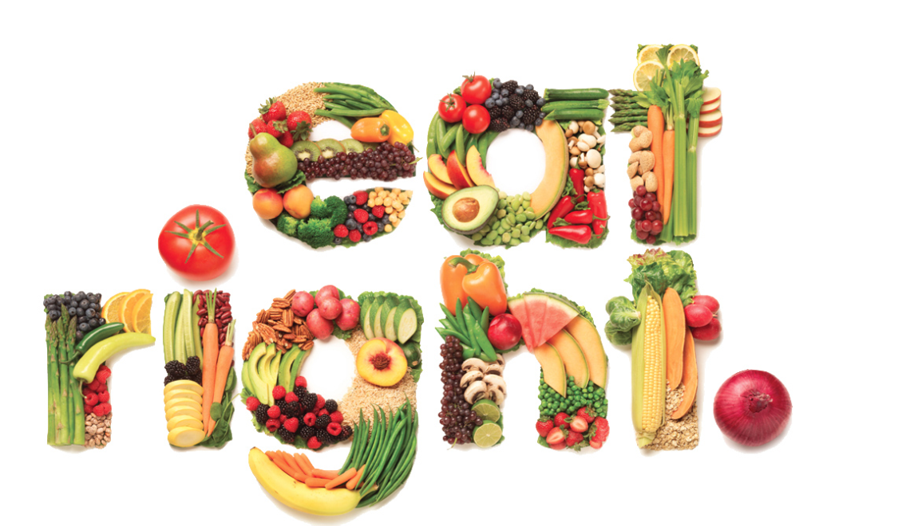
Healthy eating
What we eat every day has a big impact on our health.
The things we eat will have an impact on the amount of energy we have when we get up in the morning. A healthy diet will have a massive impact on behavior, activity levels and social wellbeing.
Why would this be?
A healthy diet doesn’t have to be boring – we can still eat delicious foods, while keeping an eye on our intake of sugar, fat and salt.

Slide 3
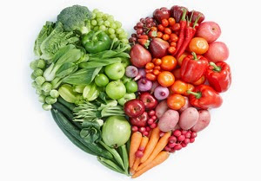
Why is your food consumption important?
Your DIET is your particular eating pattern.
It is the mixture of foods that you eat in the amounts that you actually eat them.
You need to eat food to:
Maintain life
Growth and repair
Help the body function
Without a balanced diet, you will be unable to carry out voluntary physical activity and therefore struggle to maintain your physical health.

Slide 4
Healthy eating
The key to health eating is:
Eating the right amount of food to reflect how active you are. For example, if you are extremely active in a specific day, you have to eat enough food for this purpose. However, if you are not as active, you do not need to consume as much.
Eating a range of foods to make sure that you are eating a balanced diet.
Group question: will everyone eat the same amount of food?
Personal reflection: what do you eat and drink? Write down your daily food consumption.

Slide 5
Barriers to healthy eating
What are the main factors that impact your ability to eat a balanced diet?
According to research, the main barriers for young people are:
Parental involvement or lack of.
Lack of funds to purchase their own food
Lack of ability to cook their own healthy meals.
Would you agree?

Slide 6
Introduction to the Eatwell Guide
The Eatwell Guide shows the different food groups that create a balanced diet and the proportions in which different groups of foods are needed to have a well-balanced and healthy diet.
The proportions shown are representative of food eaten over a day or more, not necessarily at each mealtime.
The different food groups help get the wide range of nutrients the body needs to stay healthy.

Slide 7
The Eatwell Guide (cont.)
Watch the video as an introduction to the Eatwell guide. https://www.youtube.com/watch?v=QaILk3SQfhw
Can you name the 5 food groups discussed in this video?
The Eatwell Guide applies to most people regardless of weight, dietary restrictions/preferences or ethnic origin.
It doesn’t apply to children under two years because they have different nutritional needs.
Children aged two to five years should gradually move to eating the same foods as the rest of their family, shown on the Eatwell Guide.

Slide 8
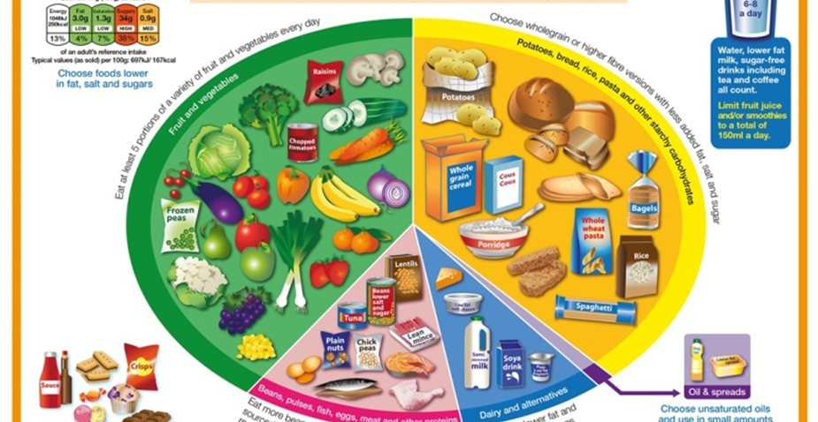
Notes:
Discuss whether the eat well guide would change depending on activity levels or should this stay the same? If it would change, which aspects and why?

Slide 9
The Food Groups
Let’s take a closer look at each food group.
Fruit and vegetables
Potatoes, bread, rice, pasta and other starchy carbohydrates
Beans, pulses, fish, eggs, meat and other proteins
Dairy and alternatives
Oils and spreads

Slide 10
Fruit and vegetables
Fruit and vegetables should make up just over a third of the food we eat each day
Aim to eat at least five portions of a variety of fruit and vegetables each day.
Choose from fresh, frozen, canned, dried or juiced.

Slide 11
Potatoes, bread, rice, pasta and other starchy carbohydrates
Starchy food should make up just over a third of the food we eat.
Choose higher-fibre, wholegrain varieties when you can by purchasing whole-wheat pasta, brown rice, or simply leaving the skins on potatoes.
Wholegrain food contains more fibre than white or refined starchy food, and often more of other nutrients. We also digest wholegrain food more slowly so it can help us feel full for longer.

Slide 12
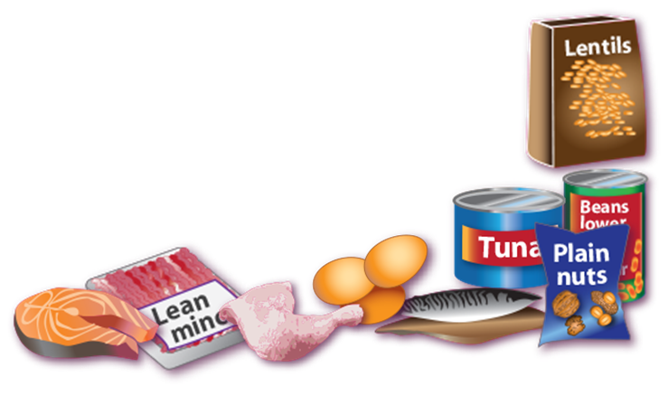
Beans, pulses, fish, eggs, meat and other proteins
These foods are sources of protein, vitamins and minerals, so it is important to eat some foods from this group.
Beans, peas and lentils (which are all types of pulses, sometimes called ‘legumes’) are good alternatives to meat because they’re naturally very low in fat, and they’re high in fibre, protein and vitamins and minerals. Other vegetable-based sources of protein include tofu and chickpeas.
Aim for at least two portions (2 x 140g) of fish a week, including a portion of oily fish. Most people should be eating more fish, but there are recommended limits for oily fish, crab and some types of white fish.

Slide 13
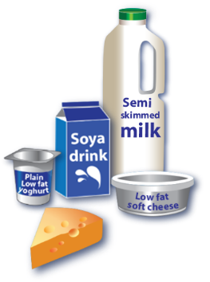
Dairy and alternatives
Try to have some milk and dairy food (or dairy alternatives) such as cheese, and yoghurt.
These are good sources of protein and vitamins, and they’re also an important source of calcium, which helps to keep our bones strong.
Some dairy food can be high in fat and saturated fat, but there are plenty of lower-fat options to choose from.

Slide 14
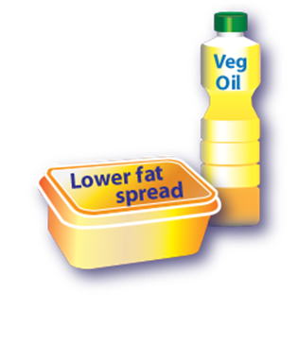
Oils and spreads
Although some fat in the diet is essential, generally we are eating too much saturated fat and need to reduce our consumption.
Unsaturated fats are healthier fats that are usually from plant sources and in liquid form as oil, for example vegetable oil, rapeseed oil and olive oil.
Swapping to unsaturated fats will help to reduce cholesterol in the blood, therefore it is important to get most of our fat from unsaturated oils.
Choosing lower fat spreads, as opposed to butter, is a good way to reduce your saturated fat intake.
Remember that all types of fat are high in energy and should be limited in the diet

Slide 15
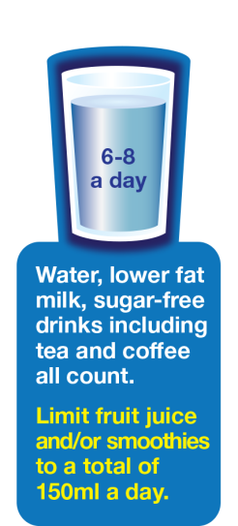
Hydration
Aim to drink 6-8 glasses of fluid every day.
Water, lower fat milk and sugar-free drinks including tea and coffee.
Fruit juice and smoothies also count towards your fluid consumption, although they are a source of free sugars and so you should limit consumption to small doses each day.
Sugary drinks are one of the main contributors to excess sugar consumption amongst children and adults in the UK.
Swap sugary soft drinks for diet, sugar-free or no added sugar varieties to reduce your sugar intake in a simple step.
Do you have 6-8 glasses of water each day?

Slide 16
Foods high in fat, salt and sugars
This includes products such as chocolate, cakes, biscuits, full-sugar soft drinks, butter and ice-cream.
These foods are not needed in the diet. If they are included, have infrequently and in small amounts.
If you consume these foods and drinks often, try to limit their consumption so you have them less often and in smaller amounts. Food and drinks high in fat and sugar contain lots of energy, particularly when you have large servings.
Try to limit these. What would happen if these made a large portion of your diet? Would it be good?

Slide 17
Summary of tips across the guide you can use.
Eat at least 5 portions of a variety of fruit and vegetables every day.
Base meals on potatoes, bread, rice, pasta or other starchy carbohydrates; choosing wholegrain versions where possible.
Eat some beans, pulses, fish, eggs, meat and other proteins (including 2 portions of fish every week, one of which should be oily).
Have some dairy or dairy alternatives (such as soya drinks); choosing lower fat and lower sugar options.
Choose unsaturated oils and spreads and eat in small amounts.
Drink 6-8 cups/glasses of fluid a day.
If consuming foods and drinks high in fat, salt or sugar have these less often and in small amounts.

Slide 18
Activity 1.1
Based on your knowledge of the Eatwell guide, fit your own diet into the format of the guide. This will help participants distinguish between food groups and reflect on how their own food consumption compares with the recommended guidelines.

Slide 19
Activity 1.2
Break the participants into three groups, one of which to create a healthy breakfast, lunch and dinner based on the Eatwell guide. This activity will equip young people with the knowledge on how to design healthy meals. Each group to present their chosen meals to the collective and discuss the food groups included.

Slide 20
Game to finish Eatwell bingo

Slide 21
Three things we learned today…

