Slide 1
Social Media and Young People
Social wellbeing
Session 6

Slide 2
Do we have more in-person relationships or online relationships? Is this a good thing?

Slide 3
Are we too reliant on social media to build relationships?

Slide 4
Online Relationships
Social media has exploded in popularity over the past 10 years. Social media is used to connect with people, people you know and people you don’t know. Connecting online to other people, has become part of everyday life.
Online relationships are like in-person ones. We need to be aware of the benefits and risks on interacting with people that we don’t know in real life. We must know what boundaries to put in place when getting to know someone online.
Relationships formed online can also be fulfilling and meaningful. However, they can also turn out to be dangerous.

Slide 5
The Internet and digital technology play an important and often very positive role in helping us build and maintain relationships.
Can you think of occasions when this may be the case?
What different online platforms and technology can be used to build and maintain relationships?

Slide 6
In pairs, copy the table below – Is social media a good form of communication?
Positives | Negatives
 | You cannot see the person’s emotions – are they upset? Sarcastic?

Slide 7
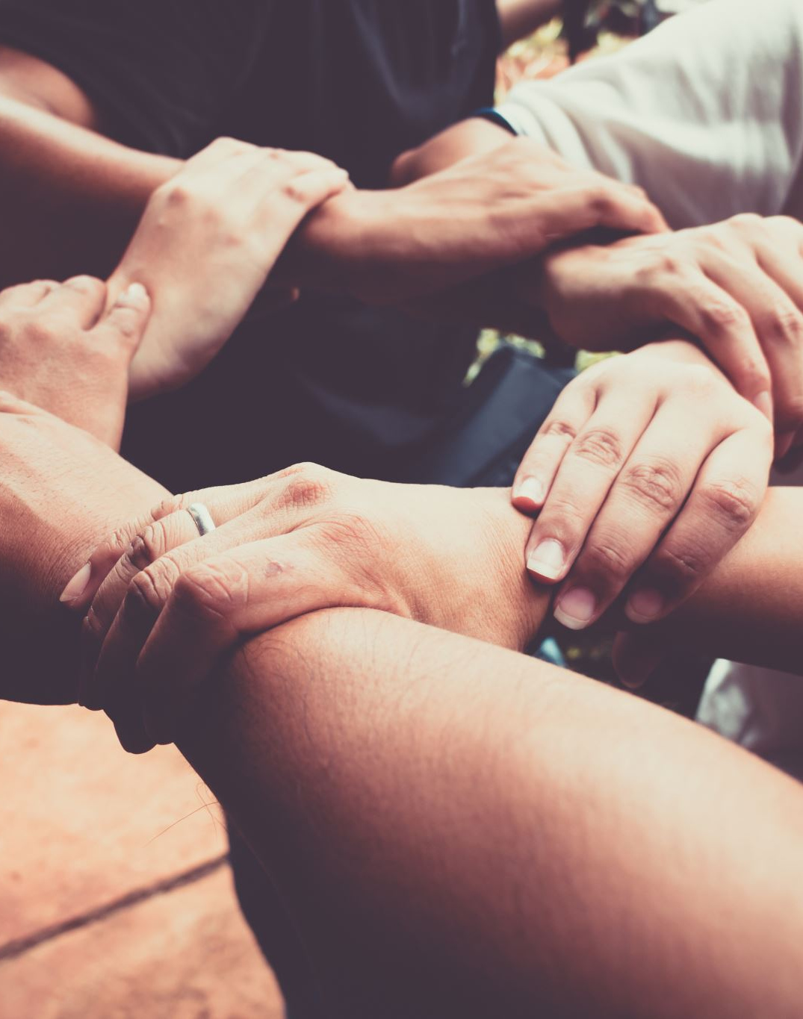
Positive Online relationships
We are treated with kindness and respect
Our privacy and personal boundaries are respected
We are accepted for who we are and are not teased or made fun of
Our feelings are considered and the others in the relationship chose to act in a way that doesn’t hurt them
We can trust the other in the relationship
We are listened to when we say no and are not put under pressure to do something we don’t want to.

Slide 8
Positive Online relationships
What’s the difference between the characteristics of an online and offline relationship?
They are the same!

Slide 9
Look at the talking heads resource sheet – are there similarities or differences in these people’s experience of social media?
How do people use social media differently?
Have they identified positives and negatives of social media?
Why do people take and post selfies?
How might social media affect someone’s confidence and self-esteem?

Slide 10
Key to Positive Online Relationships
Know the social media sites and tools you are using.
People use the internet for all different types of reasons – social media, dating sites, online gambling, computer games etc.
Instant messaging platforms allow interactions to happen instantaneously, easily and frequently.
It is extremely important that in all online interaction, your privacy must be protected. Always check the security and privacy setting on social media to make sure you know exactly what you are sharing.

Slide 11
Key to Positive Online Relationships
Understand the difference between online and in-person socializing.
Physical markers – when socializing in person, we consider facial expressions, body language, tone of voice, appearance, eye contact, and other physical context cues. When interacting online, these cues are generally not present. Take your time when establishing trust with someone.
Anonymity – it is difficult to know with full certainty exactly who you are interacting with online. A person’s screen name or profile cannot always be trusted to be representative of the actual user. Be aware that some fake profiles might be very realistic.
What goes online, stays online – it is almost impossible to take back anything that you put online. Even if you delete it yourself, someone else might have already taken a screenshot. A message meant for one friend can be copied or forwarded to others. Photos and videos can be circulated without your intention. This means it is important to be considerate of yourself and others when socializing and sharing online.

Slide 12
Key to Positive Online Relationships
Set personal boundaries
People can develop healthy and meaningful relationships online. However, news reports of cyber-bullying, trolling, scams and sexual predators can be unsettling.
The third key is all about you. The most certain way to develop healthy digital relationships is by setting and maintaining personal boundaries and involving family members or friends.
Ask yourself: What do I really know about this person? Discuss it with your family and friends. Does it seem like a good idea?

Slide 13
Write a letter..
Write a letter to the head of a social media site. The letter should provide advice to the company about how to better support young people online. What new rules/guidance should be put in place?
E.g. – Privacy settings should be automatically set to maximum unless the user chooses to change them.
It should be made clear when a photograph has been edited or changed (to see what a person really looks like).

Slide 14
Activity- act it out
For a bit of fun, put the participants into groups and allocate a scenario from below.
Select a scenario – you have met a new person online; you have been chatting for a while and decide to meet up. How does this play out? Was it the person you thought it was?
Show the difference in social media responses and real-life interaction. Your friend puts a photo up online and everyone comments under this. Would you give the same reaction in person? Why is social media any different?

