Slide 1
Hope & Self Care
Emotional wellbeing
Session 8

Slide 2
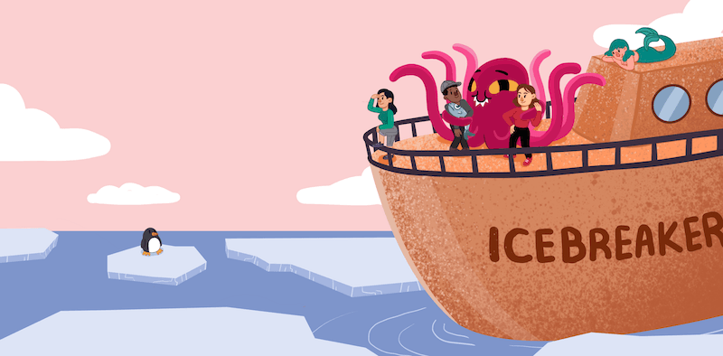
ICE BREAKER

Slide 3
HOPE
“The belief that the future will be better than the present, along with the belief that you have the power to make it so”
“…not only is hope good for your wellbeing, but it’s a measurable quality that can be increased with practice”
“…the ability to clearly and consistently articulate goals (goals thinking), develop step-by-step plans to reach those goals (pathways thinking), and persevere in spite of obstacles (agency thinking).” (Lopez, et al., 2009)

Slide 4
USE WORDS OF POSSIBILITY
The use of “WHEN” instead of “if”:
“WHEN this difficult time passes”
“WHEN they discover a vaccine for this virus”
IF and THEN thinking
The use of “COULD” instead of “should”:
“you COULD try that now” ‘’we COULD try this together’’
The use of “YET” to give possibility rather than just “can’t”
“You can’t climb that mountain YET”

Slide 5
Bear Pic 1

Slide 6
Bear Pic 2

Slide 7
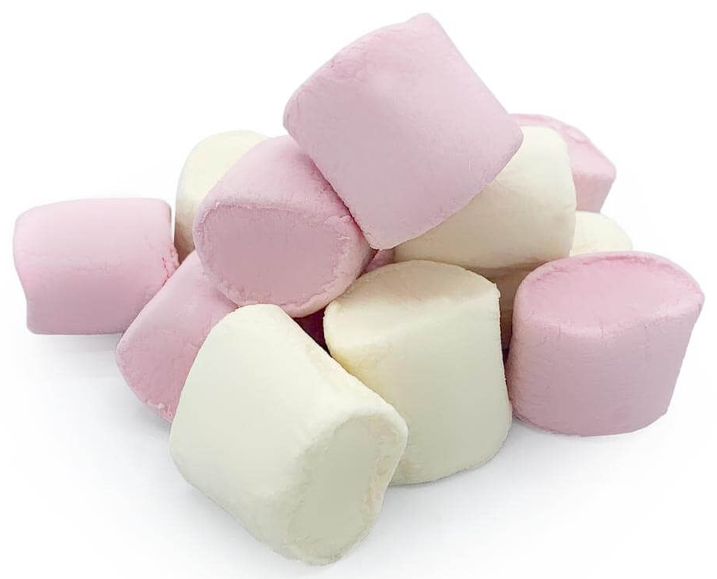
BRIDGE BUILDING
Build the tallest tower that must be standing independent of you when finished.

Slide 8
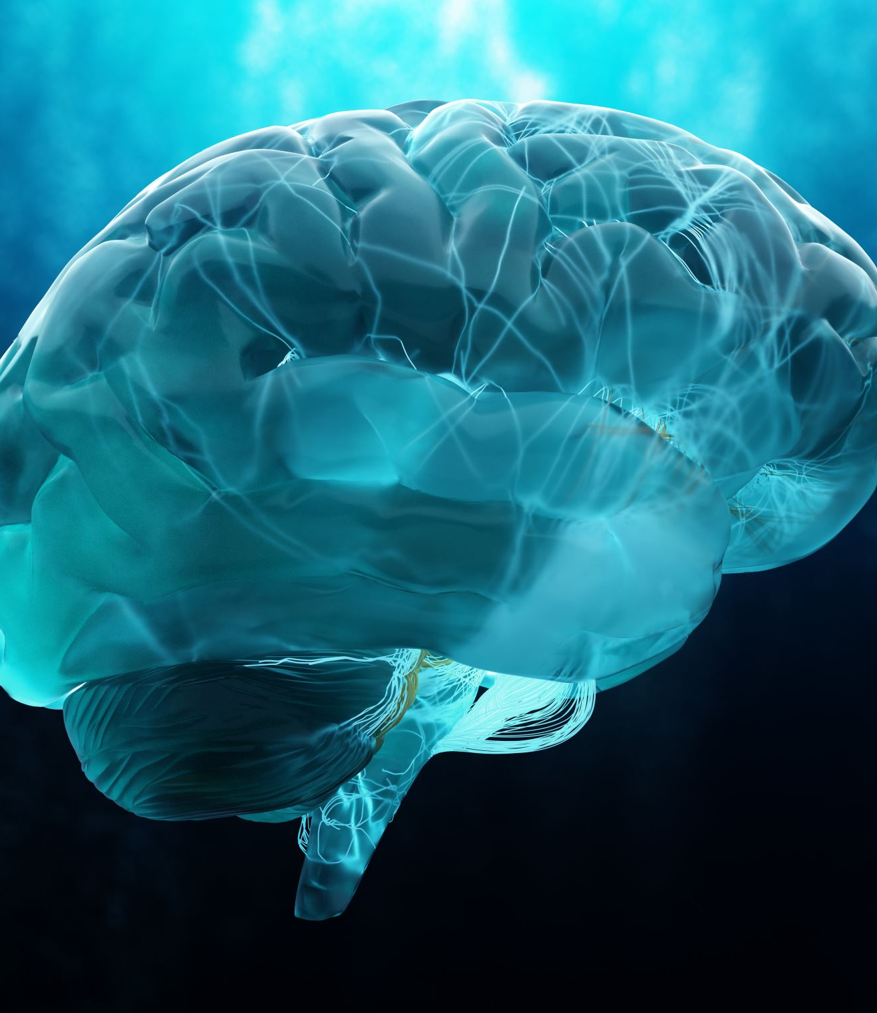
Importance of the brain

Slide 10
CIRCLES OF CONTROL
Weather
Traffic
The media
Where you were born
Strangers' behaviour
Things you can’t control
Things you can influence
Other people's actions
Where I work
Who follows me on social media
My productivity
My reputation
Things you can control
My words
My thoughts
My actions
My mindset

Slide 11
7-11 BREATHING ACTIVITY
We often freak out about things in the circle of control that we have no influence over. This can lead to increased anxiety. To overcome this, the 7-11 breathing activity can be helpful.
This breathing exercise can help you to reduce stress in the moment.
If you practice it regularly, you may also find that it helps you feel calmer generally. The more you practice, the more effective this technique becomes.
Breathe in for a count of 7, then breathe out for a count of 11. Do this for 1 minute.

Slide 12
Mindfulness

Slide 13
WHAT IS MINDFULNESS?
Mindfulness means paying full attention to something. It means taking your time to really notice what you're doing.
This can help you feel calmer when you're stressed, or more focused when you must do something difficult or complicated.
When you practice mindfulness skills, you're training your attention.

Slide 14
WHAT IS SELF CARE?
Self-care is important to maintaining a healthy relationship with yourself.
It means doing things to take care of our minds, bodies, and souls by engaging in activities that promote well-being and reduce stress.

Slide 15
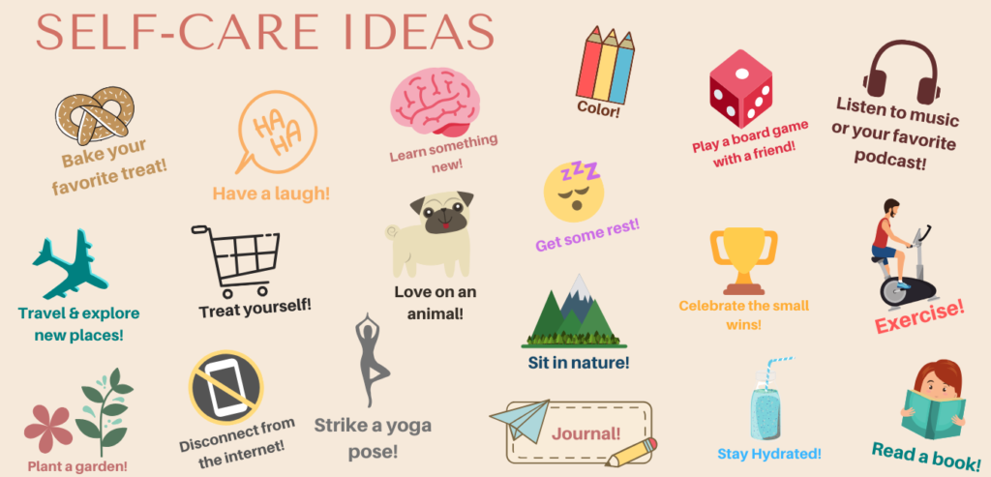

Slide 16
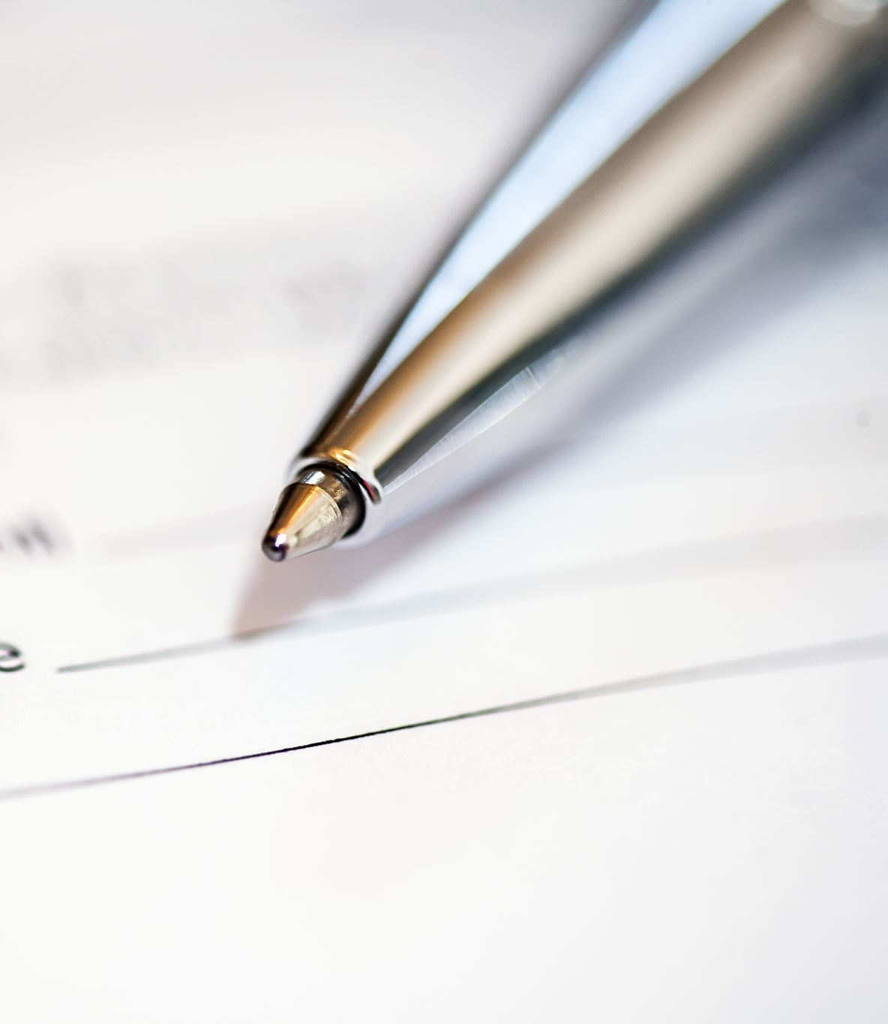
Activity: COMPASSIONATE LETTER WRITING
The idea of compassionate letter writing is to help you refocus your thoughts and feelings on being supportive, helpful and caring of yourself.
In practicing doing this it can help you access an aspect of yourself that can help tone down more negative feelings and thoughts.

Slide 17
