Slide 1
Managing Emotions
Emotional Wellbeing- session 7

Slide 2
Introduction
Last week we discussed the emotions that we experience and discussed how to engage in open dialogue to express these emotions. Has anyone practiced this in the past week or had a situation where they had to use what we learned last week? Tutor to provide a situation for reinforcement.
Ice breaker outlined in session plan
Explore existing group knowledge: what big feelings do you experience and how do you deal with them? Write as many on flipchart paper or a whiteboard.

Slide 3
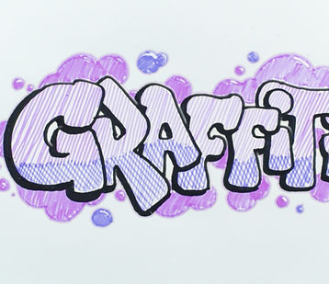
Graffiti Wall for emotions
Create a graffiti wall on the A3 page in front of you.
In groups, identify 4 emotions and how you currently manage this.

Slide 4
Strategies to manage emotions- Take 5
Notes:
Discuss the poster - ‘Take 5 Steps to wellbeing’

Slide 5
Connect: speak to people and open dialogue to manage emotions.
Be active: physical activity is an escape and is proven to help deal and manage emotions.
Take notice: try to be socially aware when others around you are struggling with emotions and be there when they need support. This also involves taking notice of your own senses, feelings and emotions. For example, how have you been feeling lately, why and what can be done for support?
Keep learning: don’t be afraid of trying something new, try new hobbies or challenge yourself. This helps cognitive development and helps goal setting.
Give: giving back provides a sense of reward, increases self worth and positive feelings. This can be done through volunteering, thanking people, or doing something nice for a friend or stranger.

Slide 6
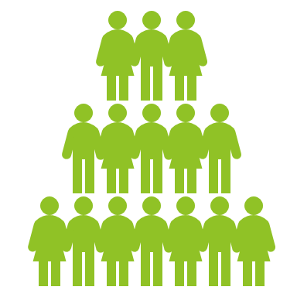
Take 5 task
Split the participants into five equal groups and assign an element of the take 5 framework to each group.
Participants are then tasked with producing how they can use their assigned element of the take 5 principle to manage their feelings.
For example, Give: people could volunteer in their youth club, this will give them a sense of achievement, help keep you focused and establishes a support network for you. Keep the examples as relevant as possible and present these to the group.

Slide 7
Activity for understanding
Linking theory to practice and individual action planning: are there any aspects of it that you could do to improve your wellbeing and help improve your emotional wellbeing?
Draw a hot air balloon with an emotion in the middle. Around the balloon, write how you can effectively deal with this. Use what you have learned over the past two weeks and think about the take 5 framework along with the 7-11 technique and positive self-talk. Also, be specific with examples. For example, in the take 5 framework, what can you do to take notice? How can you be active? How could you use positive self-talk?

