Slide 1
Understanding labels
Healthy Eating
Session 10

Slide 2
Context and background
Do you think being able to read labels is important?
Would you look at the labels when buying any products?
If so, do you understand it. If not, why?

Slide 3
Why reading labels is important
Helps keep you healthy by making informed decisions
Keeps you safe
Detects ingredients that may cause you harmful reactions
Warns you about the date of consumption
Can you think of anymore?

Slide 4
Challenges consumers face
Activity for exploratory learning: working in groups with the labels provided, can you calculate how many calories are in the whole product and the content for all the food groups.
Is this different to the figures displayed on the label attached to the product?
Why is this? Next slide

Slide 5
Continued…
https://www.youtube.com/watch?v=Orj7p3KQcyQ
This video helps explain why nutritional information may be different and what you must look for when looking to understand labels.
What is your thoughts on this?

Slide 6
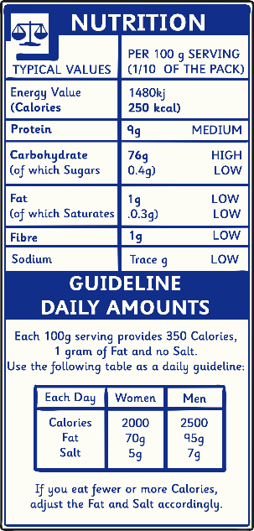
What is displayed on labels?
In the UK, companies must legally display the following information.
Name of food
Mass (weight or volume)
“Use by” and “Best Before” dates.
How to store the food
How to prepare the food
Details of the company making or selling the product
The country of production
Ingredients
The 14 most common allergies
Nutritional information

Slide 7
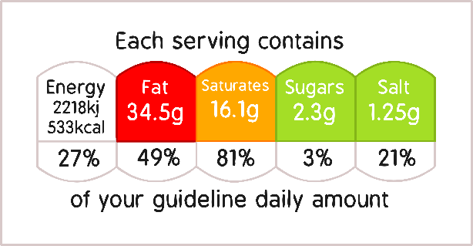
Traffic Light System
To make labels easy to understand, a new traffic light system for food labels has been recommended by the Food Information Regulation to help people make healthy choices.
A way to make heathier choices through label reading is by ensuring that each product consumed is either green or amber.
Green – healthy choice, can be eaten all the time.
Amber – medium, can be eaten most of the time.
Red – high, should only be eaten sometimes.

Slide 8
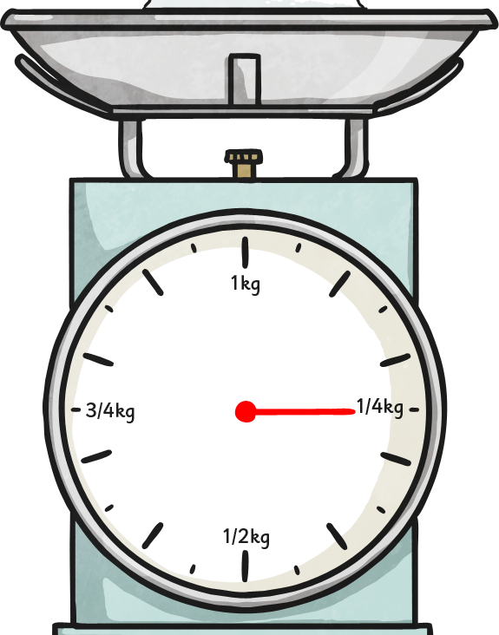
Traffic Light System
The traffic light system shows whether the food product is high or low in:
Fat
Saturated fat
Sugars
Salt
For example, sugars will be shown as red (high) if the product contains more than 22.5g of sugar per 100g. It will be green (low) if there is less than 5g of sugar per 100g.
The consensus is that you try to consume products that are green or amber to make healthier decisions.

Slide 9
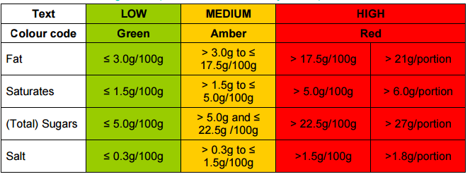
Green
A
Notes:
Green if less than those numbers.
Amber if more than those numbers.
Red if more than numbers.

Slide 10
Can the traffic light system can be wrong?
It is not as simple as looking at the colour and buying a product based on this, you need to be conscious that the product is only green for 100g.
Consumers face a range of challenges as information can be difficult to understand.
For example, the traffic light system is only based on 100g for that product. This can give a false representative because the product may have 800g and per 100g, it may be green. However, if you consume the whole product, you will be in the red as you need to multiply the green value by 8 to find out how much is in each.

Slide 11
Game for understanding
The tutor will have a range of labels with them and call out a product.
If participants think it should be categorised as mostly green they continue to run.
Amber, they jog on the spot
Red, they stop immediately.
There are variations of things game depending on resources and available space.

Slide 12
Critical reflection
Reflect on all the items you have purchased that week and what colour would typically be associated with them.
If the items you most frequently purchase are in red, what could be the consequences of this.
Did you think all your choices would be in that category?

