Slide 1
Increasing Confidence
Social Wellbeing
Week 4

Slide 2
What does it mean to be ‘confident’?
Do we consider ourselves a confident group?
What does confidence mean to you? In pairs, discuss this and relay your definition back.
Confidence means having faith in one’s abilities and aptitudes to manage in different situations.”

Slide 3
What are the differences between confidence and self-esteem?

Slide 4
Activity: what are the benefits of having self-confidence?

Slide 5
Better Performance – if you are confident and believe in your abilities, be it in public speaking, playing sport or performing a play, greater self-confidence will increase your performance.
Better Social Skills - Self-confidence will help you interact with other people and develop healthy, meaningful relationships.
Health - Self-confidence contributes to psychological wellbeing and has health benefits such as reduced stress.

Slide 6
Motivation and Resilience – Everyone experiences difficulties and lack of motivation. Self-confidence helps young people to feel energized and believe that they can act in tough situations.
Happiness – Young people who have a greater self-confidence are more likely to be happy and have higher self-esteem. A lack of self-confidence amplifies negative emotions like fear and anxiety.
Success and Fulfilment - Self-confidence will help young people achieve academically and professionally. Confident young people are more likely to live lives that fulfil them, regardless of the metrics you use to measure success.

Slide 7
What factors in your life increase confidence or decrease confidence?

Slide 8
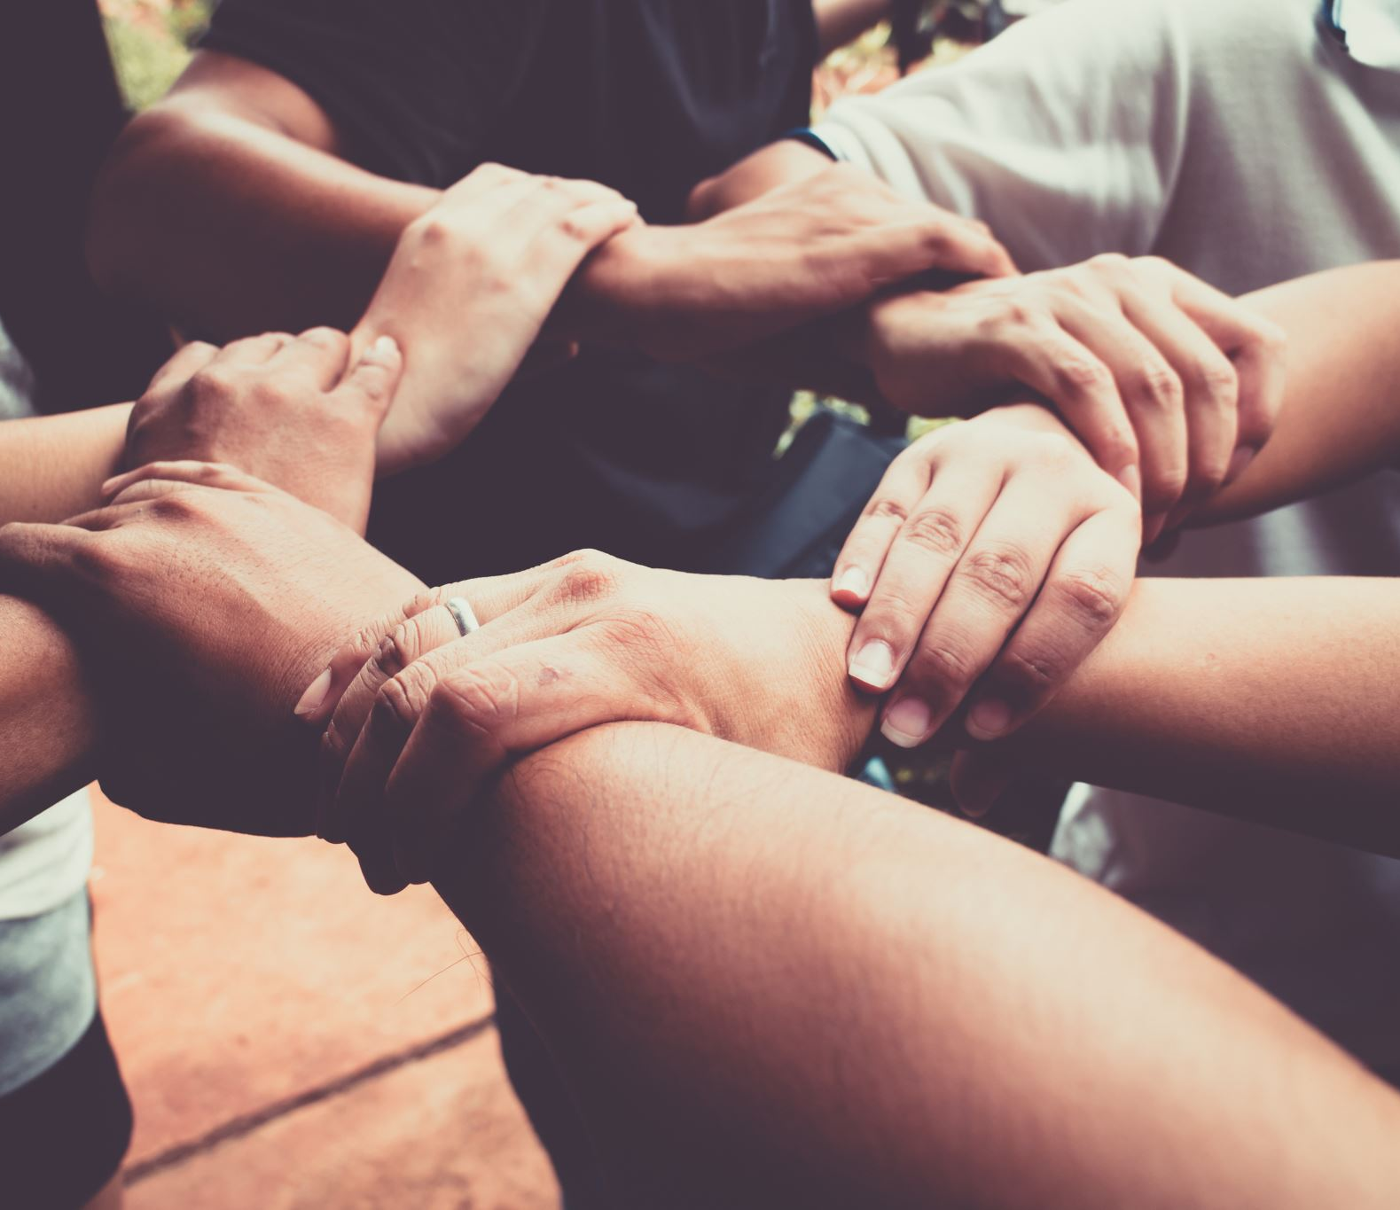
12 things you can do to build confidence
1. Practice positive self-talk and affirmations
2. Give young people more responsibility around the youth club and encourage it at home
3. Let young people choose activities and things they would like to focus on
4. Goal setting
5. Do something that makes you uncomfortable
6. Develop a new skill

Slide 9
Continued.
7. Learn about mistakes and failure
8. Make an achievements book
9. Positive visualisation
10. Yoga/Exercise
11. Challenge negative beliefs
12. Create habits of kindness and selflessness

Slide 10
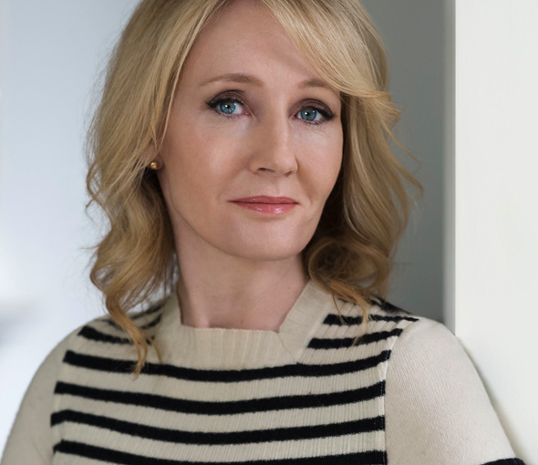
Case Study
JK Rowling – author of the Harry Potter series of books.
As she was writing Harry Potter and the Philosopher's Stone, she was a single-mother, unemployed, on welfare benefits and depressed.
Even though her books were initially rejected, she had the self-confidence to write more books and keep trying.
She is now one of the most recognisable women on the planet and has earned over $700 million due to the success of Harry Potter.

Slide 11
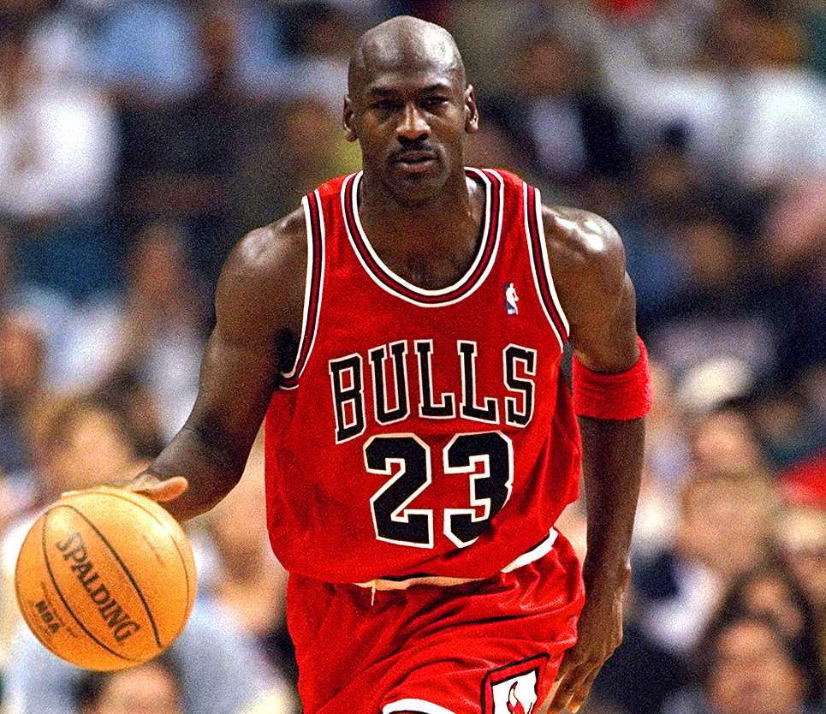
Case Study 2
“Twenty-six times I've been trusted to take the game-winning shot and missed. I've failed over and repeatedly in my life. And that is why I succeed.”
One of the most prolific and famous NBA stars.
Never made his high school basketball team.
Went on to become an All Star 14x and 6x NBA Champion.

