Slide 1
Increasing Confidence
Social Wellbeing

Slide 2
Self-Confidence
What is it? Self confidence is described as ‘belief and confidence in your own ability and value.’
Why is it important? When we are confident, we are more likely to take opportunities. When things do not work out, confidence will allow us to handle setbacks and try again.
Are you self-confident?
What does it mean to you?
Notes:
Cambridge English Dictionary defines self-esteem as ‘belief and confidence in your own ability and value.’

Slide 3
What impacts confidence?
Confidence can be impacted by results in school, social media/ advertisements, level of support you receive from people you trust, how you feel about your appearance, your achievements or skills.
Being bullied, family problems, peer pressure to fit in and physical/mental health problems.

Slide 4
How can we build confidence?
Positive self talk
Spend time with family/friends.
Learn how to assert yourself- this involves giving your opinion and learning to say no.
Participate in activities you enjoy.

Slide 5
Activity in pairs
Positive self talk is brilliant to increase confidence.
Write down all the positive qualities you have.
Share this with your partner. Is there anything positive missing from your partners list?

Slide 6
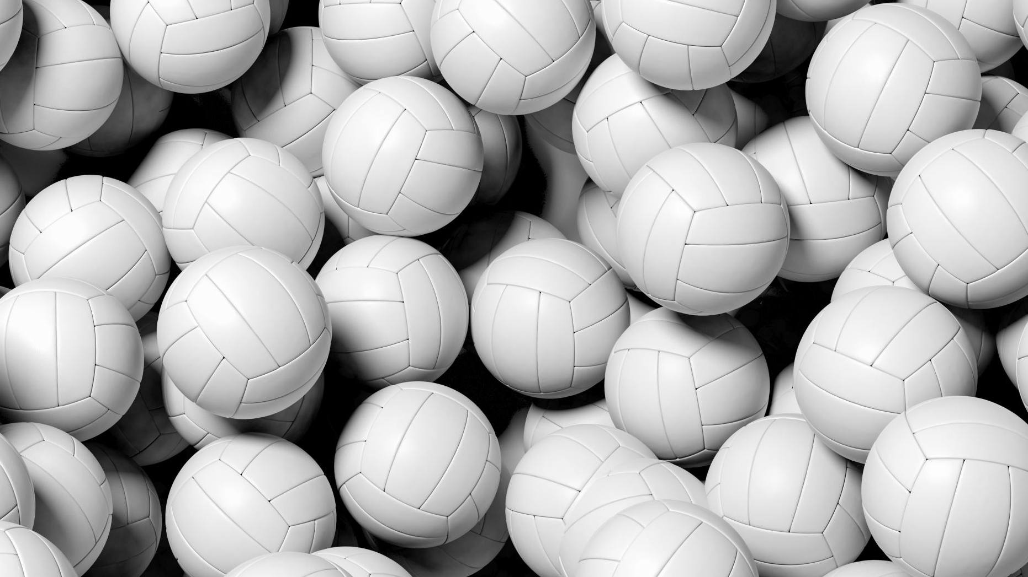
Boosting self-esteem
This is a private task:
Individually, write a list of things you are happy and proud about yourself. Examples could include:
I have a nice smile, I’m a good listener, I’m talented at sports.
No one will see this list and you won’t be asked about it.

Slide 7
Activity
In pairs, draw an outline of a person and pass your image to your partner. Your task is to draw all the positive things about that person in the picture.
Do you agree with partner’s picture? Is there anything that can be added?
Notes:
Each young person will receive various compliments about aspects they did not value and therefore increase confidence.

Slide 8
Peer to peer activity

