Slide 1
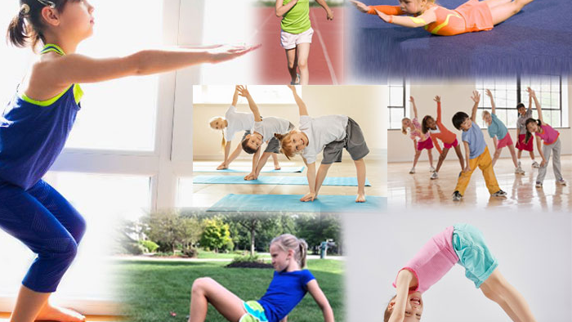
Get up and moving
Physical Health
Session 1

Slide 2
What we will achieve
Understand the importance of movements and how this relates to participation in physical activity.
1
Develop knowledge of movements needed to participate in physical activity.
2
Engage in a variety of activities to enhance motor skills.
3

Slide 3
ICEBREAKER
This is included in the lesson plan.

Slide 4
Physical movement
Is defined as any bodily movement produced by the muscles which requires you to use energy.
People will typically associate this with sport or exercise. However, you do not have to participate in sport to get active.
This involves all movement including things you do in your own (leisure) time, for transport (to get to and from places) or as part of your work.
Can you think of some?

Slide 5
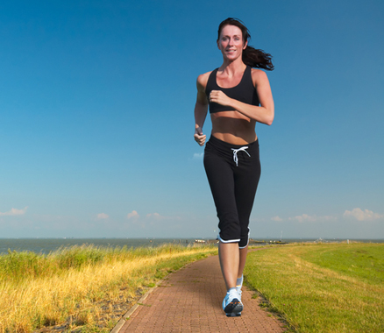
Importance of getting active
The more you exercise, the more your body can meet the demands of exercise.
Toning muscles can help improve posture.
Exercising can increase strength, stamina, mobility and flexibility.
Helps to maintain a healthy weight
Reduces the risk of heart disease, type 2 diabetes and stroke.
Can you think of anymore?

Slide 6
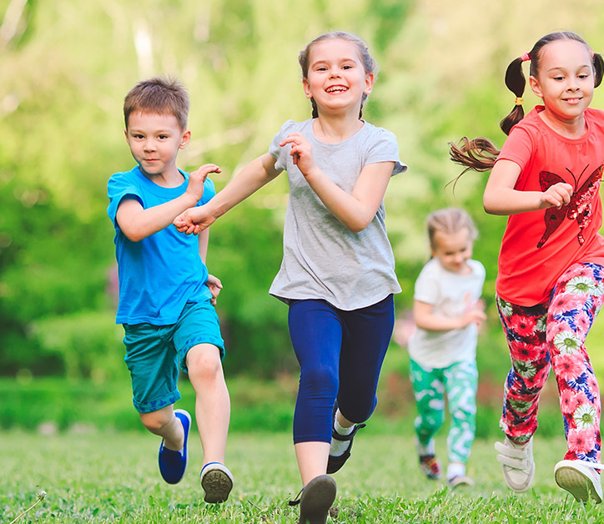
Enhance and Change Body Shape
Depending upon the type of activity, the muscle shape and size will begin to develop. This is known as muscle definition (e.g., Getting a six pack is toning your abdominal muscles).
Exercising at the correct level burns calories and can help you to lose weight.

Slide 7
Increased Life Expectancy
Regular exercise helps increase the likelihood of living a long life.
Regular exercise increases the efficiency of the heart, circulation system and lungs.

Slide 8
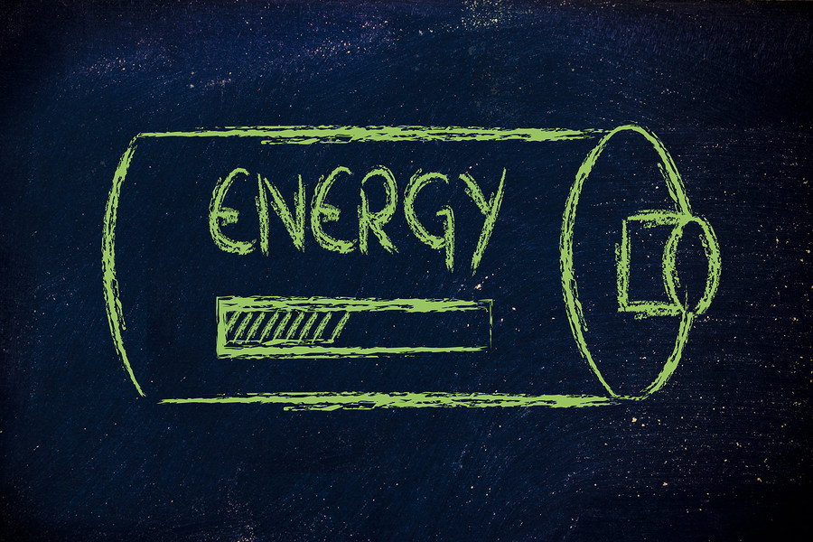
You have more energy
Everyone seems to think that regular exercise will make you constantly tired.
However, that is not the case.
Regular physical activity means the body can become stronger and build a higher tolerance to exercise.
This means the body can work harder and longer without becoming tired.

Slide 9
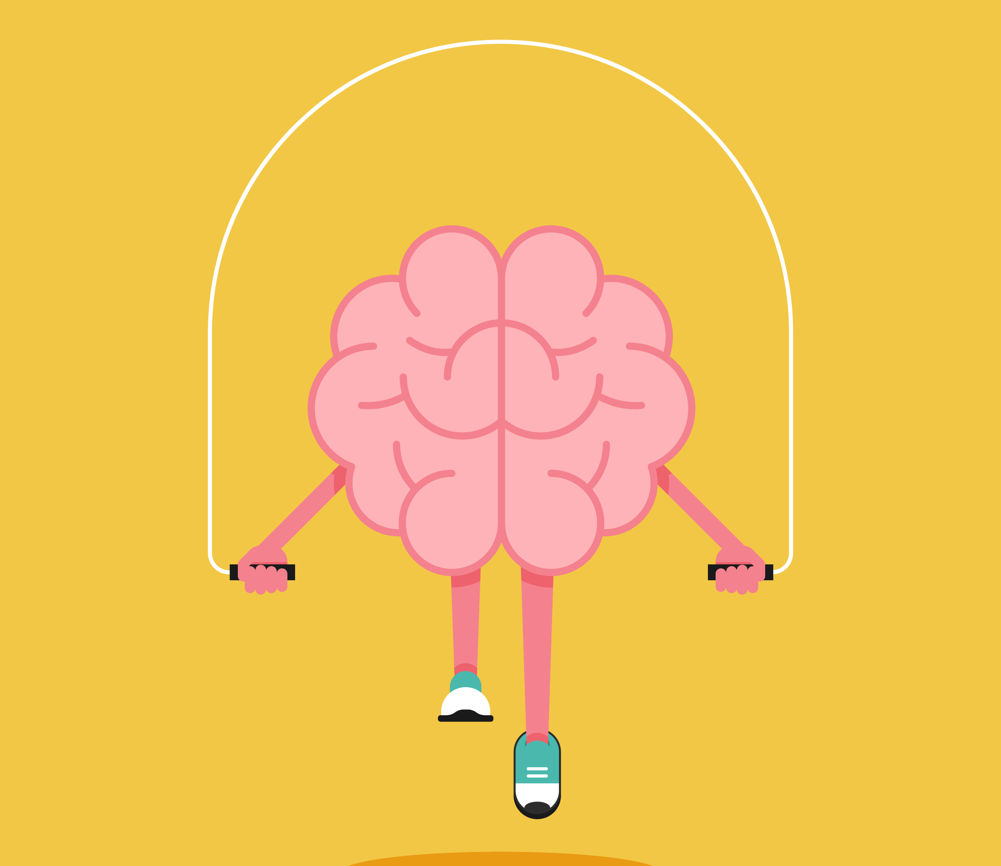
Reduce Stress Related Illness
When exercising, if you are stressed, you can forget about your problems for a while.
The body releases serotonin and endorphins when exercising. This is the ‘happy hormone’ and reduces stress.
Less stress means the heart functions better so stress related illness is reduced.

Slide 10
Offers Physical Challenge
Whether you are competing in a team or just exercising yourself, you can set yourself targets to improve your physical health.
Setting yourself a challenge encourages you to meet your target and keeps you motivated.
You might improve your flexibility, speed, strength, skills, techniques or stamina.

Slide 11
Look good, feel good
Exercising improves the body’s shape.
This can make someone feel more positive about themselves.
They might also feel like they have the energy to do more things in life.

Slide 12
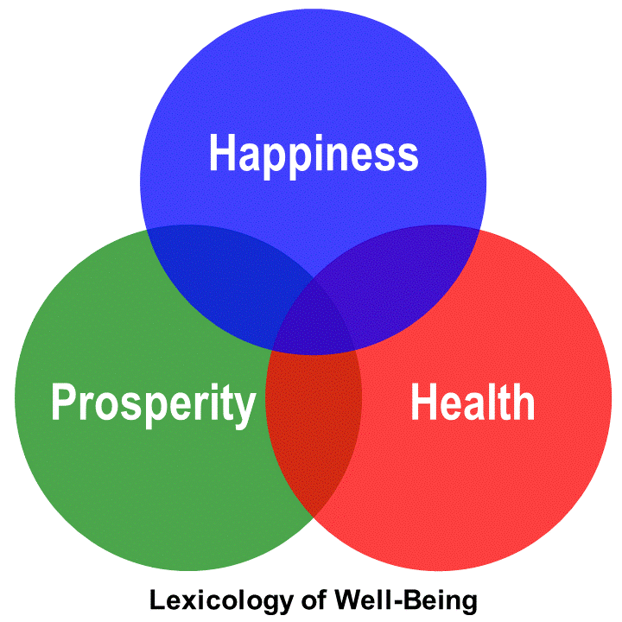
Feeling of well-being
Well-being is a state of being happy, healthy and prosperous.
An improvement in the body systems and body shape can give someone a sense of well-being.

