Slide 1
Accredited Youth Work Programmes
Good Relations

Slide 2
Introductions – Session 1 Learning Outcomes
01
Be aware of programme expectations
02
Learn more about yourself and others
03
Build friendships with others

Slide 3
Set of workshops and activities/ games which are used to help young people learn about a particular topic
Lots of young people do the same programme across NI
Opportunity for young people to show their youth leader and others what they have learned and achieved
Opportunity for young people to get a reward for their hard work e.g., certificates
What is an
accredited
programme?

Slide 4
Sessions 10
Time and date | Thursday evenings 6-8pm
Activities | Small and large group discussions, team building games and activities, games and activities around good relations
Our topic: Good Relations
You will learn more about yourself, your group members and your community. You will each receive a workbook for you to show your learning
Learning

Slide 5
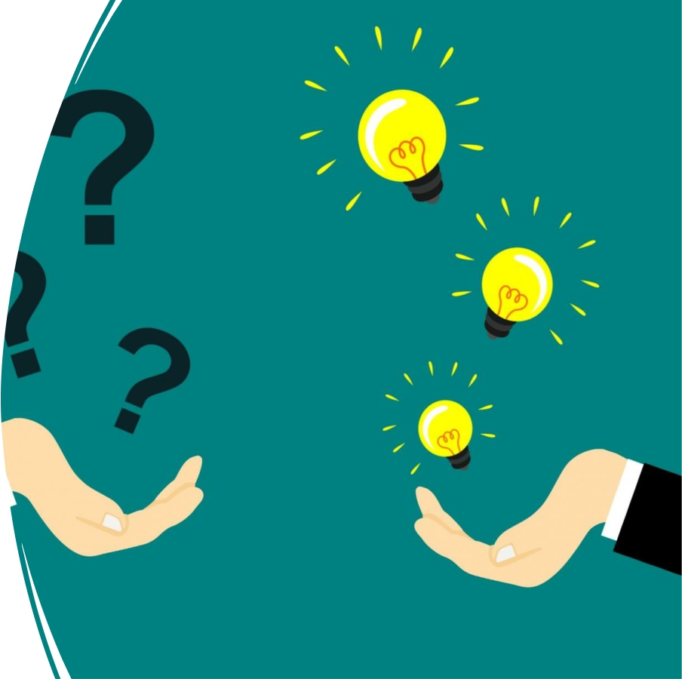
Questions?

Slide 6
Tell us your name
Do you know why you are called this?
Do you know what your name means?
Getting to know you!

Slide 7
Find Your Partner
• You are one half of a couple. This might be a famous couple from a movie or book. Or it could be a celebrity couple/ couple we see on TV!
• This game will only work if you DO NOT tell people the name on their back!
• You must mingle and ask lots of questions to find out who you might be.
• You can only answer yes or no to questions.
• If you’ve found your partner, stand beside them and get to know three things about them (that you didn’t already know)!
This Photo by Unknown Author is licensed under CC BY-ND

Slide 8
• To help ensure a safe and welcoming environment for everyone!

Slide 9
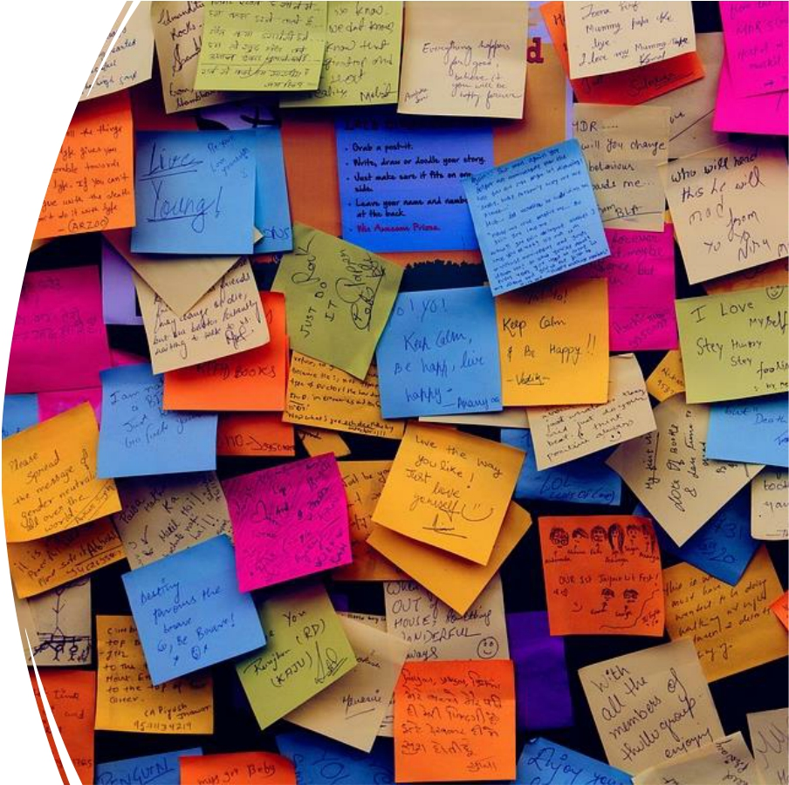
Hopes and Fears for the programme

Slide 10
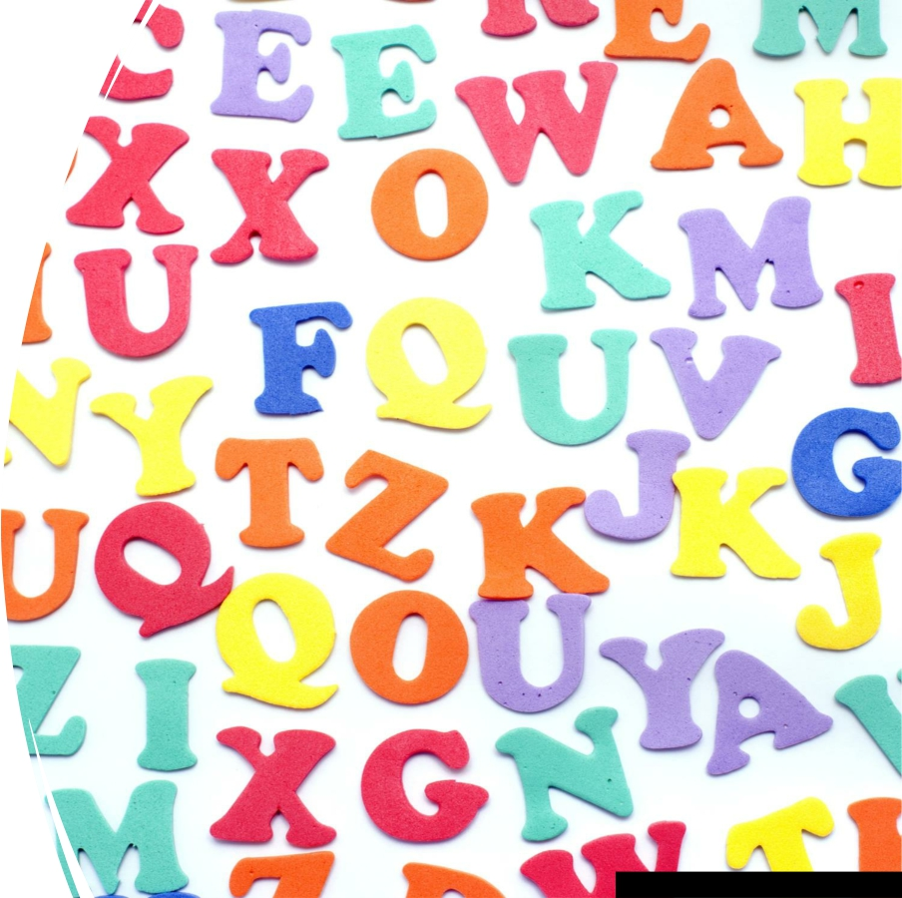
Alphabet
Game
Answer with your feet!
This Photo by Unknown Author is licensed under CC BY

Slide 11
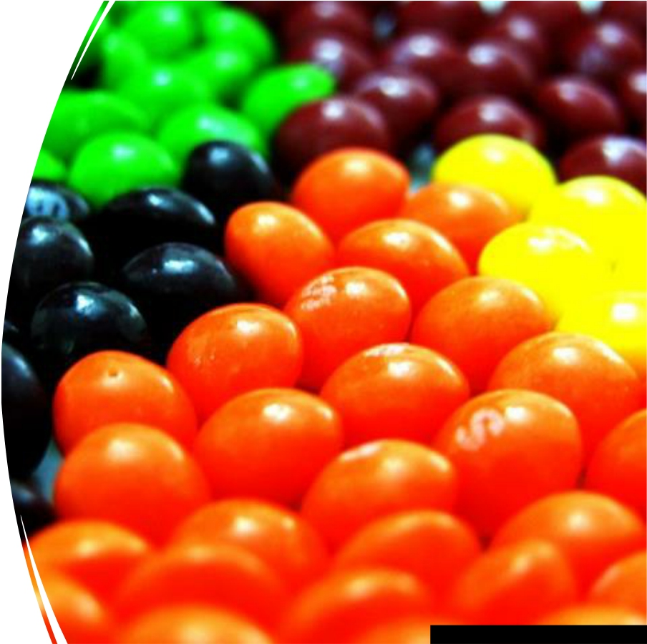
Sweet
Introductions
Pick between one and five sweets from the bag – Don’t eat them yet!
This Photo by Unknown Author is licensed under CC BY-SA

Slide 12
Sweet Introductions – What did you pick?
Best memory
Dream job Favourite place
Biggest talent
Wildcard!

Slide 13
Evaluation

Slide 14
Why Good Relations? – Session 2 Learning Outcomes
01
Explain what is meant by the term ‘good relations’
02
Understand why good relations work is important in NI
03
Be aware of NI population statistics

Slide 15
Session 2
Introduction &
check-ins – 10
mins
Icebreaker – 15
mins
What do we mean
by good relations? – 20 mins
Why is good
relations work important in NI? - Timeline - 30 mins
NI in a classroom –
20 mins
Evaluation/ check-
out– 10 mins

Slide 16
• Question 1.1
• Group discussion
• What do we mean by good relations?

Slide 17
Government, community and individuals will work together to build a united community.
Good relations is about making our communities more shared and safe. A place where people are more accepting of others and embrace and encourage the celebration of different cultures, traditions and beliefs (Together: Building a United Community Strategy).
What is Good Relations?

Slide 18
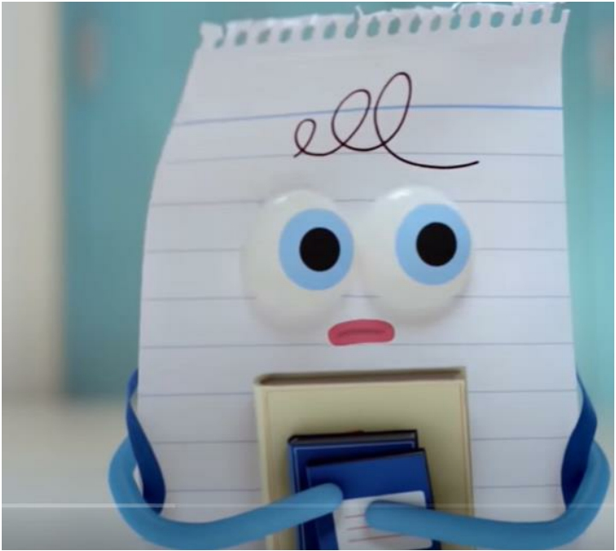
•
Rock, Paper, Scissors. Be Together. Not the Same. – YouTube

Slide 19
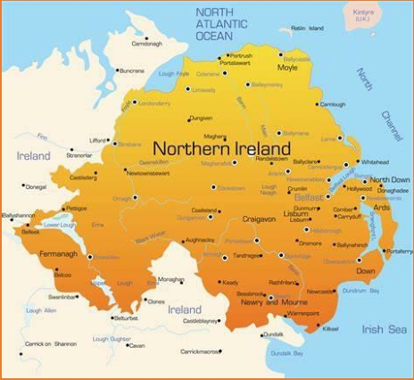
Why is Good Relations work important in NI?
Our History – Timeline
• Long history of conflict in Northern Ireland where tensions are
still high
• Feelings of hurt and anger
• Separation and segregation still existent in all areas of life – where we live, where we work, where we go to school, where we shop and where we socialise.
• “Unfinished business” – people have not yet got what they
want or their needs have not yet been dealt with.

Slide 20
• High levels of respect and shared
understanding
• Better relationships between people of
different backgrounds
• A fairer place to live where everyone is
treated equal
• A place where there is no more:
-Judging others
-Hatred -Unfriendliness
-Bullying
What we hope to achieve

Slide 21
NI in a classroom
If NI were a classroom of pupils, how many would consider themselves to be:
-Protestant -Catholic
-Other (no religion/ different religion)?
How many would consider themselves to be:
-British
-Irish -Northern Irish
-Other?
Does the population of your community reflect NI as a whole?
Northern Ireland (NISRA Statistical Bulletin, 2021) Population of 1.9 million (2020)
48% - Protestant 45% - Catholic 6% - No religion
1% - Other religion
98% - White 2% - Black
40% - British 25% - Irish
21% - Northern Irish 14% - Other

Slide 22
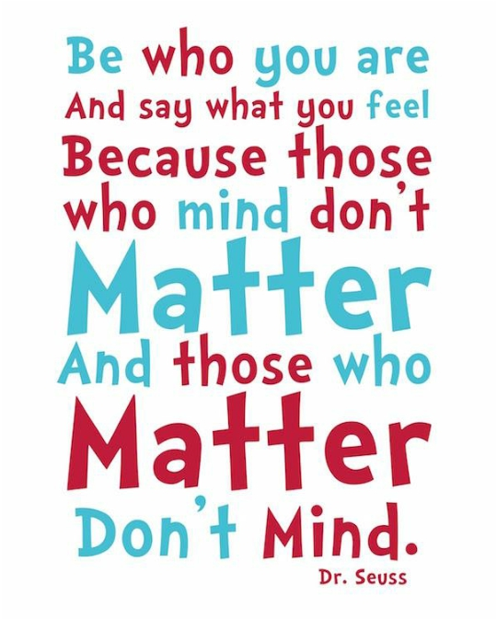
Evaluation/ Check out
Preparation for Day 2
Bring something that represents you/ something that’s very important to
you!
You will show this to the group on Day 2.

Slide 23
All about me! – Session 3 Learning outcomes
01
Understand what is meant by the term ‘identity’
02
Explore our own identity and what’s important to us
03
Understand that our identity is influenced by lots of different factors

Slide 24
Session 3
Introduction &
check-ins – 10
mins
What is
identity? – 15
mins
Show and Tell–
30 mins
All Change game – 15 mins
What influences
our identity?–
20 mins
Identity
showcase! – 60-
90 mins
Check out/ Evaluation – 10
mins
My identity – 30
mins

Slide 25
Something
that’s
important to
me is…
• Time to share that something special that is very
important to you!
This Photo by Unknown Author is licensed under CC BY-NC-ND

Slide 26
All change game
Everyone sit in a circle with one person standing in the middle.
The person standing in the middle must think of something that is part of their identity e.g. All Change if you are from County Antrim.
All those who fit this description must change seats quickly.
The person who asked the question tries to claim a seat.
You cannot swap seats with someone sitting next to you or return to your own seat.
The last person standing then must introduce something that is part of his or her own identity.

Slide 27
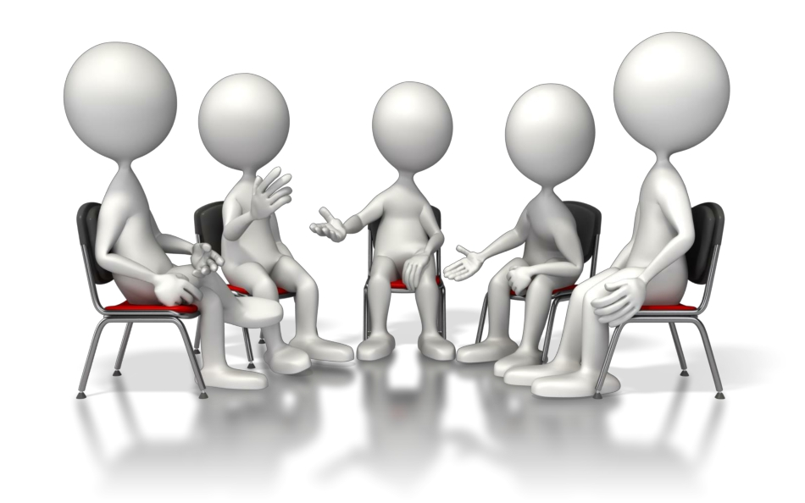
Group Discussion – What is Identity?

Slide 28
Identity
Identity is all the things that make you: YOU!
It’s not just one thing, but many different things that are mixed together. Identity is all the things that make you unique.
There is no one else quite like you!
• My Identity Shield - On the numbered sections on the shield write/ draw:
• 1 – How you see yourself
• 2 – How others see you
• 3 – How you see your future
• 4 – Your hopes and fears
• 5 – Design a logo that represents you
• 6 – Write a motto that sums up your life

Slide 29
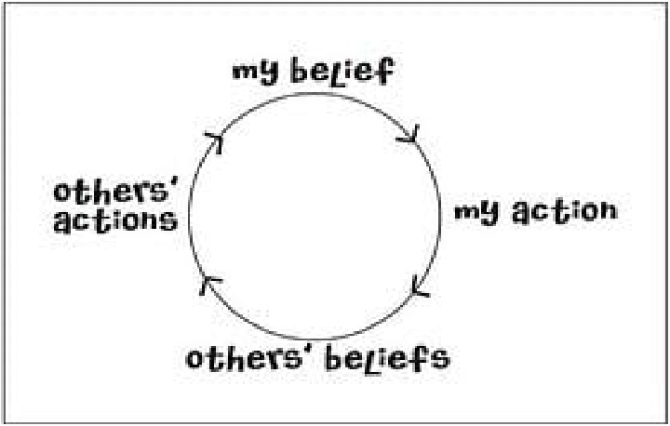
Your identity changes over time. It is influenced by things like:
• Where you live
• What you watch on TV/ social
media
• What you learn in school
• Your family’s beliefs
• Your friend’s beliefs
• Your life experiences

Slide 30
Why is having a strong identity so important?
• More confident about who we are and what we believe
in
• More happy with ourselves
• Able to develop better friendships/ relationships
• We are being true to ourselves
• We do what we believe is right
• We become the person we want to be
• Be proud to be you!

Slide 31
Identity showcase
Show us a part of your identity – an interest/ hobby/ story about growing up!
Cheerleading Irish dancing Football Irish Language

Slide 32
Evaluation

Slide 33
My Community - Session 4 Learning Outcomes
01
Understand importance of community
02
Be motivated and able
to maximize assets and opportunities available in the community
03
Understand how our community impacts us as individuals

Slide 34
Session 4
Introduction &
check-ins – 10
mins
What is
community? – 5
mins
Community
Mapping – 60-90
mins
Icebreaker – 15
mins
Exploring impact
of community –
20 mins
Evaluation/
check out – 10
mins
My stickman –
30 mins

Slide 35
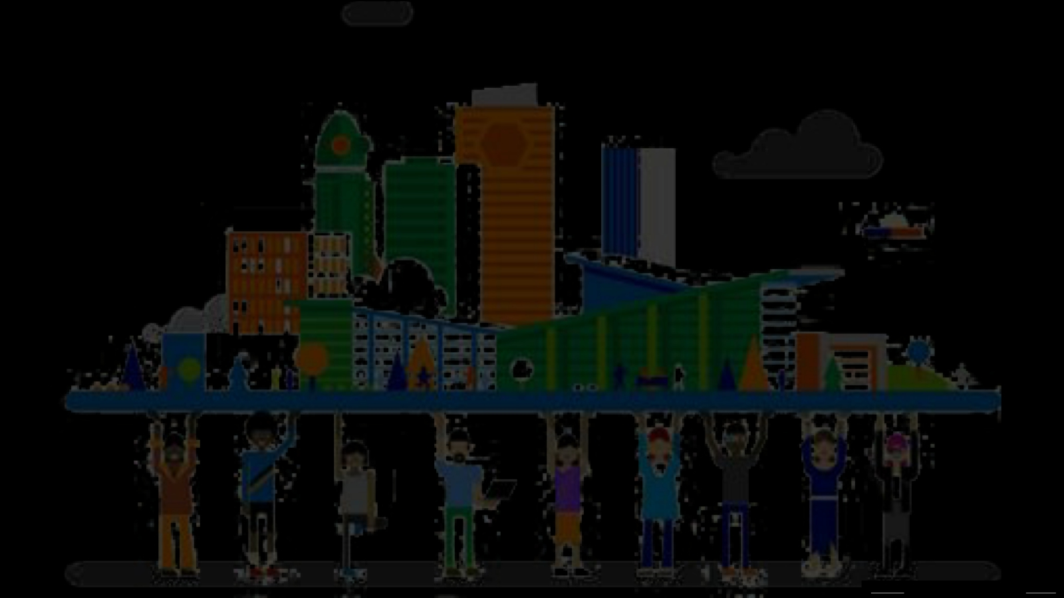
What is community?
A group of people living in the same place or having a particular
characteristic in common.
This Photo by Unknown Author is licensed under CC BY-NC

Slide 36
Before we begin, think about:
• The neighbourhood we want to focus on – what
streets/ area will be visit
• Resources in the area:
- Places/ spaces/ buildings (libraries, shops, community halls, churches, youth clubs, schools, parks etc.)
- People (community groups, people with influence,
skills or talents, sports teams etc.)
Look out for:
• Opportunities to socialise
• Opportunities to get to know others with different
backgrounds
• Places which are only used by one side of the
community
• Significant memories/ events/ flags/ symbols
• Places where you feel safe/ unsafe
Session 4 – Community Mapping

Slide 37
My community and me
The community we live in will have an impact on what we do, what we say, what we think, how we feel, what we believe in and who we will become.
This Photo by Unknown Author is licensed under CC BY-NC-ND

Slide 38
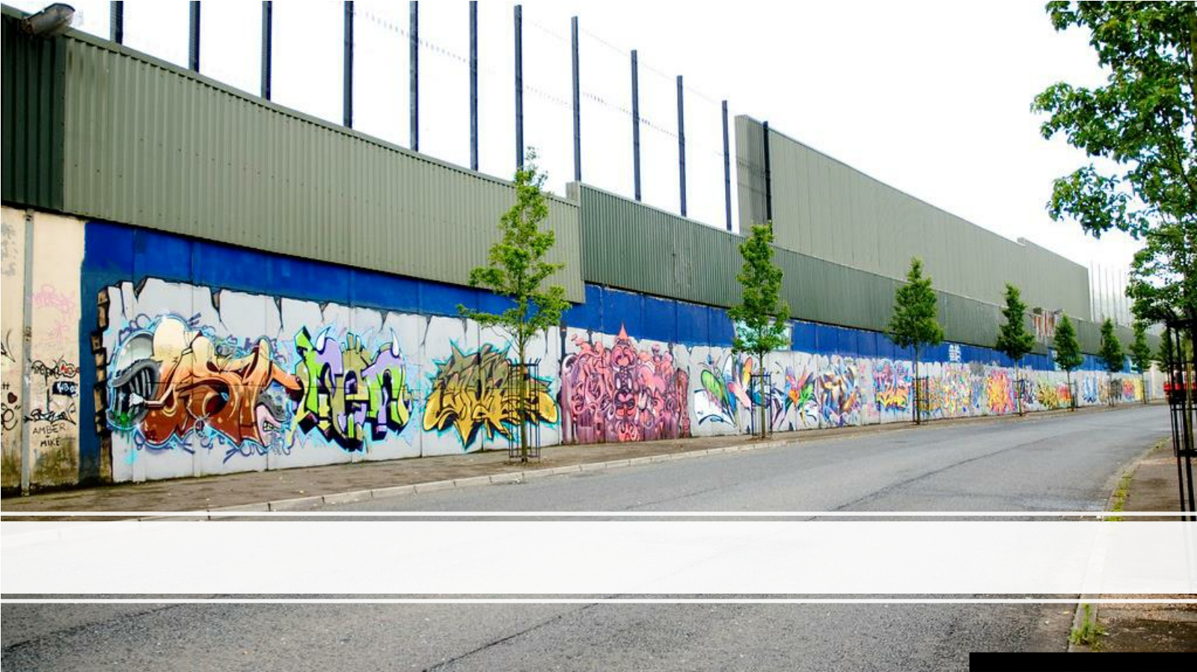
Optional exercise – Mural Tour
This Photo by Unknown Author is licensed under CC BY-NC

Slide 39
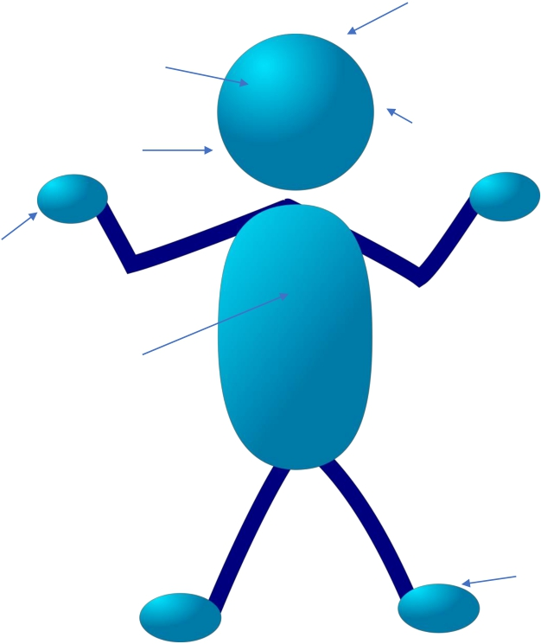
What are we thinking?
What are we seeing?
What are we hearing?
What are we saying?
What are our hands doing?
What are we feeling?
Where are our feet walking/ not walking?

Slide 40
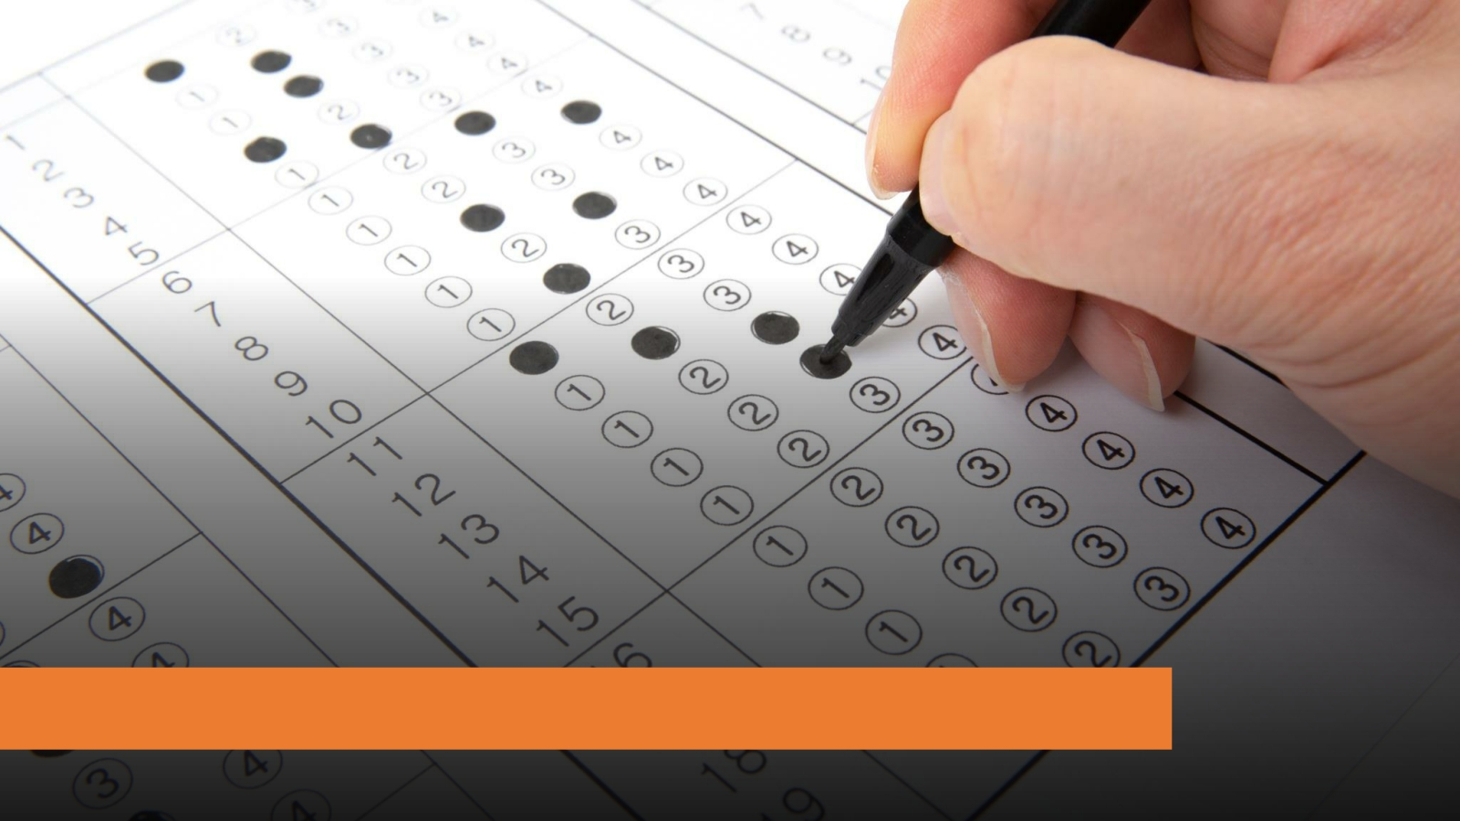
Evaluation

Slide 41
Symbols, flags, and traditions – Session 5 Learning Outcomes
01
Understand symbols and flags in our community
02
Be more aware of traditions and celebrations in our community
03
Understand the need for safer and more together community

Slide 42
Session 5
Flags and
symbols we see
in NI – 90 mins
Introduction –
10 mins
Icebreaker –
15mins
Design your
own flag – 30
mins
Evaluation and
check-out - 10
mins

Slide 43
Flags we see in NI
This Photo by Unknown Author is licensed under CC BY-SA
This Photo by Unknown Author is licensed under CC BY

Slide 44
Symbols
• Defining what a ‘symbol’ is can be quite
difficult – yet we use symbols every day.
• Symbols are usually pictures or shapes
which represent an idea or a value.
• We use symbols to communicate ideas
without words.
• Without us, symbols would just be simple
shapes and colours.

Slide 45
Design your own flag or symbol for NI

Slide 46
Evaluation

Slide 47
Judging others– Session 6 Learning outcomes
01
Understand how we sometimes judge others based on an aspect of their identity
02
Be aware of our own judgements and opinions
03
Understand where our judgements/ opinions may come from

Slide 48
Session 6
Introduction/
check in – 10 mins
Icebreaker – 15
mins
First Impressions –
30 mins
Why do we judge? – 15 mins
Who/ what influences our opinions? – 30
mins
First thoughts ball
throw – 10 mins
Evaluation/ check
out - 10 mins

Slide 49
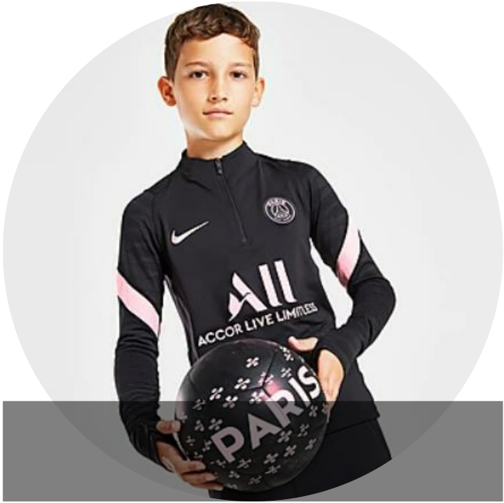
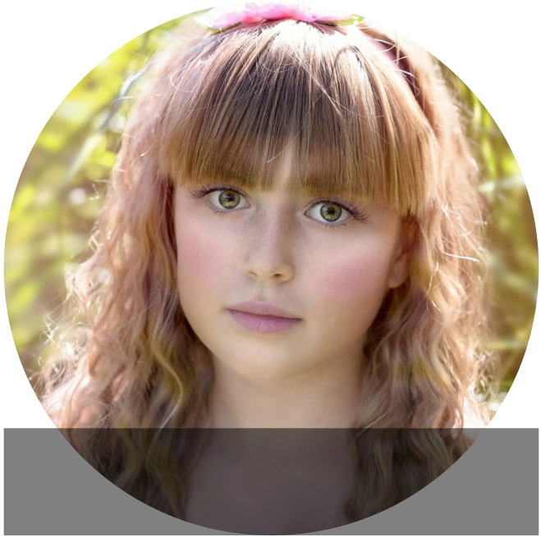
Picture 1 Picture 2

Slide 50
I play football My boyfriend is called Sam My friends say I’m strong
I am going to be a builder My best mate is called Jamie
I love make-up My favourite food is cupcakes My friends say I’m kind
I am going to be a nurse when I get older I help my dad on the farm
I can’t wait to get a car My auntie asks me to babysit at the weekends
Dancing keeps me fit I play Call of Duty on the XBOX

Slide 51
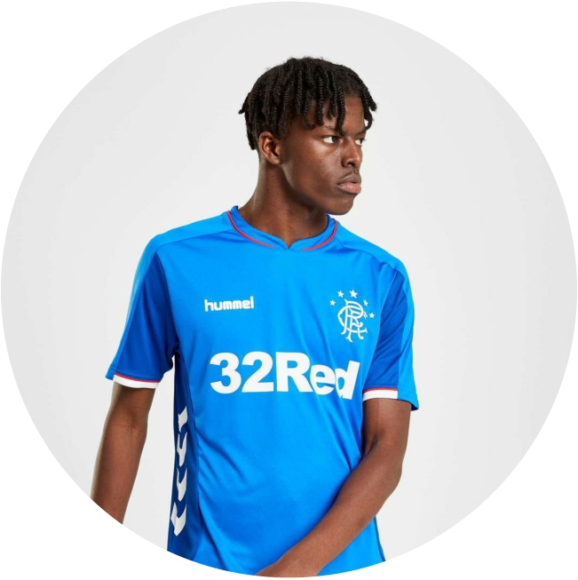
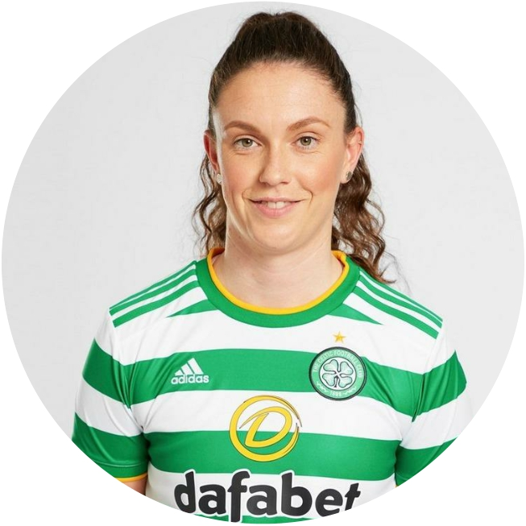
Picture 3 Picture 4

Slide 52
I am a Catholic I go to Church every Sunday I play hockey
I am a Protestant I live on the Falls Road I play Gaelic
I go to Bundoran on holidays I am British I have a granny called Mary
I go to Portrush on holidays My granny and granda are from the Shankill
I go to a school that is named after a Saint I am Irish
I play for Ballysillan FC My favourite music is Irish country

Slide 53
Basketball video Selective Attention Test – YouTube
In real life sometimes we only see the things we already believe or what we have already been told.
What we see depends on what we have experienced and what’s happening at that time.
We can be quick to judge someone based on what they look like, where they live etc.
There are different ways of seeing things (more than one truth).
Activity: First thoughts/ impressions activity – Ball throw

Slide 54
Where do our attitudes/ opinions come from?
Attitude refers to a set of emotions, beliefs, and behaviours toward a particular object, person, thing, or event.
Attitudes are often the result of experience or upbringing, and they can have a powerful influence over behaviour.
Attitudes can change over time.

Slide 55
Evaluation

Slide 56
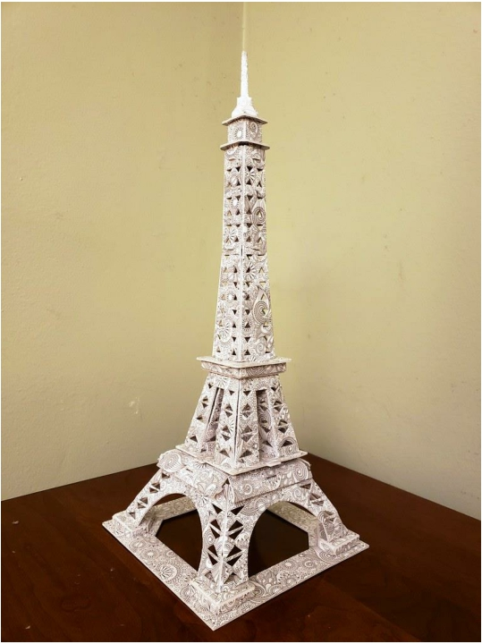
Session 7
Tower challenge

Slide 57
‘Us and them’ – Session 7 Learning outcomes
01
Understand why we should not judge others
02
Understand how it feels to be judged
03
Understand how we can get to know other people better

Slide 58
Session 7
Introduction/
Recap – 10
mins
Babysitter
activity – 30
mins
Tower Activity – 30 mins
Discrimination
– 15 mins
Individual
reflection- 20
mins
Evaluation/
check-out - 10
mins
‘Us and them’
NI – 20 mins

Slide 59
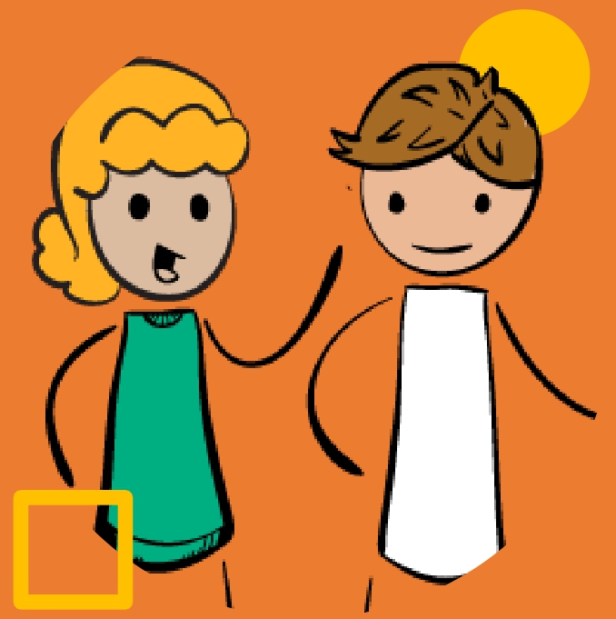
Pick a babysitter
– Activity
You are on the hunt for a new babysitter. Spend 15 minutes with your teammates to chat and decide who you would like to pick and why.
Everyone in the group must agree!
This Photo by Unknown Author is licensed under CC BY

Slide 60
Excluding someone (leaving them out)
Treating someone unfairly or unkindly
Separating different groups of people
Making assumptions can sometimes lead to
DISCRIMINATION

Slide 61
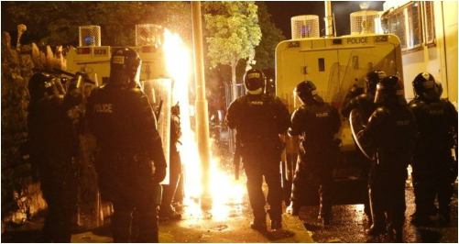
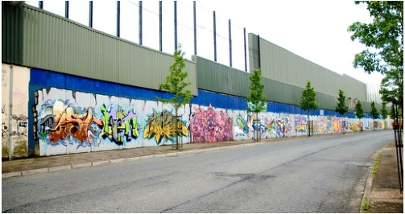
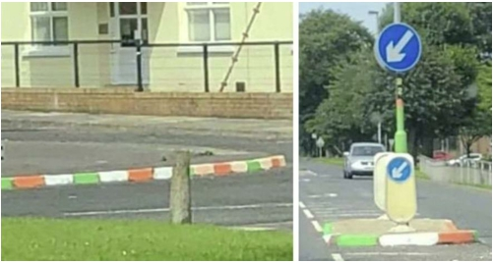
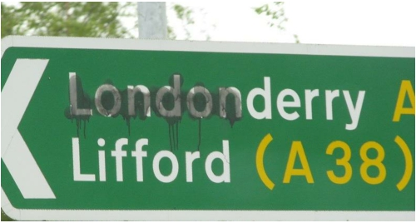
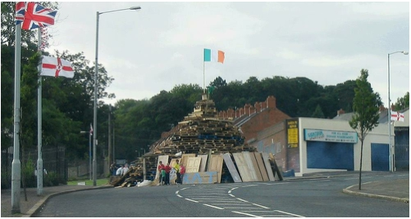
How this looks like in NI… ‘Us and them’

Slide 62
Think of a time you have been excluded, separated, or treated badly, because of who you are -
• How did it make you feel?
• How did you react?
• Did you want to change that part of your
identity?
• Has there ever been a time when you felt discriminated against because of your religion?
Reflection

Slide 63
How was
today’s
session?
This Photo by Unknown Author is licensed under CC BY-SA

Slide 64
Respect – Session 8 Learning outcomes
01
Understand what we mean by respect
02
Demonstrate how we can show respect
03
Understand the importance of respect

Slide 65
Session 8
Introduction/
Recap – 10 mins
How I can show
respect activity–
30 mins
Icebreaker – 15
mins
What is respect – 15 mins
Overcoming
disrespect - 30
mins
Positive
affirmations – 30
mins
Evaluation/
check-out - 10
mins
Respect pledge –
20 mins

Slide 66
What is Respect?
Brainstorm

Slide 67
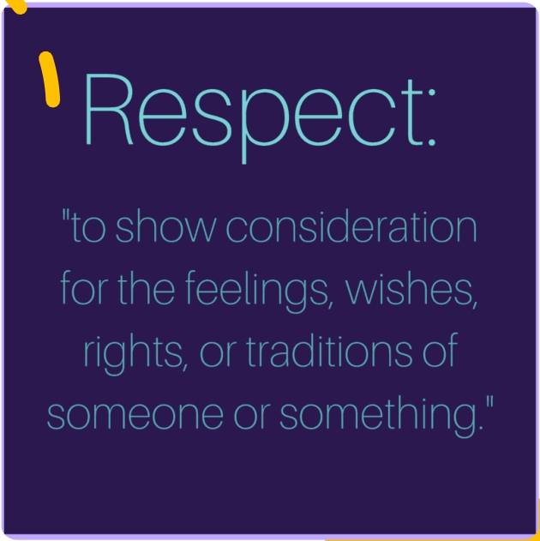
Respect is...
Treating others how we would like to be treated.
• Treating someone kindly
• Valuing how another person is feeling
• Valuing the qualities of something or
someone
We can respect:
• Places
• Things
• People

Slide 68
How do I show respect?
In school
In the youth
club
At home
In the
community

Slide 69
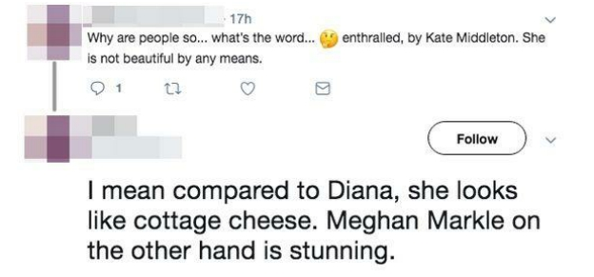
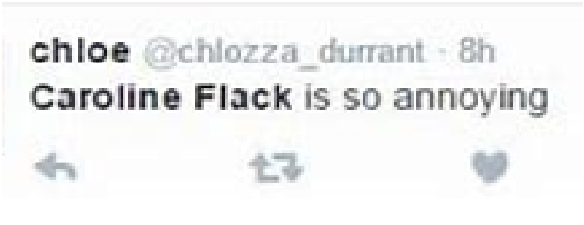
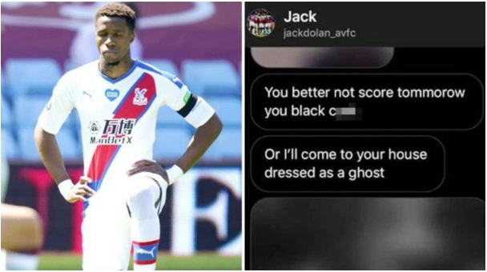
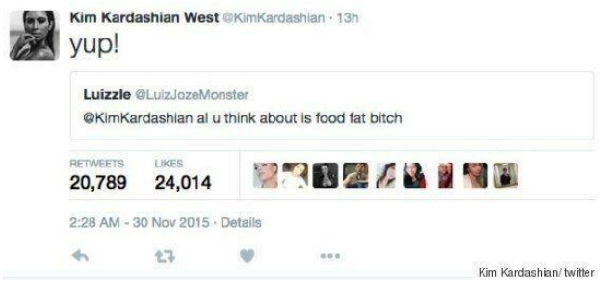

Slide 70
In a world where you can be
anything
#bekind

Slide 71
Think back to NI…
Do these images show respect?

Slide 72
Positive affirmations
• Draw around your hand
• Write your name on your palm
• Pass your handprint to the person on your
left
• As you receive each person’s handprint write one positive comment/ word about that person
• When you get your handprint back – SMILE!!
• These are all the positive things that make
you – YOU!

Slide 73
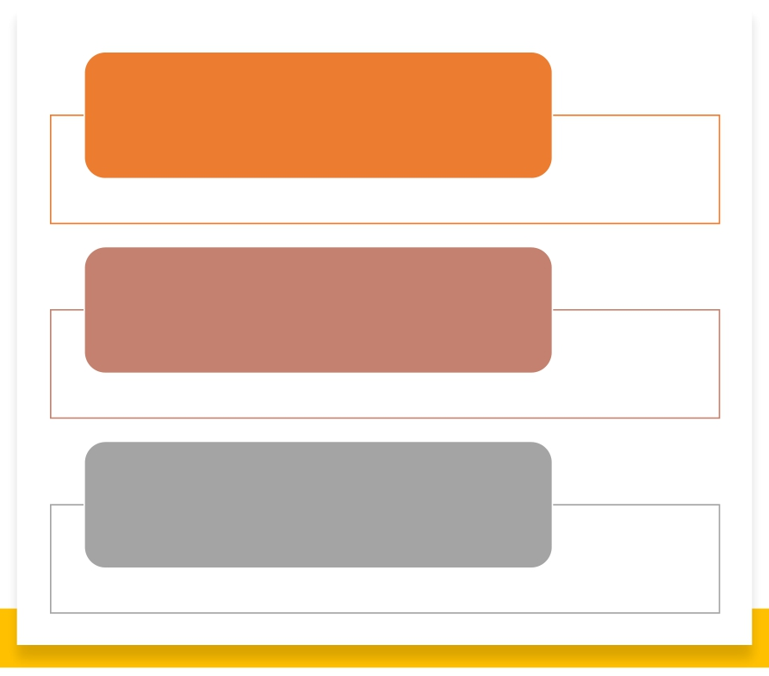
I promise to be…
I promise to do… I promise to say...
My pledge for this week ☺

Slide 74
Evaluation

Slide 75
Respect and peace in NI – Session 9 Learning outcomes
01
Be aware of respect and peace in NI
02
Gain greater awareness of others
03
Understand the need for collaboration and compromise to move towards peace in NI

Slide 76
Session 9
Introduction/
Recap/ Pledge
follow up – 20 mins
Icebreaker – 15
mins
NI to the outsider –
15 mins
Respect and peace
in NI– 30 mins
Team Crest- 30
mins
Evaluation and check-out - 10 mins

Slide 77
Group discussion how other people see people of N.Ireland?

Slide 78
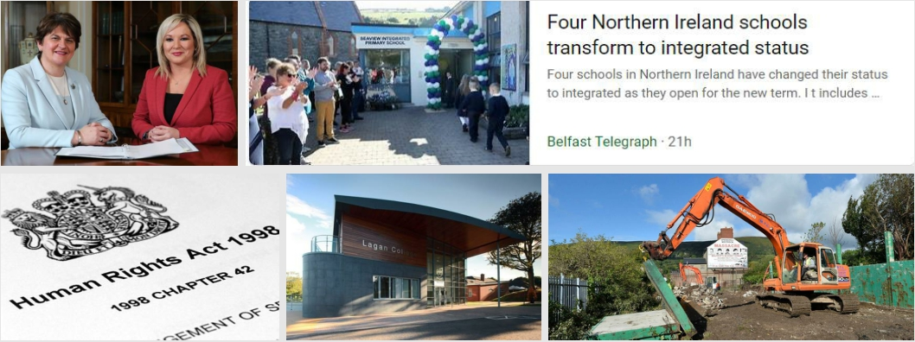
Increased respect helps to eliminate conflict and bring us closer to peace.
Where else do you see demonstrations of respect and peace in your community?

Slide 79
Team Crest
Design a team crest that represents the identities of all participants in the group.

Slide 80
Evaluation

Slide 81
Achieving peace in NI – Session 10 Learning outcomes
01
Understand our role to play in peace building
02
Illustrate our ideas on how we can contribute to peace building
03
Articulate a vision for NI

Slide 82
Session 10
Introduction/
Recap/ Pledge
follow up – 15 mins
Role to play in peace building - 40
mins
Icebreaker – 15
mins
Our vision for NI-
50 mins
Revisiting the baselines - 20 mins
Overall evaluation -
30 mins

Slide 83
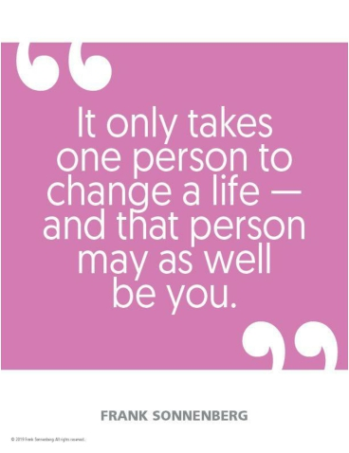
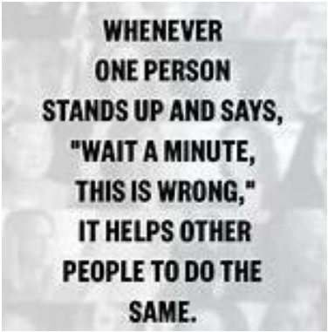
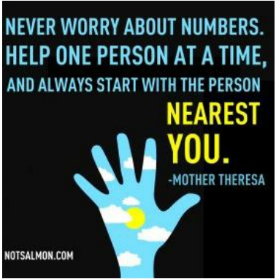
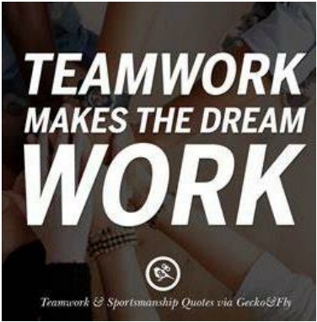
• Our power as individuals
• Our power as a group
• Our power as a community/ society
Our Role

Slide 84
How can we make NI a more peaceful place to live?
• You
• Your group
• Your community
• Make it happen!

Slide 85
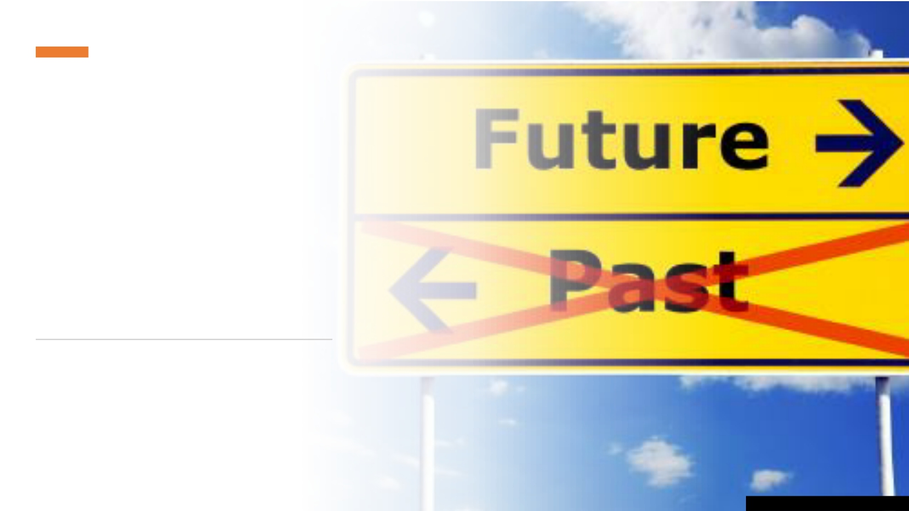
Northern Ireland in the Year 3000
What does NI look like?
Is it different from today?
Is there still a need to deliver good
relations?
Is there still segregation and hatred amongst both sides of the community?
What has changed? Why has it changed?
This Photo by Unknown Author is licensed under CC BY

Slide 86
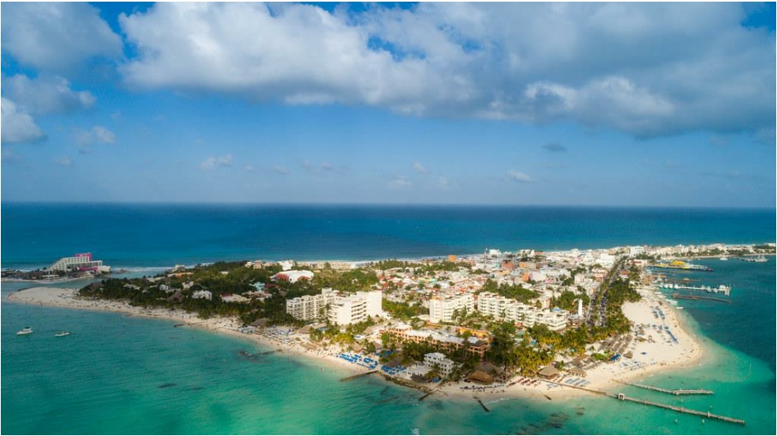
Ideal Island
Think of all the things you would choose to have on your ideal island and think of all the things you wouldn’t want. Discard these into the surrounding seas!
Once your ideal island is completed, you will present it to the rest of the group!

Slide 87
Who’s going
to make the
Ideal Island
happen?

Slide 88
End of programme evaluation

