Slide 1
Accredited Youth Work Programmes
Good Relations 14-18 years

Slide 2
Introductions – Session 1 Learning Outcomes
01
Be aware of programme expectations
02
Learn more about yourself and others

Slide 3
Structured set of workshops and activities/ games which are used to help young people learn about a particular topic
Lots of young people do the same programme across NI
Opportunity for young people to show their youth leader and others what they have learned and achieved
Opportunity for young people to get a reward for their hard work e.g., certificates
What is an accredited programme?

Slide 4
Sessions 10
Time and date | Insert here
Activities | Small and large group discussions, team building games and activities, games and activities around good relations
Our topic: Good Relations
You will each receive a workbook for you to show your learning. You can also show your learning in more creative ways e.g., photos, videos, flipchart evidence, drama etc.
Learning

Slide 5
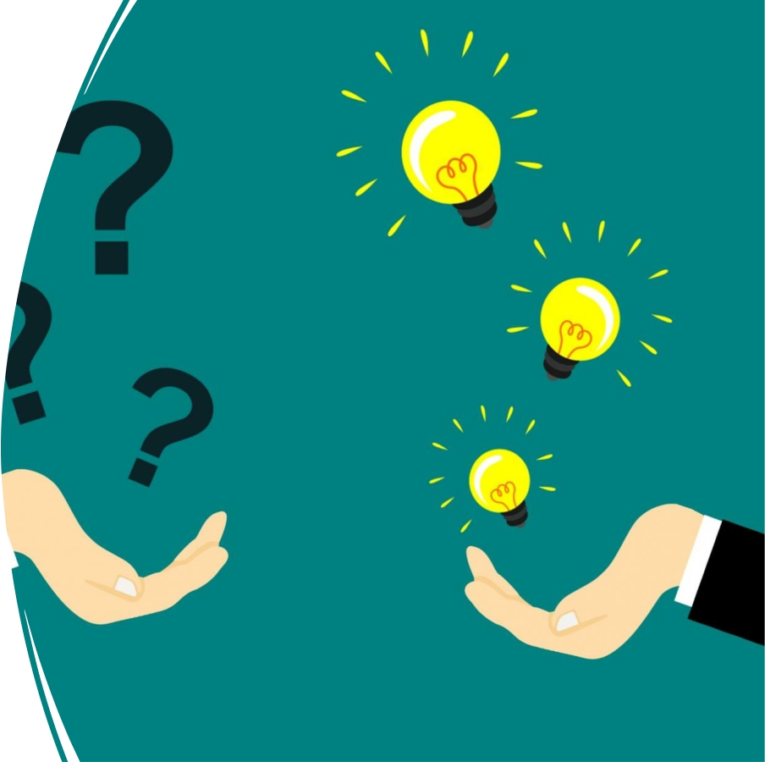
Questions?

Slide 6
Tell us your name
Do you know why you are called this?
Do you know what your name means?
Getting to know you!

Slide 7
Find Your Partner
• You are one half of a couple. This might be a famous couple from a movie or book. Or it could be a celebrity couple/ couple we see on TV!
• This game will only work if you DO NOT tell people the name on their back!
• You must mingle and ask lots of questions to find out who you might be.
• You can only answer yes or no to questions.
• If you’ve found your partner, stand beside them and get to know three things about them (that you didn’t already know)!

Slide 8
• To help ensure a safe and welcoming environment for everyone!

Slide 9
Hopes and Fears for the programme

Slide 10
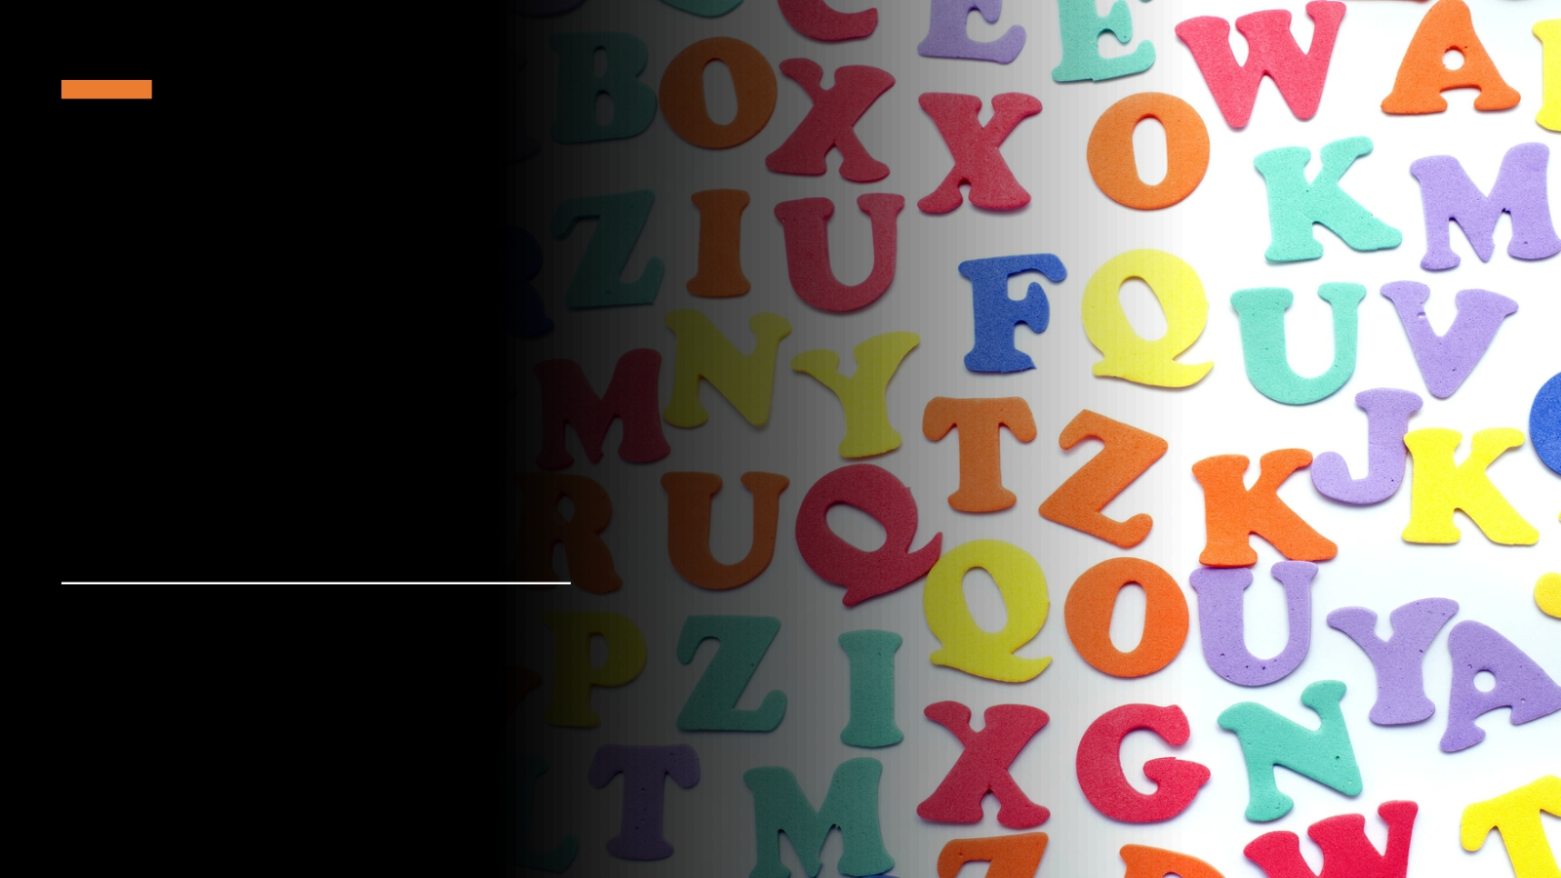
Alphabet Game
Answer with your feet!

Slide 11
Sweet
Introductions
Pick between one and five sweets from the bag.
Do not eat them yet!

Slide 12
Sweet Introductions – What did you pick?
Best memory
Dream job Favourite place
Biggest talent
Wildcard!

Slide 13
Evaluation

Slide 14
Why Good Relations? – Session 2 Learning Outcomes
01
Explain what is meant by the term ‘good relations’
02
Understand why good relations work is important in NI
03
Be aware of NI population statistics

Slide 15
Why good relations? Session 2
What do we mean by
good relations? – 30
mins
Introduction &
check-ins – 10 mins
Icebreaker – 15 mins
Why is good relations
work important in
NI? – Matchup
activity - 30 mins
Check out/
Evaluation & Prep for
next session– 10
mins
NI in a classroom –
20 mins

Slide 16
Group discussion
• What do we mean by good relations?

Slide 17
Good relations is “The growth of relationships and structures for Northern Ireland that acknowledge the religious, political and racial context of this society, and that seek to promote respect, equity and trust, and embrace diversity in all its forms.” Equality Commission, 2007
Good Relations- Definition

Slide 18
Government, community and individuals will work together to build a united community.
Good relations is about making our communities more:
Shared
Safe
Accepting of others
Open and encouraging to the celebration of different cultures and beliefs
T:BUC
Together: Building a United Community

Slide 19
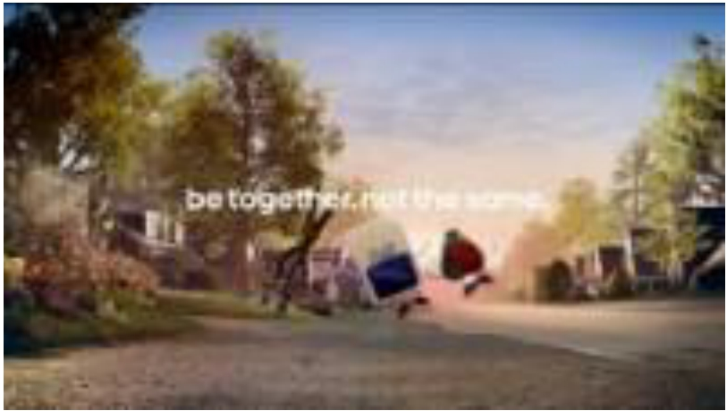
•
Video clip
Be Together. Not the Same.

Slide 20
Match Up Activity – Our History
Why is Good
Relations
work
important in
NI?
• Long history of conflict in Northern Ireland
• Feelings of hurt and anger
• Good Friday Agreement did not please everyone – some
people see it as ‘unfinished business’
• Recent concerns over the implications of Brexit and more
specifically, the Northern Ireland protocol

Slide 21
NI in a classroom
If NI were a classroom of pupils, how many would consider themselves to be:
-Protestant -Catholic
-Other (no religion/ different religion)?
How many would consider themselves to be:
-British
-Irish -Northern Irish
-Other?
Does the population of your community reflect NI as a whole?
Northern Ireland (NISRA Statistical Bulletin, 2021) Population of 1.9 million (2020)
48% - Protestant 45% - Catholic 6% - No religion
1% - Other religion
98% - White 2% - Black
40% - British 25% - Irish
21% - Northern Irish 14% - Other

Slide 22
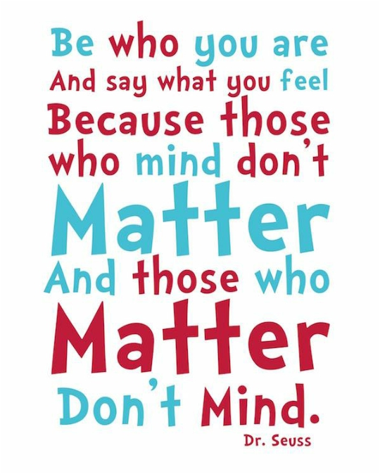
Check out/ Evaluation
Preparation for next session!
Bring something that represents you/ something that’s very important to you!
Show it to the group.

Slide 23
Identity - Session 3 Learning outcomes
01
Understand what is meant by the term Identity
02
Explore individual identity and what influences it
03
Understand how our individual identity relates to our community/ society

Slide 24
Identity
Session 3
Introduction &
check-ins – 10
mins
What is
identity? – 15
mins
Show and Tell–
30 mins
All Change game – 15 mins
What influences
our identity?–
20 mins
Identity
showcase! – 60-
90 mins
Check out/ Evaluation – 10
mins
My identity – 30
mins

Slide 25
Something
that’s
important to
me is…
• Time to share that something special that is very
important to you!

Slide 26
All change game
Everyone sit in a circle with one person standing in the middle.
The person standing in the middle must think of something that is part of their identity e.g. All Change if you are from County Antrim.
All those who fit this description must change seats quickly.
The person who asked the question tries to claim a seat.
You cannot swap seats with someone sitting next to you or return to your own seat.
The last person standing then must introduce something that is part of his or her own identity.

Slide 27
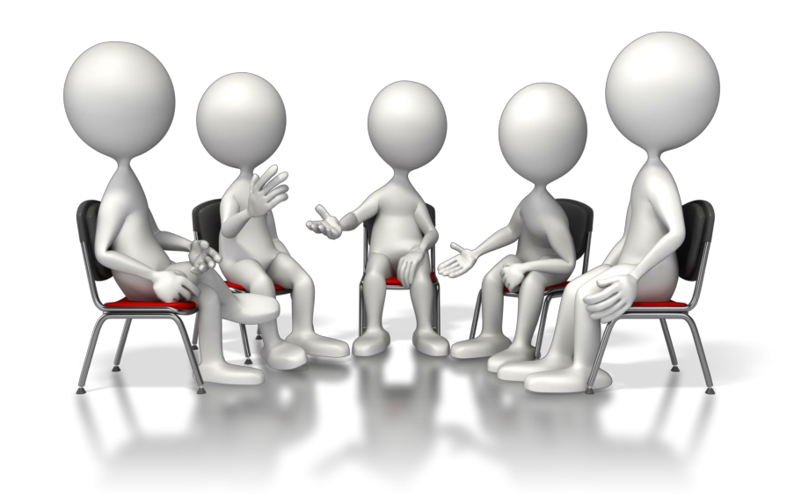
Group Discussion – What is Identity?

Slide 28
Identity
Identity is all the things that make you: YOU!
It’s not just one thing, but many different things that are mixed together. Identity is all the things that make you unique.
There is no one else quite like you!
My Identity Shield
1. How you see yourself
2. How others see you
3. How you see your future
4. Your hopes and fears
5. Design a logo that represents you
6. Write a motto that sums up your life

Slide 29
Why is having a strong identity so important?
• More confident about who we are and what we believe
in
• More happy with ourselves
• Able to develop better friendships/ relationships
• We are being true to ourselves
• We do what we believe is right
• We become the person we want to be
• Be proud to be you!

Slide 30
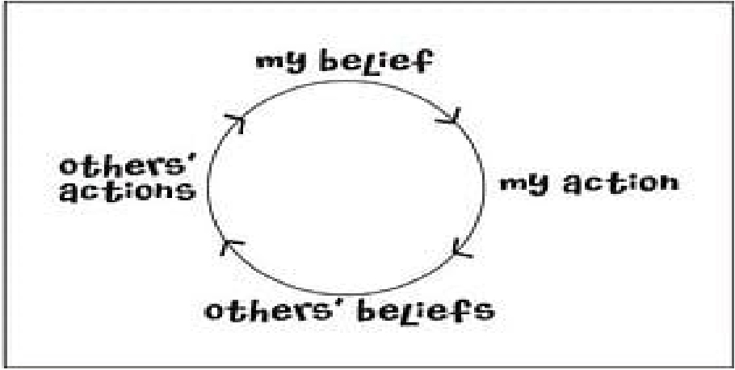
Your identity is influenced by:
• Where you live
• Your religion
• Your family’s beliefs
• Your friend’s beliefs
• Your culture
• Your life experiences

Slide 31
Identity showcase
Opportunity to showcase part of our identity – an interest/ hobby/ story about growing up
Lambeg
Drumming
Irish dancing
Rugby
Irish Language

Slide 32
Evaluation

Slide 33
Community - Session 4 Learning Outcomes
01
Understand importance of community
02
Be motivated and able
to maximize assets and opportunities available in the community
03
Understand how our community impacts us as individuals

Slide 34
Community
Session 4
Introduction &
check-ins – 10
mins
What is
community? – 5
mins
Community
Mapping – 60-90
mins
Icebreaker – 15
mins
Exploring impact
of community –
20 mins
Evaluation/
check out – 10
mins
My stickman –
30 mins

Slide 35
Before we begin, think about:
• The neighbourhood we want to focus on – what
streets/ area will be visit
• Resources in the area:
- Places/ spaces/ buildings (libraries, shops, community halls, churches, youth clubs, schools, parks etc.)
- People (community groups, people with influence,
skills or talents, sports teams etc.)
Look out for:
• Opportunities to socialise
• Opportunities to get to know others with different
backgrounds
• Places which are only used by one side of the
community
• Significant memories/ events/ flags/ symbols
• Places where you feel safe/ unsafe
Session 4 – Community Mapping

Slide 36
My community and me
The community we live in will have an impact on what we do, what we say, what we think, how we feel, what we believe in and who we will become.

Slide 37
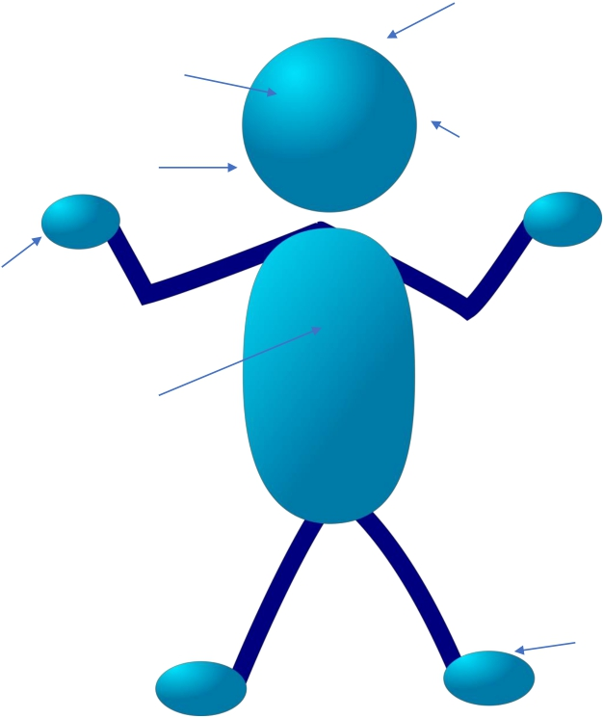
What are we thinking?
What are we seeing?
What are we hearing?
What are we saying?
What are our hands doing?
What are we feeling?
Where are our feet walking/ not walking?

Slide 38
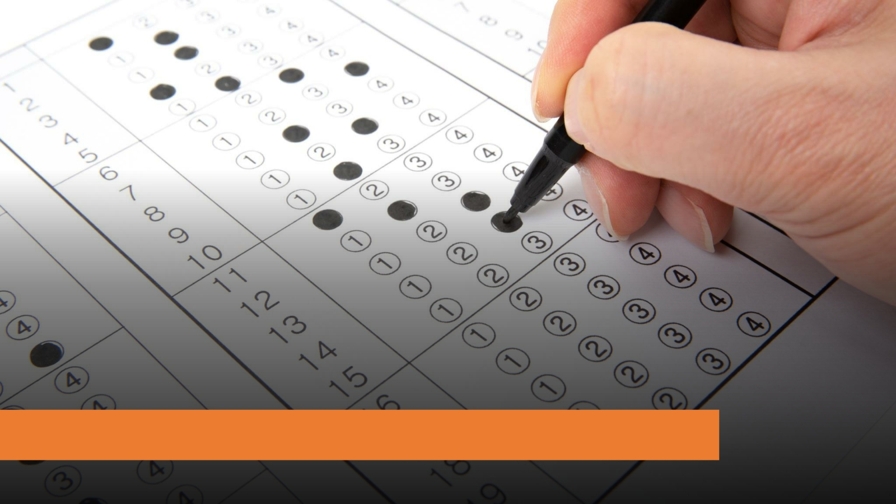
Evaluation

Slide 39
Symbols, flags, and traditions – Session 5 Learning Outcomes
01
Understand the meaning of common symbols and flags in NI
02
Be aware of traditions and celebrations in our community
03
Understand the need for safer and more together community

Slide 40
Symbols, flags and traditions Session 5
Flags and
symbols we see
in NI – 90 mins
Introduction –
10 mins
Icebreaker –
15mins
Four Corners
debate – 40
mins
Evaluation and
check-out - 10
mins

Slide 41
Flags we see in NI

Slide 42
Symbols
• Defining what a ‘symbol’ is can be quite
difficult – yet we use symbols every day.
• Symbols are usually pictures or shapes
which represent an idea or a value.
• We use symbols to communicate ideas
without words.
• Without us, symbols would just be simple
shapes and colours.

Slide 43
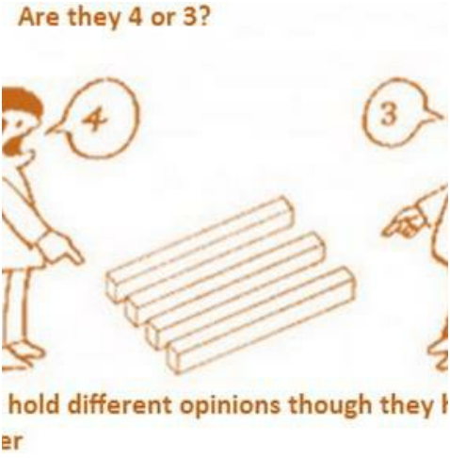
I encourage everyone to:
- Speak openly and honestly - Respect other opinions
- Learn from others in the group
Four Corners

Slide 44
Evaluation

Slide 45
Stereotyping, prejudice, and discrimination –
Session 6
Learning outcomes
01
Understand and identify the relationship between stereotyping, prejudice, and discrimination
02
Be aware of our own prejudices against others
03
Explore beliefs, values and attitudes and impact on behaviour

Slide 46
Stereotyping, prejudice and discrimination Session 6
Introduction to
judging others – 30
mins
Introduction/ check
in – 10 mins
Icebreaker – 15
mins
Pick a flatmate
activity – 30 mins
Where do
attitudes/ opinions
come from? – 30
mins
Beliefs, attitudes,
values – 30 mins
Evaluation - 10
mins

Slide 47
• Stereotyping — making an unfair assumption or generalisation about a
person based on an aspect of their identity.
“All young male drivers are little boys racers”
• Prejudice — “to judge before” - having an opinion on someone that is not
based on reason or actual experience.
“Young Tommy is going to speed and take risks when on the road”
• Discrimination - intolerance and mistreatment of a person
because of their age, race, religion, sexuality, disability or political beliefs.
“Tommy’s car insurance will cost thousands because he is young and male”
• Discrimination can lead to conflict in societies.

Slide 48
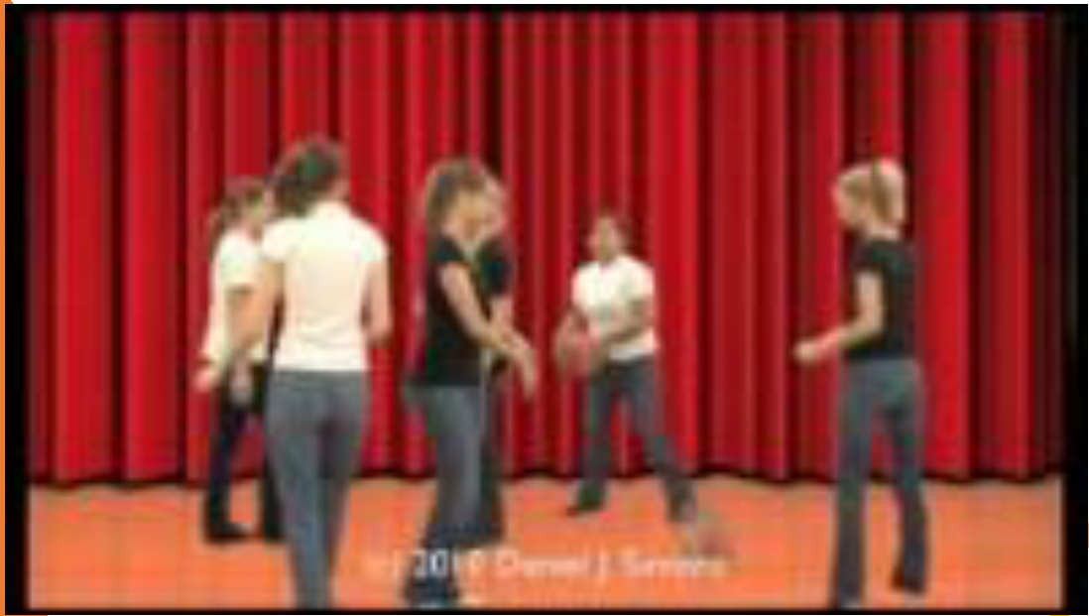
In real life we tend to see only those things which support what we already think/ believe or the ‘stereotypes’ we uphold. What we see depends on what we have experienced and what’s happening at that time. There are different ways of seeing things (more than one truth).
Keep this in mind when we play our ‘Pick a flatmate’ activity!

Slide 49
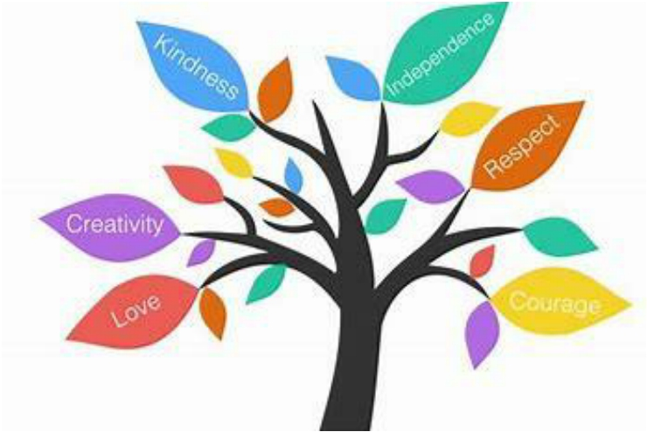
Beliefs, Values, and Attitudes

Slide 50
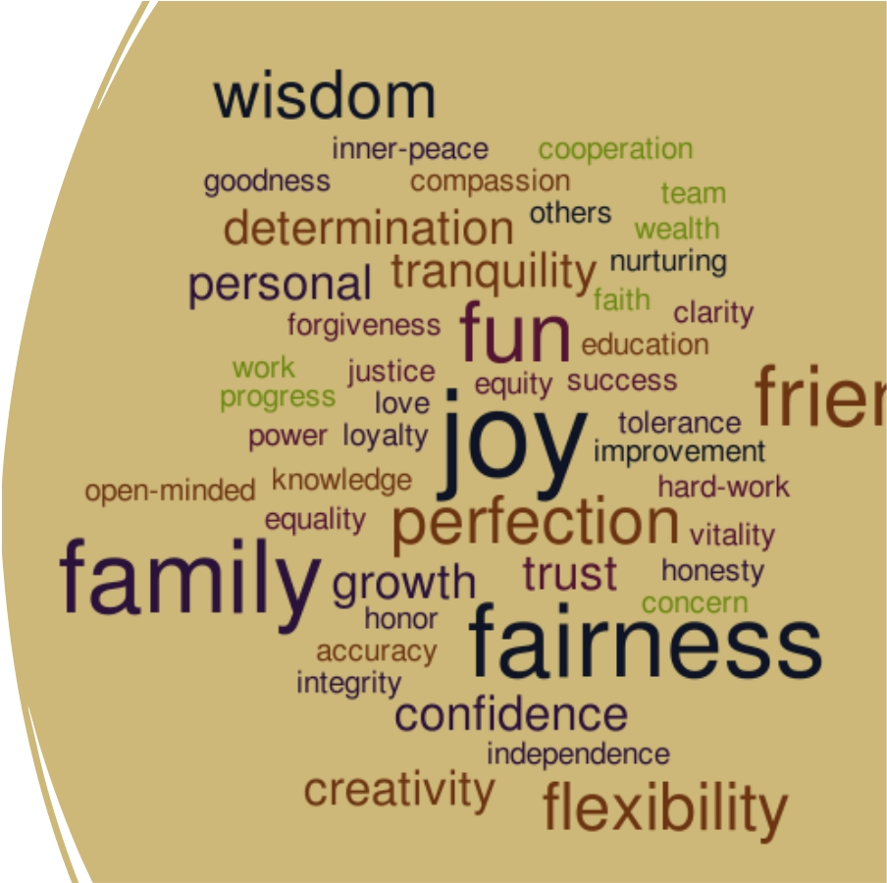
Values Discussion Cards
• Read and discuss each scenario
with your partner.
• Try to answer the questions as
truthfully as possible.
• Everyone’s responses will be different. This is OK! We all have different values which result in different attitudes/ opinions/ choices!

Slide 51
Where do beliefs, values and attitudes come from?
Beliefs, values and attitudes are often the result of experience or upbringing, and they can have a powerful influence over behaviour.
Beliefs, values, and attitudes can change over time.

Slide 52
• Know your values and stay true
to them
• Make your own choices, don’t
just go along with the crowd
• Respect yourself and others
• Think about your goals and act
accordingly

Slide 53
Evaluation

Slide 54
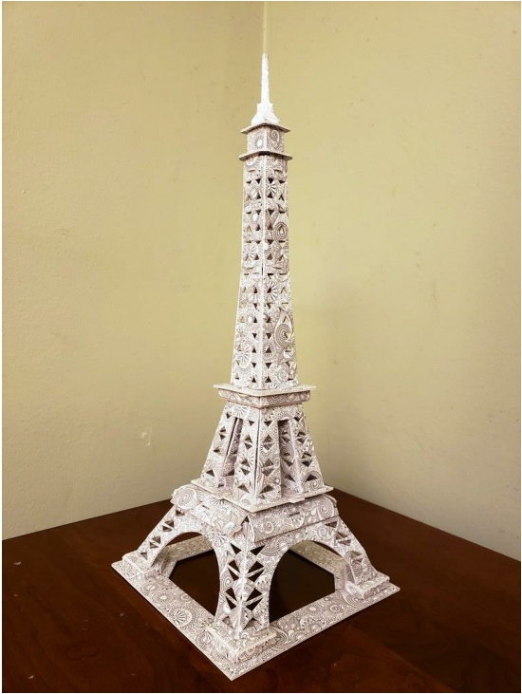
Session 7
Tower challenge

Slide 55
‘Us and them’ – Session 7 Learning outcomes
01
Explore own prejudices/ who we think is to blame for the conflict in Northern Ireland
02
Understand existence of conflict in Northern Ireland

Slide 56
Session 7
Introduction/
check in – 10
mins
Tower Activity – 30 mins
Discrimination
in NI – 30 mins
Individual
reflection - 15
mins
Who is to
blame? – 40
mins
Evaluation/
check out - 10
mins

Slide 57
Exclusion and/ or separation
Intolerance or lack of respect for someone based on an aspect of their identity
Hatred and conflict
Prejudice
can often lead to DISCRIMINATION

Slide 58
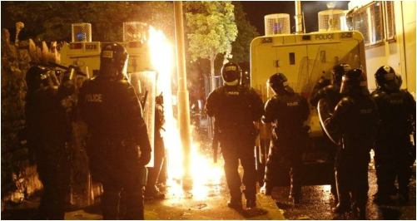
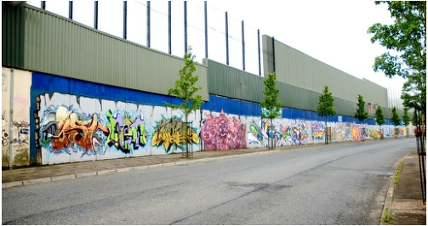
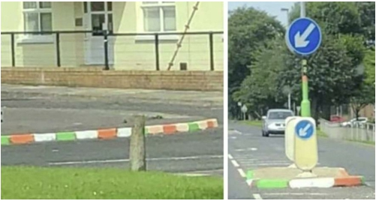
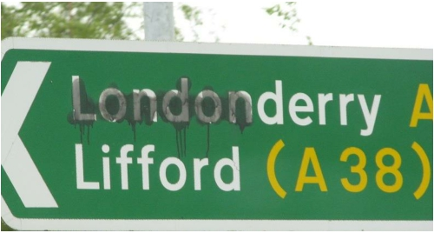
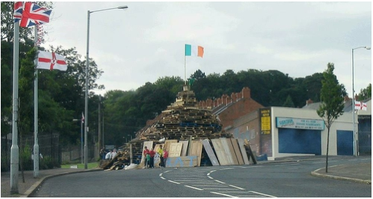
How this looks like in NI…

Slide 59
Think of a time you have been excluded, separated, or treated badly, because of who you are -
• How did it make you feel?
• How did you react?
• Did you want to change that part of your
identity?
• Has there ever been a time when you felt discriminated against because of your religion?
Quiet
reflection

Slide 60
Who’s to blame?

Slide 61
Evaluation

Slide 62
Understanding conflict – Session 8 Learning Outcomes
01
Understand conflict and how it arises
02
Be aware of different styles of conflict
03
Understand strategies to help defuse situations of conflict

Slide 63
Understanding conflict Session 8
How conflict may
arise ‘Cokey’– 30
mins
Introduction/
check in – 10 mins
Icebreaker – 15
mins
What is conflict–
15 mins
Understanding Position, Interests and Needs (PIN) -
30 mins
Animal styles of
conflict – 30 mins
Evaluation/ Check
Out - 10 mins

Slide 64
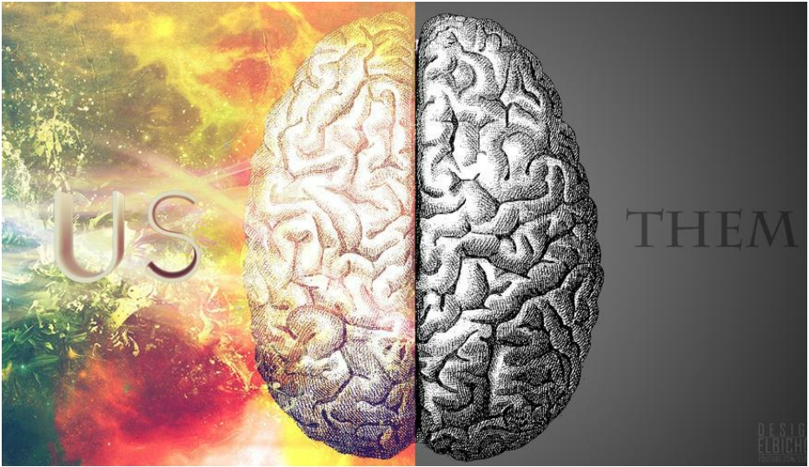
Conflict in Northern Ireland
Conflict
Is:
• A difference of opinion between
two (or more) people or two
(or more) groups
of people
• A disagreement
where there is
tension.

Slide 65
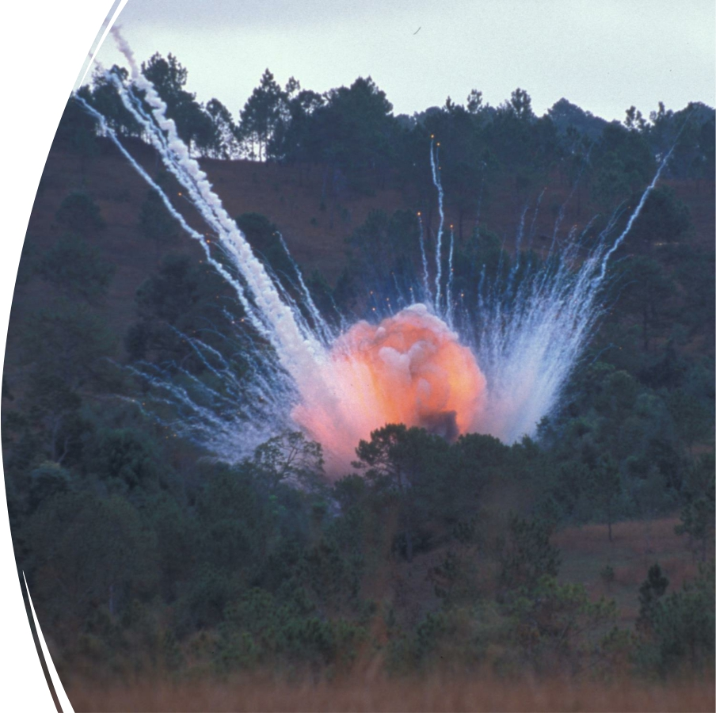
‘Cokey’
A story to illustrate
how conflict may
arise.

Slide 66
Animal styles of conflict

Slide 67
Animal styles of conflict

Slide 68
Animal styles of conflict
• For each scenario, stand by an animal style that the
person might use.
• What could be the benefits of responding in this way?
• What could the disadvantages be?

Slide 69
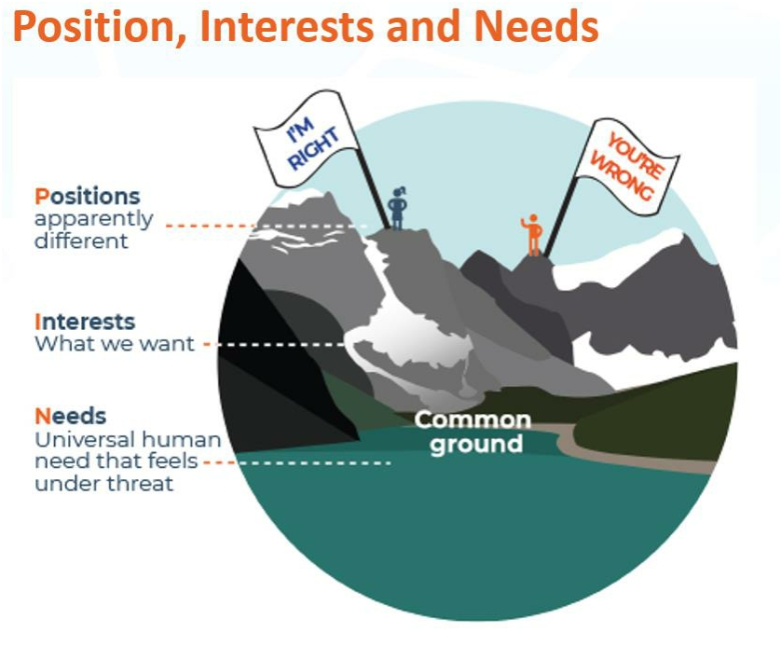
Before we respond to a difficult situation/ confrontation, we need to consider….

Slide 70
• Position - What does each person say or believe?
• Interests – What does each person want?
• Needs – What universal human needs might be under
threat?
Position, Interests and Needs

Slide 71
Evaluation

Slide 72
Understanding online conflict – Session 9 Learning outcomes
01
Develop greater understanding of online conflict and why it arises
02
Be aware of strategies to deal with both face to face and online conflict
03
Practice strategies to deal with both face to face and online conflict

Slide 73
Understanding online conflict Session 9
Introduction/
check in – 10
mins
Why does
online conflict
occur – 10 mins
Conflict
resolution tools – 30 mins
Icebreaker – 15
mins
Online
positivity - 10
mins
Positive
affirmations- 30
mins
Evaluation/
Check Out - 10
mins
Pledge - 20
mins

Slide 74
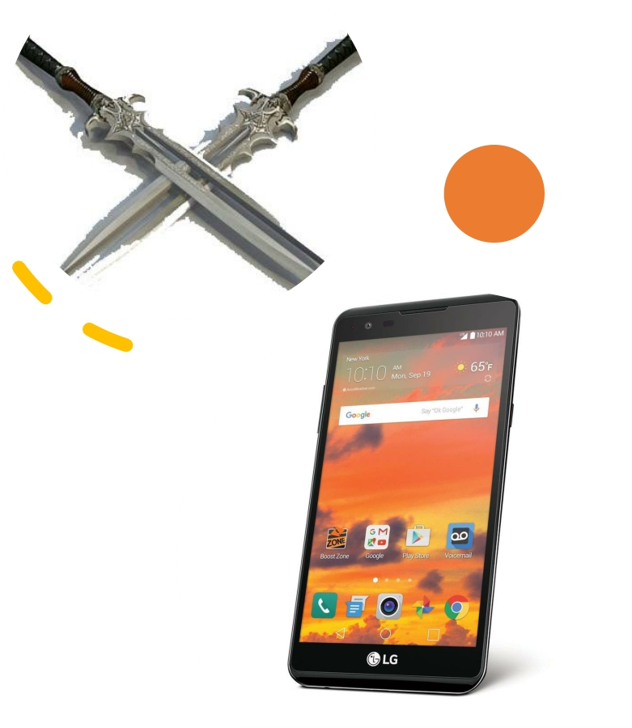
Online conflict
It's well known that people say and do things in cyberspace that they wouldn't ordinarily say or do in the face-to-face world.
They loosen up, feel less self-conscious, express themselves more openly.
“It's a double-edged sword. Sometimes people
share very personal things about themselves. They reveal secret emotions, fears, wishes.
On the other hand, out spills rude language and harsh criticisms, anger, hatred, even threats" (Dr. John Suler)

Slide 75
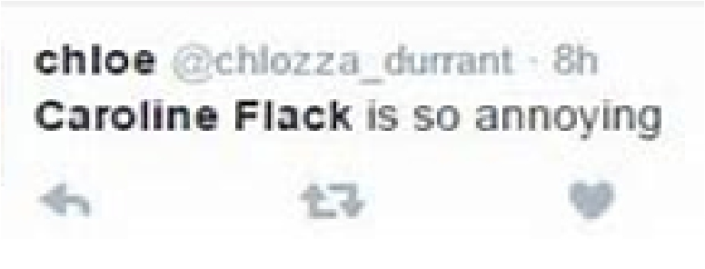
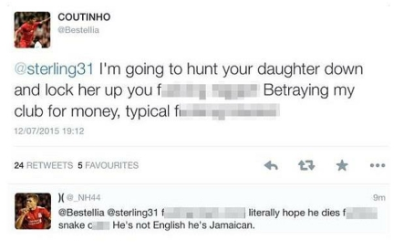
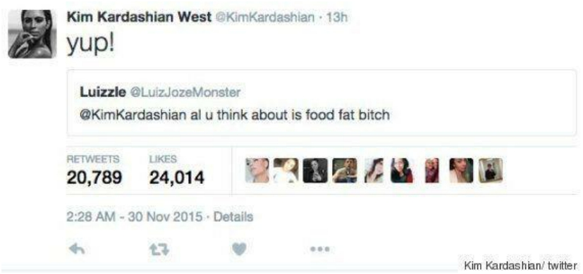
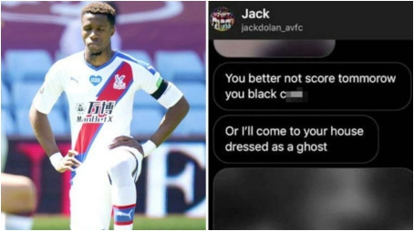

Slide 76
Why might online conflict occur?

Slide 77
Conflict resolution tools
• Don’t respond right away
• Take time to notice what you feel or need
• Listen well
• Clarify what was meant
• Use ‘I’ statements when sharing thoughts and
feelings
• Place yourself in other person’s shoes – Identify their
position, interests and needs
• Use emoticons to express tone when using text
• Choose whether or not you want to respond to
online conflict
• Start and end on a positive note
• Ask for support if needed

Slide 78
In a world where you can be
anything
#bekind

Slide 79
Positive affirmations
• Draw around your hand
• Write your name on your palm
• Pass your handprint to the person on your
left
• As you receive each person’s handprint write one positive comment/ word about that person
• When you get your handprint back – SMILE!!
• These are all the positive things that make
you – YOU!

Slide 80
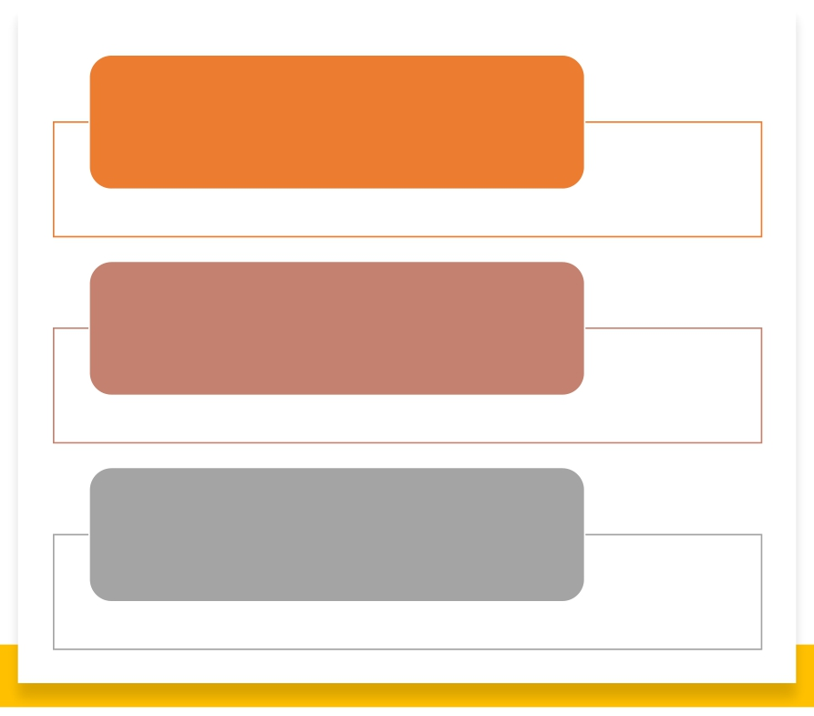
I promise to be…
I promise to do… I promise to say...
My pledge for this week ☺

Slide 81
Evaluation

Slide 82
Moving towards greater peace – Session 10 Learning outcomes
01
Recognize respect and peace in NI
02
Understand our role to play in peace building
03
Articulate a vision for peace in NI

Slide 83
Moving towards greater peace Session 10
Introduction/
Recap/ Pledge
follow up – 15 mins
Icebreaker – 15
mins
Revisiting the baselines - 20 mins
Respect and peace
in NI - 30 mins
Our role to play in
peace building - 40
mins
Our vision for NI -
40 mins
Overall evaluation -
30 mins

Slide 84
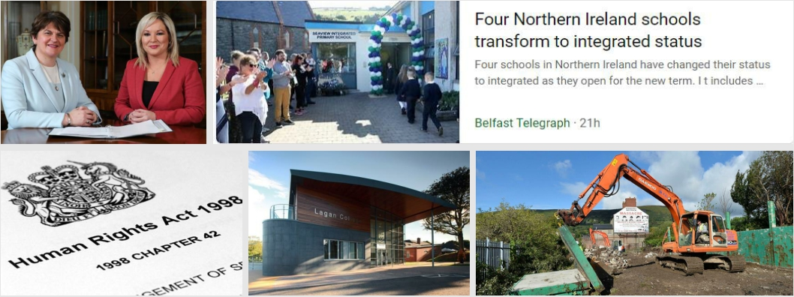
Increased respect helps to eliminate conflict and bring us closer to peace.
Where else do you see demonstrations of respect and peace in your community?

Slide 85
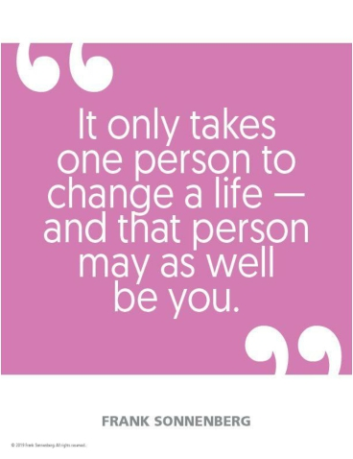
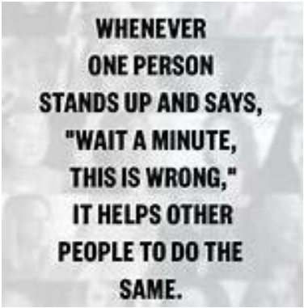
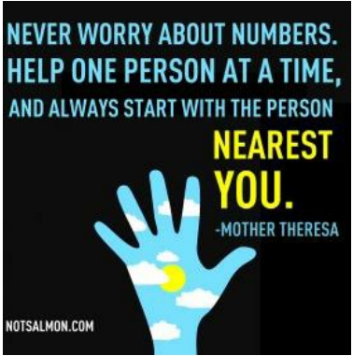
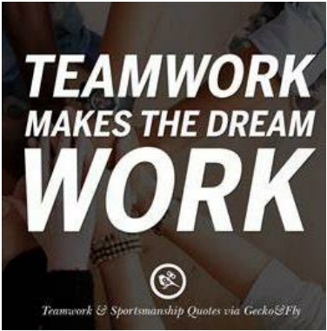
• Our power as individuals
• Our power as a group
• Our power as a community/ society
Our Role

Slide 86
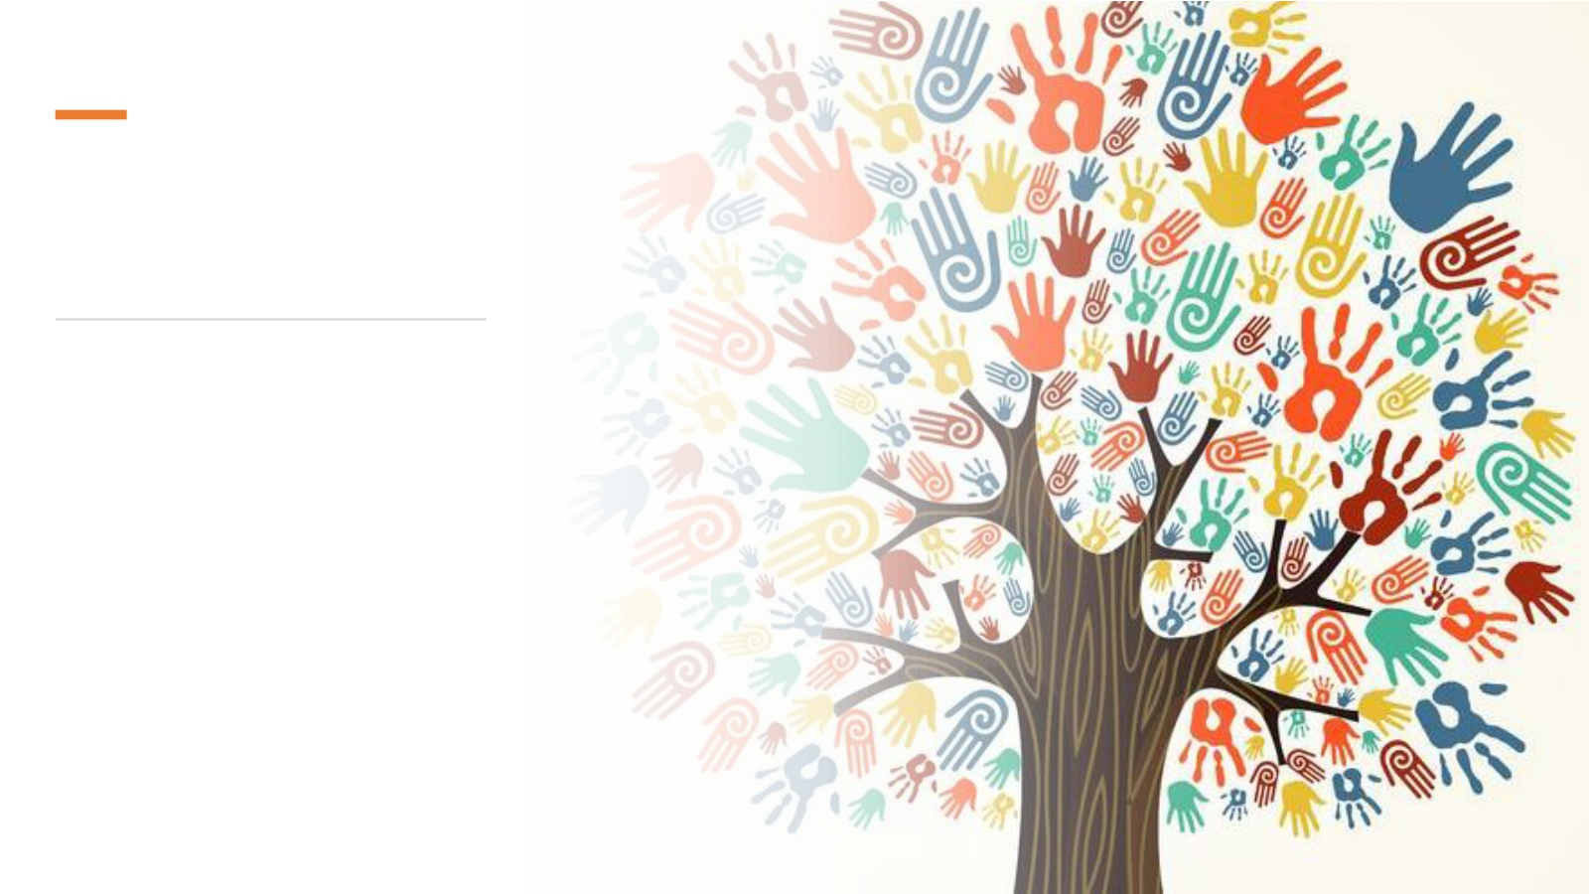
How can we make NI a more peaceful place to live?
• You
• Your group
• Your community
• Make it happen!

Slide 87
Northern Ireland in the future - Brainstorm
Imagine it is the Year 3000!
What does NI look like?
Is it different from today?
Is there still a need to deliver good relations?
Is there still segregation and hatred amongst both sides of the community? What has changed/ why has it changed?

Slide 88
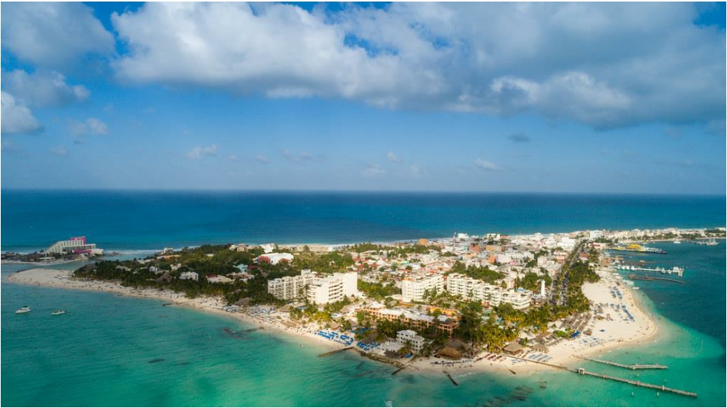
Ideal Island
Think of all the things you would choose to have on your ideal island and think of all the things you wouldn’t want. Discard these into the surrounding seas!
Once your ideal island is completed, you will present it to the rest of the group!

Slide 89
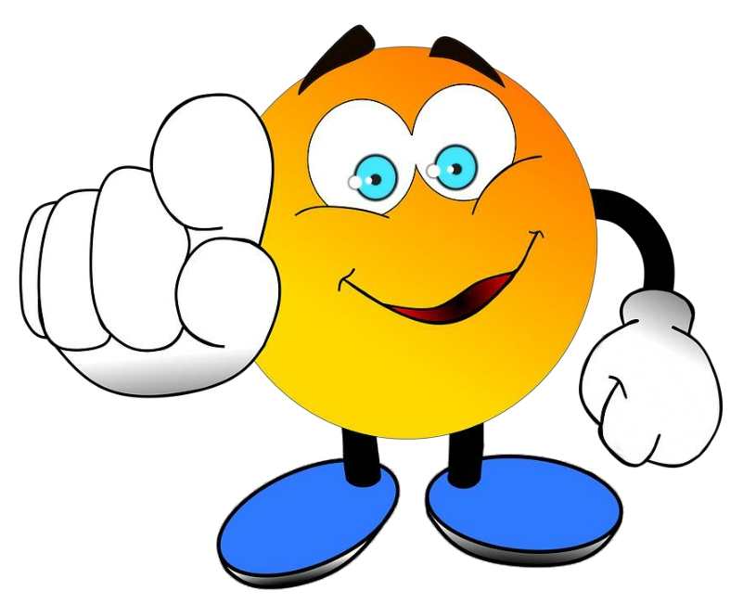
Who’s going
to make the
Ideal Island
happen?

Slide 90
End of programme evaluation

