Slide 1
Accredited Youth Work Programme Inclusion, Diversity & Equality of Opportunity 9-13 years

Slide 2
Session 1 – Introduction to Inclusion, Diversity & Equality of Opportunity
Introduction to programme
What is EDI?
Check-out
Icebreaker – Similarities and Differences
Baselines
Quiz

Slide 3
What is an accredited programme?
Set of workshops and activities/ games which are used to help young people learn about a particular topic
Lots of young people do the same programme across NI
Opportunity for young people to show their youth leader and others what they have learned and achieved
Opportunity for young people to get a reward for their hard work e.g., certificates

Slide 4
Hopes and fears

Slide 6
Start baselines

Slide 7
Icebreaker – Similarities and Differences
Get into groups of three and stand in a circle.
You have two minutes to find five things that the three of you have in common.
This cannot be obvious things, e.g., I am a human, I go to youth club. It must be things you have had to find out.

Slide 8
Icebreaker – Continued
Now you have two minutes to find five things that the three of you do NOT have in common.
Tell us what you came up with!

Slide 9
Match Up
You have three words!
Inclusion
Diversity
Equality of Opportunity
Work together in your groups to match up the word with the correct definition.
Ask for help if you need it!

Slide 10
What does each word mean? Time to explore this further.
Inclusion - being included and being able to participate in safe and welcoming environment.
Diversity - the range of human differences. It is about recognising, respecting, and valuing differences such as ethnicity, race, age, religion, political opinion, interests etc.
Equality of Opportunity - where individual needs, situations, and goals are recognised and the barriers that limit what people can do, or can be, are removed.

Slide 11
Quiz – True or False?
This is a quick quiz to get you thinking about inclusion, diversity and equality of opportunity.
It is just for fun and to give you a flavour of some of the things we will talk and learn about over the next ten sessions.

Slide 12
Evaluation/ Check Out

Slide 13
Session 2 – Exploring Diversity
Who Am I? – Activity
What influences me?
Evaluation/ Check-out
Same but different - Activity
The toast dilemma!
Identity Showcase

Slide 14
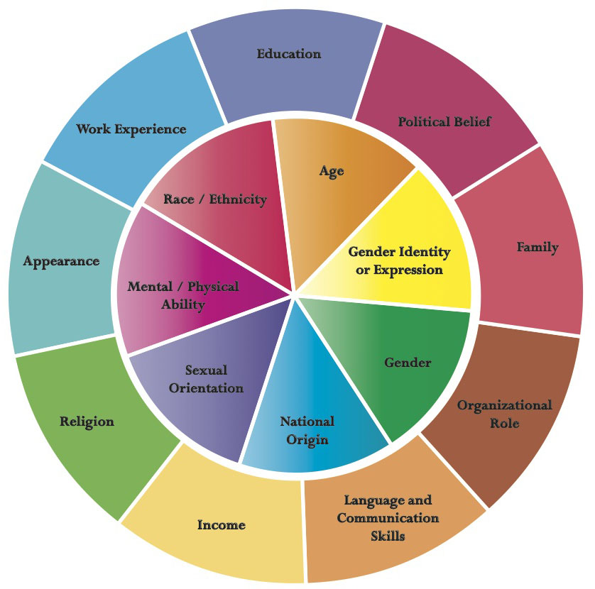
Re-Cap
What did I learn from last session?
This week’s session will focus on diversity. Do we remember what diversity is?
To help us understand it a bit better, we must understand how we as individuals are all ‘diverse’ or unique!

Slide 15
Who am I? - Activity
Be as creative as you can with this one!
Create a shield with four sections. You should include:
Favourite hobbies
Proudest moments
Hopes for the future
People/ things you admire
At the top or bottom of the page, write a motto that you live by/ your favourite saying.

Slide 16
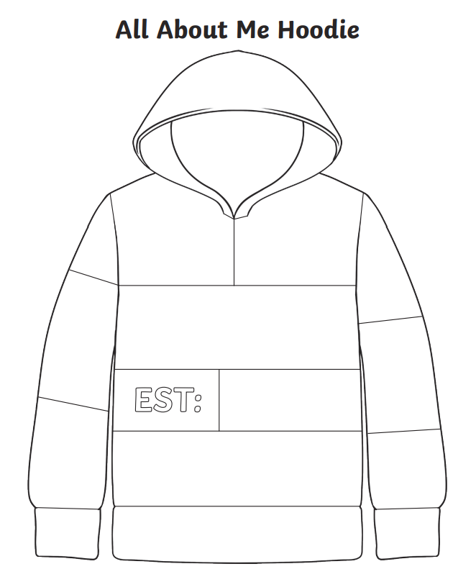
My Hoodie - Activity
Complete the hoodie template with things that make you YOU! Include things such as your favourite things, people, music, hobbies etc.
Be as creative as you like!

Slide 17
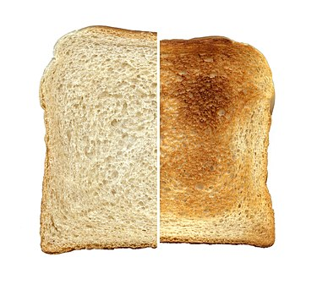
The toast dilemma!
Listen to the different ways we can enjoy toast and vote with your feet!
Life would be very dull if we all liked one type of toast!

Slide 18
Same but different - Activity
Complete your ‘Same but different’ cards.
You will be discussing your answers with people in the room and finding out what things you have in common/ are the same, and what things are different.
This activity will help you learn more about yourself and other people in the room.

Slide 19
What influences us?
Get into pairs.
You have five minutes to list things in your everyday life that are influenced or come from other countries.
It can be a person in your family, friend, music, food, fashion, sport, etc.
The pair with the longest (and correct) list wins!

Slide 20
Identity Showcase!
Showcase part of your identity to the group!
Be proud of who you are and all the unique things that make you, YOU!

Slide 21
Evaluation/ Check Out

Slide 22
Session 3 – Our Diverse Community
What is Community?
Word chain – Memory game
Evaluation/ Check-out
Scavenger Hunt
NI to the outsider

Slide 23
What is a Community?

Slide 24
Community is…
A group of people living in the same place or having a particular characteristic, attitude or interest in common.

Slide 25
NI to the outsider
How do you think people, who don’t live in NI, would describe it?
What would they say about the culture of NI? By culture we mean things like:
Food we eat
What we drink
Clothes we wear
Music we listen to
The people who live here – Are we friendly, are we helpful, etc.?
Famous things or people
First thoughts when they here ‘Northern Ireland’
Work with your group and tell us what you think! The icon to the right might help you if you are stuck!

Slide 26
Scavenger Hunt
Before we begin, think about:
The neighbourhood we want to focus on – what streets/ area will be visit
Resources in the area:
- Places/ spaces/ buildings (libraries, shops, community halls, churches, youth clubs, schools, parks etc.)
People (community groups, people with influence, skills or talents, sports teams etc.)
Diversity in the community
The aim of the scavenger hunt is to find everything on the list (accurately!) in the shortest period of time.

Slide 27
Word chain - Memory game
Thanks to diversity, I…
Add your own personal contribution
Remember everyone’s before you!
This will make you think not only of all the positive things that diversity brings to your community, but it will also test your memory skills!

Slide 28
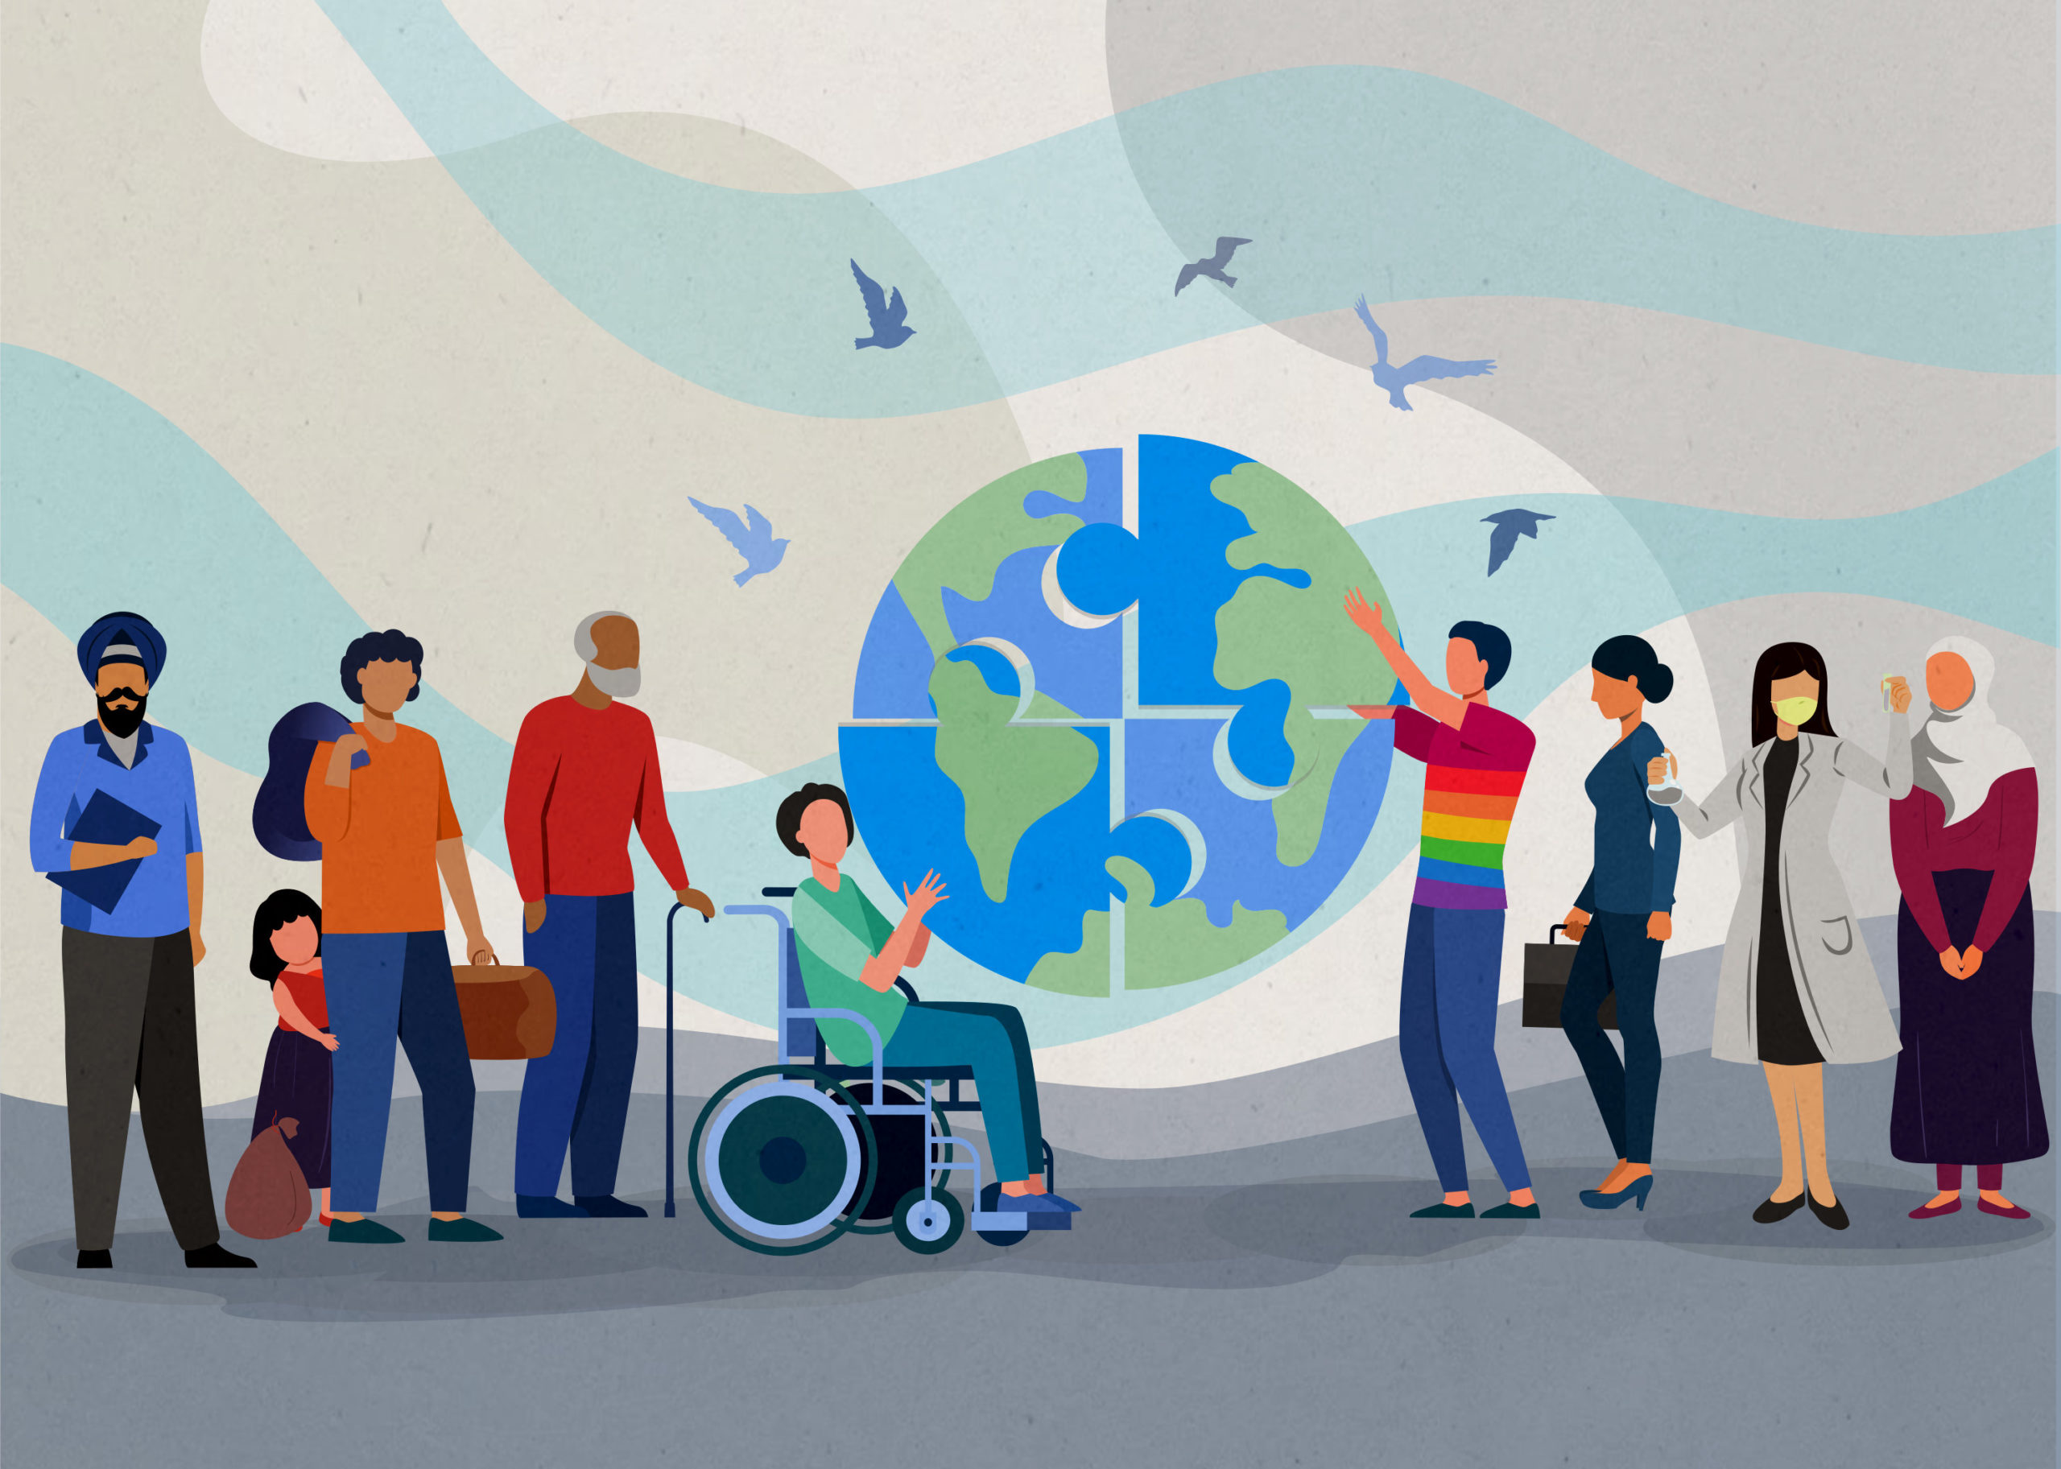
Advantages of diversity
Helps us to be more accepting and understanding of one another
Offers new and shared experiences
Brings more money into the local area through different businesses e.g., take-aways, shops, etc.
Brings different knowledge and skills into the area – 4% of our workforce here in NI is made up of migrants!
We should all celebrate diversity!

Slide 29
Evaluation/ Check Out

Slide 30
Session 4 – Respect our Rights!
Inclusion & Equality - Activities
Circle of Human Rights
Evaluation/ Check-out
Human Rights Intro
Human Survival

Slide 31
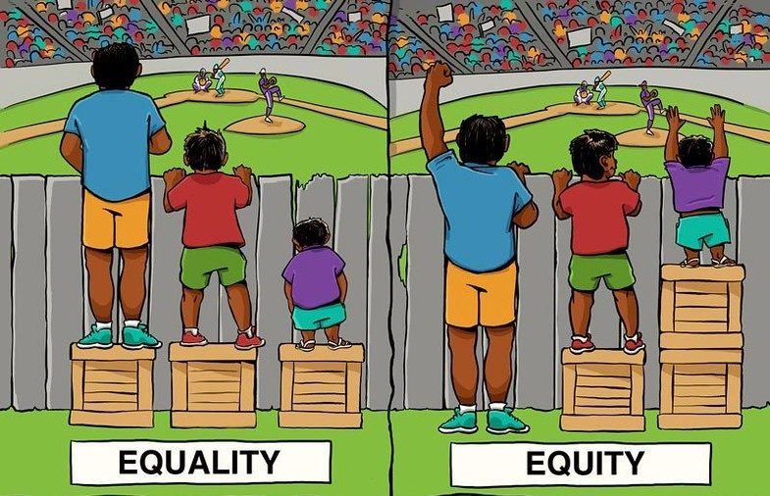
Inclusion & Equality of Opportunity
What does this mean?
What does this look like in practice?
Stride it Out
Out of Reach

Slide 32
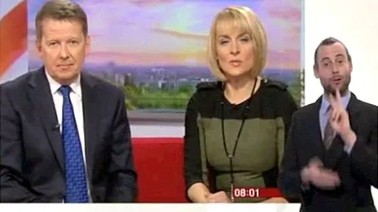
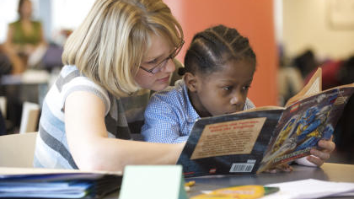
What does inclusion look like?
Here are some examples:
CBBC Newround – A news channel suitable for children and young people
Sign language and subtitles available on our favourite TV shows
Classroom assistants and one to one support in schools
Polish shops in our neighbourhoods

Slide 33
Human Survival
In your groups, brainstorm all the things that human beings need to survive.

Slide 34
Human Rights
Human Rights are the basic rights and freedoms that belong to every person in the world, from birth to death.
Here in NI, there are a number of laws that outline our human rights. The main ones are the Human Rights Act of 1998, and the European Convention of Human Rights, which we signed up to in 1951!
Each group will be provided with 16 human rights. These are taken from the European Convention of Human Rights.
Work in your groups and place the cards, in order, from most important to least important.
You must all agree, and explain your reasons why you made that choice!

Slide 35
Circle of Human Rights

Slide 36
What have we learned?
Diversity, inclusion and equality of opportunity are written in laws and protected by our human rights.
All schools, youth clubs, workplaces etc. have rules to make sure everyone is being treated with respect and being treated fairly.
We should NEVER have to choose our human rights – they belong to everybody and every human right is needed to live and grow!

Slide 37
Evaluation/ Check Out

Slide 38
Session 5 – Judging Others
That’s my Orange – Part 1
Steps apart – Steps together
Perceptions
First thoughts
Hidden Celebrities
Is that a Fact?
Assumptions
That’s my Orange – Part 2
Evaluation/ Check-Out

Slide 39
That’s my orange – Part 1
Get to know your orange!

Slide 40
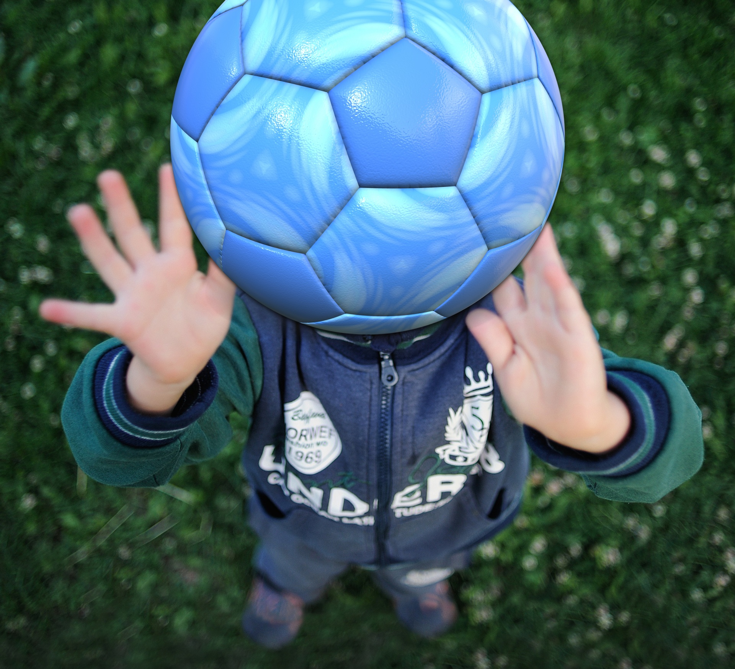
Quick fire activities
First Thoughts
Perceptions
(Pictures on next slides)

Slide 44
Steps Apart – Steps Together
We need two volunteers to come forward and stand with their backs together.
We will be exploring similarities and differences between the two.

Slide 45
Hidden Celebrities
Which one has/ had a learning disability or illness?

Slide 46
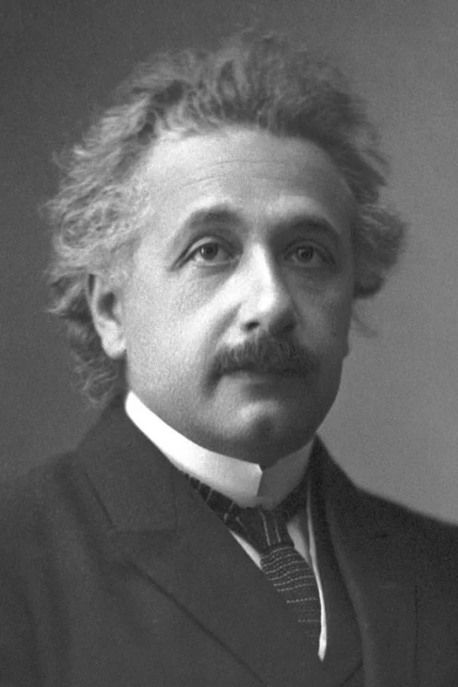
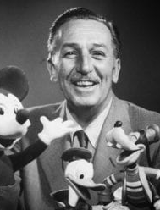
From left to right: Albert Einstein, Daniel Radcliffe, Walt Disney, Selena Gomez

Slide 47
Hidden Celebrities Revealed
All of them have a disability or an illness. This did not stop them from becoming very successful in what they wanted to do!
Albert Einstein - As a child, he could not talk until the age of three. He did not learn to read until he was nine. His teachers considered him to be ‘mentally slow’, unsociable, and a dreamer. He failed the entrance exam for school. Ultimately, he developed the Theory of Relativity.
Daniel Radcliffe – He suffers from what is called dyspraxia, a developmental coordination disorder that makes things as simple as tying his shoes or even writing a struggle. Radcliffe rose to fame playing the role of ‘Harry Potter’.
Walt Disney - He was slow in school work and did not have a successful school experience but later became a well-known movie producer and cartoonist.
Selena Gomez – She revealed she had bi-polar disorder in 2020. She is a very successful singer and actress.

Slide 48
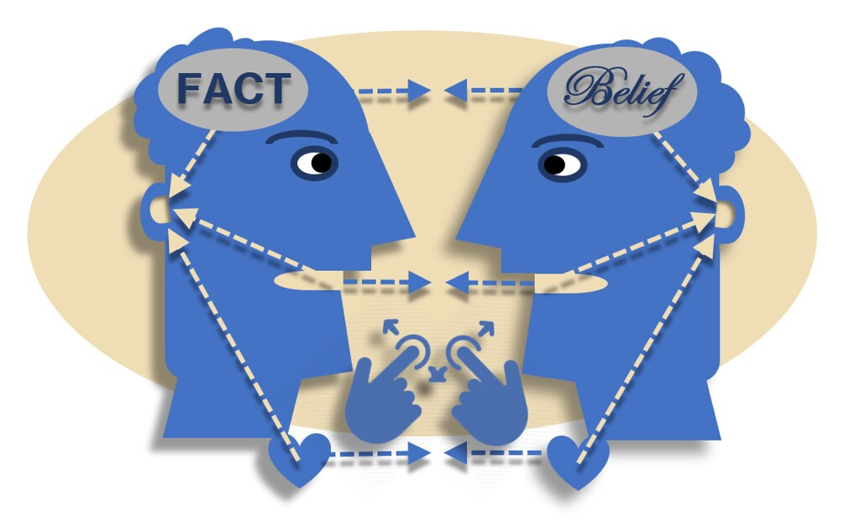
Is that a fact?
Work within your groups to decide whether the statements are FACT or whether they are just an OPINION or BELIEF.

Slide 49
Assumptions
Pair with someone you don’t know that well
Don’t look at your worksheet until told to do so
You must look at your partner and guess the answers to the questions on the sheet
You are not allowed to speak to one another or communicate in any other way!
Good luck!

Slide 50
That’s my orange – Part 2
Time to reunite with your orange!

Slide 51
Evaluation/ Check Out

Slide 52
Session 6 – Discrimination
Tower Activity
Evaluation/ Check-out
Discrimination Cards
Actions & Consequences – Role play

Slide 53
Tower Activity

Slide 54
Actions have consequences… Role play!
Work with your group and discuss the scenario card you have been given.
Act out the scenario for your group and what might happen next.
Make sure to reflect on the questions being asked.
Showcase your drama to the rest of the group!

Slide 55
Judgements can lead to discrimination.
Discrimination happens in three ways:
Excluding someone (leaving them out)
Treating someone unfairly or unkindly
Separating different groups of people
Reflect on your scenarios – what type of discrimination occurred?

Slide 56
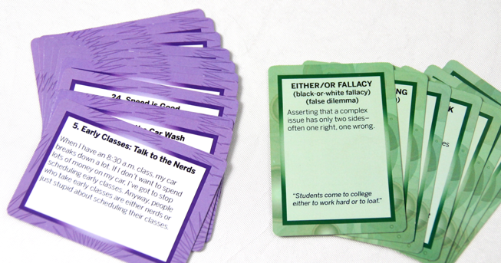
Is it Discrimination? – Card Activity
It is important to point out that specific steps are sometimes needed in order to protect the most vulnerable in our society (this is called POSITIVE ACTION).
Discuss the scenario cards in your groups and decide whether it is discrimination or positive action.

Slide 57
Evaluation/ Check Out

Slide 58
Session 7 – Exploring influences
‘Share a Coke’
Evaluation/ Check-out
Headliners
Pictures of Influence
Finding the Facts – Group Project

Slide 59
‘Share a Coke’

Slide 60
Pictures of Influence
In small groups or pairs, place the pictures of things which influence attitudes and opinions, in order of importance.
Draw or write other things/ people/ places which influence your thinking.

Slide 61
Headliners
You will work in teams.
There are three rounds to the challenge.
In each round, you will read three different newspaper headlines.
You must detect the ‘real’ headline. The other two are made up.
Each time you answer correctly, you will get one point.

Slide 62
Headliners
Round 1: Which headline is real?
Britons squeezed out of workforce by foreigners
Increase in foreign workers over past 5 years
Foreign workers flock to Britain

Slide 63
Headliners
Round 2: Which headline is real?
Stats show 67% of gun crime suspects are black
Black men 'to blame for most violent city crime’!
Black to blame or not?

Slide 64
Headliners
Round 3: Which headline is real?
Teenage girls are ‘out of control’!
A survey reveals that girls overtake boys in teenage drinking
Girls – Britain’s next generation of drinkers!

Slide 65
Headliners
Round 1: Which headline is real?
Britons squeezed out of workforce by foreigners
Increase in foreign workers over past 5 years
Foreign workers flock to Britain

Slide 66
Headliners
Round 2: Which headline is real?
Stats show 67% of gun crime suspects are black
Black men 'to blame for most violent city crime’!
Black to blame or not?

Slide 67
Headliners
Round 3: Which headline is real?
Teenage girls are ‘out of control’!
A survey reveals that girls overtake boys in teenage drinking
Girls – Britain’s next generation of drinkers!

Slide 68
Headliners
The newspaper headlines highlight how reports aren't always based on facts - so they aren’t always accurate!
That’s why it’s important to challenge what you hear and what you read, and to try to find out the facts.
Once you know the facts, you can form your own opinions and be more confident in your views.

Slide 69
Finding the Facts – Group Project
Working in small groups, do some research on a group of people/ person who is commonly judged within your local community or society.
Together, find out all the interesting and important facts about this person or group of people.
Present this as an information leaflet, letter, poster, magazine article, PowerPoint etc. Be as creative as you like!

Slide 70
Rumours

Slide 71
Fact formula
You could follow this formula to form your own opinions and have confidence in your views:
F – find out the facts
A – ask questions
C –challenge what you hear or read
T – think about all the information and form your own opinions

Slide 72
Evaluation/ Check Out

Slide 73
Session 8 – Understanding Others
All Rise!
Reflections
Odd One Out - Activity
Labels - Activity
The Bruised Apple
Evaluation/ Check-out
Describe that Feeling!
Positive affirmations

Slide 74
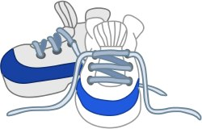
What is Empathy?
This session is all about understanding how our actions, words and behaviours make other people feel.
Empathy is considering other people’s feelings – it’s putting yourself in someone else’s shoes.

Slide 75
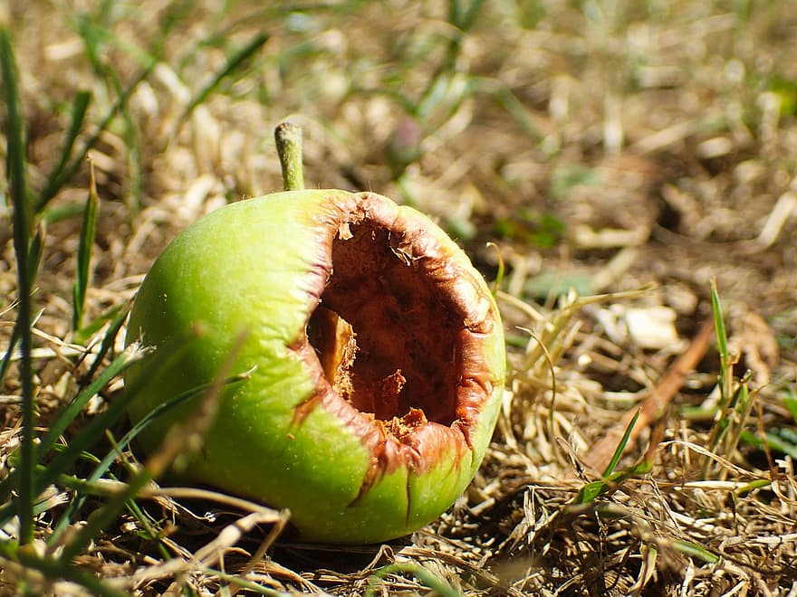
Activities
Labels
Odd One Out!
The Bruised Apple

Slide 76
Describe that feeling!
You have won the lottery!

Slide 77
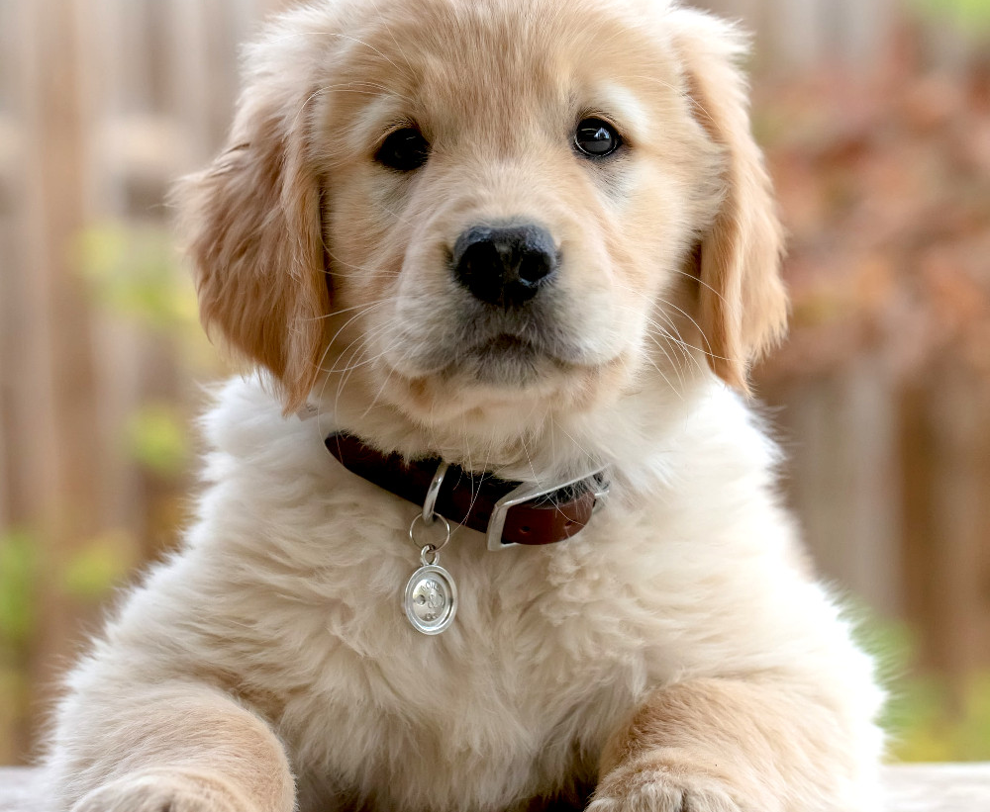
Describe that feeling!
Losing your dog

Slide 78
Describe that feeling!
Your friend has fell out with you

Slide 79
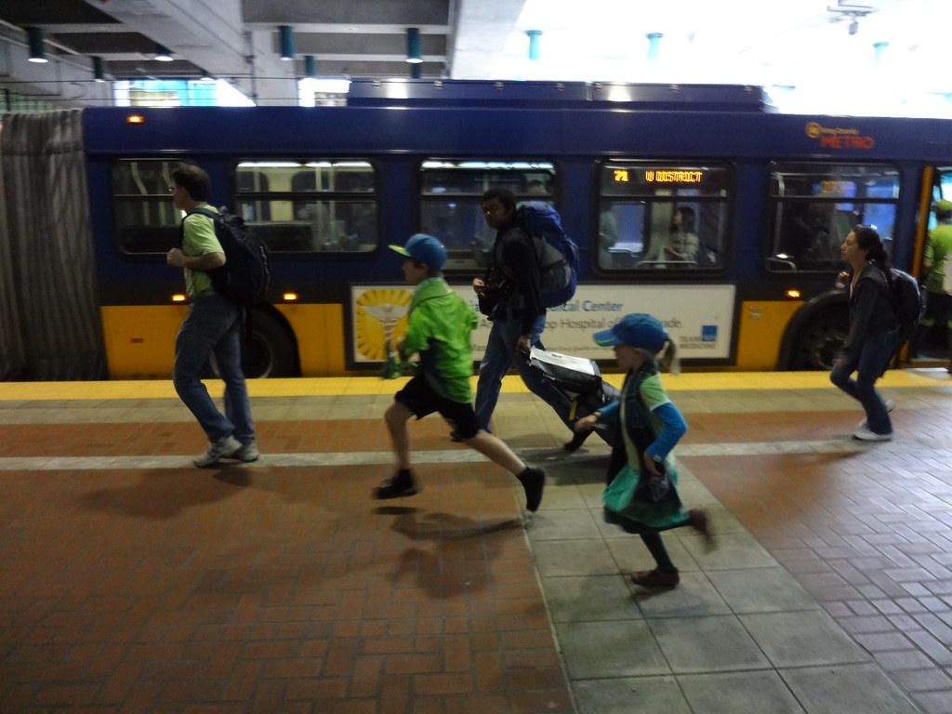
Describe that feeling!
You missed the bus

Slide 80
Describe that feeling!
You scored a hattrick in the most important match of the season!

Slide 81
Reflections
Write down a situation where you felt judged or discriminated against because of an aspect of your identity.
Be as open and honest as you feel comfortable with!

Slide 82
Positive Affirmations
Draw around your hand
Write your name on your palm
Pass your handprint to the person on your left
As you receive each person’s handprint write one positive comment/ word about that person
When you get your handprint back – SMILE!!
These are all the positive things that make you – YOU!

Slide 83
Evaluation/ Check Out

Slide 84
Session 9 – Role Modelling
Bad attitudes - Activity
Think before you speak – Tips!
Think before you speak – Group work
Pledge
Evaluation/ Check-out
Putting it into practice – Role Play

Slide 85
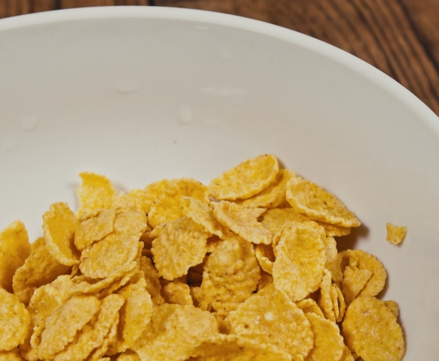
Bad attitudes
Rules
Cereal and sand must pass through everyone’s bowl
You must fill cereal then sand, cereal then sand etc.
The first team to fill their container up to the taped line wins!

Slide 86
How to keep a positive attitude amongst the sour!

Slide 87
Previously, we have talked about how attitudes are formed!
Experience
This is mainly formed from a young age by the influence of your family
Social Factors
How you see other people treat each other
Learning
Through TV programmes, advertisements, social media, etc

Slide 88
Group work!

Slide 89
How to be inclusive and respectful in the words you say!
Important tips include:
Use people first language.
If you don’t know whether someone sees themselves as boy/ girl or male/ female, use pronouns such as they/ them
Be aware that what you say may offend someone
Try not to make assumptions about people
Try not to judge people based on one thing about them e.g., a disability. Try to see them as they really are.
Think before you speak!

Slide 90
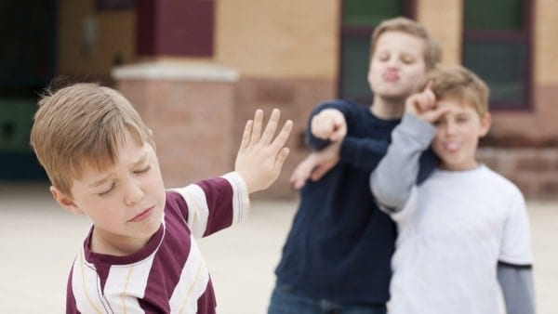
Putting it into practice through role play!
Now is a good time to put the learning from throughout the programme into action!
As this stage, you should have increased awareness and understanding around inclusion, diversity, and equality of opportunity, but you should also be somewhat confident and willing to challenge negative behaviour!
Try and imagine that the scenario is happening in real life! Act out the scenario and how you would go about helping or supporting that person.
Think about body language, attitudes, and behaviours!
You will showcase your drama to the rest of the group.

Slide 91
Pledge
A pledge is like a promise.
Take some time to think about how you are going to change as a result of the learning on this programme.
Make a pledge of a big change that you are going to make, and three everyday habits you hope to develop and practice.
We will follow-up with the pledges next week.

Slide 92
Evaluation/ Check Out

Slide 93
Session 10 – Making a Difference!
Pledge Check-In
Talking Heads
Group Discussion – Welcome to our club
End Baseline Assessments
Overall Evaluation
Club Motto

Slide 94
Pledge Check-In
How did you do?
Did you make a big change?
Did you practice three new everyday habits?
How did these make you feel?
Did family or friends notice a change in your behaviour?
Be proud of yourself! Well done and keep it up!!

Slide 95
Group Discussion – How can we make our club a more inclusive, diverse and welcoming place?

Slide 96
Promoting Inclusion, Diversity & Equality of Opportunity
Human rights and equality are about making sure everyone is treated fairly, with dignity and respect.
And that everyone has an equal chance to develop and reach their potential.
It is important that we all help to promote equality and human rights for everyone and you stand up when you or others are being treated unfairly.
It is important to help everyone feel safe and valued, and it is important to feel proud for taking action!
Be role models for your friends and people in the community.
When you do the right thing, you will feel good!

Slide 97
Talking Heads
You are going to create a display of talking heads that shout out the benefits of equality and human rights to everyone in your club.
Create some short statements that you think will provoke good thoughts about inclusion, diversity and equality of opportunity.
Practice writing them so they have real impact!
Write your statements on the talking heads.
Add lots of bright design to make them look really engaging, bright, and colourful!
Think of a motto that sums up your club!

Slide 98
Well done!
Continue to make a difference, wherever you are and whatever you do!

Slide 99
End baselines

Slide 100
Overall Evaluation

