Slide 1
Accredited Youth Work Programme Inclusion, Diversity & Equality of Opportunity 14 - 18 years

Slide 2
Session 1 – Introduction to Inclusion, Diversity & Equality of Opportunity
Introduction to programme
What is EDI?
Check-out
Icebreaker – Similarities and Differences
Baselines
Quiz

Slide 3
What is an accredited programme?
Set of workshops and activities/ games which are used to help young people learn about a particular topic
Lots of young people do the same programme across NI
Opportunity for young people to show their youth leader and others what they have learned and achieved
Opportunity for young people to get a reward for their hard work e.g., certificates

Slide 4
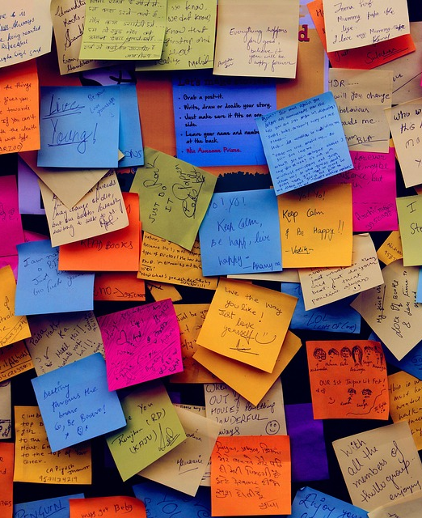
Hopes and fears

Slide 6
Start baselines

Slide 7
Icebreaker – Similarities and Differences
Get into groups of three and stand in a circle.
You have two minutes to find five things that the three of you have in common.
This cannot be obvious things, e.g., I am a human, I go to youth club. It must be things you have had to find out.

Slide 8
Icebreaker – Continued
Now you have two minutes to find five things that the three of you do NOT have in common.
Tell us what you came up with!

Slide 9
What does inclusion, diversity and equality of opportunity actually mean?
Each group will take one of the words:
Inclusion
Diversity
Equality of Opportunity
Think about what the word means, why it is important, what it might look like in real life/ in practice, examples of when it has or hasn’t happened…

Slide 10
So, what does each word mean?
Inclusion - being included and being able to participate in safe and welcoming environment.
Diversity - the range of human differences. It is about recognising, respecting, and valuing differences such as ethnicity, race, age, religion, political opinion, interests etc.
Equality of Opportunity - where individual needs, situations, and goals are recognised and the barriers that limit what people can do, or can be, are removed.

Slide 11
Quiz – True or False?
This is a quick quiz to get you thinking about inclusion, diversity and equality of opportunity.
It is just for fun and to give you a flavour of some of the things we will talk and learn about over the next ten sessions.

Slide 12
Evaluation/ Check Out

Slide 13
Session 2 – Exploring Diversity
All Change - Game
What influences me?
Evaluation/ Check-out
Same but different - Activity
The toast dilemma!
Best Skills Showdown
Who Am I? – Activity

Slide 14
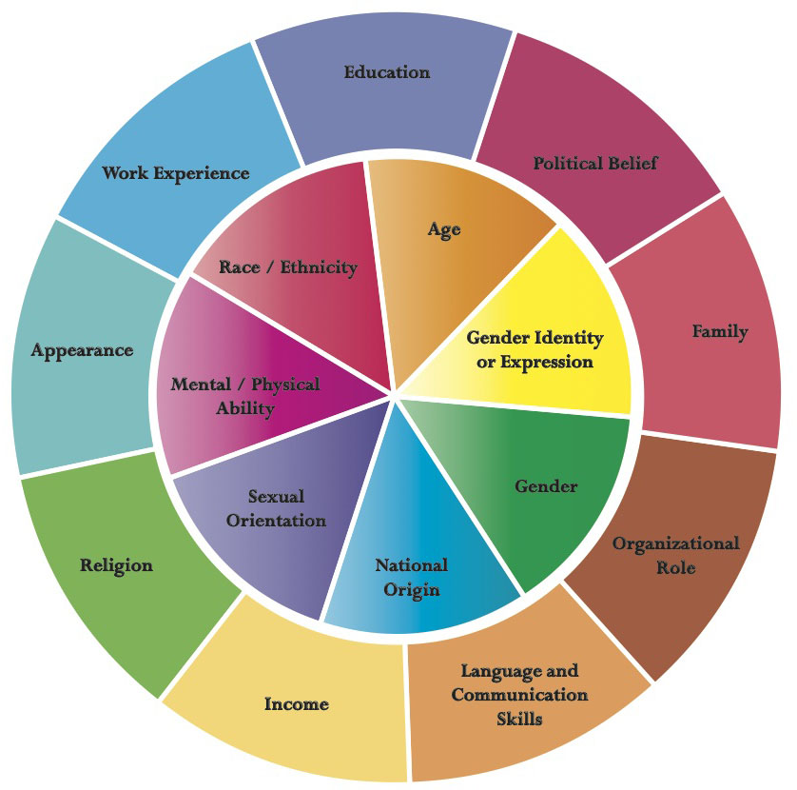
Re-Cap
What did I learn from last session?
This week’s session will focus on diversity. Do we remember what diversity is?
To help us understand it a bit better, we must understand how we as individuals are all ‘diverse’ or unique!

Slide 15
All Change!
Rules!
You must change seats when someone calls out a sentence or statement that applies to you
You cannot swap seats with someone sitting next to you or return to your own seat
If you are the last person standing you must introduce something that is part of your identity

Slide 16
Who am I? - Activity
Be as creative as you can with this one!
Create a shield with four sections. You should include:
Favourite hobbies
Proudest moments
Hopes for the future
People/ things you admire
At the top or bottom of the page, write a motto that you live by/ your favourite saying.

Slide 17
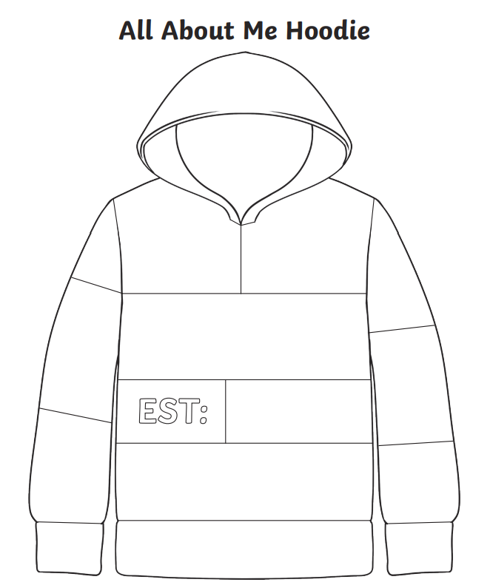
My Hoodie - Activity
Complete the hoodie template with things that make you YOU! Include things such as your favourite things, people, music, hobbies etc.
Be as creative as you like!
Notes:
Alternative activity

Slide 18
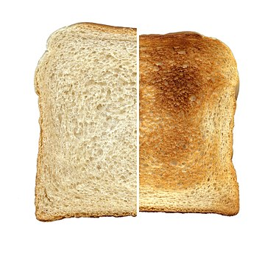
The toast dilemma!
Listen to the different ways we can enjoy toast and vote with your feet!
Life would be very dull if we all liked one type of toast!

Slide 19
Introduction to values
Values are the things in life that you feel are most important. Our values are often reflected in the way we live our lives and help to form our identity.
While one person might value their family relationships above all else, another person might value money or career.

Slide 20
Exploring values - Activity
On each post-it, write down one thing that you value.
Form two concentric circles and with the person sitting in front of you, reflect on your values and discard one that you consider to be the least important.
Once you have discarded a value, move to your right and continue the process until you are left with one value – the most important one.

Slide 21
Importance of values
It is important that we get to know our values and stay true to them​.
It is important that we make our own choices, based on our values, and don’t just go along with the crowd.
This is extremely important when talking about diversity and difference and respecting ourselves and others.

Slide 22
What influences us?
Get into pairs.
You have five minutes to list things in your everyday life that are influenced or come from other countries.
It can be a person in your family, friend, music, food, fashion, sport, etc.
The pair with the longest (and correct) list wins!

Slide 23
Best Skills Showdown!
Listen carefully to the instructions and get to know your group before you begin!
We are all good at something and bring something unique to the group!

Slide 24
Evaluation/ Check Out

Slide 25
Session 3 – Our Diverse Community
What is Community?
Word chain – Memory game
Evaluation/ Check-out
Community Mapping Exercise
NI to the outsider

Slide 26
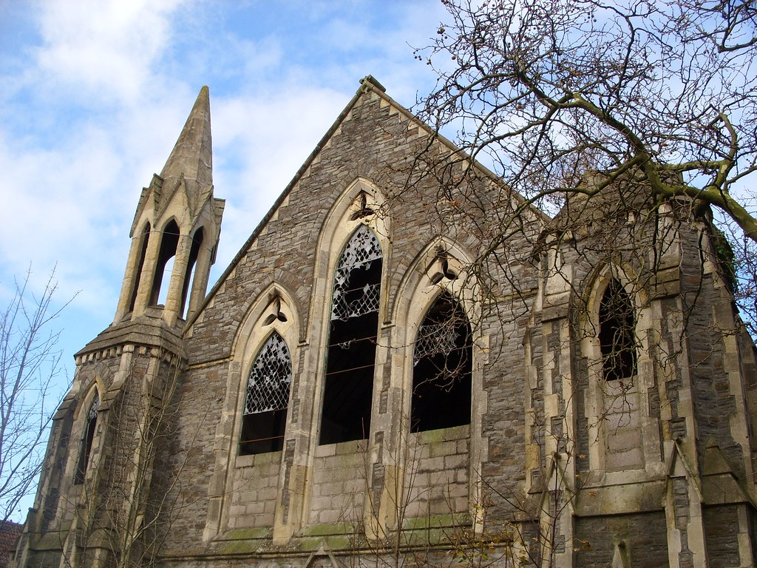
What is a Community?

Slide 27
Community is…
A group of people living in the same place or having a particular characteristic, attitude or interest in common.

Slide 28
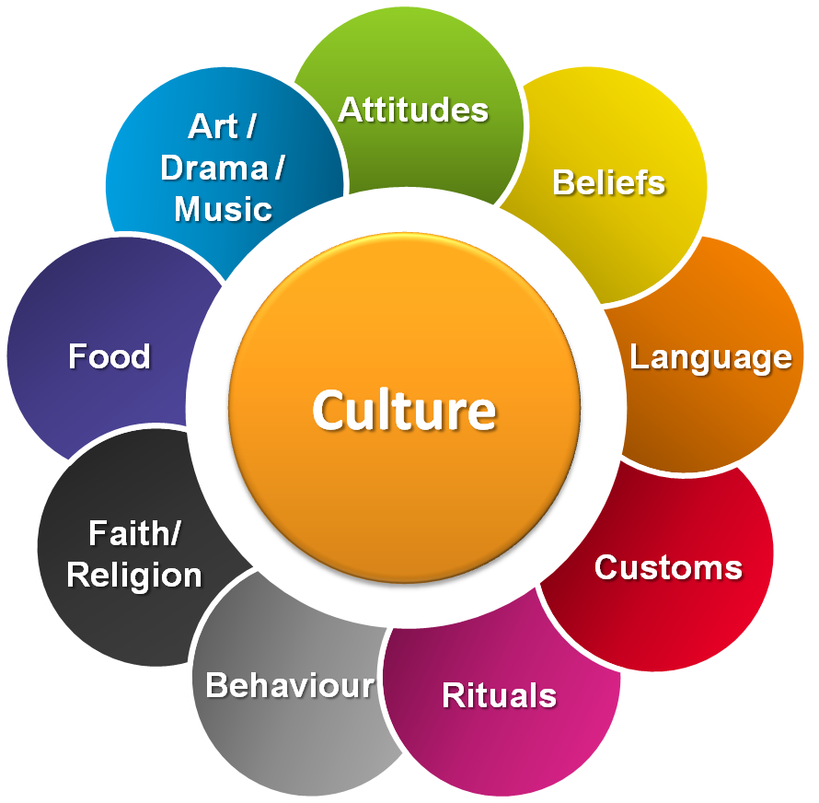
NI to the outsider
How do you think people, who don’t live in NI, would describe it?
What would they say about the culture of NI? By culture we mean things like:
Food we eat
What we drink
Clothes we wear
Music we listen to
The people who live here – Are we friendly, are we helpful, etc.?
Famous things or people
First thoughts when they here ‘Northern Ireland’
Work with your group and tell us what you think! The icon to the right might help you if you are stuck!

Slide 29
Community Map
Before we begin, think about:
The neighbourhood we want to focus on – what streets/ area will be visited
Resources in the area:
- Places/ spaces/ buildings (libraries, shops, community halls, churches, youth clubs, schools, parks etc.)
People (community groups, minority groups, people with influence, skills or talents, sports teams etc.)
Diversity in the community
Opportunities to socialise and get to know new people

Slide 30
Word chain memory game
Thanks to diversity, I…
Add your own personal contribution
Remember everyone’s before you!
This will make you think not only of all the positive things that diversity brings to your community, but it will also test your memory skills!

Slide 31
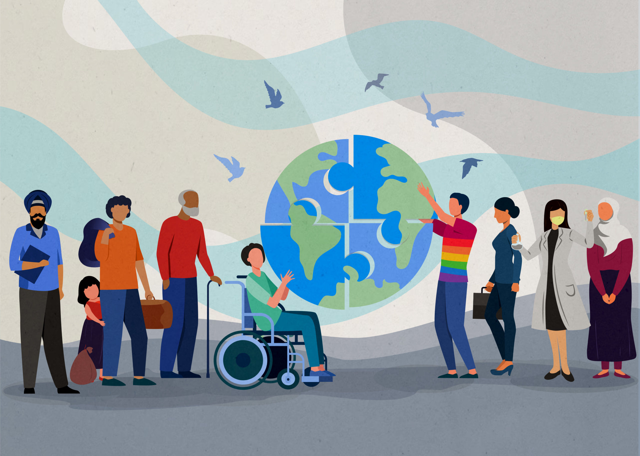
Advantages of diversity
Helps us to be more accepting and understanding of one another
Offers new and shared experiences
Brings more money into the local area through different businesses e.g., take-aways, shops, etc.
Brings different knowledge and skills into the area – 4% of our workforce here in NI is made up of migrants!
We should all celebrate diversity!

Slide 32
Evaluation/ Check Out

Slide 33
Session 4 – Respect our Rights!
Inclusion & Equality - Activities
Circle of Human Rights
Evaluation/ Check-out
Human Rights Intro
Human Survival

Slide 34
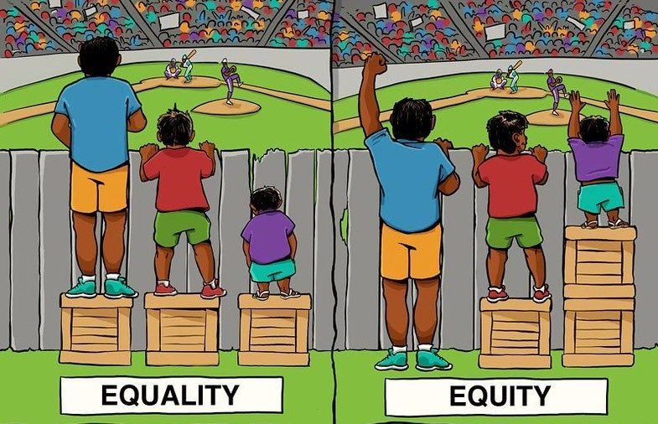
Inclusion & Equality of Opportunity
What does this mean?
What does this look like in practice?
Stride it Out
Out of Reach

Slide 35
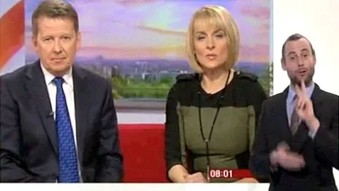
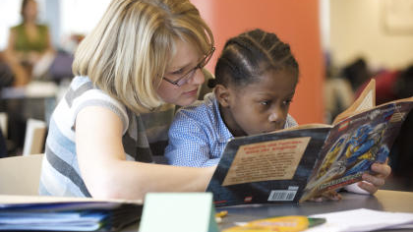
What does inclusion look like?
Here are some examples:
CBBC Newround – A news channel suitable for children and young people
Sign language and subtitles available on our favourite TV shows
Classroom assistants and one to one support in schools
Polish shops in our neighbourhoods

Slide 36
How about this?
Rose Ayling-Ellis was the first deaf star to dance on strictly.
They decided to film part of the dance with no music so we could all experience what Rose was experiencing!

Slide 37
Human Survival
In your groups, brainstorm all the things that human beings need to survive.

Slide 38
Human Rights
Human Rights are the basic rights and freedoms that belong to every person in the world, from birth to death.
Here in NI, there are a number of laws that outline our human rights. The main ones are the Human Rights Act of 1998, and the European Convention of Human Rights, which we signed up to in 1951!
Each group will be provided with 16 human rights. These are taken from the European Convention of Human Rights.
Work in your groups and place the cards, in order, from most important to least important.
You must all agree, and explain your reasons why you made that choice!

Slide 39
Circle of Human Rights

Slide 40
What have we learned?
Diversity, inclusion and equality of opportunity are written in laws and protected by our human rights.
All schools, youth clubs, workplaces etc. have rules to make sure everyone is being treated with respect and being treated fairly.
We should NEVER have to choose our human rights – they belong to everybody and every human right is needed to live and grow!

Slide 41
Evaluation/ Check Out

Slide 42
Session 5 – Stereotyping and Prejudice
That’s my Orange – Part 1
Guess who
Perceptions
First thoughts
Hidden Celebrities
Is that a Fact?
That’s my Orange – Part 2
Evaluation/ Check-Out

Slide 43
That’s my orange – Part 1
Get to know your orange!

Slide 44
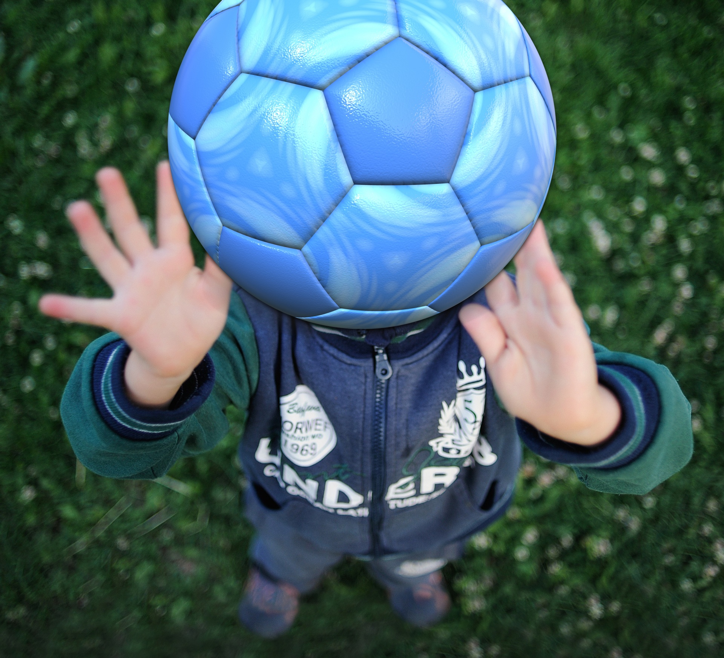
Quick fire activities
First Thoughts
Perceptions
(Pictures on next slides)

Slide 45
What do you see?

Slide 46
Read the text in the triangle!

Slide 47
What do you see?

Slide 48
What do you see?

Slide 49
Last one!
Count every ' F ' in the following text:
FINISHED FILES ARE THE RESULT OF YEARS OF SCIENTIFIC STUDY COMBINED WITH THE EXPERIENCE OF YEARS...
How many?

Slide 50
Guess who?
Match up the statement to the picture.
Guess if you don’t know the answer!

Slide 51
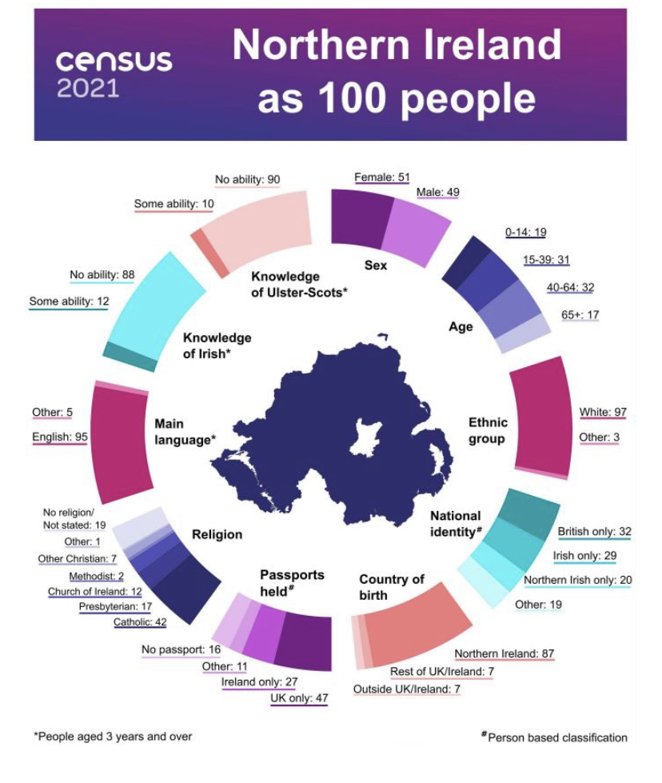
NI is becoming more and more diverse!

Slide 52
Hidden Celebrities
Which one has/ had a learning disability or illness?

Slide 53
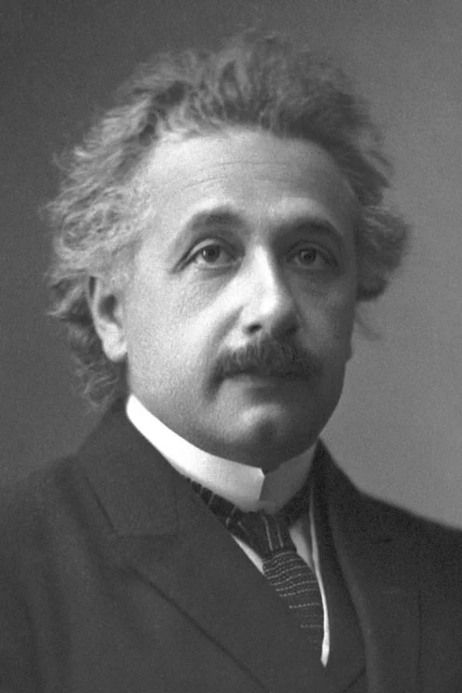
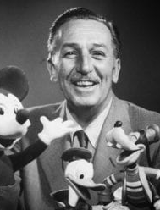
From left to right: Albert Einstein, Daniel Radcliffe, Walt Disney, Selena Gomez

Slide 54
Hidden Celebrities Revealed
All of them have a disability or an illness. This did not stop them from becoming very successful in what they wanted to do!
Albert Einstein - As a child, he could not talk until the age of three. He did not learn to read until he was nine. His teachers considered him to be ‘mentally slow’, unsociable, and a dreamer. He failed the entrance exam for school. Ultimately, he developed the Theory of Relativity.
Daniel Radcliffe – He suffers from what is called dyspraxia, a developmental coordination disorder that makes things as simple as tying his shoes or even writing a struggle. Radcliffe rose to fame playing the role of ‘Harry Potter’.
Walt Disney - He was slow in school work and did not have a successful school experience but later became a well-known movie producer and cartoonist.
Selena Gomez – She revealed she had bi-polar disorder in 2020. She is a very successful singer and actress.

Slide 55
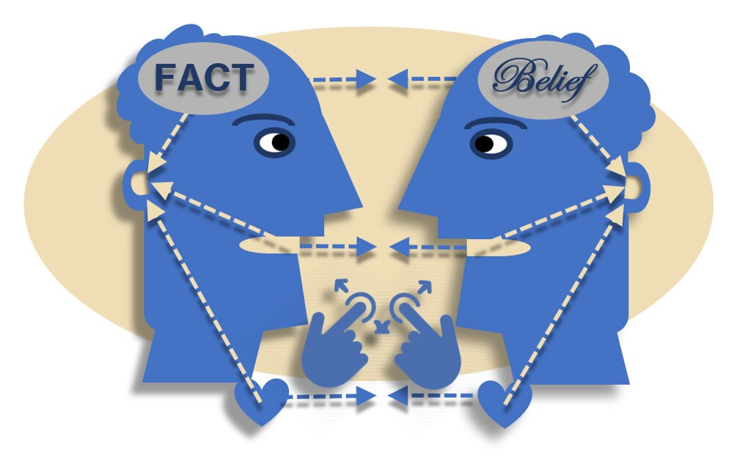
Is that a fact?
Work within your groups to decide whether the statements are FACT or whether they are just an OPINION or BELIEF.

Slide 56
That’s my orange – Part 2
Time to reunite with your orange!

Slide 57
Evaluation/ Check Out

Slide 58
Session 6 – Discrimination
Tower Activity
Is it Discrimination? - Cards activity
Always Debatable
Choose an Apprentice
Evaluation/ Check-out

Slide 59
Tower Activity

Slide 60
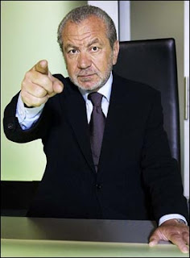
The Apprentice
You are an entrepreneur, like Alan Sugar on The Apprentice.
You need to ‘hire’ an engineer to set up life on the moon!
It’s a big, challenging job that will make history.
It needs the right apprentice - someone with resilience, determination, engineering expertise and great people skills!

Slide 61
Choose your apprentice
The apprentices…
Fire one now so you have six remaining
Ali
Patrick
Jamie
David
Adriana
Hannah
Delroy

Slide 67
Who was your choice?
What choice did you make?
Are you pleased with your hired apprentice?
Would you have made a different decision if you had the qualification information first?
What could be the consequences of pre-judging people?

Slide 68
Judgements can lead to discrimination.
Discrimination happens in three ways:
Excluding someone (leaving them out)
Treating someone unfairly or unkindly
Separating different groups of people

Slide 69
Always debatable!

Slide 70
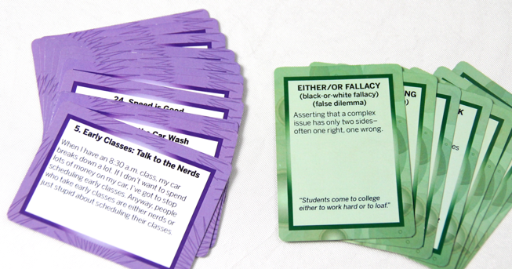
Is it Discrimination? – Card Activity
It is important to point out that specific steps are sometimes needed in order to protect the most vulnerable in our society (this is called POSITIVE ACTION).
Discuss the scenario cards in your groups and decide whether it is discrimination or positive action.

Slide 71
Evaluation/ Check Out

Slide 72
Session 7 – Exploring influences
‘Share a Coke’
Evaluation/ Check-out
Headliners
Swayed opinions
Finding the Facts – Group Project

Slide 73
‘Share a Coke’

Slide 74
Swayed opinions
Draw or write things/ people/ places which influence your attitudes and opinions.

Slide 75
Headliners
You will work in teams.
There are three rounds to the challenge.
In each round, you will read three different newspaper headlines.
You must detect the ‘real’ headline. The other two are made up.
Each time you answer correctly, you will get one point.

Slide 76
Headliners
Round 1: Which headline is real?
Britons squeezed out of workforce by foreigners
Increase in foreign workers over past 5 years
Foreign workers flock to Britain
Notes:
Answer on slide 79

Slide 77
Headliners
Round 2: Which headline is real?
Stats show 67% of gun crime suspects are black
Black men 'to blame for most violent city crime’!
Black to blame or not?
Notes:
Answer on slide 80

Slide 78
Headliners
Round 3: Which headline is real?
Teenage girls are ‘out of control’!
A survey reveals that girls overtake boys in teenage drinking
Girls – Britain’s next generation of drinkers!
Notes:
Answer on slide 81

Slide 79
Headliners
Round 1: Which headline is real?
Britons squeezed out of workforce by foreigners
Increase in foreign workers over past 5 years
Foreign workers flock to Britain

Slide 80
Headliners
Round 2: Which headline is real?
Stats show 67% of gun crime suspects are black
Black men 'to blame for most violent city crime’!
Black to blame or not?

Slide 81
Headliners
Round 3: Which headline is real?
Teenage girls are ‘out of control’!
A survey reveals that girls overtake boys in teenage drinking
Girls – Britain’s next generation of drinkers!

Slide 82
Headliners
The newspaper headlines highlight how reports aren't always based on facts - so they aren’t always accurate!
That’s why it’s important to challenge what you hear and what you read, and to try to find out the facts.
Once you know the facts, you can form your own opinions and be more confident in your views.

Slide 83
Finding the Facts – Group Project
Working in small groups, do some research on a group of people/ person who is commonly judged or discriminated against within your local community or society.
Together, find out all the interesting and important facts about this person or group of people.
Present this as an information leaflet, letter, poster, magazine article, PowerPoint etc. Be as creative as you like!

Slide 84
Rumours

Slide 85
Fact formula
You could follow this formula to form your own opinions and have confidence in your views:
F – find out the facts
A – ask questions
C –challenge what you hear or read
T – think about all the information and form your own opinions

Slide 86
Evaluation/ Check Out

Slide 87
Session 8 – Understanding Others
All Rise!
Reflections
Labels - Activity
How Are You?
Odd one out - Activity
Evaluation/ Check-out
The Torn Heart
Positive Affirmations

Slide 88
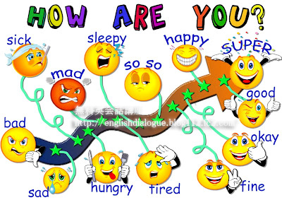
Think about what skills we are using!

Slide 89
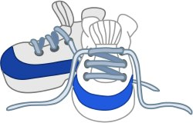
Developing empathy
This session is all about understanding how our actions, words and behaviours make other people feel.
Empathy is considering other people’s feelings – it’s putting yourself in someone else’s shoes.

Slide 90
Empathetic skills Skills needed to be more empathetic:
Curous
Be curious – ask questions to find out exactly what is going on for the other person
Listen
Actively listen – focus on what they are saying, maintain eye contact, nod to show understanding. Don’t just listen to respond!
Notice
Take notice – look at people’s body language, changes in behaviour etc. These can tell a lot about how someone is feeling!
Open-minded
Be open minded – you don’t have to agree with that they are saying, just understand their point of view.

Slide 91
Activities
Labels
Odd One Out!
The Torn Heart

Slide 92
Reflections
Write down a situation where you felt judged or discriminated against because of an aspect of your identity.
Be as open and honest as you feel comfortable with!

Slide 93
Positive Affirmations
Draw around your hand
Write your name on your palm
Pass your handprint to the person on your left
As you receive each person’s handprint write one positive comment/ word about that person
When you get your handprint back – SMILE!!
These are all the positive things that make you – YOU!

Slide 94
Evaluation/ Check Out

Slide 95
Session 9 – Role Modelling
Secret Leader
Think before you speak – Tips!
Think before you speak – Group work
Pledge
Evaluation/ Check-out
Putting it into Practice!

Slide 96
Secret Leader

Slide 97
Previously, we have talked about how attitudes are formed!
Experience
This is mainly formed from a young age by the influence of your family
Social Factors
How you see other people treat each other
Learning
Through TV programmes, advertisements, social media, etc

Slide 98
Group work!

Slide 99
How to be inclusive and respectful in the words you say!
Important tips include:
Use people first language.
If you don’t know whether someone sees themselves as boy/ girl or male/ female, use pronouns such as they/ them
Be aware that what you say may offend someone
Try not to make assumptions about people
Try not to judge people based on one thing about them e.g., a disability. Try to see them as they really are.
Think before you speak!

Slide 100
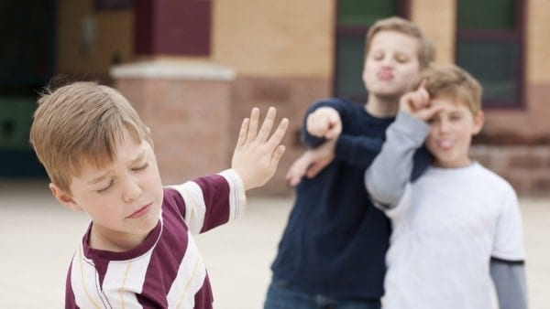
Putting your new skills and knowledge into practice!
Now is a good time to put the learning from throughout the programme into action!
As this stage, you should have increased awareness and understanding around inclusion, diversity, and equality of opportunity, but you should also be somewhat confident and willing to challenge negative behaviour!
Try and imagine that the scenario is happening in real life! How would you go about helping or supporting in that scenario?
Think about body language, attitudes, and behaviours!

Slide 101
Pledge
A pledge is like a promise.
Take some time to think about how you are going to change as a result of the learning on this programme.
Make a pledge of a big change that you are going to make, and three everyday habits you hope to develop and practice.
We will follow-up with the pledges next week.

Slide 102
Evaluation/ Check Out

Slide 103
Session 10 – Making a Difference!
Pledge Check-In
Talking Heads
Group Discussion – Welcome to our club
End Baseline Assessments
Overall Evaluation
Club Motto

Slide 104
Pledge Check-In
How did you do?
Did you make a big change?
Did you practice three new everyday habits?
How did these make you feel?
Did family or friends notice a change in your behaviour?
Be proud of yourself! Well done and keep it up!!

Slide 105
Group Discussion – How can we make our club a more inclusive, diverse and welcoming place?

Slide 106
Promoting Inclusion, Diversity & Equality of Opportunity
Human rights and equality are about making sure everyone is treated fairly, with dignity and respect.
And that everyone has an equal chance to develop and reach their potential.
It is important that we all help to promote equality and human rights for everyone and you stand up when you or others are being treated unfairly.
It is important to help everyone feel safe and valued, and it is important to feel proud for taking action!
Be role models for your friends and people in the community.
When you do the right thing, you will feel good!

Slide 107
Talking Heads
You are going to create a display of talking heads that shout out the benefits of equality and human rights to everyone in your club.
Create some short statements that you think will provoke good thoughts about inclusion, diversity and equality of opportunity.
Practice writing them so they have real impact!
Write your statements on the talking heads.
Add lots of bright design to make them look really engaging, bright, and colourful!
Think of a motto that sums up your club!

Slide 108
Well done!
Continue to make a difference, wherever you are and whatever you do!

Slide 109
End baselines

Slide 110
Overall Evaluation

