Slide 1
Combatting Inactivity
Physical Activity – week 2

Slide 2
Learning objectives
To recognise and understand the strategies that can be used to overcome inactivity.
To recap the importance of physical activity when pursing a healthy lifestyle.
To explore the concept of physical inactivity and why it has become prevalent.
To understand the consequences of an inactive/sedentary lifestyle.

Slide 3
Physical activity
Last week we discussed the importance of physical activity and getting active.
Today we are going to move on a bit and explore what happens when you are “inactive”.
In pairs and to recap from the last session, discuss as many reasons as possible about why you should engage in physical activity.
Write them down on the page in front of you.

Slide 4
Benefits of physical activity
Strengthens muscles
Keeps joints flexible
Increases bone density
Relieves stress
Improves muscle tone
Lowers blood pressure and cholesterol
Increase in strength and endurance
Improves body shape
Burns excess fat
Improves self esteem
It is social- helps you make friends
Develops your interpersonal skills
Less prone to injury
Did we miss any?

Slide 5
What happens if you do not stay physically active?
Lack of physical activity can result in a range of health-related consequences.
The three main risks of a sedentary lifestyle are:
Cardiovascular diseases (heart disease)
Diabetes
Obesity
Can you think of anymore?
Notes:
Write them down

Slide 6
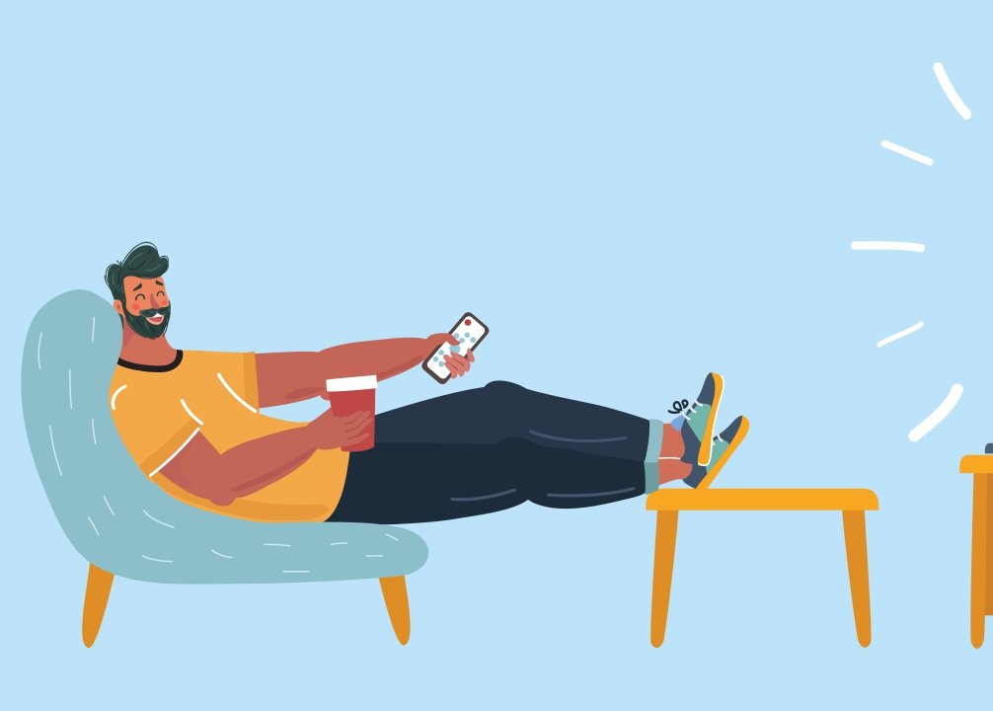
Why we need to prioritise physical activity
Over the previous decades, sedentary lifestyles have become more common, and people are becoming less active due to convenience.
For example, jobs have become less labour intensive, transport is more assessable, and cars are more available for usage.
Does this mean we have to go out of our way to become physically active?

Slide 7
Barriers that prevent physical activity
Location: Urban V Rural
Hiking, rock climbing and sailing are unable to occur in urbanised areas.
All-weather pitches, gyms, public transport are absent in rural areas.
Accessibility to provision
Are there hockey clubs in catholic areas?
Are there GAA clubs in protestant areas?
Economic
Golf in deprived areas, skiing, polo and tennis. Expenses to play.
Characteristics: lack of confidence, being resistant to exercise yourself due to shyness.

Slide 8
Barriers to physical activity/exercise Can you explain some of these?
Time
Personality
Motivation
Characteristics
Wealth/access to money
Disability
Health
Age
Facilities
Parents
Motivation

Slide 9
In your groups, how could you/we overcome some of those barriers to physical activity for your club?

Slide 10
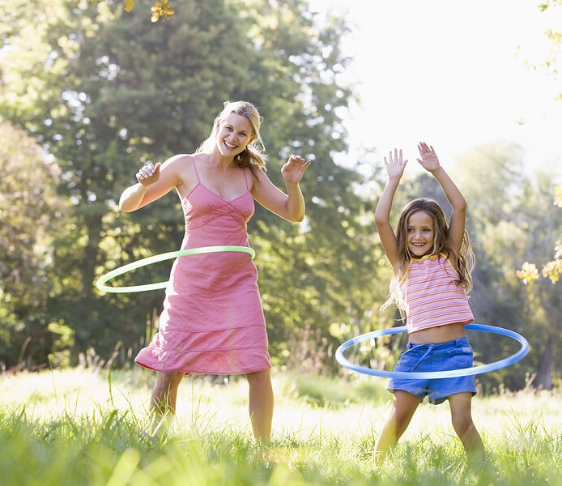
Strategies to overcome inactivity
Time – try to incorporate a specific time each day that you can participate in physical activity. For example, each day after school you will walk home.
Invite friends and family members to exercise with you. Plan social activities involving exercise.
Wealth/Lack of facilities - Select activities that require minimal facilities or equipment, such as walking, jogging, jumping rope, or running.
Characteristics – work on it, put yourself in that uncomfortable position, take someone with you for support.

Slide 11
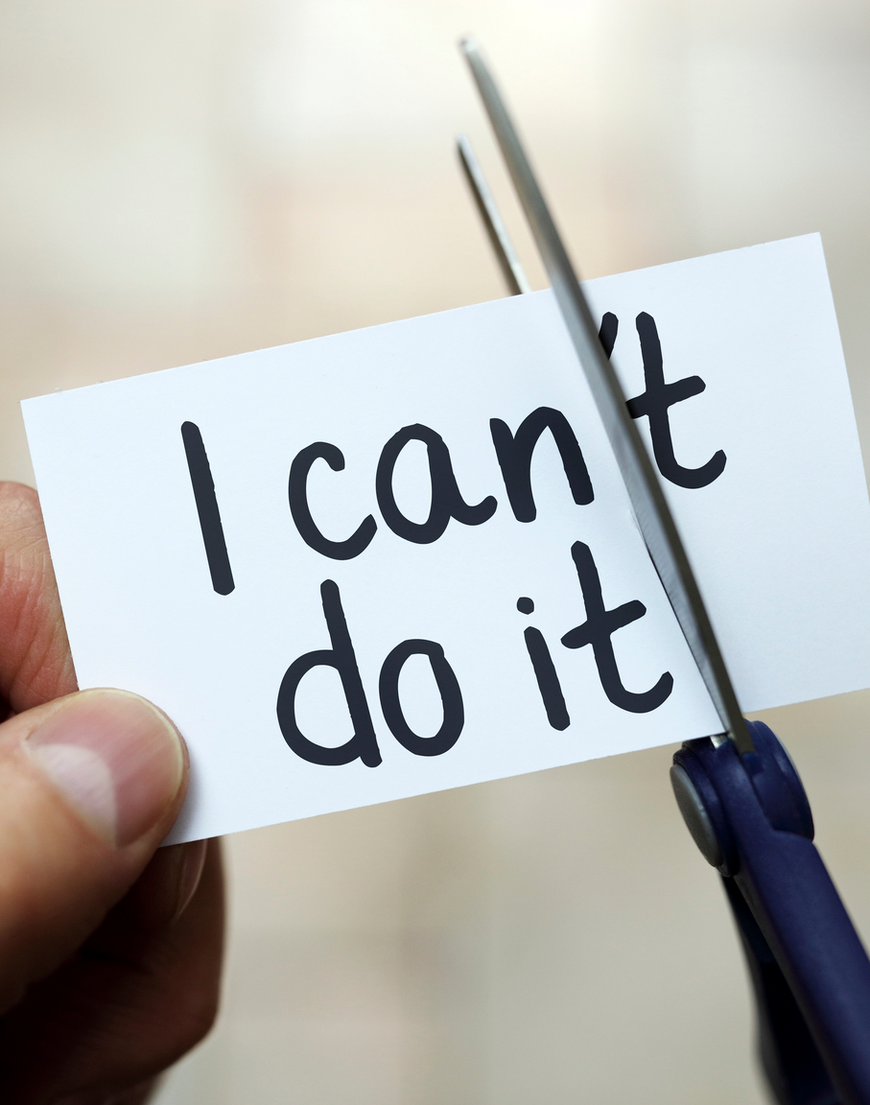
Individualised action plan
Select three barriers from what we learned today and use the following format for the action plan.
Barrier to exercise
How I will overcome this.

