Slide 1
Building Resilience – Understanding Our Emotions
Emotional Wellbeing
Session 6

Slide 2
Introduction to the topic, session outcomes and ice breaker

Slide 3
Introduction
Form a circle of resilience, name two emotions that you have felt today and two things that you are grateful for.

Slide 4
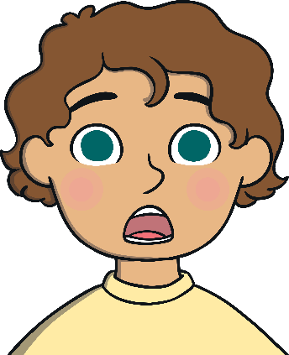
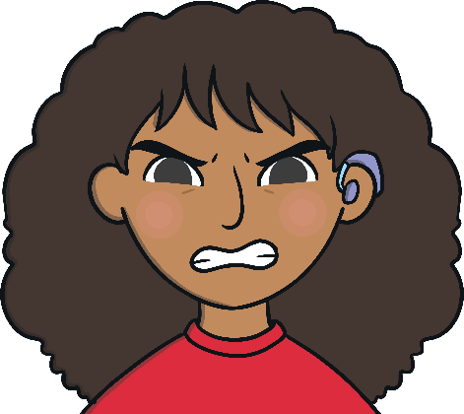
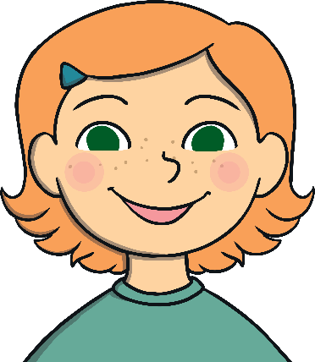
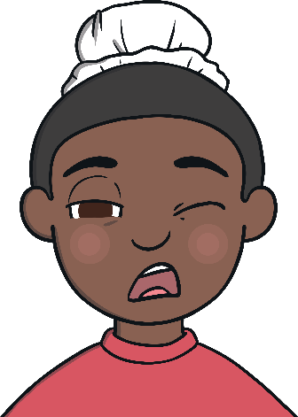
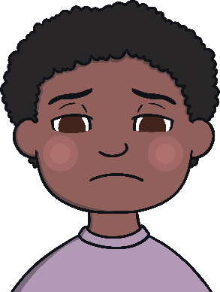
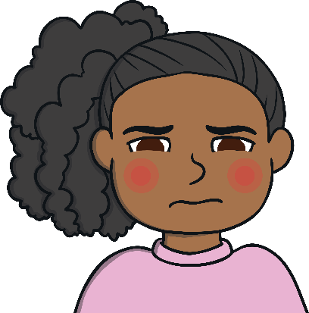
Feelings – are any of these familiar?
shocked
angry
happy
tired
sad
embarrassed

Slide 5
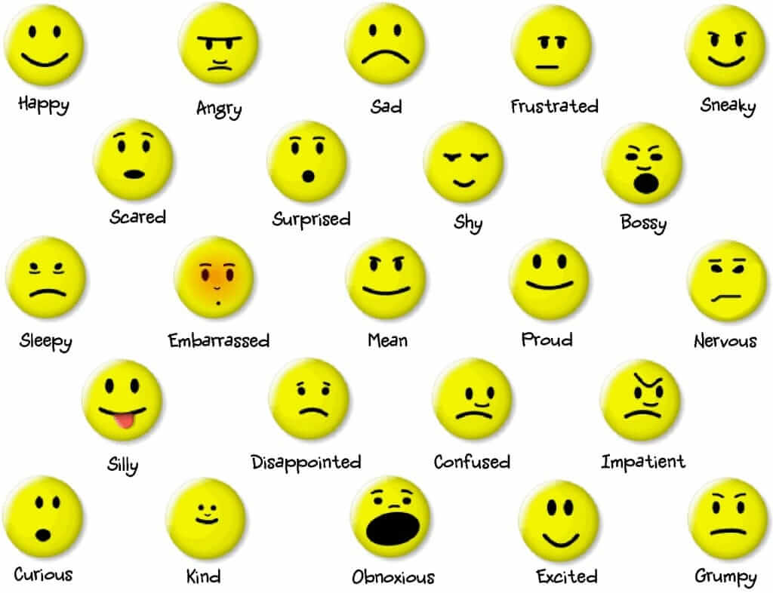
Activity
Run around the hall, when I call out an emotion, I want you to do an action or make a noise associated with that emotion. For example, when I call sad, act the emotion, when I call happy, act the emotion.
Notes:
This will provide the tutor with understanding and whether young people understand each emotion. Mix the activity up to be moderate and generic or comprehensive.

Slide 6
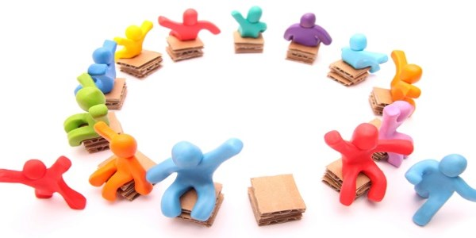
Musical Chairs
Notes:
Play a game of musical chairs, at the end of each game ask;
How they felt being put out?
How they felt winning?
How others felt watching?

Slide 7
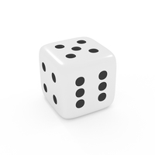
Dice game
This activity combines creativity and understanding of what emotions are needed in specific situations.
Try different emotions rather than sticking to the two prevalent ones (Happy & Sad).
Before telling the group, what emotion was selected, try to see if the group can find this out themselves.

Slide 8
Drama - act it out
James has had a hard day at school. He comes home to find that his brother has broken his PlayStation controller.
Sarah has been looking forward to her birthday party for a long time. At the last minute, her party has had to be cancelled.
Gemma has always wanted a puppy. She wakes up one morning to find one licking her toes..
Your best friend who you haven’t seen in ages calls to your house to see you..
It’s the night before a big test, you think you have done enough studying but are not so sure..
Notes:
Provide a relevant situation, break the young people into smaller groups and discuss different aspects of the situation. For example one group discusses what emotions the individual in the case study would experience at different parts and the other group discusses how that person can control their emotions.

Slide 9
Managing emotions
Discuss actions that make you feel different emotions and may lead to unpleasant reactions – can you identify any strategies that you can do to overcome these.
7-11 breathing technique: breath in for a count of 7, breath out for a count of 11. All breathing to occur through the nose and continue for 5/10 minutes. If you find this hard, reduce it to 3 in, 5 out.
Physical activity: this is a brilliant way to manage emotions and protect your emotional wellbeing. The most simplistic way of this is through walking.
Notes:
Overcoming – sadness, anger, anxiety.
Breathing techniques, journals, physical activity
Covering what you can do when your experiencing a strong accumulation of emotions-
Starting a conversation
Talk to a friend
Listen

Slide 10
Drama activity
In groups, produce a dialogue on how you would start a conversation with an adult about your emotions.
For example, “lately I have not been feeling so good because…”
Alternatively, “I have been feeling really happy lately …”
It is not always negative but good to be able to create dialogue that can unveil how we feel.

