Slide 1
Building Positive Relationships
Social Health – week 4

Slide 2
Different types of relationships you have in your life
Examples…
Relationships with friends...
Relationships with parents...
In pairs, write down as many types of relationships that you can have with other people that you can think of.

Slide 3
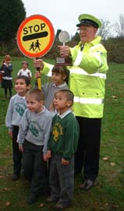
Friends
Families
Neighbours
Boyfriends/girlfriends
Parents
Teachers
Sisters/brothers
Aunts/uncles
Doctors/dentists
Librarians
Shopkeeper
Postman
Lollipop man
Local policeman
Social worker
Youth group leader
Sports coach
Pets
Did we miss any?

Slide 4
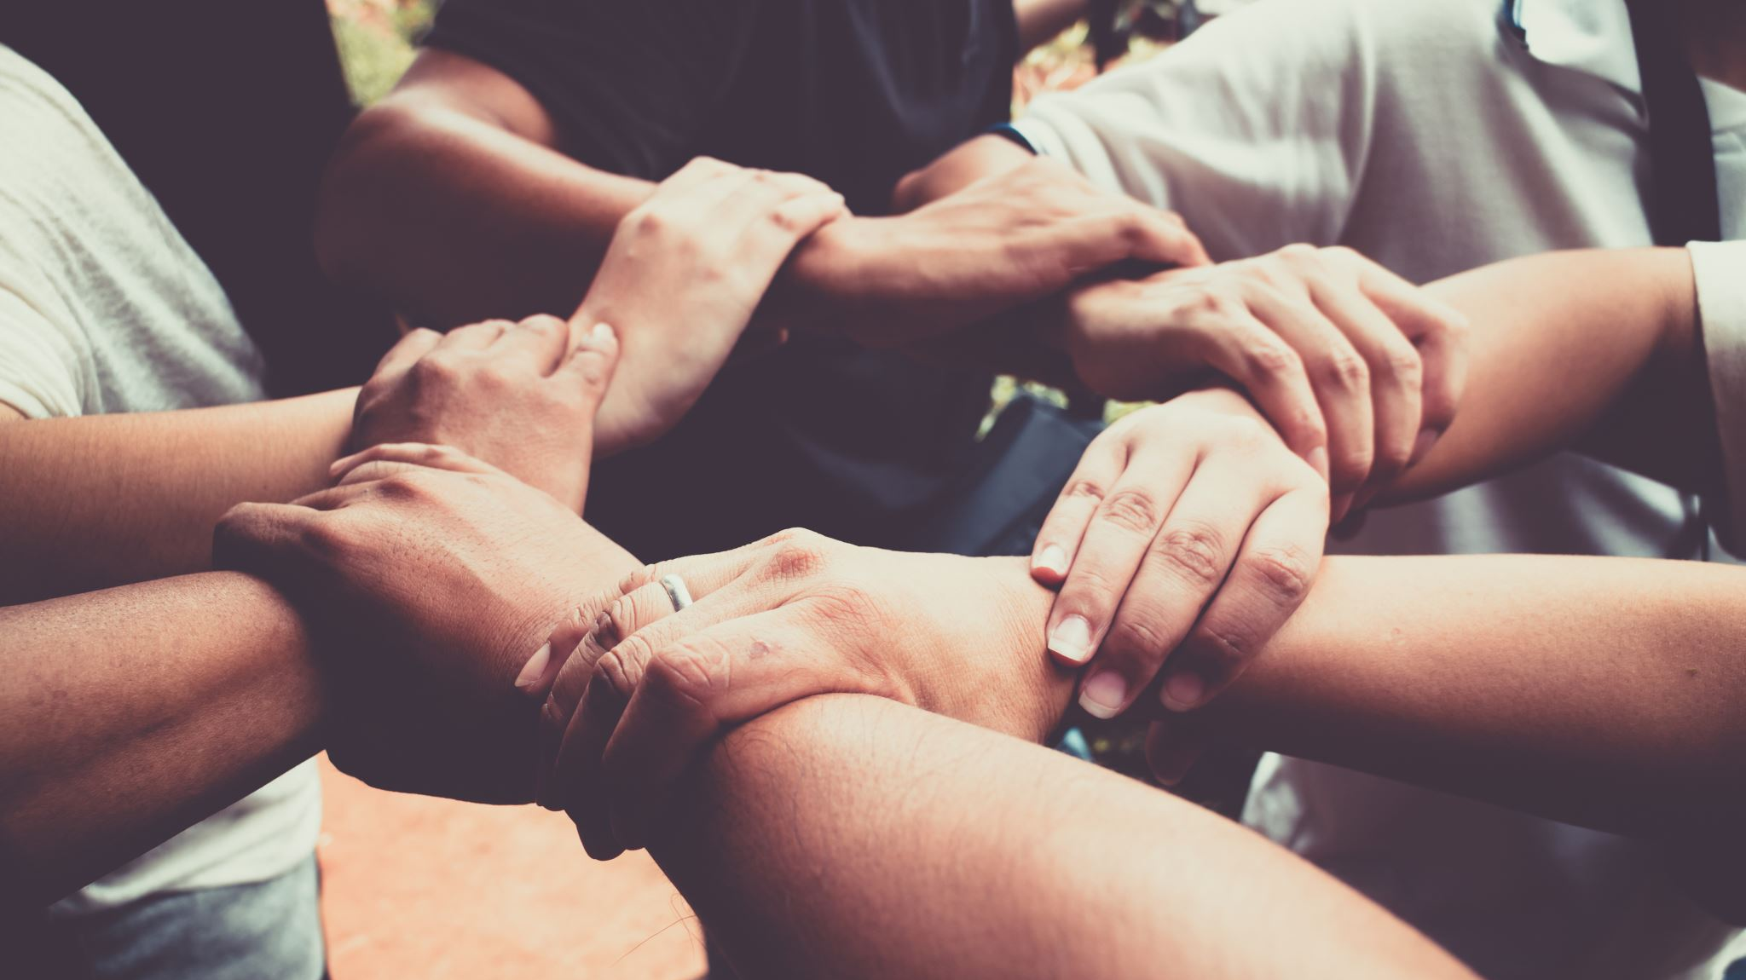
Do you have the same relationship with each person on this list?
What’s the difference?

Slide 5
Activity
Think of a close relationship you have with another person
1
Write down the name of this person
2
Write down why this relationship is important to you
3
Write down the good things about this relationship
4
Write down anything that makes this relationship difficult at times
5
Write down what you want from this relationship
6
Write down anything you can give to the relationship
7

Slide 6
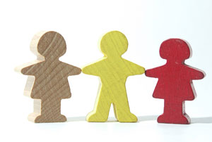
Types of relationships
Is there a difference between relationship and friendship?
What are the differences?

Slide 7
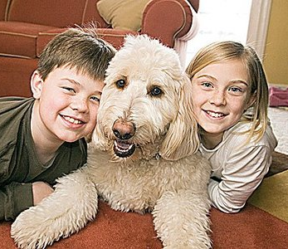
Easy relationships
Can you think of someone who you get on really well with and you enjoy having a relationship with them
What kind of things makes it an ‘easy’ relationship?

Slide 8
Difficult relationships
Can you think of someone who you don’t get on well with and you don’t enjoy their company.
What kind of things makes it difficult?

Slide 9
Split room task

Slide 10
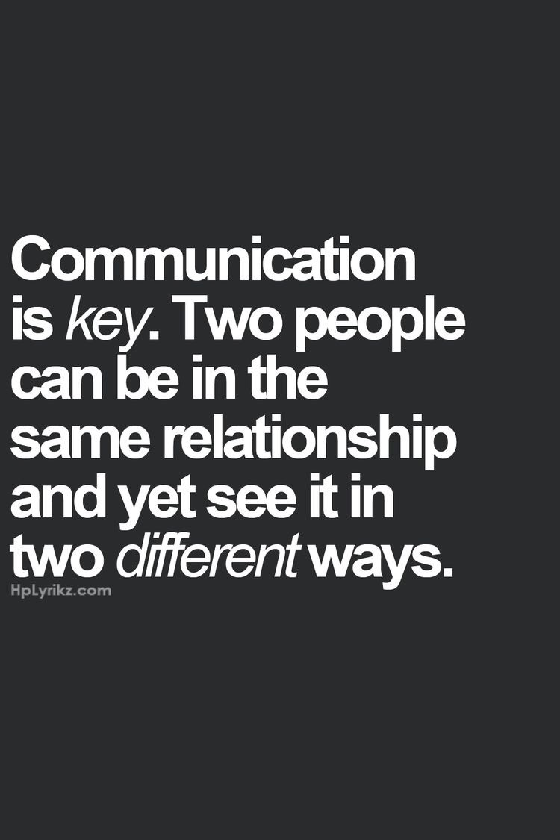
Communication
In relationships communication can be key.
Without effective communication, you cannot build a positive relationship. This enables you to communicate to solve issues and prevent them from festering.
As we get older, communication becomes more and more important; in school, university, work, youth clubs.
Reflective task: can you think of a time where you solved an issue with communication or a time where an issue became worse because there was no communication?
Notes:
Game to demonstrate this. There is a grid laid out around the hall, young people are paired off and blind folded, their partner has to put their hands on their back and navigate them around the hall and in the lane. This works on effective communication and trusting your friend to guide you.
Explain the purpose of this at the end and discussion on how their experience was. When they did not get proper instructions, did it make their relationship harder?

Slide 11
Guidelines for good communication
Know what you want
Look at the other person directly
Listen to the other person
Have a clear, firm voice
Say no and don’t make excuses
Use clear body language
Say what you want
Repeat what you want
Suggest reasonable alternatives

