Slide 1
Accredited Youth Work Programme
Participation 9-13 years

Slide 2
Workshops and activities/ games to help young people learn about a topic
Lots of young people do the same programme across NI
Opportunity for young people to show their youth leader and others what they have learned and achieved
Opportunity for young people to get a reward for their hard work e.g., certificates
WHAT IS AN
ACCREDITED
PROGRAMME?

Slide 3
Sessions
• 10
Time and date
Activities
• Small and large group discussions, team building
games, individual and group activities
Learning
• You will learn more about … You will each receive a workbook for you to show your learning
OUR TOPIC:
PARTICIPATION

Slide 4
QUESTIONS?

Slide 5
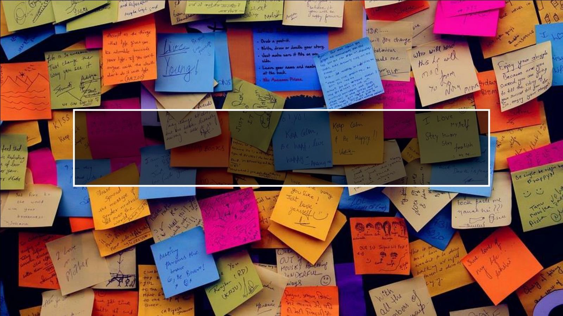
HOPES AND FEARS FOR THE
PROGRAMME.

Slide 7
SWEET
INTRODUCTIONS
• Pick between one and five sweets from the bag.
• Do not eat them yet!

Slide 8
SWEET INTRODUCTIONS – WHAT DID YOU
PICK?
Best memory
Dream job
Favourite place
Biggest talent
Wildcard!

Slide 9
SESSION 1 – INTRODUCTION TO PARTICIPATION
LEARNING OUTCOMES
01
Be aware of programme expectations
02
Understand what it meant by participation in youth work
03
Understand the benefits of participation for young people and society

Slide 10
INTRODUCTION TO PARTICIPATION -
OVERVIEW
What we mean by
Participation?
Why
participation is
important?
Introduction
Icebreaker
Quiz – Know Your Rights!
Evaluation/
check out

Slide 11
WHAT DO WE MEAN BY
‘PARTICIPATION’?

Slide 12
PARTICIPATION IS…
HAVING CONTROL
OVER YOUR OWN
WORLD!
Telling people what you think/ feel and having the power to make decisions on things that affect you.
Understanding the activities, organisations, and people that affect your lives.
It’s more than just being there or showing up – it is about making an impact on the situation you are in.

Slide 13
Your voice is protected by the law:
The UN Convention on the Rights of the Child outlines that children and young people have the right to express views and to be listened to.

Slide 14
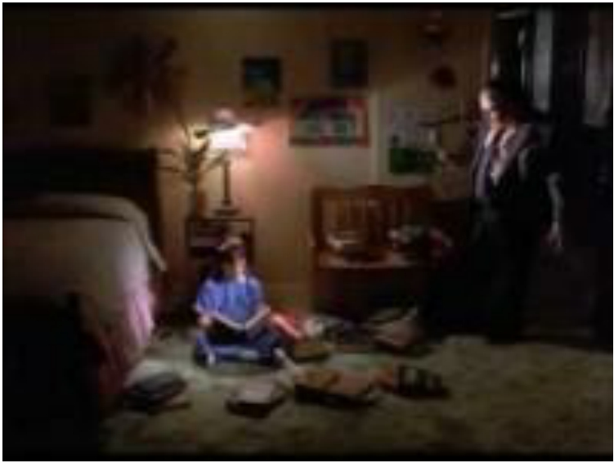
MATILDA
Questions to
think about:
Does Matilda have control over her own world? Why/ why not?
For those who have watched or read Matilda, how did she get more control over her life?
What steps did she take to gain some control over decisions which affected her?

Slide 15
WHY IS PARTICIPATION IMPORTANT?
Brainstorm

Slide 16
WHY YOUR VOICE MATTERS –
“CHILDREN LEARN HOW TO MAKE GOOD DECISIONS BY MAKING
DECISIONS, NOT BY FOLLOWING DIRECTIONS.” ALFIE KOHN
• Helps you grow your skills and gives you a better sense of how society works and how
decision-making happens
• Creates the energy for you to represent your ideas or your interests
• Develops your skills to be a leader
• Connects the ideas of who you are to your community/ wider world
• Helps you believe in yourself
• Encourages you to behave responsibly

Slide 17
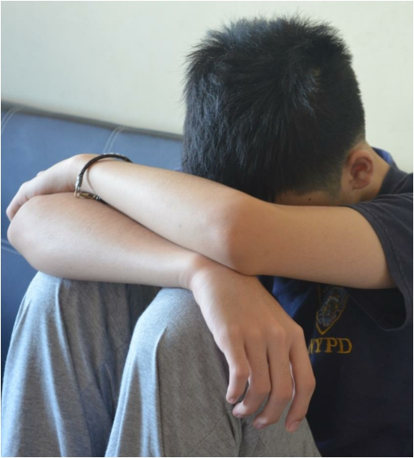
SCENARIO 1 – TOMMY,
AGED 9
“My dad says that I’m not allowed to play with Jake. Apparently he is a bad influence on me. He is allowed to do all the stuff I’m not – go up to the park with the ones from school, play Fortnite on the Xbox and even have a phone. I hate the way Dad is so strict.”

Slide 18
SCENARIO 2 – KATE,
AGED 12
“I can’t wait for the match on Saturday. I’m travelling to the pitch with my mates on the bus for the first time.
I don’t know why Mum panics so much! She thinks there will be people who will try to get me into their cars instead or steal my money.
She told me to think carefully about my behaviour when I’m out, to be careful of strangers, and to remember that I could come chat to her about anything like that.”

Slide 19
QUIZ
• Do you know your rights?
• https://childrenslawcentre.or
g.uk/your-rights/

Slide 20
EVALUATION/ CHECK OUT

Slide 21
SESSION 2 – ESSENTIAL SKILLS
(COMMUNICATION)
LEARNING OUTCOMES
Understand the importance of effective communication
Be aware of skills necessary for effective communication
Improve ability to
communicate effectively
with both peers and adults

Slide 22
ESSENTIAL SKILLS (COMMUNICATION) -
OVERVIEW
Overview of
skills &
Baselining
What does
communication
look like?
Introduction
Icebreaker
Communication
skill in action! -
Games
Evaluation/
check out

Slide 23
IMPORTANT SKILLS TO HELP US FULLY
PARTICIPATE…
• Communication: understanding how to connect with others and
make your idea or issue clear and relevant to the audience
• Teamwork & Negotiation: working together and finding shared
solutions
• Self-awareness: understanding your input and impact, why you
are joining in and how you make a difference
• Community/ societal awareness: understanding how your
communities and the wider world work
• Advocacy: explaining your message, getting others involved and
finding a goal or idea for you to work together
• Leadership: leading the way
We will explore and practise these skills throughout the next 9 sessions!

Slide 24
Speaking, listening, reading and writing are all vital skills for expressing ourselves and understanding others.
COMMUNICATION
Communication is how we exchange information with others.

Slide 25
Friendliness
Having a friendly tone to your voice is
important because it will encourage others to
engage in open and honest communication
with you. Having a smile on your face will
make the other person feel appreciated.
Be a good listener
This is one of the best communication skills. Take time to listen to the other person and pay close attention to what they are saying.
Non-verbal communication
This is about body language, eye-
Important
communication
skills
contact and hand gestures. It is important to pay attention to other people's non-verbal signals as it can
show how a person is feeling.
Confidence
Having confidence can be as simple as
Be clear
When communicating with someone, you should always make sure you are clear when
speaking, so the other person can
understand what you are saying.
Empathy
This is about understanding and respecting other people’s point of view (putting yourself in someone
else’s shoes). Respect other
people’s opinions.
making eye contact and using a firm but
friendly tone, but be careful not to sound
arrogant or aggressive.

Slide 26
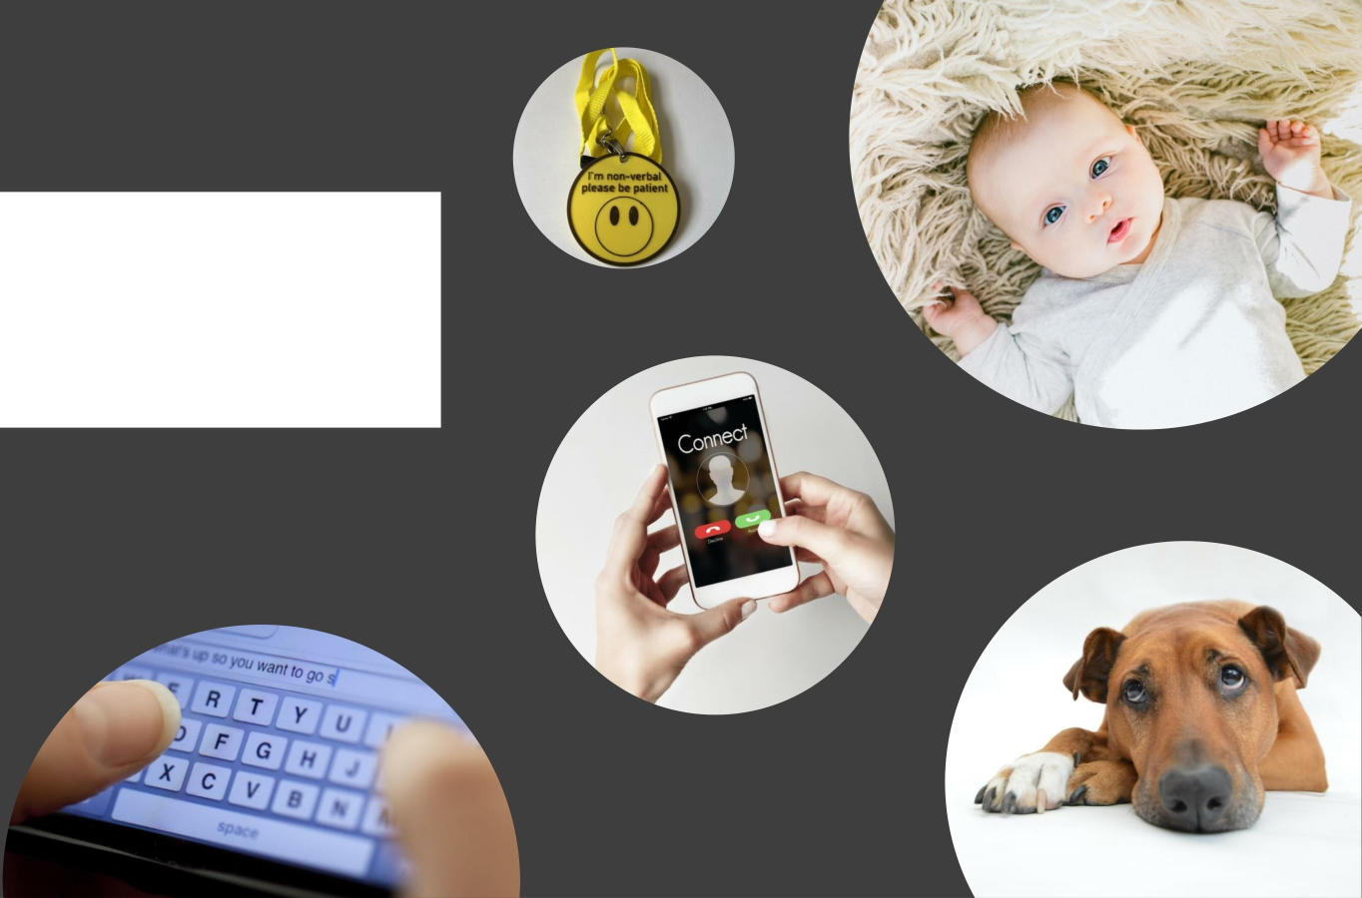
WE
COMMUNICATE IN LOTS OF DIFFERENT
WAYS…

Slide 27
COMMUNICATION
SKILLS – IN ACTION
We are always trying to improve communication skills, even as adults!

Slide 28
COMMUNICATION SKILLS – IN ACTION
These next few activities will provide us with an opportunity to practise our communication skills, make us more aware of communication methods we are using, and essentially improve communication within the group!

Slide 29
20 QUESTIONS
• Stand in a circle.
• Let one person stand in the centre. This person must think of a famous place or person/ celebrity.
• Everyone else must guess it by asking a set of
20 questions. The person in the centre can only answer yes or no.
• If your teammates fail to guess, the person in
the centre is declared the winner!
• Take turns at standing in the centre.

Slide 30
YOU DON’T SAY!
• You will each receive a card which says an
emotion/ feeling e.g., happy, sad.
• You must not show anyone else in the group
what is written on your card.
• Sit in a circle and take turns to act out the emotion you have been given – without speaking!
• The rest of the group must try to guess what
it is.
• Some are harder than others!

Slide 31
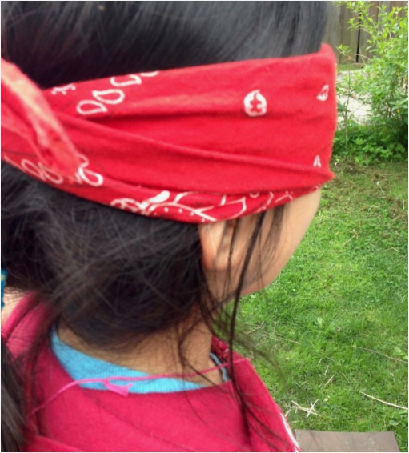
BLINDFOLD LEADS
• You will work in pairs. One person in each pair will be
blindfolded.
• The sighted person must help their blindfolded partner
across a clear area.
• Some obstacles might be introduced into this ‘clear’
area as the activity progresses – so be mindful!
• The sighted person can lead with physical contact at first e.g., guiding by the arm, but must stop any physical contact when the leader says so!
• The sighted person must support the blindfolded
person and ensure they are safe.
• Swap roles once you are finished!

Slide 32
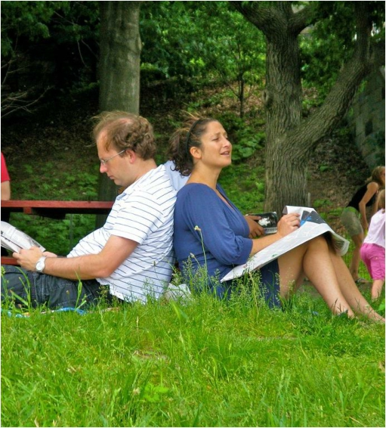
BACK TO BACK
DRAWING
• Get into pairs and sit back-to-back with your partner
• One of you will be the listener
• One of you will be the speaker
• The speaker will be provided an image and must
describe the image in detail
• The listener will attempt to recreate the image on a
blank piece of paper, based upon the instructions
• Neither partner can see the others’ paper, and the
listener may NOT communicate with the speaker

Slide 33
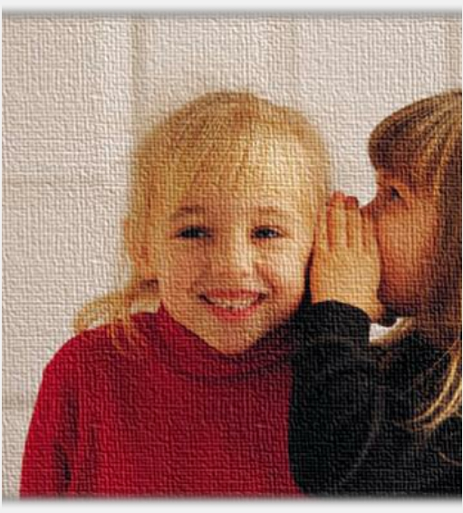
TELEPHONE
• Everyone sit in a circle!
• One person will be chosen to say a message into the ear of
the person sitting next to them.
• That person then relays that message onto the next person,
and so on.
• You are only allowed to say the message once and must say
it quietly so as only the person sitting next to you can hear.
• Once the message gets back to the originator (the person who said it first), you will be asked to call out what was said to you.
• Is it different to the message you passed on at the
beginning?

Slide 34
EVALUATION/ CHECK OUT

Slide 35
SESSION 3 – ESSENTIAL SKILLS (TEAM WORK
AND NEGOTIATION) LEARNING OUTCOMES
Understand the benefits of working
cooperatively within a team
Improve ability to work cooperatively
within a team
Improve negotiation skills

Slide 36
ESSENTIAL SKILLS (TEAM WORK AND
NEGOTIATION) - OVERVIEW
Brainstorm – What
is teamwork and
why is it important?
Teamwork skills in
action! - Games
Introduction
Icebreaker
Brainstorm – What
is negotiation and
why is it important?
Negotiation skills in
action! - Games
Evaluation/ check
out

Slide 37
Teamwork is working respectfully with a group and doing your share so that the whole team can achieve a common goal or complete a task.
TEAMWORK
Working in a team recognises that different members are good at different skills and tasks.
We can learn from each other in a team.

Slide 38
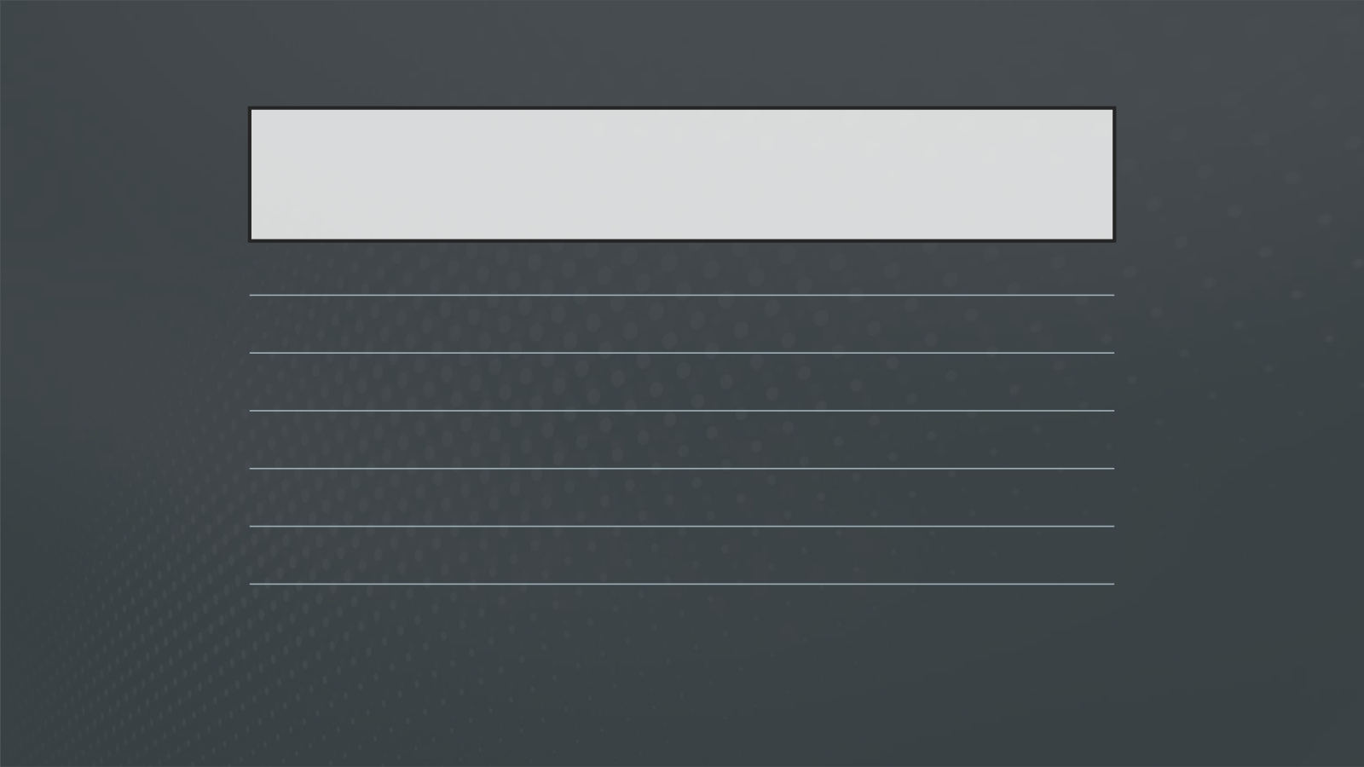
BENEFITS OF TEAMWORK
Builds relationships
Provides opportunities to learn from others Sharpens communication skills
Motivates
Enhances co-operation with others Develops leadership skills

Slide 39
Talking in Circles – Form the shape your leader calls out. Trickier than it sounds!
Minefield – Group members will take turns to guess the sequence by walking to the correct markers. If you take a wrong step, you must go to the back of the line. You are allowed to walk straight, back, forward or diagonally, but must not cross over more than one row. The winning team is the first to get all teammates
successfully through the sequence with no wrong steps!
Magic Carpet - Flip over the mat so that you are standing on the other side of it. Do this without getting off the mat or touching the ground!
TEAMWORK
SKILLS IN ACTION!

Slide 40
NEGOTIATION SKILLS
• Negotiation is about talking to someone and
coming to an agreement.
• It is about reaching a compromise where everyone
involved is satisfied.

Slide 41
HOW TO IMPROVE NEGOTIATION SKILLS
Identify • What do you want?
Consider • What do others think?
Understand
• What are you good at? Who can help you? What are
other people around you good at?
Be confident
• Remember all the communication skills from last week – speaking clearly, standing tall, using eye contact!
Try Again!
• What can you do if things don’t go as planned or you
make a mistake? Learn from it and try again!

Slide 42
NEGOTIATION SKILLS IN ACTION!
• The Barter Puzzle
• Your small group will be provided with a different jigsaw puzzle. The only
problem is, the puzzle pieces are mixed up with other groups’ jigsaws.
• Your team must come up with ways to get the pieces back through negotiation, trading, exchanging team members, etc. However, it should be a group decision and not individual choice.
• The team that is able to put all the pieces together in the least possible time is
the winner.

Slide 43
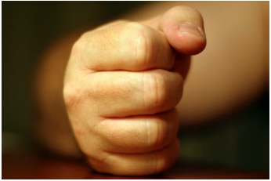
NEGOTIATION SKILLS IN ACTION!
Fists
• Follow the instructions
given!
Drama activity
• Act out the scenario and come to an agreed solution.
This Photo by Unknown Author is licensed under CC BY-SA-NC

Slide 44
EVALUATION/ CHECK OUT

Slide 45
SESSION 4 – WHO AM I?
LEARNING OUTCOMES
Understand our feelings and thoughts, and how these impact
our decisions/ behaviour
Increase awareness of what we
care about
Understand factors which
influence our identity/ who we
are

Slide 46
WHO AM I? - OVERVIEW
Introduce
yourself
activity
PASTA
check-in
Introduction
Icebreaker
Evaluation/
check out
This or that?
Show and Tell

Slide 47
WHO DO WE SPEND THE MOST TIME
WITH?

Slide 48
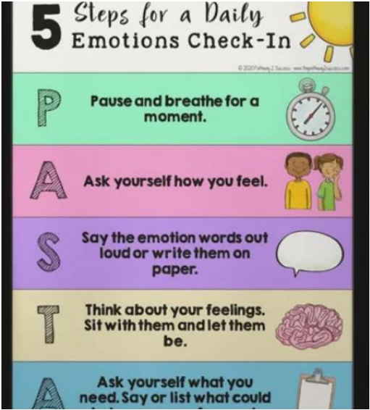
CHECK-IN
• It is important to take time to recognize how we are
feeling!
• Practise PASTA as often as you can. It can be useful during times when you are feeling a bit unsure about something, anxious or overwhelmed!
• As human beings, we experience different feelings and emotions all the time – it is how we react to them which is important.

Slide 49
INTRODUCE YOURSELF!
In pairs, introduce yourself using the four phrases:
I AM…
I LIKE…
I BELIEVE…
I THINK…
Be as open and creative as you can!

Slide 50
EXPLORING OUR IDEAS AND
FEELINGS!
• This or that – Pick which one you pick in the Would You Rather statements. Try to answer as honestly and as quickly as possible!

Slide 51
SHOW AND TELL
•
You will have 15 minutes to think of a place, person or thing that you value. This will likely be very important to you or something that you are passionate about.
• You will each have three minutes to talk about this place, person or thing to the rest of the group.
•
Tell them the key facts about it, but also why you have chosen this person, place or thing/ why it is important to you.
•
Draw a picture of your chosen item to showcase to the rest of the group (if you have a picture on your phone or the item with you, you can show this).
•
The rest of the group have two minutes to ask questions about the item.
Remember:
• Be respectful at all times
• All the communication skills which we learned in session three!

Slide 52
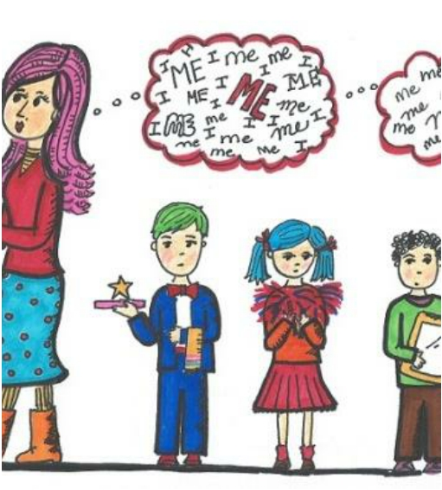
All the things we have learnt today about who we are and what we care about, have an impact on those around us and the environment in which we live.
Take notice of yourself, but also others around you.

Slide 53
EVALUATION/ CHECK OUT

Slide 54
SESSION 5 – MY COMMUNITY
LEARNING OUTCOMES
Understand importance of
community
Be motivated and able to use opportunities available in the
community
Understand the connection between
individual and community

Slide 55
MY COMMUNITY - OVERVIEW
Scavenger
Hunt
Group
reflection
Introduction
Icebreaker
Individual and
community
Evaluation/
check out

Slide 56
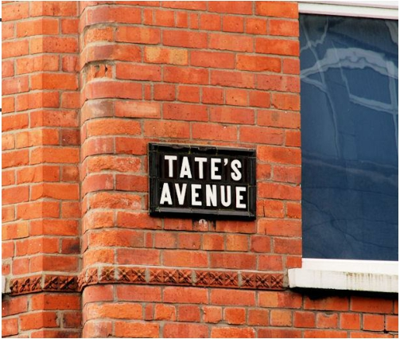
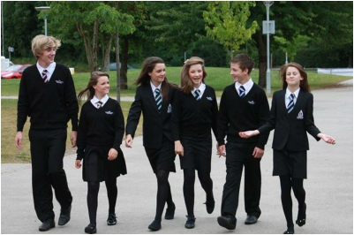
WHAT IS A COMMUNITY?
What is a
community?

Slide 57
Community is…
• A group of people living in the same place or having a particular
characteristic, attitude or interest in common.

Slide 58
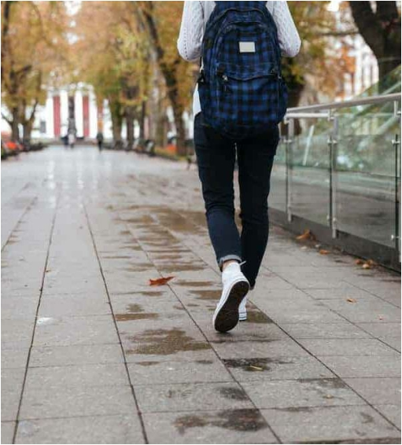
SCAVENGER HUNT
Whoever finds everything on their list, in the shortest time, is the winner!
Answers must be accurate!

Slide 59
IN YOUR GROUPS,
DISCUSS…
• What are the positive things about living in your area?
• What makes you proud?
• How well looked-after is it?
• How diverse it is as a population?
• Do we make the most of out area?
• What are the negative things about living in your area?
• Think about how these things make you feel. Do they make you
feel unsafe?
• Do they affect your own personal well-being?
• Who is responsible for these negative issues?
• What further opportunities does your community present?
• How could you make your community better?

Slide 60
The community we live in will have an impact on what we do, what we say, what we think, how we feel, what we believe in and who we will become.

Slide 61
EVALUATION/ CHECK OUT

Slide 62
SESSION 6 - ADVOCACY
LEARNING OUTCOMES
Understand what is meant by
the term advocacy
Increase knowledge and
awareness of influential people
who have an advocacy role
Increase own confidence and
ability to advocate

Slide 63
ADVOCACY - OVERVIEW
Influential
advocates –
Quiz!
What is
advocacy?
Introduction
Icebreaker
Advocacy in
action –
Teacher’s Den
Evaluation/
check out
Round Up

Slide 64
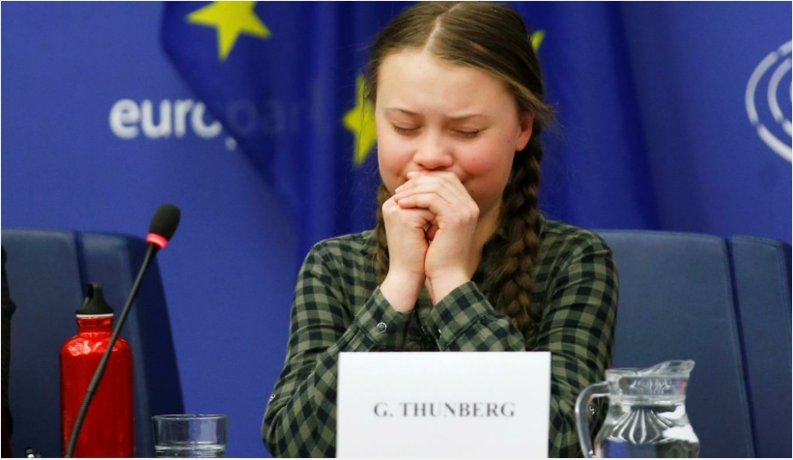
WHAT IS
ADVOCACY?
Advocacy is arguing or supporting an idea or a plan.
This can be self-advocacy (arguing or supporting an idea/ plan on our own behalf) or it can be peer- advocacy (arguing or supporting an idea/plan on behalf of others).
Advocacy is an important skill to have in order to support ourselves, and others, to achieve what we believe is right or needed.
To be a successful advocate we need to be able to:
- Define the problem we are concerned about
- Research the issue and understand it in detail
- Remain confident and firm when challenged by
others
- Be persistent (don’t give up!)

Slide 65
WHO CAN ADVOCATE
ON OUR BEHALF?
• Friends
• Family
• Teachers
• Youth workers
• Sports coaches
• Social workers
• Police
• Charities
• Councillors
• MLAs
• MPs
• Can you think of anymore?

Slide 67
1. AT WHAT AGE CAN PEOPLE VOTE IN
NI?
A.16
B. 17
C. 18
D.21

Slide 68
2. WHO WOULD YOU CONTACT IF YOUR BIN
WASN’T EMPTIED?
A.Local Council
B. The NI Assembly
C. Your local waste disposal unit D.Local community centre

Slide 69
3. WHAT DOES MLA STAND FOR?
A.Member of Local Area
B. Member of Local Authority
C. Member of Legislative Assembly D.Member of Legal Action

Slide 70
4. WHERE DO THE MLA’S MEET TO MAKE
LAWS?
A.Belfast City Hall
B. Enniskillen Castle
C. Newry Cathedral
D.Parliament Buildings (Stormont)

Slide 71
5. HOW MANY MLA’S ARE THERE IN NI?
A.18
B. 30
C. 90
D.230
Hint: There are 5 MLAs for every area – do you know your local MLA’s?

Slide 72
6. HOW MANY LOCAL COUNCILS ARE
THERE?
A. 11
B. 21
C. 31
D. 50
Extra point if you can name which Council area you live in!

Slide 73
7. WHICH STATEMENT IS NOT TRUE?
HOW DOES OUR GOVERNMENT AFFECT THE
FOOD YOU EAT?
A. Controls the “sell by” and “best before” dating
system
B. Tells restaurants what prices they must sell their
food for
C. Sets hygiene standards for food and takeaways
D. Determines which artificial additives can and
can’t be used in foods

Slide 74
8. WHICH STATEMENT IS NOT TRUE?
HOW DOES OUR GOVERNMENT AFFECT YOUR
MUSIC?
A.Says you cannot play music on a school night
B. Says whether it is legal to download music
from the internet
C. Limits how loudly music is played in public
places
D.Licenses music festivals

Slide 75
9. WHICH STATEMENT IS NOT TRUE?
HOW DOES OUR GOVERNMENT AFFECT YOUR
SPORT?
A.Says how much Lottery money will be spent
on sport
B. Decides what local sports facilities you get
C. Says you cannot play sport on a Sunday D.Decides which sports are supported

Slide 76
10. WHICH STATEMENT IS NOT TRUE?
HOW DOES OUR GOVERNMENT AFFECT HOW
YOU GET ABOUT?
A.Sets speed limits
B. Sets the level of tax on petrol
C. Decides which roads should have bus or cycle
lanes
D.Decides how far you can walk

Slide 77
ROUND UP - WHAT DOES A MEMBER OF
THE LEGISLATIVE ASSEMBLY (MLA) DO?
• They work with other people and other political parties to make decisions about Northern Ireland.
• It’s their job to make sure that hospitals, schools, museums, sports centres, and all the other public spaces
are open and working well.
• They make sure there are buses and trains for people to get to work/ socialize/ stay connected.
• They make sure that businesses and charities have support and money to do their work.
• They make sure that roads and communities are safe, and that the environment is protected.
• They represent their constituents (the people who elected them) by listening and advocating on their
behalf.
• They make laws which aim to protect people, promote equality and enrich diversity.

Slide 78
• Teachers – You must pick one group/ one rule for the school handbook. Listen to each three minute pitch and ask questions after if you need more information.
• Pitchers/ Pupils – You have 10-15 minutes to write your rule and do some background research.You will then have three minutes to pitch your new rule to the teachers.You must be prepared for questions after.
• Think about:
• What is the rule
• How will it work
• Why it is needed (the issue/ problem)
• Back this up with some research/ statistics
• Explain how your rule will help pupils/ the school
• What will your rule achieve?
• Will the best rule win? Or the best pitchers win?
ADVOCACY IN
ACTION –
TEACHER’S DEN!

Slide 79
EVALUATION/ CHECK OUT

Slide 80
SESSION 7 – LEADERSHIP & SKILLS
LEARNING OUTCOMES
Understand skills and qualities
required for effective leadership
Be able to identify personal
strengths and areas for
improvement

Slide 81
LEADERSHIP & SKILLS - OVERVIEW
A good
leader
Quiz the
leader!
Introduction
Icebreaker
Leadership
in action!
In the
driver’s seat
Power
hands
Evaluation/
check out

Slide 82
IMPORTANT SKILLS WE HAVE LEARNED
THROUGHOUT THE PROGRAMME
• Communication
• Teamwork & Negotiation
• Self-awareness
• Community/ societal awareness
• Advocacy
These are all very important skills to have in order to be a good leader!

Slide 83
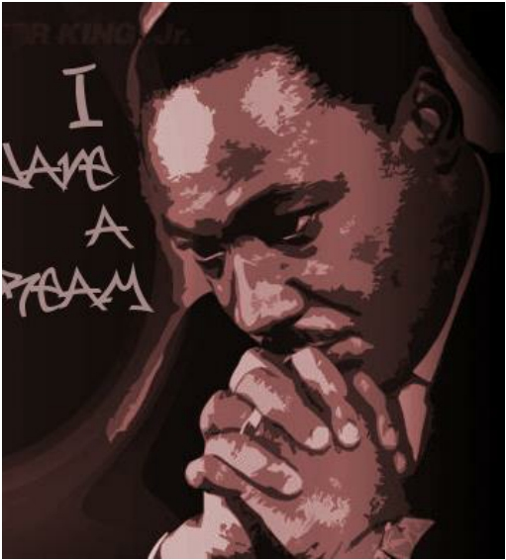
A GOOD LEADER
• Think about someone you admire who is in a leadership position.This can be someone you know or a celebrity/ well known figure.
• What skills and qualities does this person
have that makes them a good leader?
• Label the top 5 skills and qualities that you
admire!

Slide 84
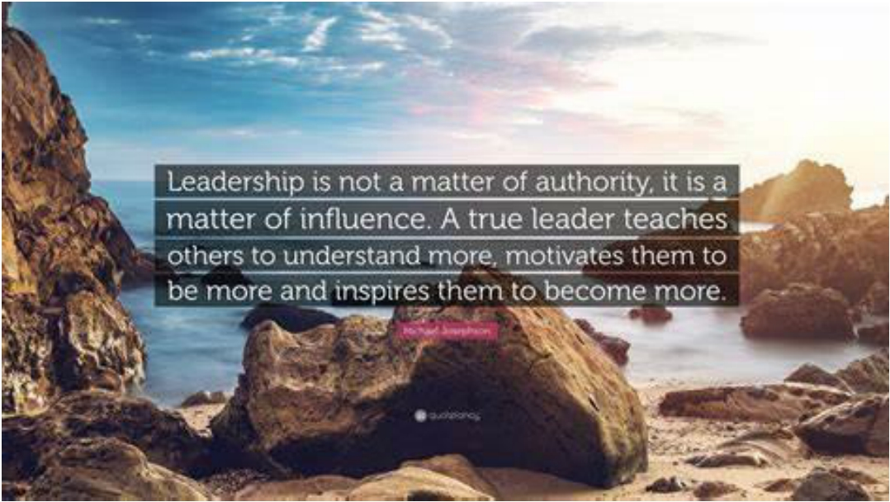

Slide 85
QUIZ YOUR LEADER!
Here are some questions for you to think about/ ask:
• What does your day-to-day activities look like?
• How did you become a leader? Did you have to train/
learn?
• What are the challenges of being a leader?
• What skills do you need to be a leader?
• Do you have any tips for us to become better leaders?

Slide 86
LEADERSHIP IN ACTION
• Silent line-up
You are not allowed to say a word during this one! Only use hand signals/ gestures.
• Blindfold leader game
Arrange yourselves into a single line.You will each have to put on a blindfold, apart from the leader at the front of the line. Put your left hand on the left shoulder of the person in front of you.When I shout “go”, the leader (who is not blindfolded) walks towards the finish point, providing instructions to those behind, who are blindfolded.

Slide 87
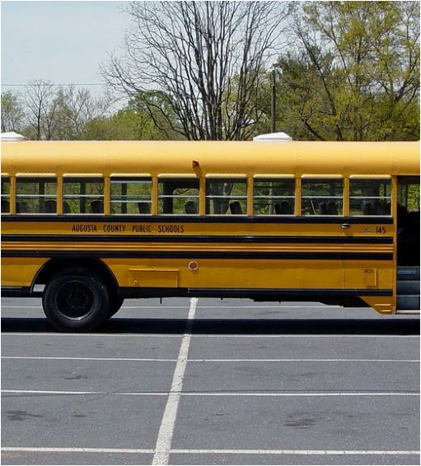
DID YOU MAKE THE
BUS?
Reflect on all the activities/ tasks to date:
Those who felt like they lead the group - sit at the front of the bus, driving
Those that supported the leaders – sit in the front seats
Those that felt they let others do all the talking/ thinking – sit in the back seats
Those that felt they motivated the group/ kept the group going – you are the engine underneath the bus (lie on the ground for this one)
Those that felt they didn’t contribute at all or didn’t make any effort - you missed the bus altogether (stand away from the bus)!

Slide 88
POWER HANDS!
• Palm – Name
• Thumb – Personal quality
• Index finger – Skill
• Middle finger – Something you would like
to improve
• Ring finger – Something you are passionate
about
• Little finger – Describe yourself in one
word!

Slide 89
EVALUATION/ CHECK OUT

Slide 90
SESSION 8 – EXPLORING SOCIAL ACTION
LEARNING OUTCOMES
Understand benefits of social
action to the individual
Understand benefits of social
action to the community
Understand the four key steps
to undertake social action

Slide 91
EXPLORING SOCIAL ACTION -
OVERVIEW
Introduction
to social
action
What’s in it
for me?
Introduction
Icebreaker
What’s in it
for the community?
Exploring the
four action
steps
Evaluation/
check out
Ideation stage

Slide 92
• Social action can be defined as ‘practical action in the service of
others’.
• Social action is doing something, of your choice, for the benefit of
other people or the environment that we live in.
• It empowers young people to influence others/ decisions and
encourages them to contribute and participate in the community.
• It shares the same values as volunteering.
• Social action can be awareness raising or taking direct action.
SOCIAL ACTION – WHAT IS IT?

Slide 93
It ensures you:
• Have a safe and open space to think, discuss and make decisions on
things
• Have clear information and support in using your voice.
• Are taken seriously.
• Are listened to by those who have influence/ make decisions.
YOUTH SOCIAL
ACTION IS AN
EFFECTIVE WAY
TO ENSURE
MAXIMUM
PARTICIPATION.

Slide 94
WHAT’S IN IT FOR
ME?
Think about the last time you did something nice/ went above and beyond for someone else.
Why did you do it? How did it make you feel?

Slide 95
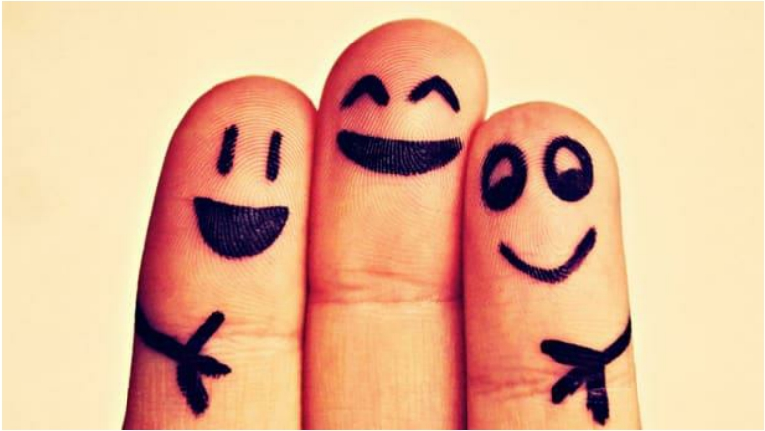
WHAT’S IN IT FOR OTHERS?
How it make the other person/ people feel?

Slide 96
SOCIAL ACTION -
WHAT’S IN IT FOR YOU?
➢ Learn new skills
➢ Increase confidence
➢ Improve emotional wellbeing
➢ Use your skills for others
➢ Make a difference and influence things that matter to you
➢ Meet new people
➢ Do good for others
➢ Give you a sense of purpose
➢ Give you a sense of satisfaction
➢ Use your time better
➢ Help you with future opportunities

Slide 97
SOCIAL ACTION – WHAT’S IN
IT FOR OTHERS?
➢ Giving up your time is important – sometimes there is not
enough money or enough compassion for someone else to do something!
➢ You can bring different knowledge and different skills to the community
➢ You can spread a positive message and really help make a difference to the lives of others or the environment in which you live

Slide 98
FOUR KEY SOCIAL
ACTION STEPS
• Explore
• Organise
• Act
• Review

Slide 99
STEP 1 - EXPLORE
• Think about issue/s you would like to focus on
• Identify the most important issue to your group
• Research the issue – some background information on who,
what, where, when and why
• Identify what change you would like to see from the social
action project
It is important at this stage you identify what your successful project/ campaign will look like.This will help you evaluate your project at the end – Did you do/ achieve what you set out to do?

Slide 100
STEP 2 - ORGANISE
• Make clear goals to make the change you want to
see
• Know what actions you will need to take to achieve
these goals
• Create an action plan (What needs to be done,Who is doing it,When will it be completed by, What resources are needed,Who else can support/ help, What will this action achieve)
• Gather some contact information for others who
may be able to support/ help

Slide 101
STEP 3 - ACT
HAVE A CLEAR MESSAGE ON
WHAT YOU ARE LOOKING
TO ACHIEVE
CARRY OUT THE ACTION
PLAN
GET STARTED!

Slide 102
STEP 4 - REVIEW
• What have you learned?
• What challenges did you face?
• What could you do differently next time?
• Did you achieve what you set out to achieve?
• Celebrate and gain recognition for your hard work!

Slide 103
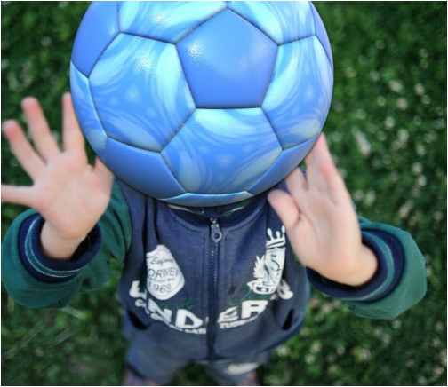
IDEATION ENERGISER

Slide 104
STAGE 1 - EXPLORE

Slide 105
EVALUATION/ CHECK OUT

Slide 106
SESSION 9 – SOCIAL ACTION – IN ACTION
LEARNING OUTCOMES
Gain knowledge and skills to create an action plan including tasks, roles,
timeframes, resources, and outcomes
Understand importance of creating
SMART objectives
Be able to work co-operatively
within a group to complete social
action activity

Slide 107
SOCIAL ACTION - IN ACTION -
OVERVIEW
Overview of
four key steps
Introduction
Icebreaker
SMART goals
Action planning – HOW change
happens
Barriers we
may face
Who can help
and support
Evaluation/
check out

Slide 108
FOUR KEY SOCIAL
ACTION STEPS
Can you remember?
• Explore
• Organise
• Act
• Review

Slide 109
WE ARE NOW ON STAGE 2 - ORGANISE
• Make clear goals to make the change you want to
see
• Know what actions you will need to take to achieve
these goals
• Create an action plan (What needs to be done,Who is doing it,When will it be completed by, What resources are needed,Who else can support/ help, What will this action achieve)
• Gather some contact information for others who
may be able to support/ help

Slide 110
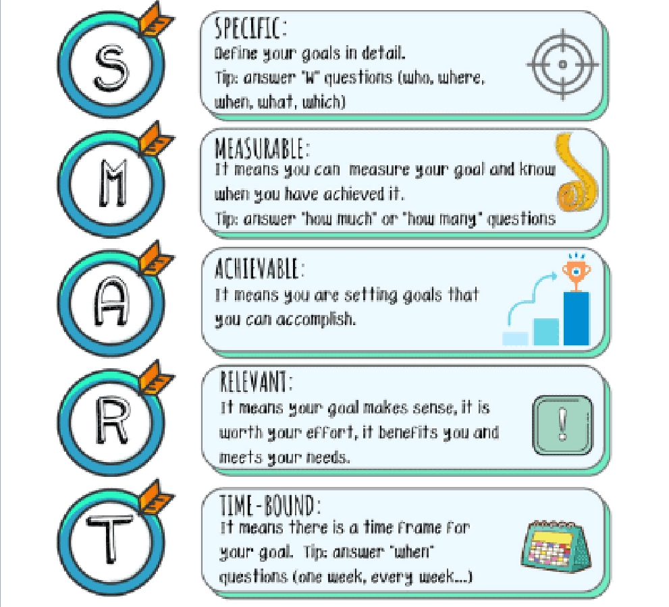
SMART
GOALS

Slide 111
ACTION PLANNING

Slide 112
SHOW THE WORLD WHAT
YOU ARE DOING!
Be sure to take some pictures or videos of you and your group carrying out your social action activity (just make sure to get permission first!).
You can generate some more support/ promotion for your project through things like:
• Social media posts
• Contacting the local newspaper
• Asking your local school/ community centre to highlight your work
• Contacting local councillors or other people of influence in the
community

Slide 113
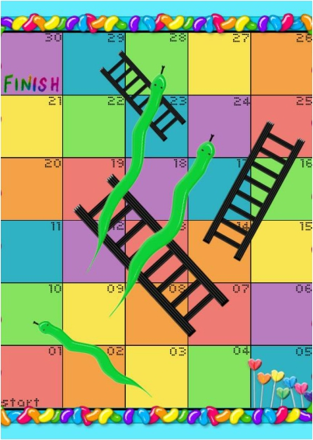
POTENTIAL CHALLENGES
• It is important that you think about any potential challenges you might face/ any obstacles you might encounter along the way.
• If we plan for challenges, we are better prepared to
deal with them.
• After you complete the challenges worksheet, you
might need to re-visit your action plan!

Slide 114
STAGE 3 – ACT!
• You are now ready, and organized, to put your plan into
action!
• In your groups remember to:
• - Support each other
• - Listen to one another
• - Use your knowledge and skills to help make the
project a success
• - Seek support and help when you need it!

Slide 115
EVALUATION/ CHECK OUT

Slide 116
SESSION 10 – LOOKING BACK, PLANNING AHEAD
LEARNING OUTCOMES
Understand the importance of
measuring success
Understand how to measure
success
Understand the importance of reflecting on own success and
abilities.

Slide 117
LOOKING BACK, PLANNING AHEAD -
OVERVIEW
How did we
do?
Promoting
our work
Introduction
Icebreaker
Overall
project
evaluation
Planning
ahead
End baselines
How did I do?

Slide 118
YOU MADE IT TO STEP
4! TIME TO REFLECT…
• On a flipchart page, work with your group
and answer the following questions:
• What have you learned?
• What challenges did you face?
• What could you do differently next time?
• Did you achieve what you set out to
achieve? Tell us what this was!

Slide 119
SHOWCASE YOUR SUCCESS!
Celebrate • Celebrate and gain recognition for your hard work!
• Write a short blurb or make a short video on what your project achieved.
Write/
Video
• Think about what you gained from the project (Any new skills? Did you learn anything? Did it make
you look at things differently?)
Your success
• Think about what your project did for others/ what it achieved (Who benefitted? How did they
benefit from it?)
Helping
others

Slide 120
HOW DID YOU DO?
Reflect on your contribution throughout the programme and social action activity.
Tell everyone one thing you did well/ made a good effort with throughout the programme/ activity.

Slide 121
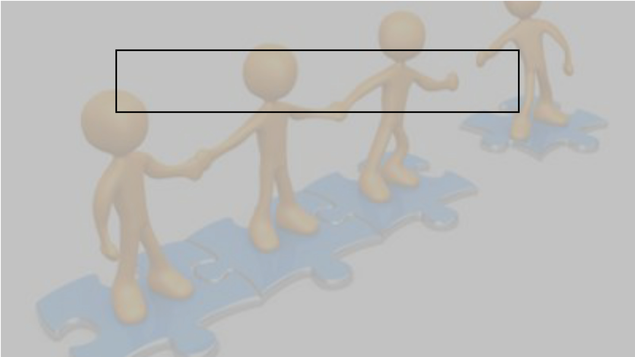
PLANNING AHEAD -
PARTICIPATION IS FOR LIFE!
Write your ideas on how we can increase participation within the club.

Slide 122
OVERALL EVALUATION

