Slide 1
ACCREDITED YOUTH WORK PROGRAMMES
Participation
14-18 years

Slide 2
WHAT IS AN ACCREDITED PROGRAMME?
Set of workshops and activities/ games which are used to help young people
learn about a particular topic
Lots of young people do the same programme across NI
Opportunity for young people to show their youth leader and others what they have
learned and achieved
Opportunity for young people to get a reward for their hard
work e.g., certificates

Slide 3
Sessions 10
Time and date
Activities | Small and large group discussions, team building games, individual and group activities
OUR
TOPIC:
PARTICIPATION
Learning
You will learn more about … You will each receive a workbook for you to show your learning

Slide 4
QUESTIONS?

Slide 6
HOPES AND FEARS FOR THE
PROGRAMME

Slide 7
SWEET
INTRODUCTIONS
• Pick between one and five sweets from the bag.
• Do not eat them yet!

Slide 8
SWEET INTRODUCTIONS – WHAT
DID YOU PICK?
Best memory
Dream job
Favourite place
Biggest talent
Wildcard!

Slide 9
SESSION 1 – INTRODUCTION TO PARTICIPATION
LEARNING OUTCOMES
Understand what is meant by
participation
Understand the benefits of
participation for young people
Understand the benefits of
participation for the
community and wider society

Slide 10
INTRODUCTION TO PARTICIPATION -
OVERVIEW
What we
mean by
‘Participation’
Why participation is important
Introduction
Icebreaker
Quiz – Know
Your Rights!
Evaluation/
check out

Slide 11
WHAT DO WE MEAN BY
‘PARTICIPATION’?

Slide 12
PARTICIPATION IS…
• A process where young people, as active citizens, take part in, express views on, and have decision-making power about issues that affect them.
• Involving young people in processes,
institutions and decisions that affect their lives.
• More than just being there or showing up – it is about being in control and having an influence over the situation you are in.

Slide 14
EXAMPLE – ‘HAVE YOUR SAY DAY’
Space – One evening per month in the youth club there is a ‘Have Your Say’ day where young people can express their views on the club (e.g. what’s working well, what’s not working well, what they would like to see/ plan in the near
future)
Voice – Youth worker lets all participants and parents know date and time for session. A variety of tools/ techniques are used to gain people’s
views (e.g., small group work discussions, suggestions boxes)
Influence – ‘Have Your Say’ days take place before action plans, funding applications etc. are completed. This allows for young people’s views and interests to influence the overall direction of the organisation.
Audience – Youth worker in charge and/ or management committee members are present at ‘Have Your Say’ days and are duly responsible for providing feedback on progress.

Slide 15
WHY IS PARTICIPATION IMPORTANT?
Brainstorm

Slide 16
WHY YOUR VOICE MATTERS –
“CHILDREN LEARN HOW TO MAKE GOOD DECISIONS BY MAKING
DECISIONS, NOT BY FOLLOWING DIRECTIONS.” ALFIE KOHN
• Enhances personal, social and political development
• Empowers children and young people to be active citizens and engage with wider society
• Develops leadership skills
• Increases sense of ownership and belonging to community
• Increases communication, negotiation and collaboration skills
• Enhances self confidence and self esteem
• Encourages young people to behave responsibly

Slide 17
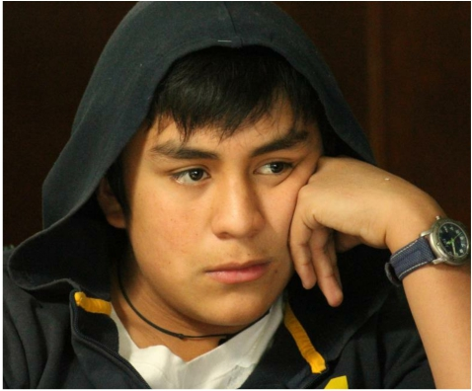
SCENARIO 1 – TOMMY, AGED 15
My dad says that I’m not allowed to play with Jake.Apparently he is a bad influence on me. He is allowed to do all the stuff I’m not – go up to the park with the ones from school, play Fortnite on the Xbox, go onto social media. I hate the way Dad is so strict.

Slide 18
SCENARIO 2 – KATE, AGED 16
I can’t wait to go out to town with my mates on Saturday night. I don’t know why Mum panics so much! She thinks there will be people with drugs there. She told me to think carefully about my behaviour when I’m out and to remember that I could come chat to her about anything like that.

Slide 19
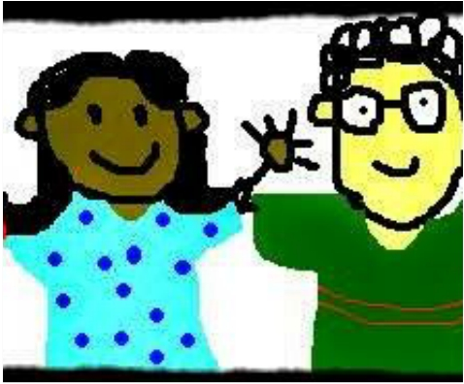
QUIZ
• Do you know your rights? https://childrenslawcentre.org.uk/y our-rights/

Slide 20
KNOW YOUR RIGHTS…
Our Government signed up to the United Nations Convention on the Rights of the Child (UNCRC) in 1990. Our Government have a duty under international law to make sure that the rights of all children and young people in NI are protected and to work towards making these rights a reality in our law.
Article 12 -
• The Right to express views
• The Right to have views given due weight
(taken seriously)
What does this mean in your everyday life? Think about: Space,Voice, Influence & Audience.

Slide 21
EVALUATION/ CHECK OUT

Slide 22
SESSION 2 – ESSENTIAL SKILLS
(COMMUNICATION)
LEARNING OUTCOMES
Understand the importance of effective communication
Be aware of skills necessary for effective communication
Improve ability to
communicate effectively
with both peers and adults

Slide 23
ESSENTIAL SKILLS (COMMUNICATION) -
OVERVIEW
Overview of
skills &
Baselining
What does
communication
look like?
Introduction
Icebreaker
Communication
skill in action! -
Games
Evaluation/
check out

Slide 24
IMPORTANT SKILLS TO MAXIMISE
ABILITY TO ACTIVELY PARTICIPATE
• Communication
• Teamwork & Negotiation
• Self-awareness
• Community/ societal awareness
• Advocacy
• Leadership

Slide 25
COMMUNICATION
SPEAKING, LISTENING, READING AND
WRITING ARE ALL VITAL SKILLS FOR
EXPRESSING OURSELVES AND
UNDERSTANDING OTHERS.
COMMUNICATION IS HOW WE
EXCHANGE INFORMATION WITH
OTHERS.

Slide 26
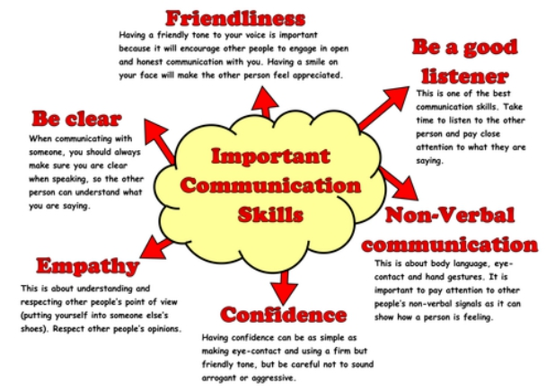

Slide 27
WE CAN
COMMUNICATE IN
LOTS OF DIFFERENT
WAYS…

Slide 28
COMMUNICATION SKILLS – IN ACTION
These next few activities will provide us with an opportunity to practise our communication skills,
make us more aware of
communication methods we are
using, and essentially improve
communication within the group!
We are always trying to improve
communication skills, even as
adults!

Slide 29
STAND UP FOR
FILLERS!
• You will each receive a topic that you will
speak about for 1-3 minutes.
• During your speaking time, the remainder of the group will stand when they hear any ‘fillers’ words occur in the speech e.g., like, um, uh, so, right…
• The purpose of this activity is to make you mindful of vocabulary you are using but also to say – silence is OK!

Slide 30
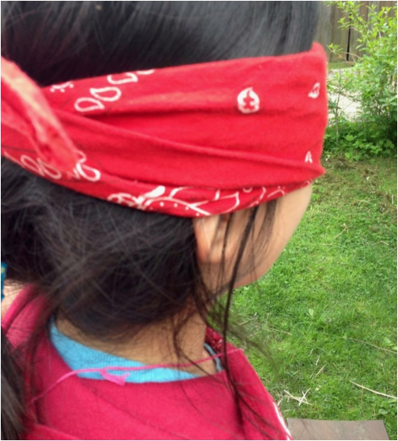
BLINDFOLD LEADS
• You will work in pairs. One person in each pair will be
blindfolded.
• The sighted person must help their blindfolded partner
across a clear area.
• Some obstacles might be introduced into this ‘clear’
area as the activity progresses – so be mindful!
• The sighted person can lead with physical contact at first e.g., guiding by the arm, but must stop any physical contact when the leader says so!
• The sighted person must support the blindfolded
person and ensure they are safe.
• Swap roles once you are finished!

Slide 31
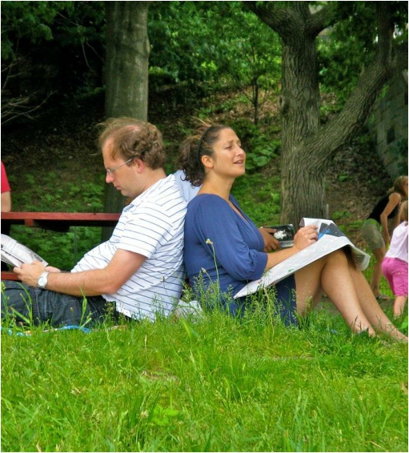
BACK TO BACK
DRAWING
• Get into pairs and sit back-to-back with your partner
• One of you will be the listener
• One of you will be the speaker
• The speaker will be provided an image and must
describe the image in detail
• The listener will attempt to recreate the image on a
blank piece of paper, based upon the instructions
• Neither partner can see the others’ paper, and the
listener may NOT communicate with the speaker

Slide 32
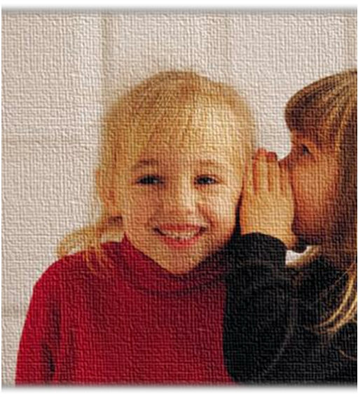
TELEPHONE
• Everyone sit in a circle!
• One person will be chosen to say a message into the ear of
the person sitting next to them.
• That person then relays that message onto the next person,
and so on.
• You are only allowed to say the message once and must say
it quietly so as only the person sitting next to you can hear.
• Once the message gets back to the originator (the person who said it first), you will be asked to call out what was said to you.
• Is it different to the message you passed on at the
beginning?

Slide 33
EVALUATION/ CHECK OUT

Slide 34
SESSION 3 – ESSENTIAL SKILLS (TEAM WORK
AND NEGOTIATION)
LEARNING OUTCOMES
Understand the benefits
of working cooperatively
within a team
Improve ability to work
cooperatively within a
team
Improve negotiation skills

Slide 35
ESSENTIAL SKILLS (TEAM WORK AND
NEGOTIATION) - OVERVIEW
Brainstorm – What
is teamwork and
why is it important?
Teamwork skills in
action! - Games
Introduction
Icebreaker
Brainstorm – What
is negotiation and
why is it important?
Negotiation skills in
action! - Games
Evaluation/ check
out

Slide 36
TEAMWORK
Working with others to achieve a common goal or
complete a task
People within a group use their skills and qualities to
overcome each other’s weaknesses and achieve a
goal which was otherwise not possible

Slide 37
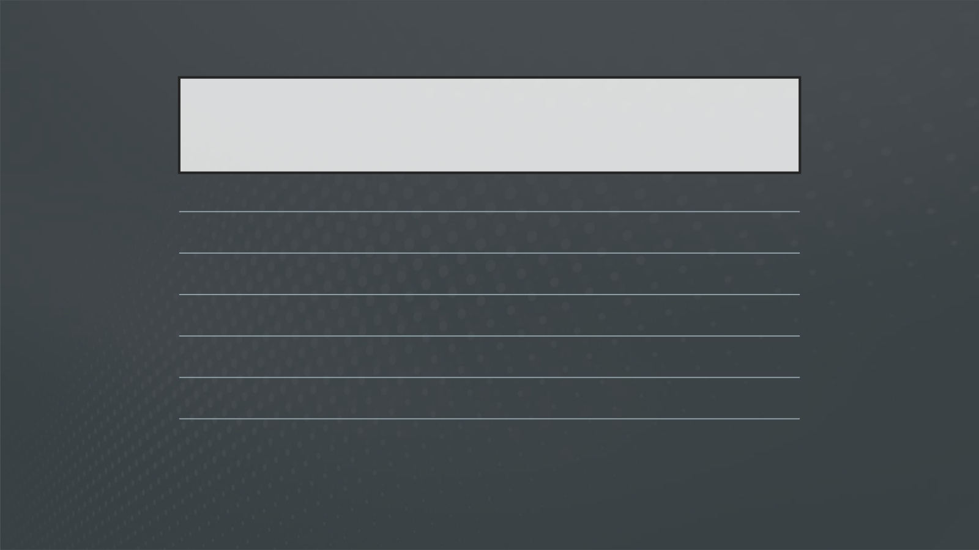
BENEFITS OF TEAMWORK
Builds relationships
Provides opportunities to learn from others Sharpens communication skills
Motivates
Enhances co-operation with others to achieve a common goal Develops leadership skills

Slide 38
TEAMWORK SKILLS IN ACTION!
Talking in Circles – Form the shape your leader calls out.Trickier than it sounds!
Minefield – Group members will take turns to guess the sequence by walking to the correct markers. If you take a wrong step, you must go to the back of the line.You are allowed to walk straight, back, forward or diagonally, but must not cross over more than one row. The winning team is the first to get all teammates successfully through the sequence with no wrong steps!
Magic Carpet - Flip over the mat so that you are standing on the other side of it. Do this without getting off the mat or touching the ground!

Slide 39
NEGOTIATION SKILLS
• Negotiation is a type of discussion used to reach agreements between two or
more people.
• It is about reaching a compromise where everyone involved is satisfied.

Slide 40
HOW TO IMPROVE NEGOTIATION SKILLS
Identify • Identify your goals
Consider • Consider the opinions of others
Understand • Understand strengths and weaknesses
Build • Build your confidence
Don’t • Don’t be afraid to make mistakes

Slide 41
NEGOTIATION SKILLS IN ACTION!
• The Barter Puzzle
• Your small group will be provided with a different jigsaw puzzle. The only
problem is, the puzzle pieces are mixed up with other groups’ jigsaws.
• Your team must come up with ways to get the pieces back through negotiation, trading, exchanging team members, etc. However, it should be a group decision and not individual choice.
• The team that is able to put all the pieces together in the least possible time is
the winner.

Slide 42
NEGOTIATION SKILLS IN
ACTION!
Drama activity
• Act out the scenario and come to an agreed
solution.

Slide 43
EVALUATION/ CHECK OUT

Slide 44
SESSION 4 – SELF AWARENESS
LEARNING OUTCOMES
Understand thoughts, emotions,
and values and how these impact
our behaviour
Understand the power of
relationships and how we impact
others and our environment
Understand factors which
influence our identity

Slide 45
SELF-AWARENESS - OVERVIEW
Introduce
yourself
activity
Introduction
Icebreaker
This or that?
Valuable
squares
Evaluation/
check out
Fill me up!

Slide 46
BRAINSTORM – WHO DO WE
SPEND THE MOST TIME WITH?

Slide 47
SELF-AWARENESS
Self-awareness is the ability to understand and recognize our emotions, what we care about and how we view ourselves. It is about observing our inner and external world i.e., what is happening inside of us – our thoughts, feelings and emotions, and the impact these have on others around us.
In pairs, introduce yourself using the four phrases:
I AM…
I LIKE…
I BELIEVE… I THINK…
Be as open and creative as you can!

Slide 48
EXPLORING OUR THOUGHTS,
EMOTIONS AND VALUES
• This or that – Pick which one you pick in the Would You Rather statements.Try to answer as honestly and as quickly as possible!
• Valuable Squares – You are provided with 16 squares each.You have to write something in each square, depending on it’s title e.g., in ‘favourite activity’ you might include ‘football’. Once complete, place your squares into four stacks – Activities, People, Goals, Possessions. Now you are ready to listen to the story ‘Once upon a time’ and make some difficult decisions!

Slide 49
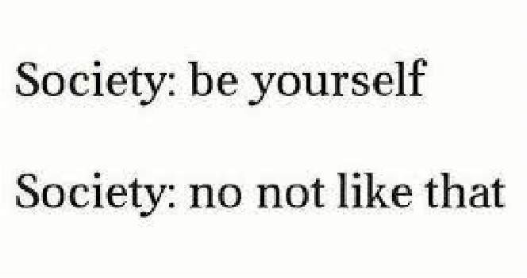
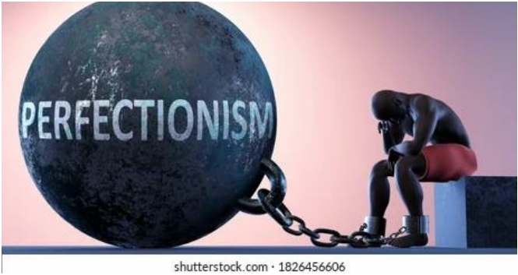
FILL ME UP!
Fill your gingerbread man with all the demands that, you feel, society places on you!

Slide 50
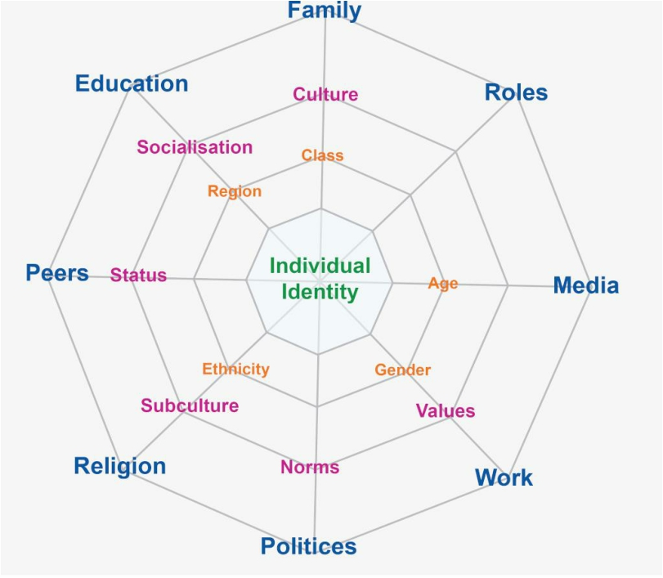
Who you are is influenced by lots of different factors
• Family
• Media/ Social media
• Youth workers
• Sports coaches
• Friends
• Religion
• School
• Grandparents
• Area where you live

Slide 51
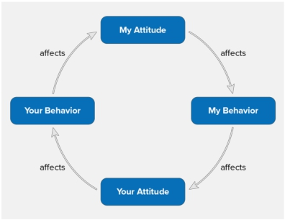
AND SO TOO…
Who we are as individuals massively impacts those around us. Take notice of yourself, but also others around you.

Slide 52
EVALUATION/ CHECK OUT

Slide 53
SESSION 5 – MY COMMUNITY
LEARNING OUTCOMES
Understand importance of
community
Be motivated and able to
maximize assets and opportunities
available in the community
Understand the connection
between individual and community

Slide 54
MY COMMUNITY - OVERVIEW
Community
Mapping
Group
reflection
Introduction
Icebreaker
Individual and
community
Evaluation/
check out

Slide 55
Before we begin, think about:
• The neighbourhood we want to focus on – what streets/ area will be visit
Look out for:
•
•
•
•
•
Resources in the area including places/ spaces/ buildings (libraries, shops, community halls, churches, youth clubs, schools, parks etc.)
People (community groups, diverse groups of people who make up the community, people with influence, skills or talents, sports teams etc.)
Opportunities to socialise
Opportunities to get to know others from different backgrounds
Places which are segregated and/or only used by a specific group of people
SESSION 4 –
COMMUNITY
MAPPING
• Significant memories/ symbols
• Places where you feel safe/ unsafe

Slide 56
IN YOUR GROUPS,
DISCUSS:
•
What are the positive things about living in your area? What makes you proud? Think about what resources/ amenities are available, influential people who live there, how well looked-after it is, how diverse it is as a population etc. Do we utilize these things?
•
What are some of the negative things about living in your area? Think about how these things make you feel. Do they make you feel unsafe? Do they affect your own personal well- being? Who is responsible for these negative issues?
• What further opportunities does your community present?

Slide 57
AS WE LEARNED IN LAST
WEEK’S SESSION…
The community we live in will have an impact on what we do, what we say, what we think, how we feel, what we believe in and who we will become.

Slide 58
EVALUATION/ CHECK OUT

Slide 59
SESSION 6 - ADVOCACY
LEARNING OUTCOMES
Understand what is meant by
the term advocacy
Increase knowledge and
awareness of influential people
who have an advocacy role
Increase own confidence and
ability to advocate

Slide 60
ADVOCACY - OVERVIEW
Influential
advocates –
Quiz!
What is
advocacy?
Introduction
Icebreaker
Advocacy in
action – Dragons Den
Power of
social media
Evaluation/
check out

Slide 61
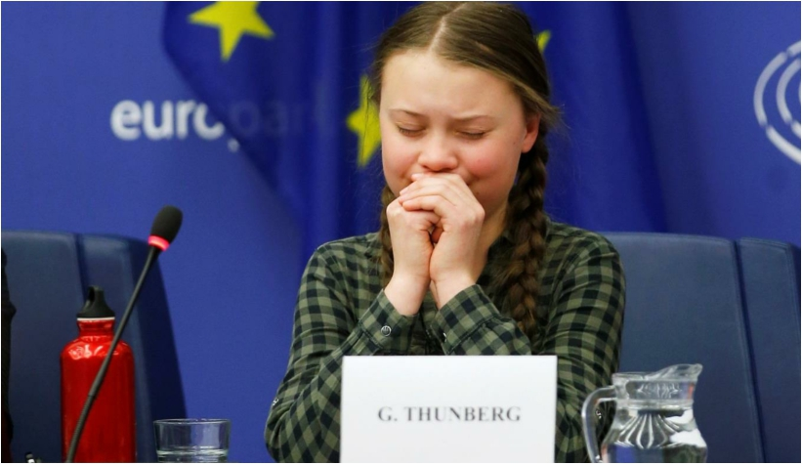
WHAT IS
ADVOCACY?
Advocacy is arguing or supporting an idea or a plan.
This can be self-advocacy (arguing or supporting
an idea/ plan on our own behalf) or it can be peer- advocacy (arguing or supporting an idea/ plan on behalf of others).
Advocacy is an important skill to have in order to support ourselves, and others, to achieve what we believe is right or needed.
To be a successful advocate we need to be able to: - Define the problem we are concerned about
- Research the issue and understand it in detail
- Remain assertive and firm when challenged by
others
- Be persistent (don’t give up!)

Slide 62
WHO CAN ADVOCATE ON
OUR BEHALF?
• Friends
• Family
• Teachers
• Youth workers
• Sports coaches
• Social workers
• Police
• Charities
• Councillors
• MLA’s
• MP’s
• Can you think of anymore?

Slide 63
Time to learn about people who will help us become better, and more influential, advocates!

Slide 64
1. AT WHAT AGE CAN PEOPLE VOTE IN
NI?
A.16
B. 17
C. 18
D.21

Slide 65
2. WHO WOULD YOU CONTACT IF YOUR BIN
WASN’T EMPTIED?
A.Local Council
B. The NI Assembly
C. Your local waste disposal unit D.Local community centre

Slide 66
3. WHAT DOES MLA STAND FOR?
A.Member of Local Area
B. Member of Local Authority
C. Member of Legislative Assembly D.Member of Legal Action

Slide 67
4. WHERE DO THE MLA’S MEET TO MAKE
LAWS?
A.Belfast City Hall
B. Enniskillen Castle
C. Newry Cathedral
D.Parliament Buildings (Stormont)

Slide 68
5. HOW MANY MLA’S ARE THERE IN NI?
A.18
B. 30
C. 90
D.230
Hint: There are 5 MLAs for every area – do you know your local MLA’s?

Slide 69
6. HOW MANY LOCAL COUNCILS ARE
THERE?
A. 11
B. 21
C. 31
D. 50
Extra point if you can name which Council area you live in!

Slide 70
7. WHICH STATEMENT IS NOT TRUE?
HOW DOES OUR GOVERNMENT AFFECT THE
FOOD YOU EAT?
A. Controls the “sell by” and “best before” dating
system
B. Tells restaurants what prices they must sell their
food for
C. Sets hygiene standards for food and takeaways
D. Determines which artificial additives can and
can’t be used in foods

Slide 71
8. WHICH STATEMENT IS NOT TRUE?
HOW DOES OUR GOVERNMENT AFFECT YOUR
MUSIC?
A.Says you cannot play music on a school night
B. Says whether it is legal to download music
from the internet
C. Limits how loudly music is played in public
places
D.Licenses music festivals

Slide 72
9. WHICH STATEMENT IS NOT TRUE?
HOW DOES OUR GOVERNMENT AFFECT YOUR
SPORT?
A.Says how much Lottery money will be spent
on sport
B. Decides what local sports facilities you get
C. Says you cannot play sport on a Sunday D.Decides which sports are supported

Slide 73
10. WHICH STATEMENT IS NOT TRUE?
HOW DOES OUR GOVERNMENT AFFECT HOW
YOU GET ABOUT?
A.Sets speed limits
B. Sets the level of tax on petrol
C. Decides which roads should have bus or cycle
lanes
D.Decides how far you can walk

Slide 74
WHAT DOES A MEMBER OF THE
LEGISLATIVE ASSEMBLY (MLA) DO?
MLAs have a number of important jobs to do while in office:
• They must engage in discussions and work with other political parties to make decisions about Northern Ireland;
• They have to represent their constituents (the people who elected them);
• They need to listen to their constituents and make decisions;
• They will make laws which will protect people, promote equality and enrich diversity;
• They promote human rights;
• They promote community relations in Northern Ireland.

Slide 75
ADVOCACY IN ACTION – DRAGON’S
DEN
• Dragons – You must pick one group/ one product to invest in. Listen to each
three minute pitch and ask questions after if you need more information.
• Pitchers – You have 10-15 minutes to design your product and do some background research.You will then have three minutes to pitch your product to the dragons.You must be prepared for questions after.
• Will the best product win? Or the best pitchers win?

Slide 76
HAVE YOU HEARD OF THESE
ONLINE CAMPAIGNS?
Always #LikeAGirl Campaign
Always (the feminine hygiene product brand) launched the #LikeAGirl campaign with a video that challenged female stereotypes with the purpose of empowering young girls.The film showcased how the phrase “like a girl” has come to have a negative or weak connotation.They showed confident young girls redefining the phrase into a meaningful and powerful statement instead of an insult.
Why It Worked: The video encouraged viewers to participate in what it meant to do things like a girl. Social media was flooded with anecdotes, personal achievements, and encouragement to adolescent girls.
The video has amassed over 66 million views on YouTube!
By facilitating such a strong emotional connection with a large base of their consumers and beyond,Always created a viral hashtag that inspired everyone to lift up young women.

Slide 77
LONELY WHALE
FOUNDATION
#STOPSUCKING CAMPAIGN
The Lonely Whale Foundation launched a social media campaign challenging people to #StopSucking and cease their use of single-use plastic straws. Straws are one of the biggest polluters of oceans and other waterways.
After this campaign launched, it quickly became viral thanks to celebrity support.
Plastic straws are now largely illegal in the UK!

Slide 78
CAROLINE FLACK
#BEKIND
Caroline Flack’s death prompted the rise of the #BeKind hashtag, initially launched by Lucy Alexander in 2017 after her son took his life following years of being bullied.The tabloids quickly deleted recent online articles that had, only weeks or days before, shamed and berated her, and in their place called for kindness.
The hashtag is still widely used today to remind people that comments hurt, and we should be kind!

Slide 79
POWER OF SOCIAL MEDIA
• Social media is a powerful way to influence others.
• Messages/ pictures/ videos are instant and can reach
people from all over the world.
Brainstorm?
What made these social media campaigns successful?
Is there more good than bad on social media? How can we use social media to our advantage?

Slide 80
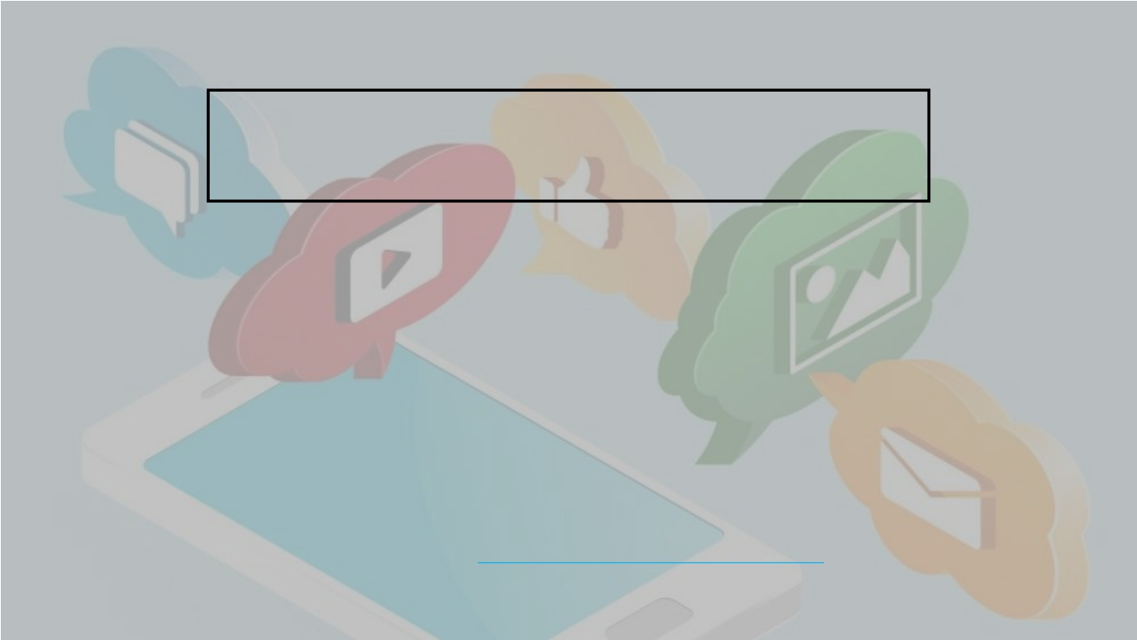
TIPS FOR ADVOCATING ONLINE
• You must believe in your message and convey this to your friends/
followers
• A picture speaks a thousand words – this can help your campaign!
• Make your post public and shareable
• Share across all available social media platforms – staying consistent
with your message
• Create a catchy #hashtag to share with your post and ask friends/
followers to use it
• Ask people of influence to share and spread your positive message
Remember, keeping yourself safe online is priority! For some online safety tips visit the CEOP website https://www.thinkuknow.co.uk/11_18/ , or ask a trusted adult for advice and support!

Slide 81
EVALUATION/ CHECK OUT

Slide 82
SESSION 7 – LEADERSHIP & SKILLS
ASSESSMENT
LEARNING OUTCOMES
Understand skills and qualities
required for effective
leadership
Be able to identify personal
strengths and areas for
improvement
Be able to identify
opportunities and threats to
participation

Slide 83
LEADERSHIP & SKILLS ASSESSMENT -
OVERVIEW
Introduction
to leadership
Introduction
Icebreaker
What makes a good leader?
Individual SWOT analysis
Evaluation/
check out

Slide 84
IMPORTANT SKILLS WE HAVE LEARNED
THROUGHOUT THE PROGRAMME
• Communication
• Teamwork & Negotiation
• Self-awareness
• Community/ societal awareness
• Advocacy
These are all very important skills to have in order to be a good leader!

Slide 85
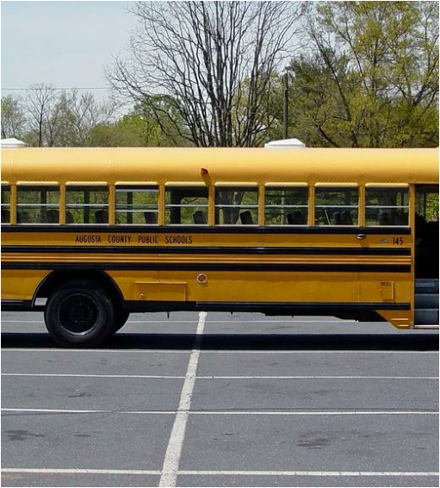
DID YOU MAKE THE
BUS?
Reflect on all the activities/ tasks to date:
Those who felt like they lead the group - sit at the front of the bus, driving
Those that supported the leaders – sit in the front seats
Those that felt they let others do all the talking/ thinking – sit in the back seats
Those that felt they motivated the group/ kept the group going – you are the engine underneath the bus (lie on the ground for this one)
Those that felt they didn’t contribute at all or didn’t make any effort - you missed the bus altogether (stand away from the bus)!

Slide 86
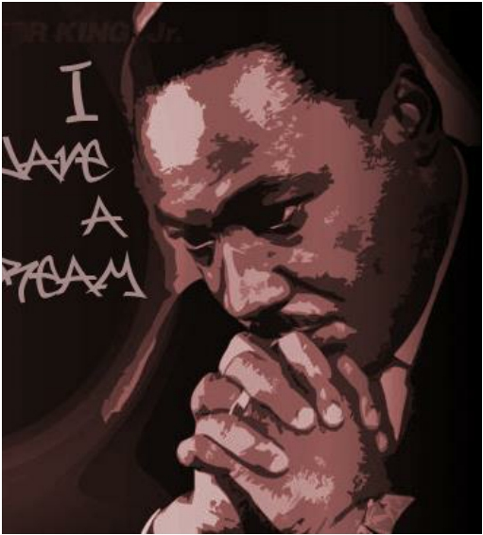
WHAT MAKES A GOOD LEADER?
• Think about someone you admire who is in a leadership position.This can be someone you know or a celebrity/ well known figure.
• What skills and qualities does this person
have that makes them a good leader?
• Label the top 5 skills and qualities that you
admire!

Slide 87
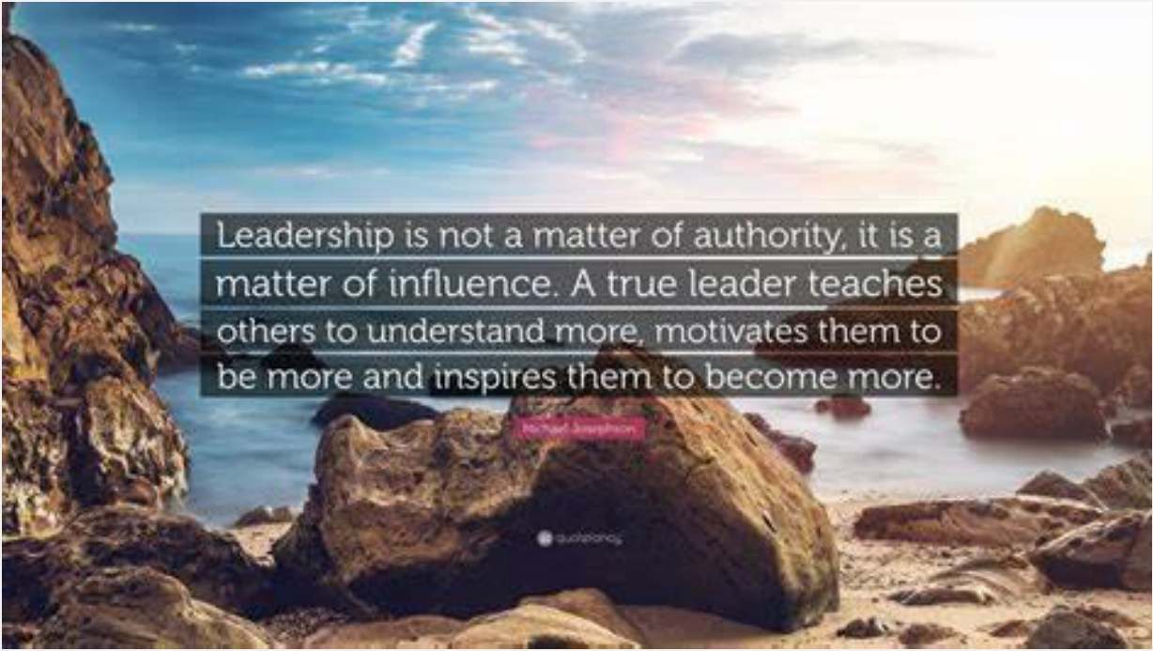

Slide 88
LEADERSHIP STYLES
Leadership style is a leader’s approach to providing direction, implementing plans, and motivating people.
There are three main types of leadership:
Authoritarian/ Autocratic - A leader who adopts the authoritarian style dictates policy and procedure, and directs the work done by the group without looking for any meaningful input from them.The group led by an authoritarian would be expected to complete their tasks under close supervision.
Participative/ Democratic - Group members feel part of the decision making process when they have a participative leader. Those leaders practicing the participative leadership style
offer guidance to the group, ask for their input in decision making but retain final say. Participative leaders make their group feel like they’re part of a team, which creates commitment within the group.
Delegative/ Laissez-Faire - Leaders practicing the delegative leadership style are very hands-off.They offer little or no guidance to their group and leave decision making up to the group.A delegative leader will provide the necessary tools and resources to complete a project and will take
responsibility for the group’s decisions and actions, but power is basically handed over to the group.

Slide 89
WHO ARE YOU?
POSITIVE GROUP ROLES
• Group building and maintenance roles
• Group building roles are roles that help build a group-centred identity for the members; whereas maintenance roles are roles that help keep that group-centred identity over the lifecycle of the group or team.
Encourager Praises, encourages and welcomes new ideas/ suggestions | Harmonizer Helps solve conflicts within the group | Compromiser Compromises his/ her ideas to help groups make better decisions | Gatekeeper Ensures everyone in the group is freely and openly involved
Standard setter The ‘ego’ of the group – ensuring they meet a certain quality level | Observer/ Commentator Looks on to make sure everyone is contributing, and things are going well | Follower Acts as an audience in discussions/ decision making

Slide 90
WHO ARE YOU?
NEGATIVE GROUP ROLES
Self-centred roles
Self-centred roles are roles that individual group members embody that focus on the individual desires of group members and not necessarily what is best for the group or its decisions.
Aggressor Takes everyone else down to make them look good | Blocker Hates everything the group is doing and rejects all decisions | Recognition-seeker Always looking attention and showcasing his/ her talents | Self-confessor Tells you his/ her whole life story. An open book!
Cynic Joker of the group. Couldn’t care less about group or goals | Dominator Sees their ideas as superior and tries to control other members | Help-seeker Wants team member to care for him/ her | Special Interest Pleader Always looking to talk about something else important to them

Slide 91
SWOT
Strengths
Weaknesses
Opportunities
Threats

Slide 92
EVALUATION/ CHECK OUT

Slide 93
SESSION 8 – SOCIAL ACTION
LEARNING OUTCOMES
Understand benefits of social
action to the individual
Understand benefits of social
action to the community
Understand the four key steps
to undertake social action

Slide 94
SOCIAL ACTION - OVERVIEW
Introduction
to social
action
What’s in it
for me?
Introduction
Icebreaker
What’s in it
for the community?
Exploring the
four action
steps
Evaluation/
check out
Ideation stage

Slide 95
• Social action can be defined as ‘practical action in the service of
others’.
• Social action is doing something for the benefit of other people or
the environment that we live in.
• It empowers young people to influence others/ decisions and
encourages them to contribute and participate in the community.
• It shares the same values as volunteering.
• Social action can be awareness raising or taking direct action.
SOCIAL ACTION – WHAT IS IT?

Slide 96
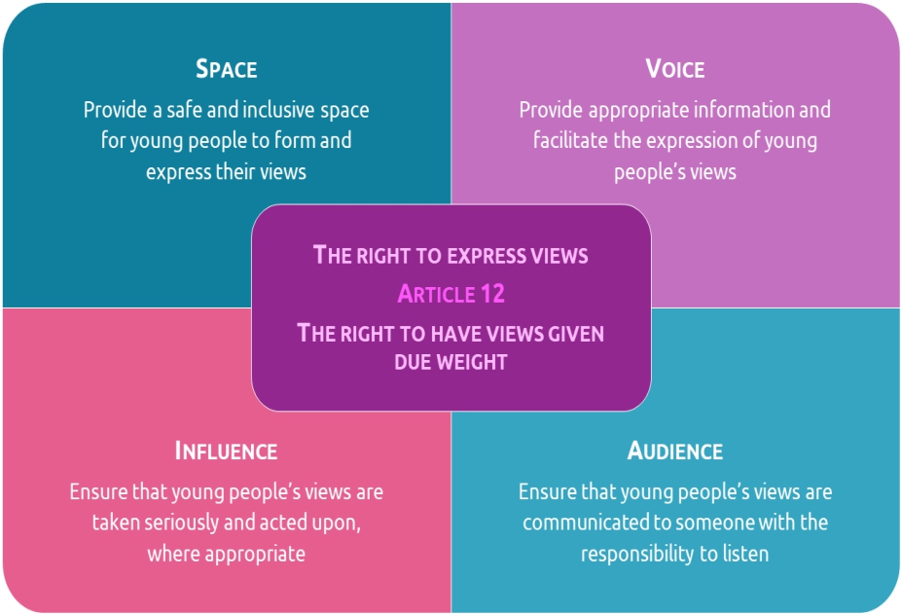
YOUTH SOCIAL
ACTION IS AN
EFFECTIVE WAY
TO ENSURE
MAXIMUM
PARTICIPATION.

Slide 97
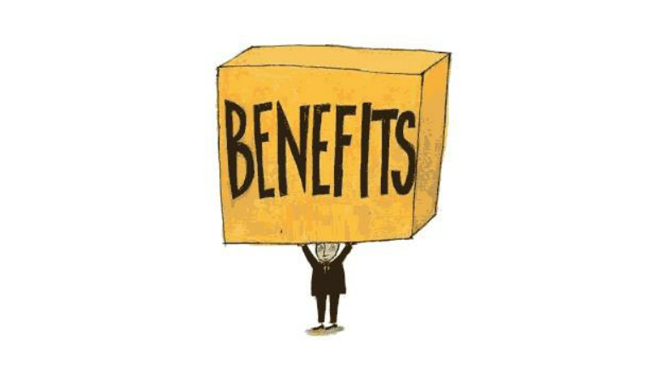
WHAT’S IN IT
FOR ME?
Think about the last
time you did something nice/ went above and beyond for
someone else.
Why did you do it?
How did it make you
feel?

Slide 98
WHAT’S IN IT FOR OTHERS?
How it make the other person/ people feel?

Slide 99
SOCIAL ACTION -
WHAT’S IN IT FOR YOU?
➢ Learn new skills
➢ Increase confidence
➢ Improve emotional wellbeing
➢ Use your skills for others
➢ Make a difference and influence things that matter to you
➢ Meet new people
➢ Do good for others
➢ Give you a sense of purpose
➢ Give you a sense of satisfaction
➢ Use your time better
➢ Help your career/ future job opportunities

Slide 100
SOCIAL ACTION – WHAT’S IN
IT FOR OTHERS?
➢ Giving up your time is important – sometimes there is not
enough money or enough compassion for someone else to do something!
➢ You can bring different knowledge and different skills to the community
➢ You can spread a positive message and really help make a difference to the lives of others or the environment in which you live

Slide 101
FOUR KEY SOCIAL
ACTION STEPS
• Explore
• Organise
• Act
• Review

Slide 102
1. EXPLORE
• Think about issue/s you would like to focus on
• Identify the most important issue to your group
• Research the issue – some background information on who,
what, where, when and why
• Identify what change you would like to see from the social
action project
It is important at this stage you identify what your successful project/ campaign will look like.This will help you evaluate your project at the end – Did you achieve what you set out to achieve?

Slide 103
2. ORGANISE
• Make clear goals to make the change you want to
see
• Know what actions you will need to take to achieve
these goals
• Create an action plan (What needs to be done,Who is doing it,When will it be completed by, What resources are needed,Who else can support/ help, What will this action achieve)
• Gather some contact information for others who
may be able to support/ help

Slide 104
3. ACT
RE-ITERATE CLEAR MESSAGE
ON WHAT YOU ARE
LOOKING TO ACHIEVE
CARRY OUT THE ACTION
PLAN
GET STARTED!

Slide 105
4. REVIEW
• What have you learned?
• What challenges did you face?
• What could you do differently next time?
• Did you achieve what you set out to achieve?
• Celebrate and gain recognition for your hard work!

Slide 106
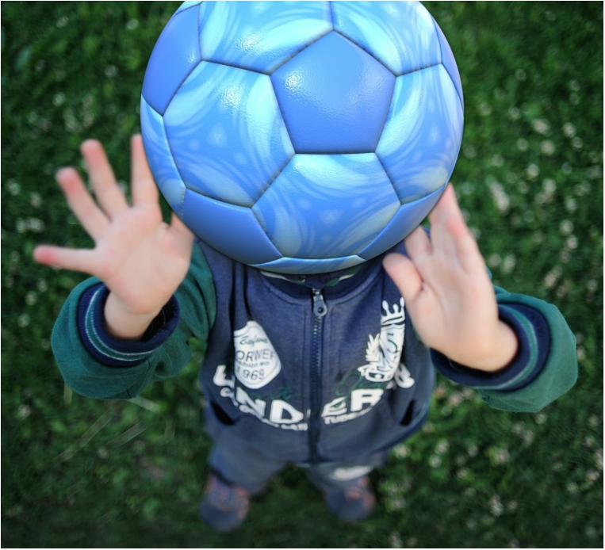
IDEATION
ENERGISER

Slide 107
STAGE 1 - EXPLORE

Slide 108
EVALUATION/ CHECK OUT

Slide 109
SESSION 9 – SOCIAL ACTION – IN ACTION
LEARNING OUTCOMES
Gain knowledge and skills to create an action plan including tasks, roles,
timeframes, resources, and outcomes
Understand importance of creating
SMART objectives
Be able to work co-operatively
within a group to complete social
action activity

Slide 110
SOCIAL ACTION - IN ACTION -
OVERVIEW
Overview of
four key steps
Introduction
Icebreaker
SMART goals
Action planning – HOW change
happens
Barriers we
may face
Who can help
and support
Evaluation/
check out

Slide 111
FOUR KEY SOCIAL
ACTION STEPS
Can you remember?
• Explore
• Organise
• Act
• Review

Slide 112
WE ARE NOW ON STAGE 2 - ORGANISE
• Make clear goals to make the change you want to
see
• Know what actions you will need to take to achieve
these goals
• Create an action plan (What needs to be done,Who is doing it,When will it be completed by, What resources are needed,Who else can support/ help, What will this action achieve)
• Gather some contact information for others who
may be able to support/ help

Slide 113
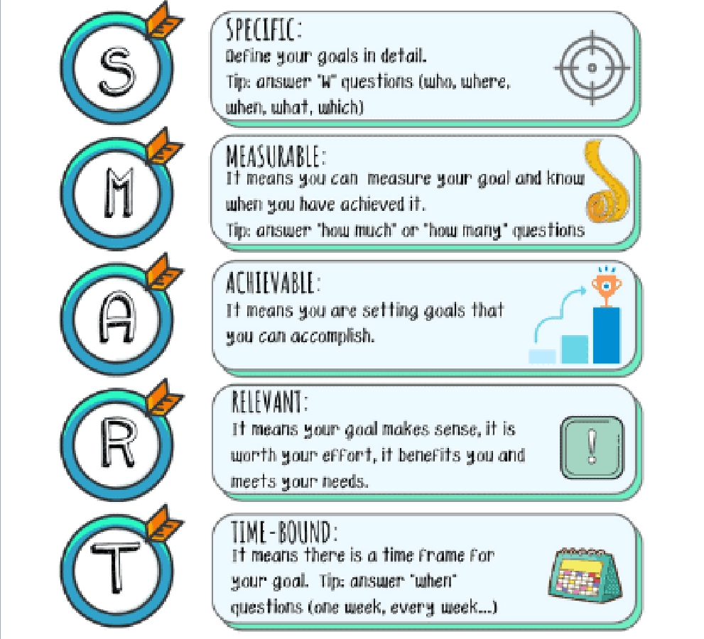
SMART
GOALS

Slide 114
ACTION PLANNING

Slide 115
Be sure to take some pictures or videos of you and your group carrying out your social action activity (just make sure to get permission first!).
You can generate some more support/ promotion for your project through things like:
• Social media posts
• Contacting the local newspaper
• Asking your local school/ community centre to
highlight your work
• Contacting local councillors or other people of
influence in the community
SHOW THE WORLD WHAT
YOU ARE DOING!

Slide 116
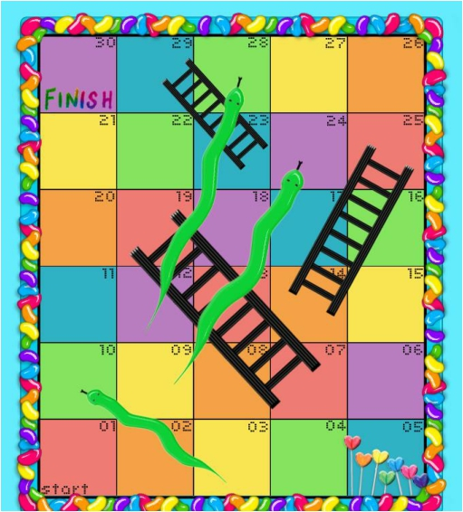
POTENTIAL
CHALLENGES
• It is important that you think about any potential challenges you might face/ any obstacles you might encounter along the way.
• If we plan for challenges, we are better
prepared to deal with them.
• After you complete the challenges worksheet, you might need to re-visit your action plan!

Slide 117
STAGE 3 – ACT!
• You are now ready, and organized, to put your
plan into action!
• In your groups remember to:
• - Support each other
• - Listen to one another
• - Use your knowledge and skills to help make
the project a success
• - Seek support and help when you need it!

Slide 118
EVALUATION/ CHECK OUT

Slide 119
SESSION 10 – LOOKING BACK, PLANNING
AHEAD
LEARNING OUTCOMES
Understand the importance of
monitoring and measuring
success
Understand how to measure
success
Understand the importance of reflecting on own success and
abilities.

Slide 120
SOCIAL ACTION - IN ACTION -
OVERVIEW
How did we
do?
Promoting
our work
Introduction
Icebreaker
Overall
project
evaluation
Planning
ahead
End baselines
How did I do?

Slide 121
YOU MADE IT TO STEP 4!
TIME TO REFLECT…
• On a flipchart page, work with your group and
answer the following questions:
• What have you learned?
• What challenges did you face?
• What could you do differently next time?
• Did you achieve what you set out to achieve? Tell us
what this was!

Slide 122
Celebrate
Write/
Video
Think
about
Celebrate and gain recognition for your hard work!
Write a short blurb or make a short video on what your project achieved.
Think about what you gained from the project (Any new skills? Did you learn anything? Did it make you look at things differently?)
SHOWCASE
YOUR SUCCESS!
Think
about
Think about what your project did for others/ what it achieved (Who benefitted? How did they benefit from it?)

Slide 123
HOW DID YOU DO?
Reflect on your contribution throughout the programme and social action activity. Draw around your hand and fill in the following:
• Palm – Name
• Thumb – Personal quality they have
• Index finger – Skill
• Middle finger – Something they would like to be better
at
• Ring finger – Something they are passionate about
• Little finger – Describe themselves in one word!

Slide 124
PLANNING AHEAD
PARTICIPATION IS FOR LIFE!
Write your ideas on how we can maximise participation within the club.

Slide 125
OVERALL EVALUATION

