Slide 1
Accredited Youth Work Programmes Living in Safety & Stability 9-13 years

Slide 2
Session One – Introduction to Living in Safety & Stability
What is Safety and Stability
Group game/ icebreaker
Contract
Hopes and fears for the programme
What influences our Safety and Stability?
Quiz!
Check Out

Slide 3
What is an accredited programme?
Set of workshops and activities/ games which are used to help young people learn about a particular topic
Lots of young people do the same programme across NI
Opportunity for young people to show their youth leader and others what they have learned and achieved
Opportunity for young people to get a reward for their hard work e.g., certificates

Slide 4
Our topic: Living in Safety and Stability
Sessions
10
Time and date
Activities
Small and large group discussions, team building games and activities, games and activities around safety and stability
Learning
You will learn more about how to stay safe, make better decisions, cope with difficult situations and achieve your full potential!

Slide 5
What do we mean by Living in Safety and Stability?

Slide 6
Living in Safety is…
When you are safe from harm in your social and physical environment
Living in Stability is…
Healthy relationships and environments that are predictable and consistent, in which all your needs are met

Slide 7
Helps to keep us all feeling safe and comfortable with one another!

Slide 8
Hopes and Fears for the programme!

Slide 9
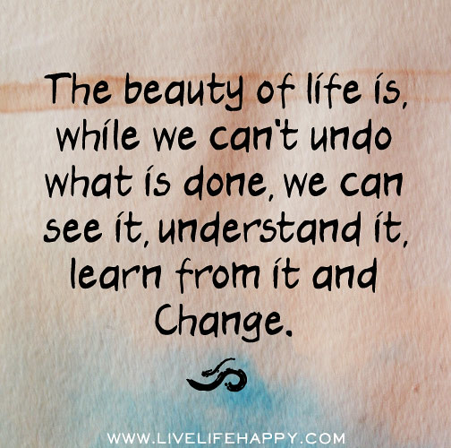
What impacts our safety and stability?

Slide 10
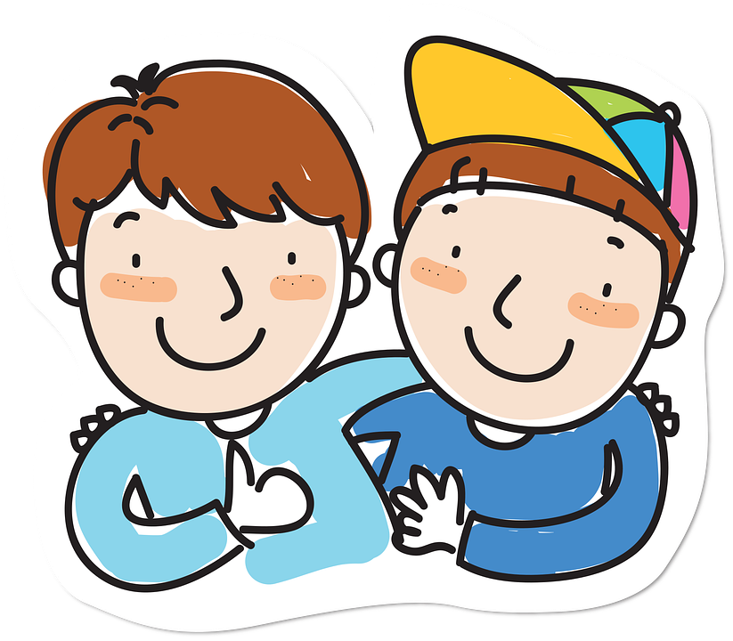
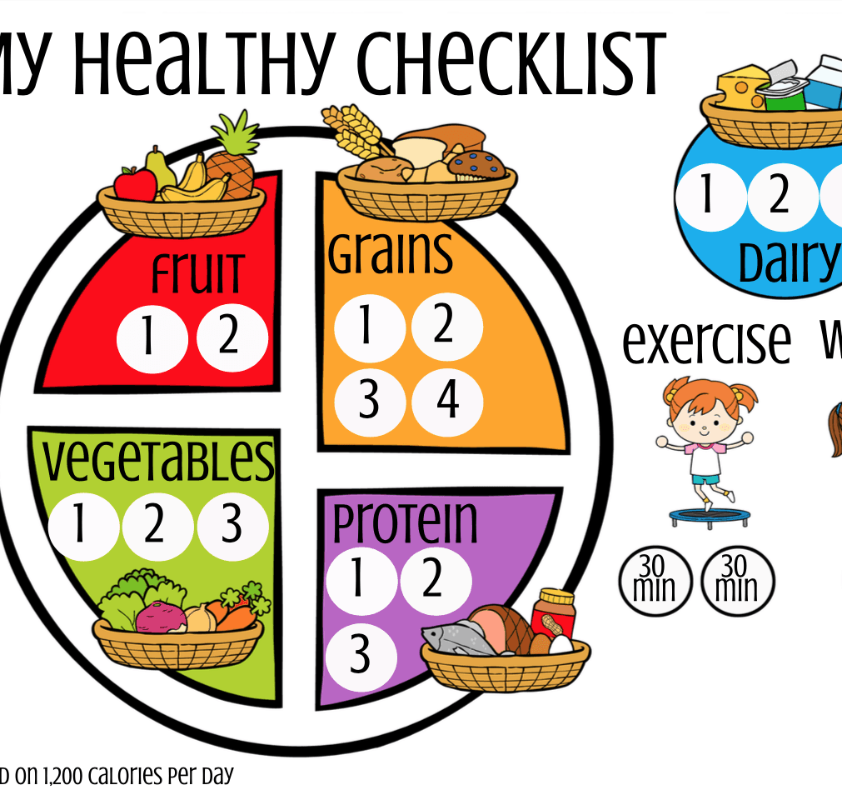
True/ false Quiz!

Slide 11
Check Out

Slide 12
Session two – Staying safe online
Check in
Group game/ icebreaker
Our online habits
Online risks
Friend or frenemy? - Game
The power of online
Check Out

Slide 13
Staying safe online

Slide 14
Screen time…How much is too much?

Slide 15
Scenarios Work with your group to discuss and answer the questions.

Slide 16
Online Risks 4 C’s
Content – Violent, hateful, inappropriate behaviour
Contact – Being bullied, meeting strangers
Conduct – Bullying someone, creating or uploading inappropriate behaviour
Commercial – advertising or marketing scams, hidden costs

Slide 17
It’s important to identify what’s real and what’s not.
Social media can give you the impression that everyone else has a beautiful body and perfect life.
People’s lives are often edited and filtered on social media.
There are lots of fake profiles on social networks.
It can be difficult to tell the difference between someone who’s genuine and a fake.

Slide 18
People only put out there what they want you to know…

Slide 19
OK to share?

Slide 20
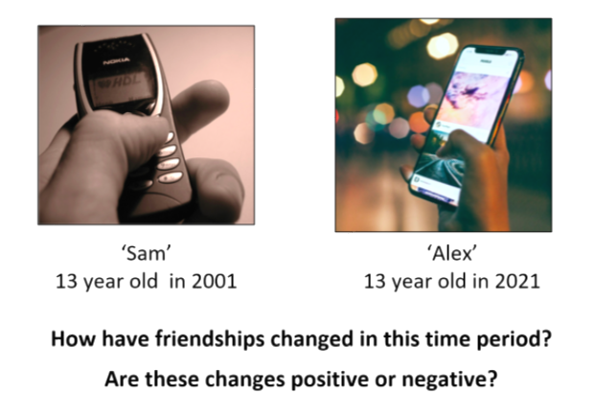
Friendships in a digital world

Slide 21
Good or Bad Friend?

Slide 22
Game of Chase

Slide 23
Online vs Face-to-face
It's well known that people say and do things online that they wouldn't say or do in the face-to-face world.
They loosen up, feel less self-conscious, express themselves more openly.
It's a double-edged sword.
Sometimes people share very personal things about themselves.
Sometimes people show anger, hatred, even threats.

Slide 24
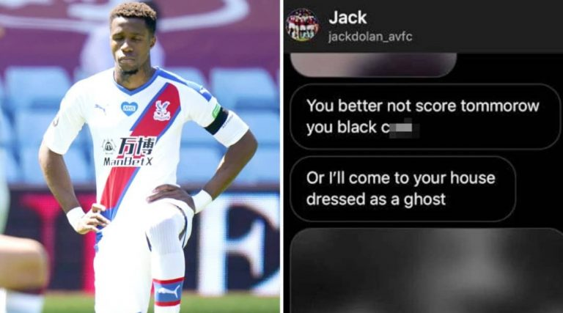
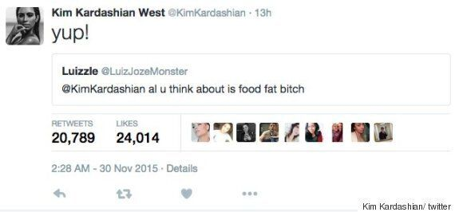
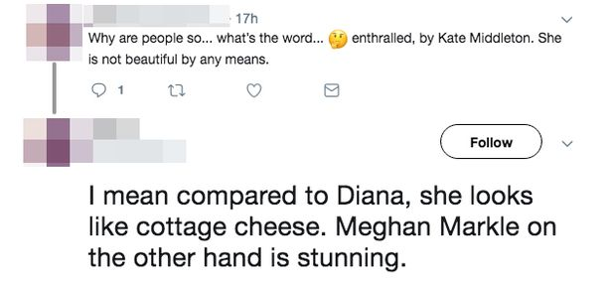
Notes:
These are some examples of a lack of respect in society. The media and internet trolls are partly to blame for the death of Caroline Flack. Footballers have been subject to racist abuse both online and in the stadium.

Slide 25
Why?

Slide 26
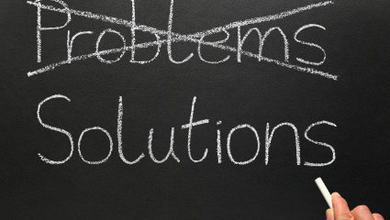
Online Tips
If you feel uncomfortable – UNFOLLOW, BLOCK OR REPORT.
Always get consent before posting a photo or video of someone else.
Privacy settings can stop other people from seeing your posts.
Be careful when sharing information about yourself
Always choose a username that does not reveal any personal information
Don’t click on a link from someone you don’t know
And in all online conversations:
Take time to notice how you feel or what you need, before you respond
Clarify what was meant
Use ‘I’ statements when sharing YOUR thoughts and feelings
Place yourself in other person’s shoes
Use emojis to express tone when using text
Choose whether or not you want to rePLY to online conflict or uncomfortable situations
Ask for support if needed

Slide 27
In a world where you can be anything #bekind
Notes:
This slide demonstrates campaigns initiated to encourage respect in society. Have you came across any of these?

Slide 28
Check Out

Slide 29
Session Three
Staying Safe in the Community - QUIZ

Slide 30
Rules
NO CHEATING
Anyone caught using a phone forfeits 40 points
The answer on the quizmaster's answer sheet is the right answer - even if it is wrong!
Team size: Up to four
Questions: 30 and 3 Challenges

Slide 31
Round one - Road safety

Slide 32
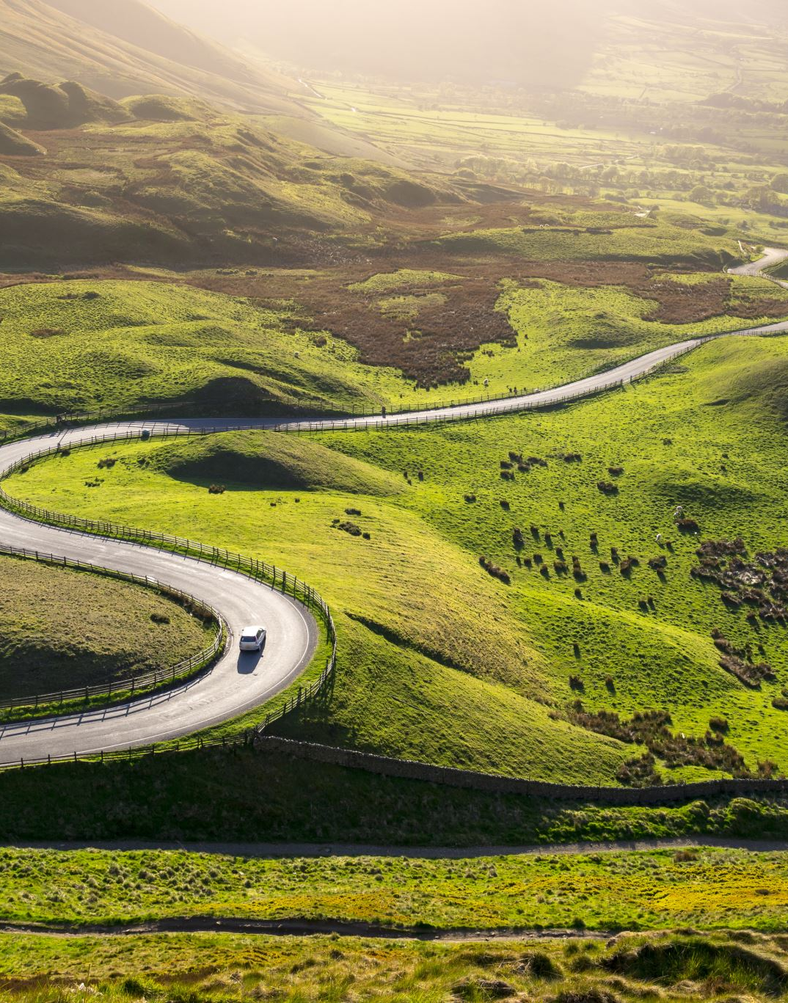
Road safety
Question One
Which is the safest place to cross a road?
On a bend
Behind a parked car
On the brow of a hill
On a straight clear road.
Notes:
The correct answer is On a straight clear road
You should be able to see traffic coming on both sides of the road in plenty of time to cross

Slide 33
Road safety
Question Two
Before you cross the road you should ....... ?
Stop Listen and Run
Stop, Look and Listen
Stop, Look and Talk
Keep walking while looking and talking
Notes:
The correct answer is stop, look and listen
Listen for cars, motorbikes and bicycles

Slide 34
Road safety
Question Three
What should you always wear when cycling?
Trainers
Shorts
Baseball Hat
Helmet
Notes:
The correct answer is D - Helmet. This protects your head

Slide 35
Road safety
Question Four
When riding in a car what must you always do?
Have a travel sickness tablet
Fasten your seat belt
Listen to the radio
Look out of the window
Notes:
The correct answer is Fasten your seat belt
It is against the law not to wear your seat belt

Slide 36
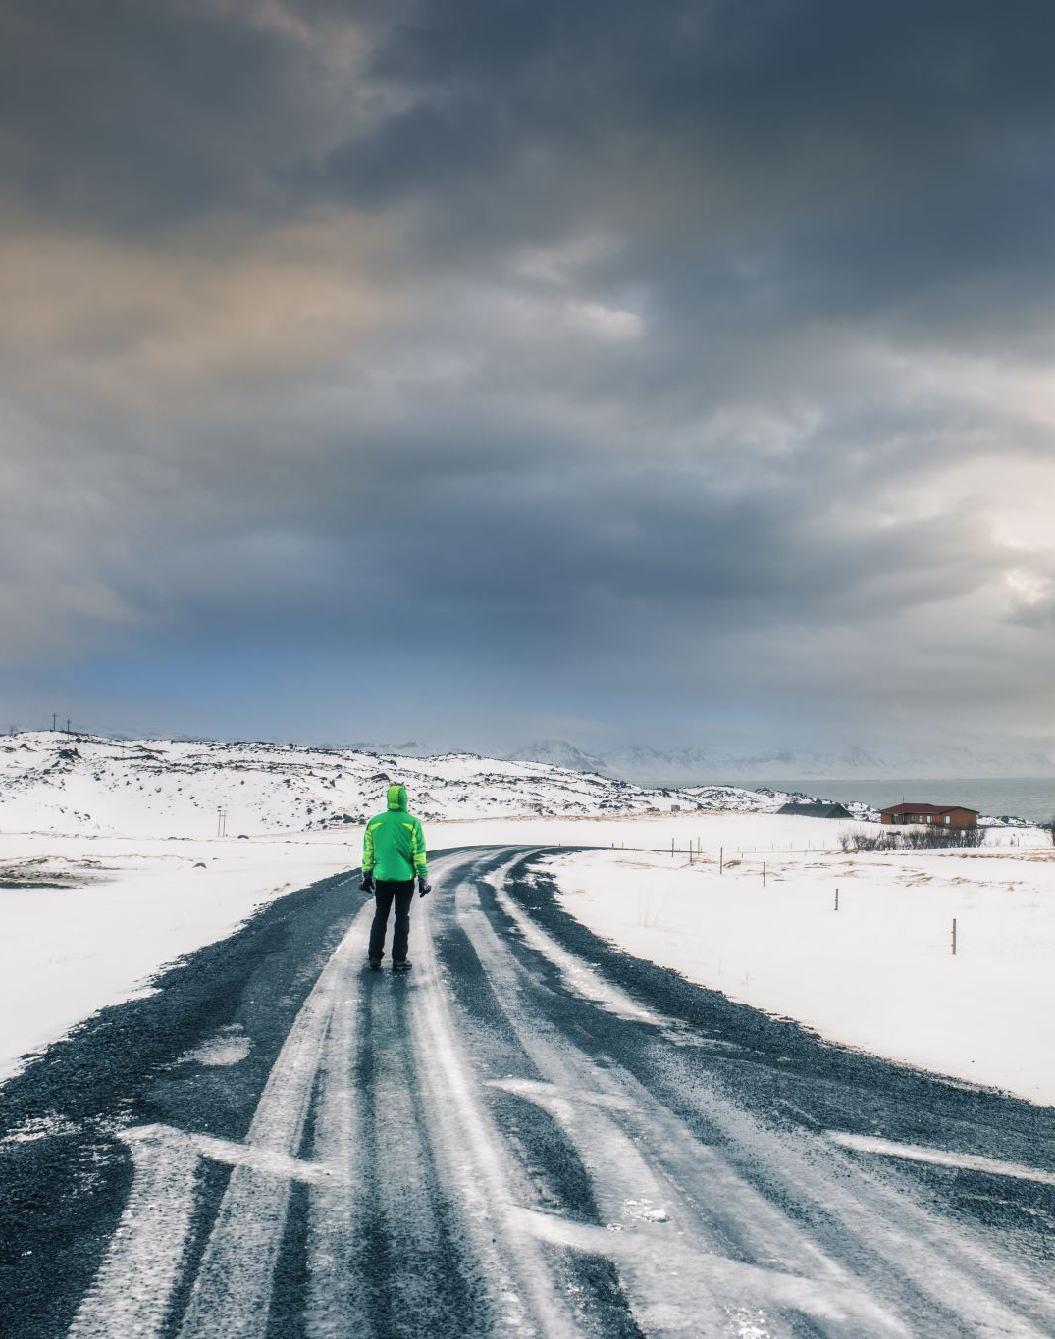
Road safety
Question Five
When out at night what should you wear to be seen by traffic?
Reflective Clothing
Dark Clothes
The latest trend
A warm coat
Notes:
The correct answer is A – Reflective Clothing
This could save your life

Slide 37
Road safety
Question Six
When is it safe to cross at a zebra crossing?
When the traffic on both sides has slowed down
When the traffic on one side has stopped
When the traffic on both sides has stopped
When the traffic on one side has slowed down
Notes:
The correct answer is When the traffic on both sides has stopped
Sometimes drivers are distracted and may not stop

Slide 38
Road safety
Question Seven
Which side should you get out of a car?
The road side
At the front
The pavement side
A the back
Notes:
The correct answer is The pavement side
It's much safer

Slide 39
Road safety
Question Eight
What must you do while crossing the road?
Keep looking and listening
Run
Talk to friends
Listen to music
Notes:
Correct Answer is A. Wait until you are safely on the other side before talking

Slide 40
Road safety
Question nine
At a pelican crossing what does a flashing green man mean?
Do not start to cross
Run
Start to cross
Go back to the pavement
Notes:
Correct Answer is A- Do not start to cross.
If you have started to cross you should continue, if safe.

Slide 41
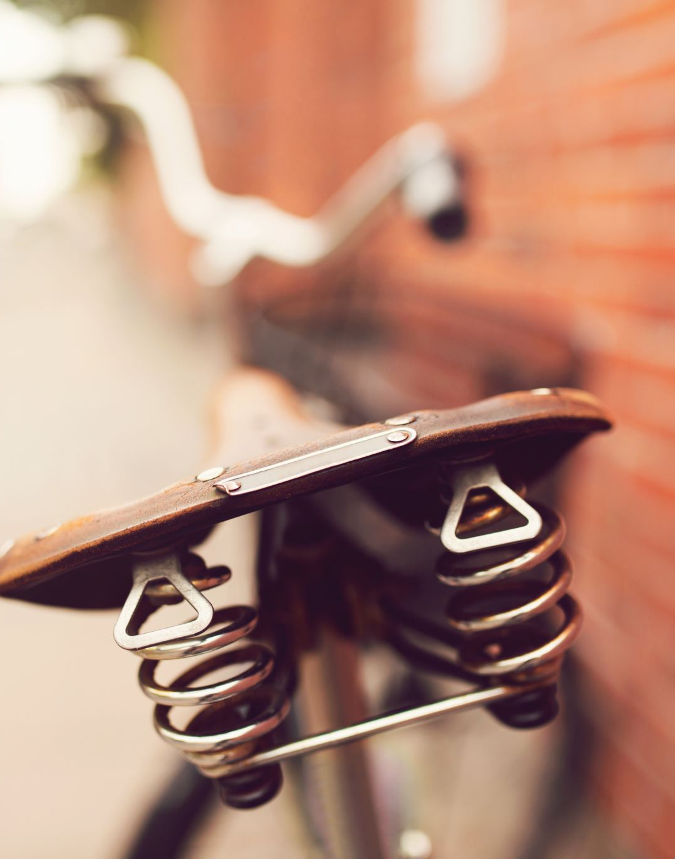
Road safety
Question Ten
While cycling when should you use a bell?
When you see your friend
To warn someone you are there
When you arrive home
To show off
Notes:
The correct answer is To warn someone you are there
If you are going round a corner and can't see ahead, this is a good time to ring your bell

Slide 42
Solve a puzzle 1st Place: 20 Points 2ND Place 15 Points 3rd Place: 10 Points Last Place: 5 Points
Challenge Round One

Slide 43
Round two – Guess the symbol

Slide 44
Notes:
Hospital Sign

Slide 45
This Photo by Unknown Author is licensed under CC BY-NC
Notes:
Recycle

Slide 46
This Photo by Unknown Author is licensed under CC BY-SA-NC
Notes:
Toxic/ Posionous

Slide 47
Notes:
First aid

Slide 48
Notes:
School crossing

Slide 49
Notes:
Fire

Slide 50
Notes:
Toilets

Slide 51
Notes:
No food or drink allowed

Slide 52
Notes:
No entry

Slide 53
Notes:
Keep out of reach of children

Slide 54
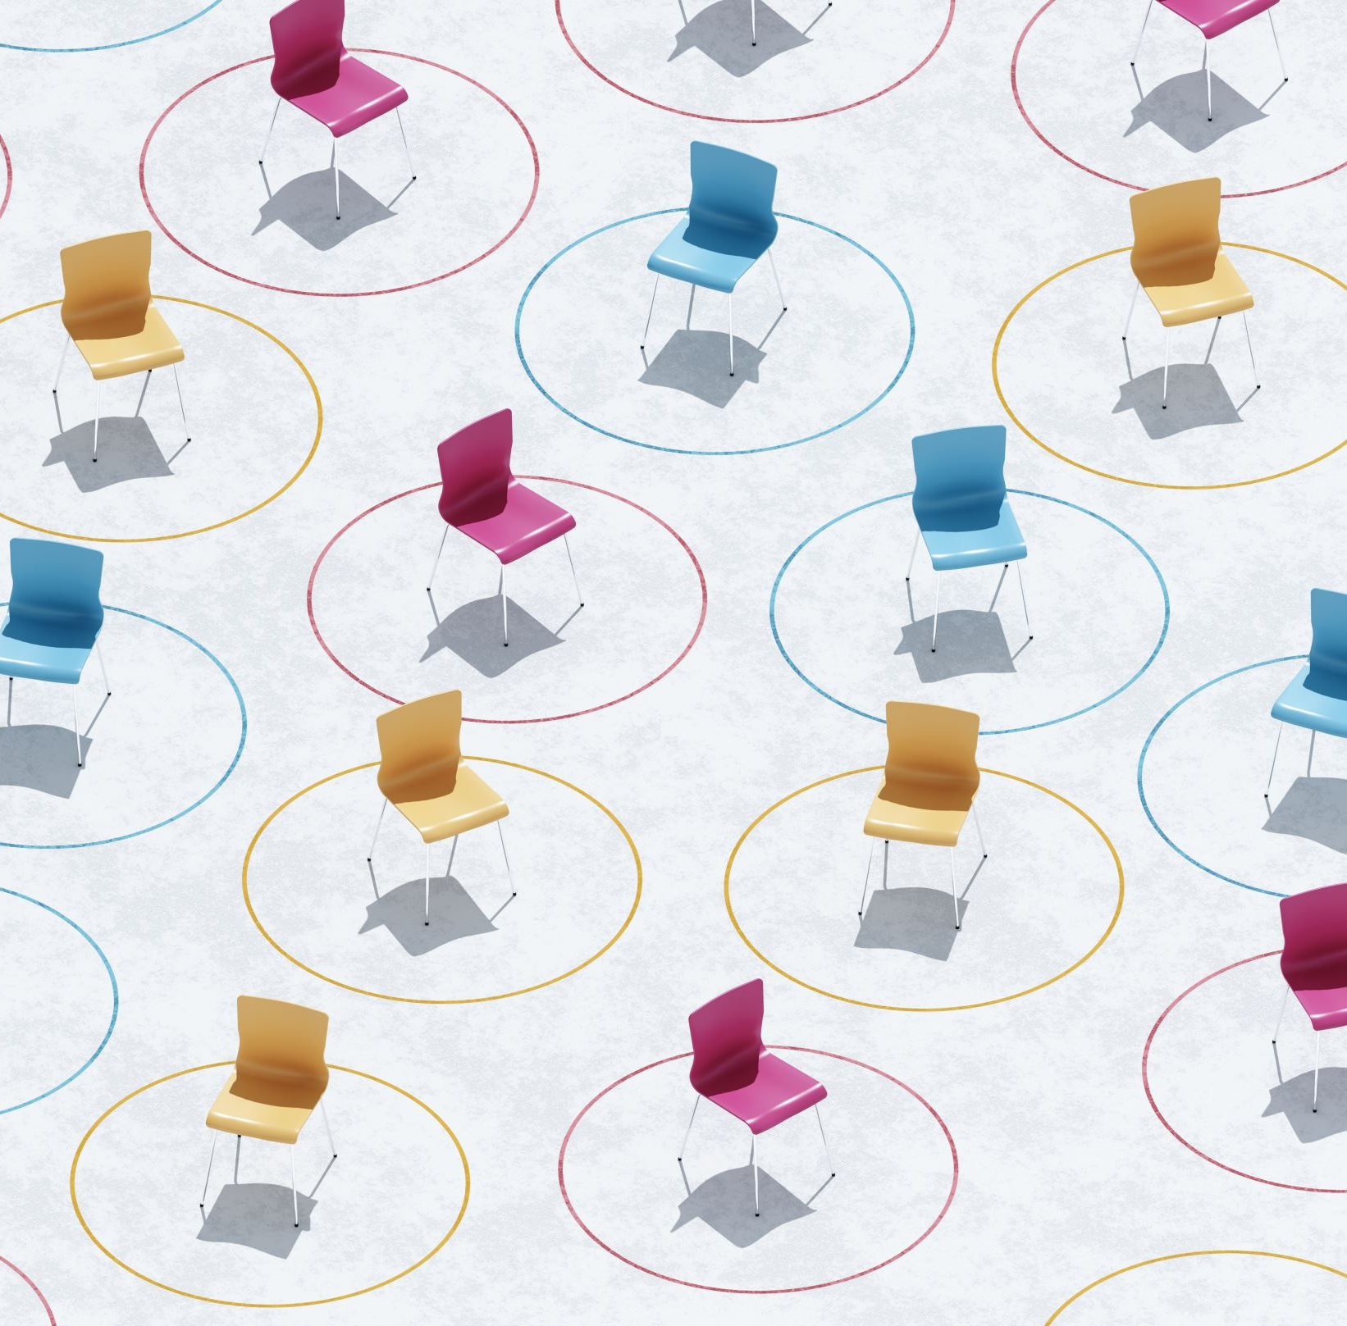
MUSICAL CHAIRS 1st Place: 20 Points 2nd Place 15 Points 3rd Place: 10 Points Last Place: 5 Points
CHALLENGE ROUND - TWO

Slide 55
Round three –
Support system’s round

Slide 56
Support systems round
What is Childline’s correct number?
0800 1111
0800 00 1066
0800 1001
0800 116 123
Notes:
The correct answer is A

Slide 57
Support systems round
Children in Need work with young people from which countries?
The UNITED KINGDOM
The UNITED KINGDOM AND REPUBLIC OF IRELAND
KENYA, CONGO AND SOUTH AFRICA
CANADA, GERMANY AND JAPAN
Notes:
The correct answer is A, CIN only works with children in England, Scotland, Wales and NI

Slide 58
Support systems round
What % of global young people aged 10-19 experience mental health conditions?
1%
5%
8%
14%
Notes:
Globally, it is estimated that 1 in 7 (14%) 10-19 year-olds experience mental health conditions, yet these remain largely unrecognized and untreated.
https://www.who.int/news-room/fact-sheets/detail/adolescent-mental-health

Slide 59
Support systems round
Which of these following people can help provide support if you are feeling depressed, scared or sad.
Youth Workers
Teacher
Police
Doctors
Notes:
All these people can provide assistance or referrals if you are feeling depressed, scared or sad

Slide 60
Support systems round
The UN Convention on the Rights of The Child has how many rights for young people and children?
10
12
33
54
Notes:
The UN Convention on the Rights of The Child enshrines how many articles for young people and children
54 Article’s

Slide 61
Support systems round
‘Pantosaurus’ is a character from which organisation to help teach young children about saying NO?
NSPCC
Children in Need
NHS
Childline
Notes:
Pantosaurus is a character from the NSPCC
Find out more about talking PANTS (Underwear Rule): http://bit.ly/2apl6FS

Slide 62
Support systems round
What are the mental health disorders affecting children and young people?
Depression
Attention Deficit Hyperactive Disorder
Anxiety
Autism
Notes:
All of the above

Slide 63
Support systems round
Local Councillor
Teacher
Local MLA
Youth Worker
Who could you contact about installing more street lights in the area?
Notes:
Local Councillor’s and MLA’s are the best people to chat with about community upgrades

Slide 64
Support systems round
Which Health and Care Trust Area do we live in?
Hint: It is the same as our EA School area.
Northern
South- Western
Southern
Western
Notes:
Amend as appropriate.

Slide 65
Support systems round
Which of these organisations offers a free text service for young people struggling to cope?
Young Minds
Children in Need
Voice of Young People in Care (VOYPIC)
Parenting NI
Notes:
Young Minds – If you are a young person struggling, you can text 85258 to receive text support 24/7.

Slide 66
Challenge round three - Ping pong basketball
Nominate one person from your team
Each person gets ten chances to score
10 points for each score

Slide 67
AND The winner is…
Well done to everyone!

Slide 68
Session Four – Managing Risk
Check in
Group game/ icebreaker
Introduction to risk – Bucket List activity
Dealing with our emotions
Check out
How risky? - Scenarios
Why engage in risk taking behaviours?

Slide 69
Bucket List
We can achieve our bucket lists through hard work, support and, sometimes, taking risks!

Slide 70
How Risky? Scenario Cards Discuss with your team and decide how risky each situation/ scenario is!
Low Risk
Medium Risk
High Risk

Slide 71
Brainstorm
Why do we engage in risk-taking behaviour?

Slide 72
Some reasons you might engage in risk taking behaviours…
To be cool
To be liked
Peer pressure
For the thrill/ excitement
We aren’t aware of the danger or consequences
Boredom
Lack of understanding
Copying behaviour we have seen from family, friends, on TV etc.

Slide 73
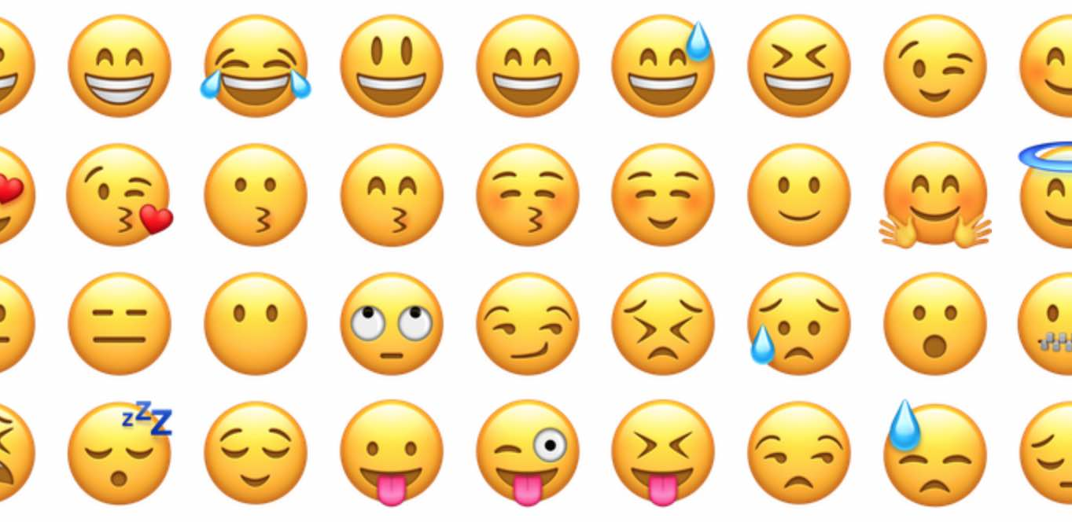
Managing Emotions
Identify
Identify Emotion
How do I feel? Where do I feel the emotion in my body? Label and accept the emotion.
Take
Take Action
Decide if you need to express your emotion. Think about how best to deal with this emotion.
Get
Get Help
Seek support of a trusted adult or friend if you don’t feel like you can manage the emotion on your own.

Slide 74
If we can manage our emotions better, we may also be better at making better decisions – less risky decisions!

Slide 75
Check Out

Slide 76
Session Five – Dealing with Bullying
Check in and introductions
Group game/ icebreaker
What is bullying?
Positive affirmations
Check out
Bullying profiles
Stop, Speak, Support

Slide 77
Bullying

Slide 78
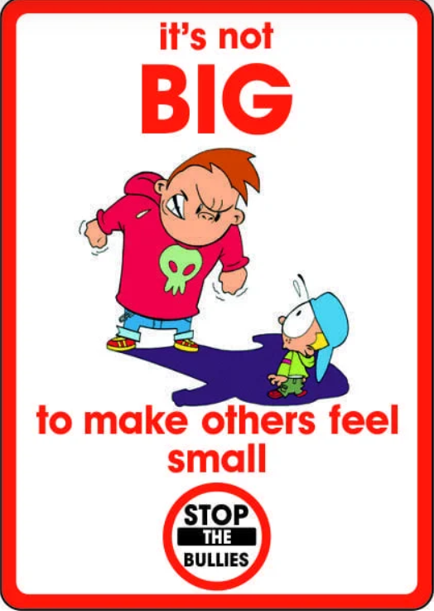
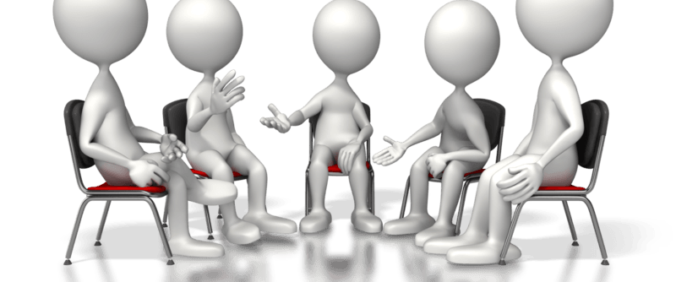
What is bullying?

Slide 79
NSPCC say…
Bullying is behaviour that hurts someone else. It includes name calling, hitting, pushing, spreading rumours, threatening or undermining someone.
It can happen anywhere – at school, at home or online. It's usually repeated over a long period of time and can hurt a child both physically and emotionally.

Slide 80
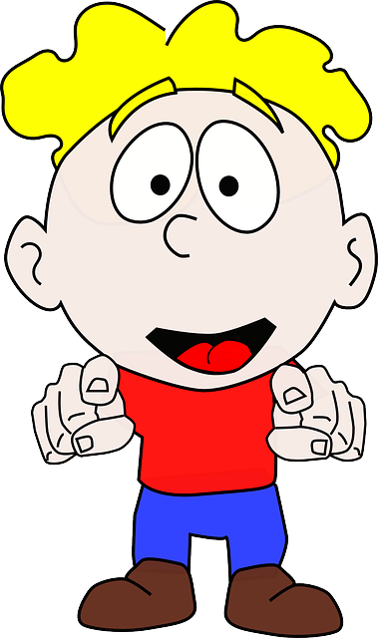
Profile 1 - Johnny
I’m 12 years old and live in Craigavon. I go to school in Portadown. I love it there but there is this one boy in my class who constantly bugs me. His name is Sam. He calls me names, messes up my stuff, and he has even started to take things from my lunch box! He really scares me. He just seems so mean and angry all the time. I hate the way he makes he feel.

Slide 81
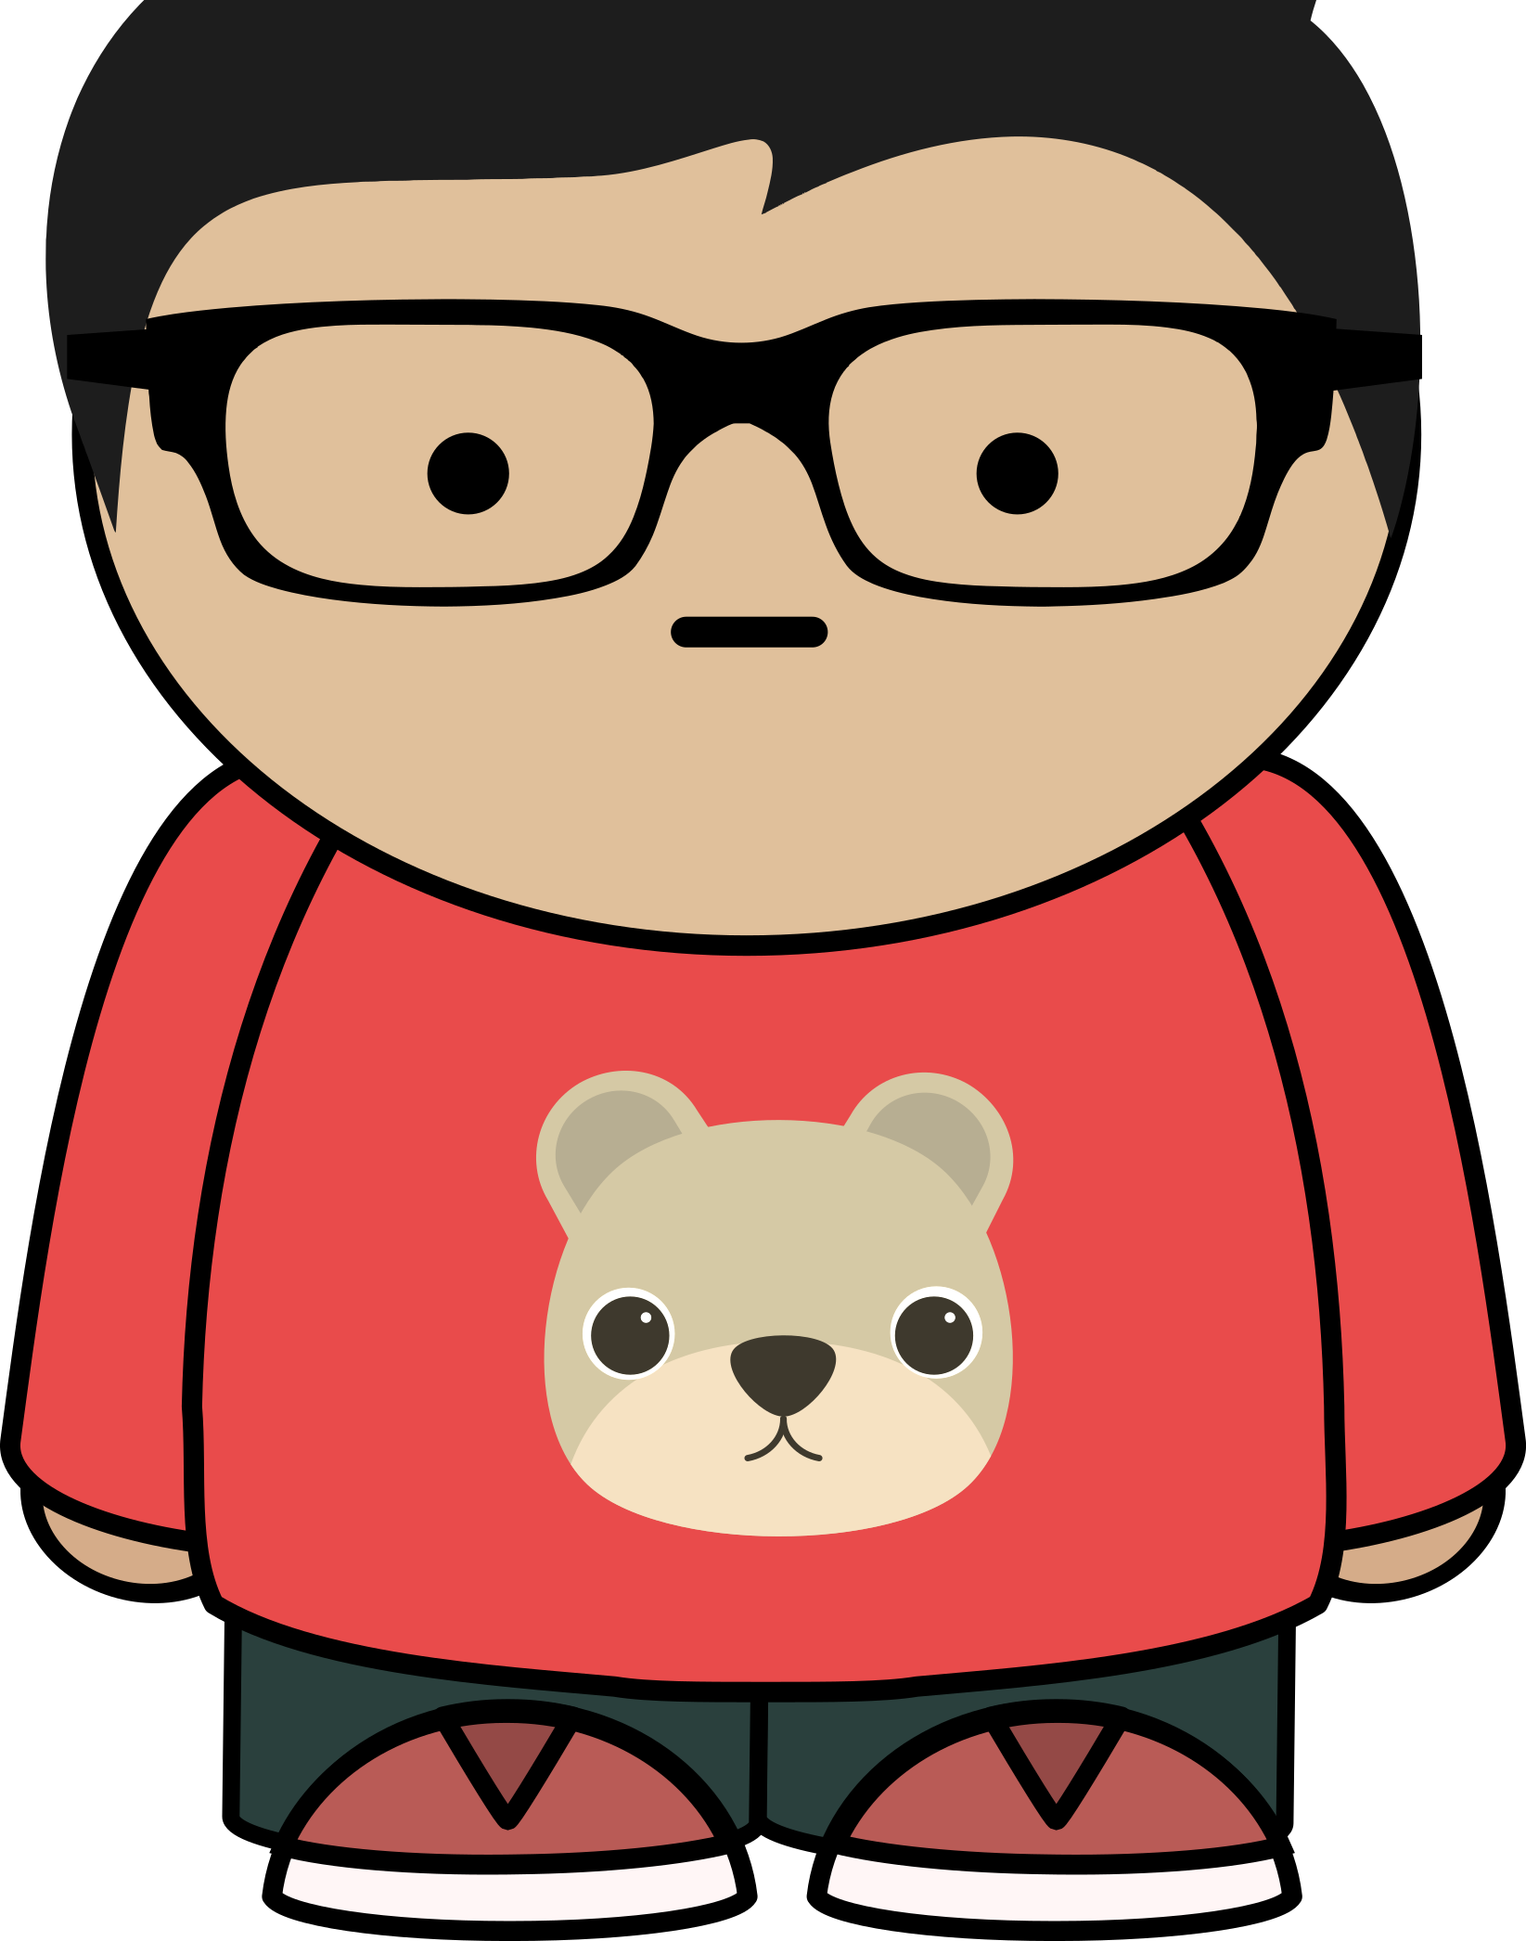
Profile 2 – ‘Sam’
I am 12 years old and live in Portadown. Things aren’t going great for me at the minute. My dad’s moving out of the house this weekend. I’m really going to miss him, and I think mum’s really going to miss his money coming in. But at the same time, I am just so fed up with all the shouting and arguing. My older brother takes it all out on me too. Yesterday he called me a pig and smashed up my room. Of course, I ended up being the one who got shouted at! I’m just so angry and fed up with everything. To top it all off I’ve got detention this afternoon for calling wee Johnny names again in P.E.

Slide 82
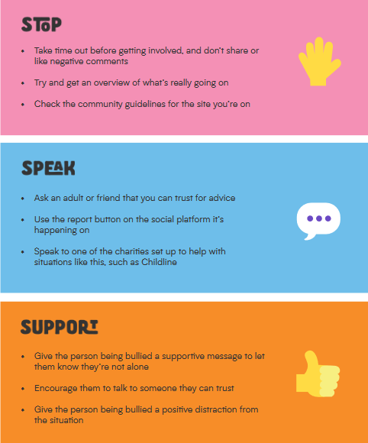
When you see someone is getting bullied…

Slide 83
My pledge: This week I will…
Stop
Speak
Support

Slide 84
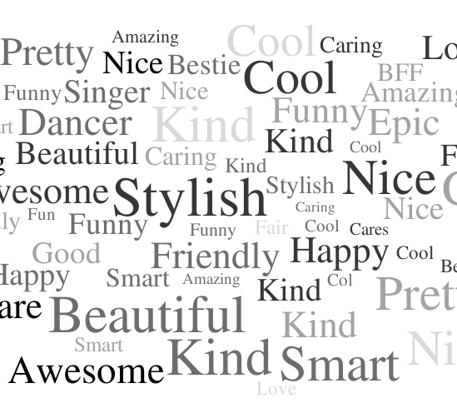
Positive affirmations
Draw around your hand
Write your name on your palm
Pass your handprint to the person on your left
As you receive each person’s handprint write one positive comment/ word about that person
When you get your handprint back – SMILE!!
These are all the positive things that make you – YOU!

Slide 85
Check Out

Slide 86
Session Six – Peer pressure
Check in and introductions
Group game/ icebreaker
Introduction to peer pressure
Check out
Peer pressure in action - Drama
Believe in Yourself – Art activity

Slide 87
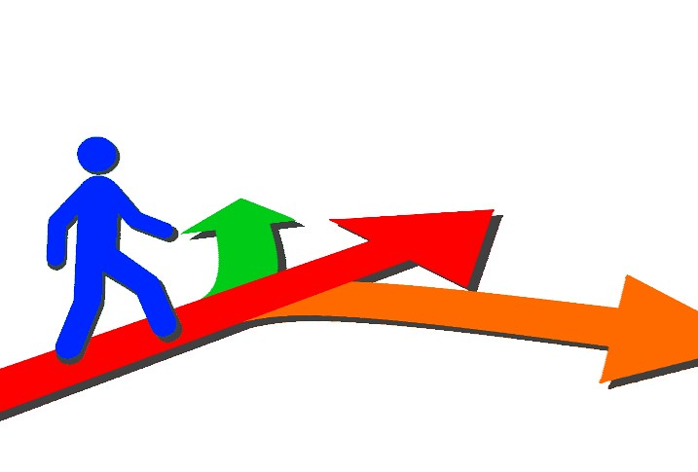
Session Four – Dealing with peer pressure

Slide 88
Peer pressure
A feeling that you must do the same things as other people in order to be liked or respected by them
Can you think of some examples?

Slide 89
Drama time
Think about body language and the way things are said. This will have a big impact on the situation!

Slide 90
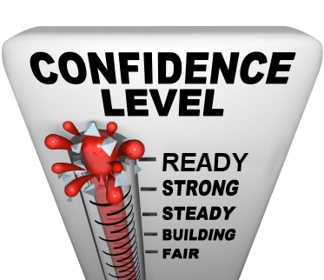
Saying no…
Confident – believe in your ability to handle a situation
Clear – message you have is clear and easy to understand
Controlled – you speak calmly

Slide 91
Number one rule – Believe in Yourself

Slide 92
Check Out

Slide 93
Session Seven – Money management for a better future
Difference between want and need – Our Desert Island
Shopping smart
Saving and spending – group task!
Check Out

Slide 94
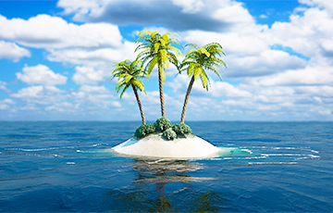
Desert Island
You are stranded on a desert island. You can only choose three items to bring with you.
What will you bring?
Why?

Slide 95
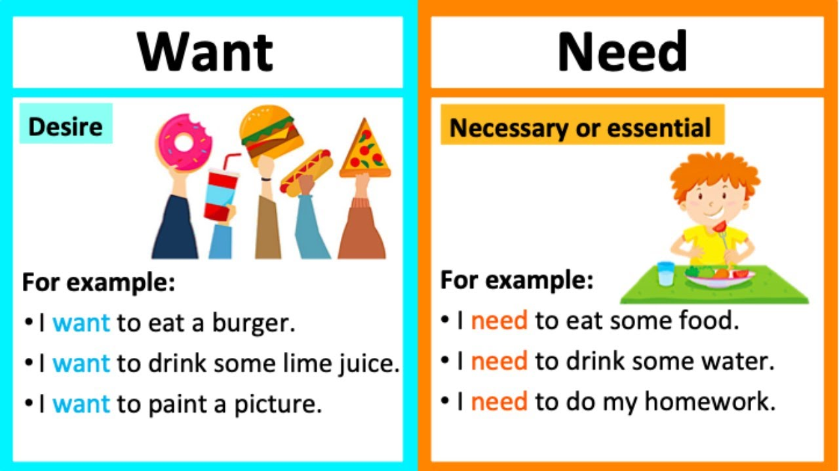
Did you pick wants or needs?

Slide 96
Individual reflection
Think about last non-food item you bought or asked someone else to buy you.
How did it make you feel when you got it?
How often have you used it?
Did you really NEED it?
Do you feel pressure to buy certain things?

Slide 97
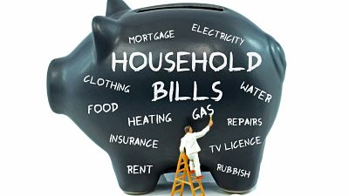
Brain Teaser
How much does the average family in NI spend per week on essential household costs?

Slide 98
£486.40 per week (2020 figures)
Notes:
Use up-to-date figures

Slide 99
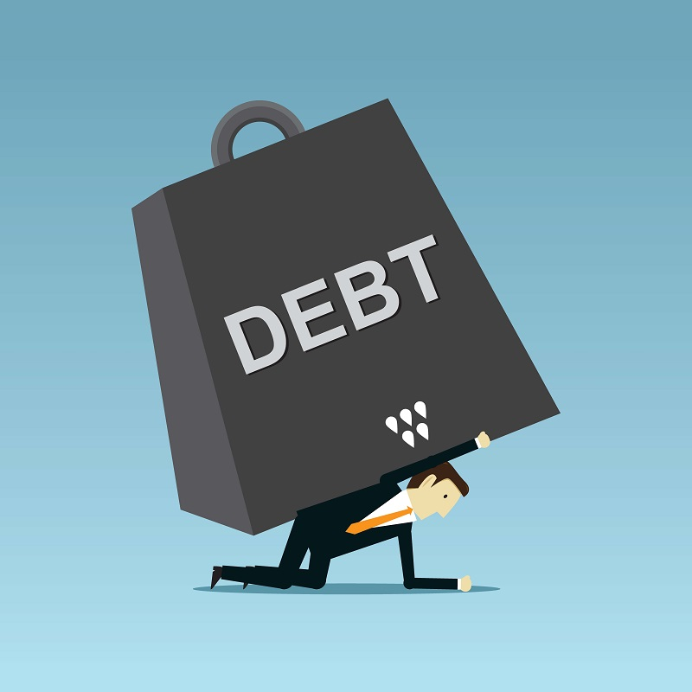
Average income of people in NI - £485.25 per week (2020 figures)
Average person has £1.15 to spend on non-essential items per week (2020 figures)
Notes:
Use up-to-date figures

Slide 100
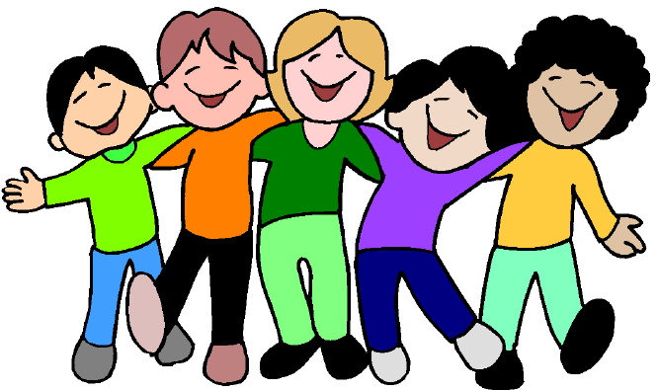
Group task – Saving and spending!
Organise a family or friends day out
Your budget is £60.00 (you don’t have to spend all this!)
Must be fun for all
Think about food, transport, entrance and other essential costs
This Photo by Unknown Author is licensed under CC BY-SA-NC

Slide 101
Saving tips!

Slide 102
Check Out

Slide 103
Session Eight – Healthy mind, healthy body
Check in
What is a stressful situation?
Group game/ icebreaker
Our health & wellbeing
Pledge
Jar of Importance
Managing stress
Check out

Slide 104
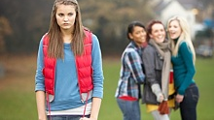
What is a stressful situation?

Slide 105
Health & Wellbeing wheel

Slide 106
Pledge We will follow-up on your success next week!

Slide 107
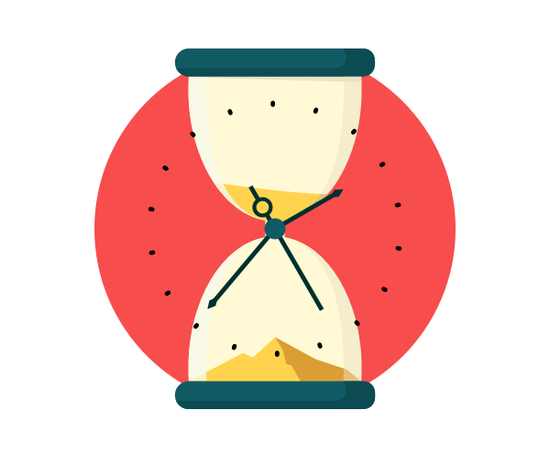
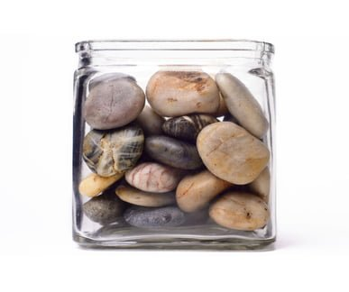
Jar of Importance

Slide 108
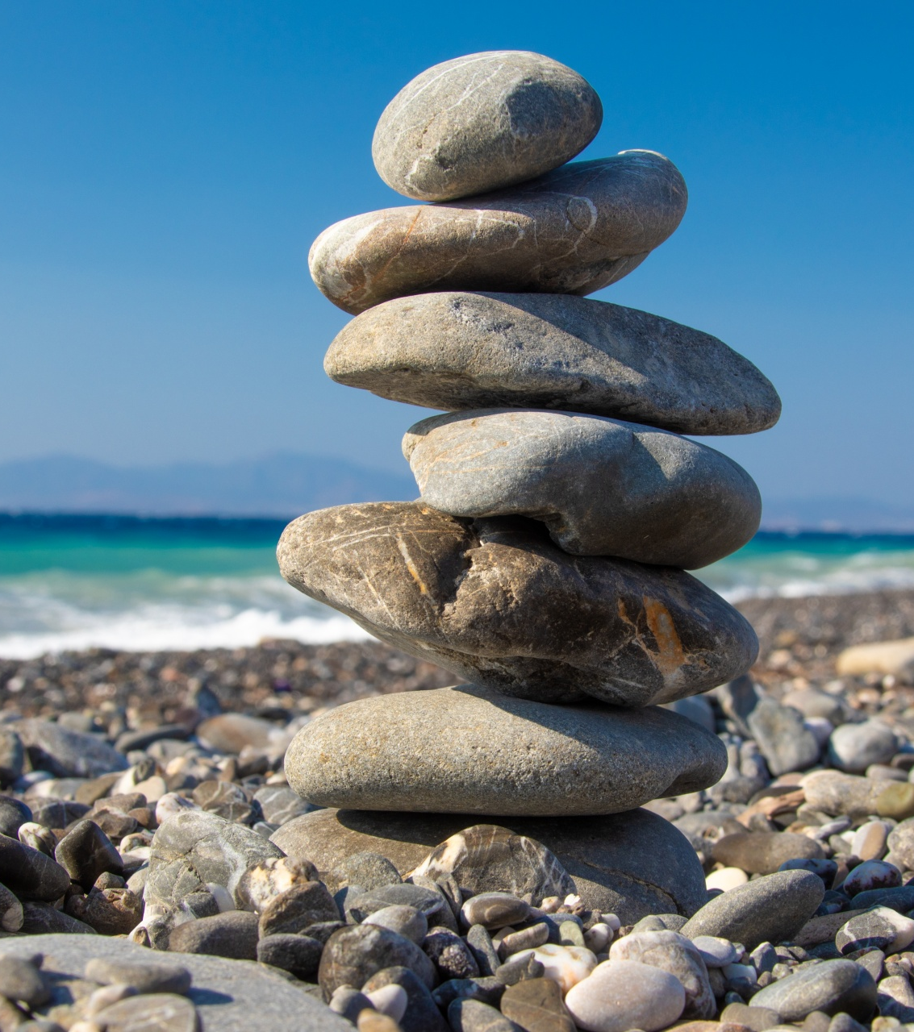
Rocks – Big things such as family, friends, passions, health Pebbles – Other important things such as home, school, exams, area we live Sand – Small stuff such as the latest shoes, how many likes on social media, messages pinging through on phone Water – There is always time to do the things you enjoy such as going for a walk, watching a movie, laughing!

Slide 109
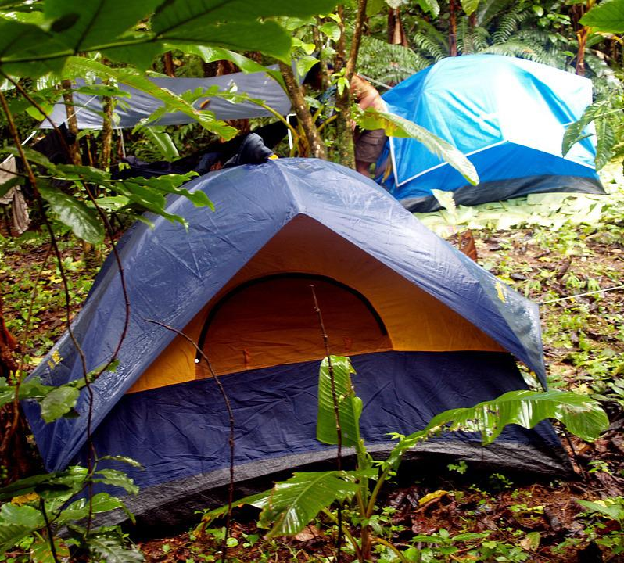
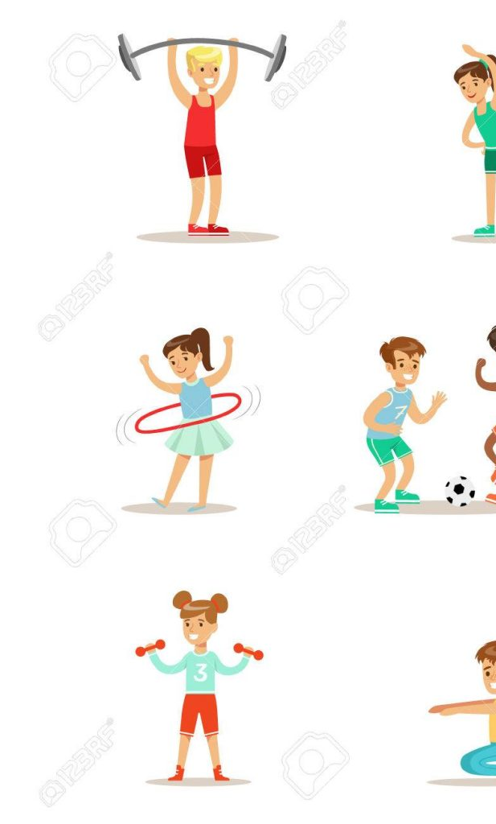
Managing stress in our bodies
There are lots of tools and techniques which help us to be healthier and happier!

Slide 110
Check Out

Slide 111
Session Nine – Looking after ME
Check in & Pledge review
Group game/ icebreaker
Letter to a stranger
Power poses
What motivates us?
Self-care bingo!
Gratitude journal
Check out

Slide 112
Pledge follow up
How did you do?
Was it easy/ difficult?
Will you continue to make this change every week?
Has it made you feel better?

Slide 113
Letter to a Stranger
7 billion in the whole world – and there is no one quite like you!
Tell your stranger all about you!
Include your personal skills and qualities, what you are good at, things you enjoy doing and what type of person you are.
The stranger is only interested in how you are as a person, not what you look like!

Slide 114
Rate your confidence
This Photo by Unknown Author is licensed under CC BY

Slide 115
Confidence – Power Poses

Slide 116
Now hold a high power pose, turn around to the person on your right and say one positive thing about yourself!

Slide 117
Rate your confidence now
This Photo by Unknown Author is licensed under CC BY

Slide 118
What motivates us?

Slide 119
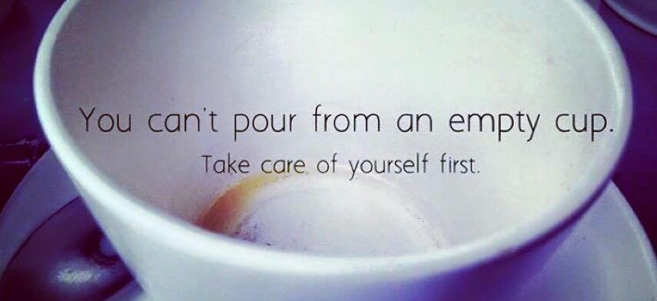
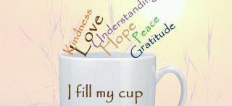
Self-care bingo!
Give yourself one point for every item on the list you have done in the last 24 hours!
Tally up your points and let us know your score.

Slide 120
Time to say thank you!
Reminding ourselves of what we are grateful for, helps boost our self-confidence and self-esteem
It allows us to recognize all the good things in our lives
It reminds us to focus on the positive things!
This Photo by Unknown Author is licensed under CC BY-NC

Slide 121
Check Out

Slide 122
Session Ten – Our healthy community
Check in
What is a community?
Human Knot icebreaker
If I was on the Village Council activity
Social action activity
Check out

Slide 123
What is a Community?

Slide 124
Community is…
A group of people living in the same place or having a particular characteristic, attitude or interest in common.

Slide 125
Human Knot
Stand in a circle.
Put your right hand up in the air, and then grab the hand of someone across the circle.
Repeat this with the left hand, ensuring you grab a different person’s hand.
Make sure you are holding the hands of two different people and you are not holding hands with someone either side of you.
You must now try to untangle yourselves to form a circle without breaking the chain of hands!

Slide 126
Imagine you are on the Village Council
What are the positive things about living in my area?
Think about what resources/ amenities are available, influential people who live there, how well looked-after it is. Do we make use of all the positive things are community offers?
What are some of the negative things about living in the area?
Think about how these things make you feel. Do they make you feel unsafe? Do they affect your own personal well-being? Who is responsible for these negative issues?
Develop an action plan of what can be done to make the community feel safer and be a better place to live.
Think about –
What small changes could you make? What steps would you need to take? Who could help you?

Slide 127
Group Task
Pick one thing from your action plan which can make your community a safer and better place to live.
This might be something simple such as random acts of kindness, picking up litter in the local park, helping an elderly neighbour etc.
Carry out this task/ activity within the next 7 days and send photos to your leader of you carrying out the activity (ensure you have got consent to take and share the photo!).
Be proud of yourself for making a positive contribution to your community!
This Photo by Unknown Author is licensed under CC BY-NC-ND

Slide 128
Overall evaluation & Check Out

