Slide 1
Accredited Youth Work Programmes Living in Safety and Stability 14-18 years

Slide 2
Session One – Introduction to Living in Safety & Stability
What is Safety and Stability
Group game/ icebreaker
Contract
Hopes and fears for the programme
What influences our Safety and Stability?
Quiz!
Check Out

Slide 3
What is an accredited programme?
Set of workshops and activities/ games which are used to help young people learn about a particular topic
Lots of young people do the same programme across NI
Opportunity for young people to show their youth leader and others what they have learned and achieved
Opportunity for young people to get a reward for their hard work e.g., certificates

Slide 4
Our topic: Living in Safety and Stability
Sessions
10
Time and date
Activities
Small and large group discussions, team building games and activities, games and activities around safety and stability
Learning
You will learn more about staying safe, health and wellbeing, confidence and motivation, resilience, and preparing for the future.

Slide 5
What do we mean by Living in Safety and Stability?

Slide 6
Living in Safety is…
When you are safe from harm in your social and physical environment
Living in Stability is…
Healthy relationships and environments that are predictable and consistent, in which all your needs are met

Slide 7
Contract

Slide 8
Hopes and Fears

Slide 9
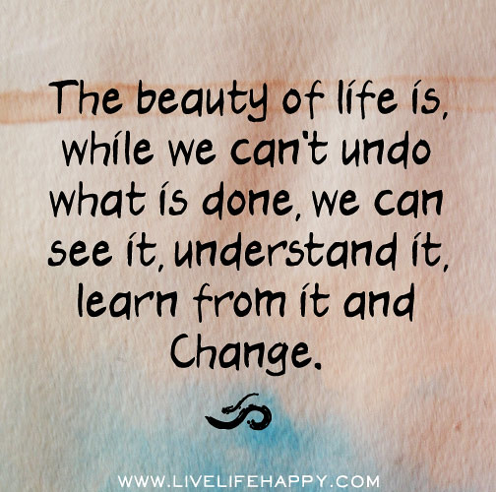
Factors which influence living in safety and stability?

Slide 10
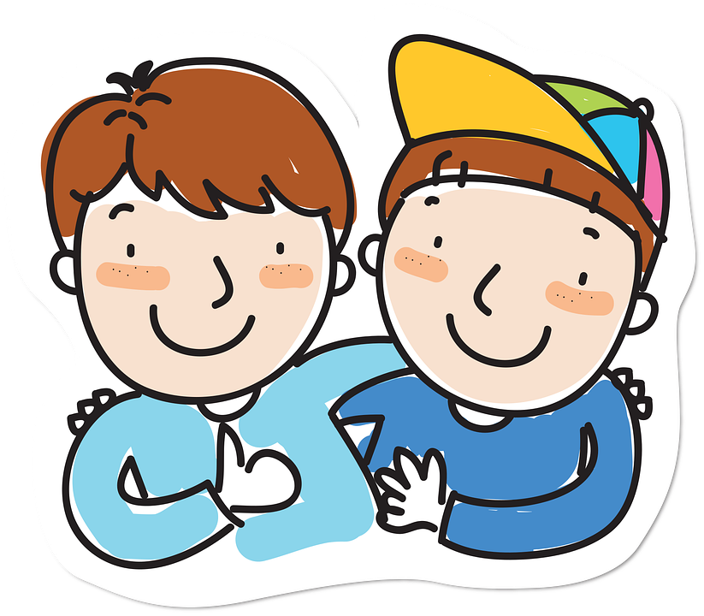
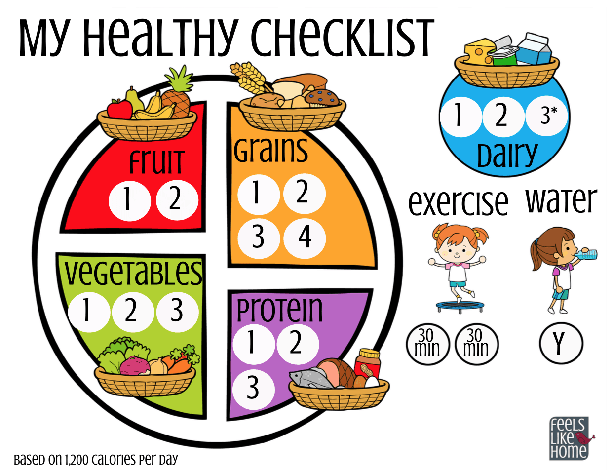
Quiz!

Slide 11
Check Out

Slide 12
Session Two – Staying Safe Online
Check in and introductions
Group game/ icebreaker
Our online habits
Friend or Frenemy? - Game
The power of online
Online risks - Scenarios
Sharing content online
Check out

Slide 13
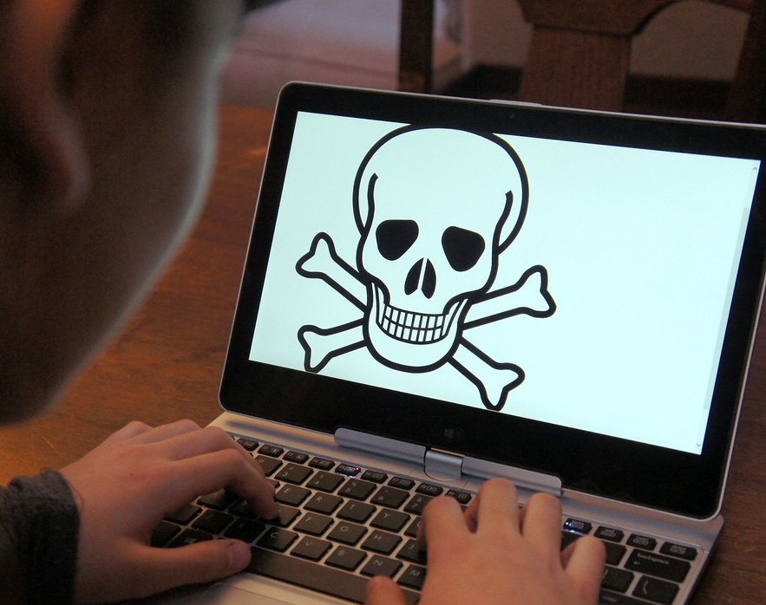
Staying Safe Online
This Photo by Unknown Author is licensed under CC BY-SA

Slide 14
Screen time…How much is too much?

Slide 15
You’ve got a text!
This Photo by Unknown Author is licensed under CC BY-SA-NC

Slide 16
Online Risks 4 C’s
Content – Violent, hateful, inappropriate behaviour
Contact – Being bullied, meeting strangers
Conduct – Bullying someone, creating or uploading inappropriate behaviour
Commercial – advertising or marketing scams, hidden costs

Slide 17
It’s important to identify what’s real and what’s not.
Social media can give you the impression that everyone else has a beautiful body and perfect life.
People’s lives are often edited and filtered on social media.
There are lots of fake profiles on social networks.
It can be difficult to tell the difference between someone who’s genuine and a fake.

Slide 18
People only put out there what they want you to know…

Slide 19
OK to share?

Slide 21
Good or Bad Friend?

Slide 22
Game of Chase

Slide 23
Online vs Face-to-face
It's well known that people say and do things online that they wouldn't ordinarily say or do in the face-to-face world.
They loosen up, feel less self-conscious, express themselves more openly.
“It's a double-edged sword. Sometimes people share very personal things about themselves. They reveal secret emotions, fears, wishes.
On the other hand, out spills rude language and harsh criticisms, anger, hatred, even threats" (Dr. John Suler)

Slide 24
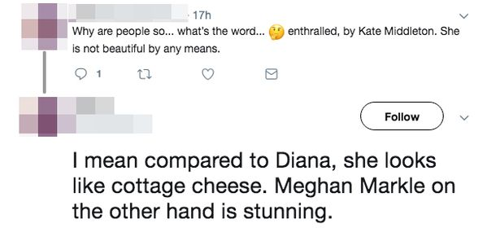
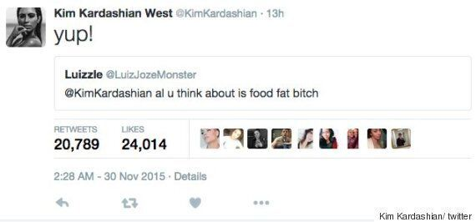
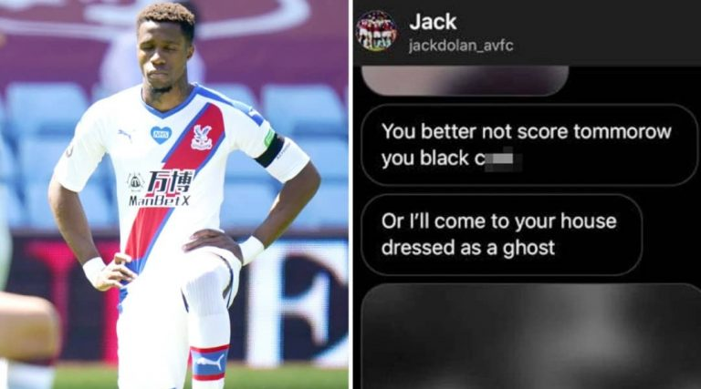
Notes:
These are some examples of a lack of respect in society. The media and internet trolls are partly to blame for the death of Caroline Flack. Footballers have been subject to racist abuse both online and in the stadium.

Slide 25
Why?

Slide 26
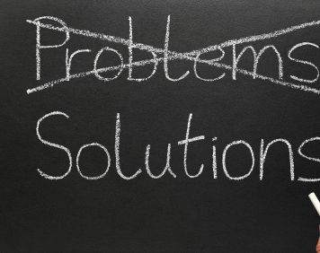
Online Tips
If you feel uncomfortable - unfollow, block or report.
Always get consent before posting a photo or video of someone else.
Privacy settings can stop other people from seeing your posts.
Be careful when sharing information about yourself
Always choose a username that does not reveal any personal information
Don’t click on a link from someone you don’t know
And in all online conversations:
Take time to notice how you feel or what you need, before you respond
Clarify what was meant
Use ‘I’ statements when sharing thoughts and feelings
Place yourself in other person’s shoes
Use emoticons to express tone when using text
Choose whether or not you want to respond to online conflict or uncomfortable situations
Ask for support if needed
This Photo by Unknown Author is licensed under CC BY-ND

Slide 27
In a world where you can be anything #bekind
Notes:
This slide demonstrates campaigns initiated to encourage respect in society. Have you came across any of these?

Slide 28
Check Out

Slide 29
Session Three – Risk taking behaviour
Check in
Group game/ icebreaker
Introduction to risk – Bucket List activity
Dealing with our emotions
Check out
How risky? - Scenarios
Why engage in risk taking behaviours?

Slide 30
Bucket List
We can achieve our bucket lists through hard work, support and, sometimes, taking risks!

Slide 31
How Risky? Scenario Cards
Low Risk
Medium Risk
High Risk

Slide 32
Brainstorm
Why do we engage in risk-taking behaviour?

Slide 33
Some celebrity examples around drug and alcohol use…

Slide 34
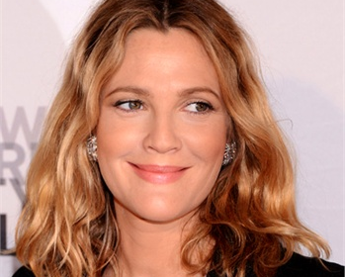
Drew Barrymore
11 months – Begins acting career
7 years old – huge film star pouring Baileys over her ice cream
8 – Partying five nights a week with her mother
9- Mother introduced her to drugs and ‘dancing with young men’
11 – Alcohol addiction
12 – Drug addiction
13 – Hospitalised after self-harming
14 – Legally divorced from her parents
Notes:
Reasons include lack of parental support/ care and learned behaviour

Slide 35
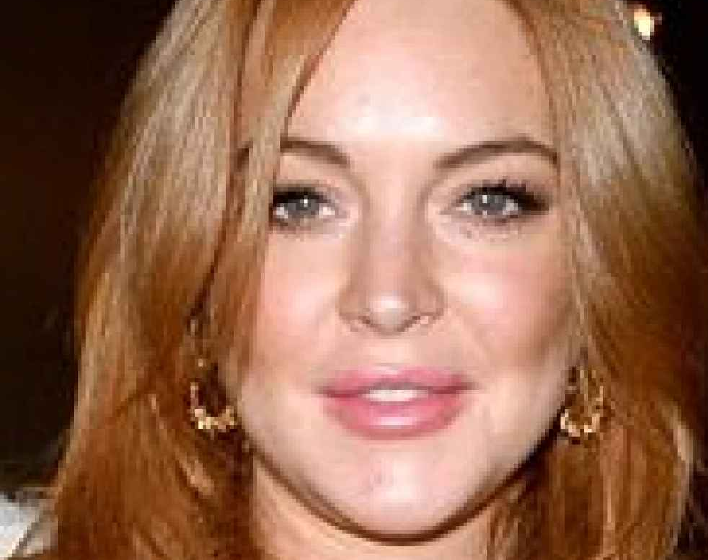
Lindsay Lohan
3 years old – Signed to Ford Models
12 – Huge movie star after starring in The Parent Trap
18 – Became a Hollywood A-lister after starring in Mean Girls
Early 20’s - cut off contact with her father calling him unpredictable and hard to deal with
Early-mid 20’s – Mass media coverage of court cases, drunk photos and stints in rehab due to alcoholism.
Notes:
Reasons include stardom at such a young age and the pressure associated with this. Family breakdown including her parents divorce may have been a factor.

Slide 36
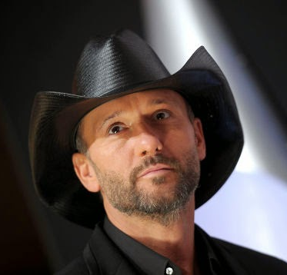
Tim McGraw
Started drinking as a teenager and began drinking shots of alcohol before taking to the stage.
Notes:
McGraw blames his low confidence for his alcohol intake and admits that he used to consume alcohol before going on stage to help him relax a bit better and cope with the nerves.

Slide 37
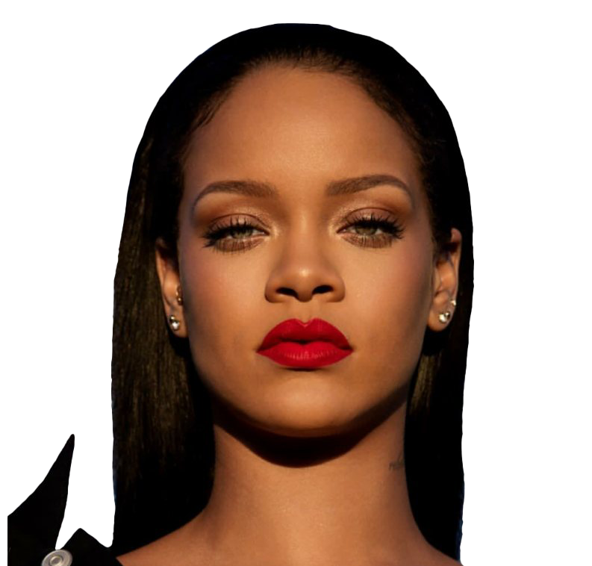
Rihanna
Likes to party sometimes and states her favourite alcoholic drink is Jameson.
Notes:
It can be suggested that Rihanna drinks for fun and for the social aspect of it. She denies doing drugs after numerous claims and states that drugs destroyed her father who was a crack addict.

Slide 38
Can you relate to some of these reasons?

Slide 39
Some reasons you might engage in risk taking behaviours…
To be cool
To be liked
Peer pressure
For the thrill/ excitement
We aren’t aware of the danger or consequences
Boredom
Lack of understanding
Copying behaviour we have seen from family, friends, on TV etc.

Slide 40
Check Out

Slide 41
Session Four – Choices & Consequences
Check In
Group game/ icebreaker
Our Values
Choices & Consequences – Drama activity
Being confident in our choices
Managing Emotions
Check Out

Slide 42
Principles and Values
Principles are standards of behaviour. They are the principles of right and wrong e.g., Treat others as you would like to be treated.
Principles are driven by values.
Values are things that you believe are important in the way you live your life e.g., respect.
Values should determine your priorities, and, deep down, they’re probably the measures you use to tell if your life is turning out the way you want it to.
Understanding your own personal values can help you make better decisions, however big or small.

Slide 43
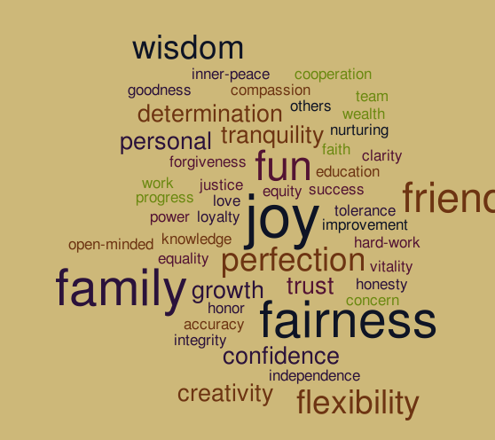
Values Discussion Cards
Read and discuss each scenario with your partner.
Try to answer the questions as truthfully as possible.
Everyone’s responses will be different. This is OK! We all have different values which will drive different choices.

Slide 44
Reflect…
A good choice you made this week.
A not so good choice you made this week.
Why was it a good/ not so good choice? What was the consequence of that choice?

Slide 45
Choices & Consequences
Drama Activity

Slide 46
Being confident in our choices
Peer pressure is a feeling that you must do the same things as other people in order to be liked or respected by them.

Slide 47
Tips to dealing with peer pressure
Surround yourself with people who respect your values and opinions
Be mindful of body language and the way you say things
Be confident – believe in your ability to handle a situation
Be clear – message you have is clear and easy to understand
Be Controlled – you speak calmly
Talk to a trusted adult if the situation is worrying you!

Slide 48
If we can manage our emotions better, we may also be better at making better decisions – less risky decisions!

Slide 49
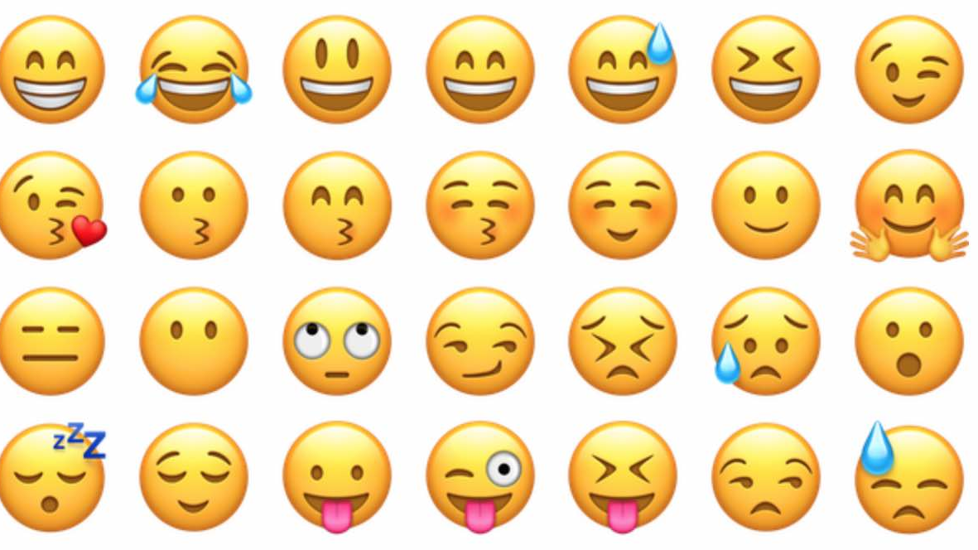
Managing Emotions
Identify Emotion
How do I feel? Where do I feel the emotion in my body? Label and accept the emotion.
Take Action
Decide if you need to express your emotion. Think about how best to deal with this emotion.
Get Help
Seek support of a trusted adult or friend if you don’t feel like you can manage the emotion on your own.

Slide 50
Number one rule – Believe in Yourself

Slide 51
Check Out

Slide 52
Session Five – Coping with difficult situations
Check in
Juggling life
Managing emotions in context
Resilience
Pledge
Jar of Importance
Check out

Slide 53
Managing Emotions - Refresh
Identify Emotion
How do I feel? Where do I feel the emotion in my body? Label and accept the emotion.
Take Action
Decide if you need to express your emotion. Think about how best to deal with this emotion.
Get Help
Seek support of a trusted adult or friend if you don’t feel like you can manage the emotion on your own.

Slide 54
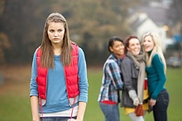
Juggling Life

Slide 55
Managing Emotions in Context
Individually:
Think about an experience/situation in your life where the outcome was not what you wanted
In your groups:
How do you think you would feel in that situation?
What do you see as the worst-case scenario happening because of that situation?
What could you do to turn the experience from a negative into a positive?

Slide 56
Brainstorm – What is Resilience?

Slide 57
Health & Wellbeing wheel

Slide 58
Pledge

Slide 59
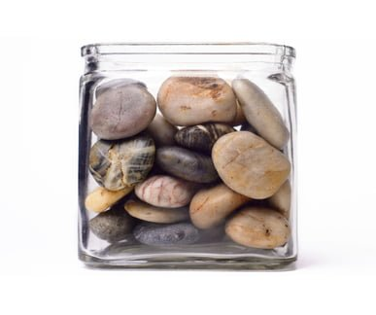
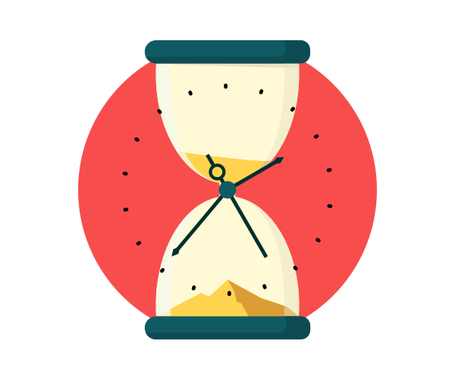
Jar of Importance

Slide 60
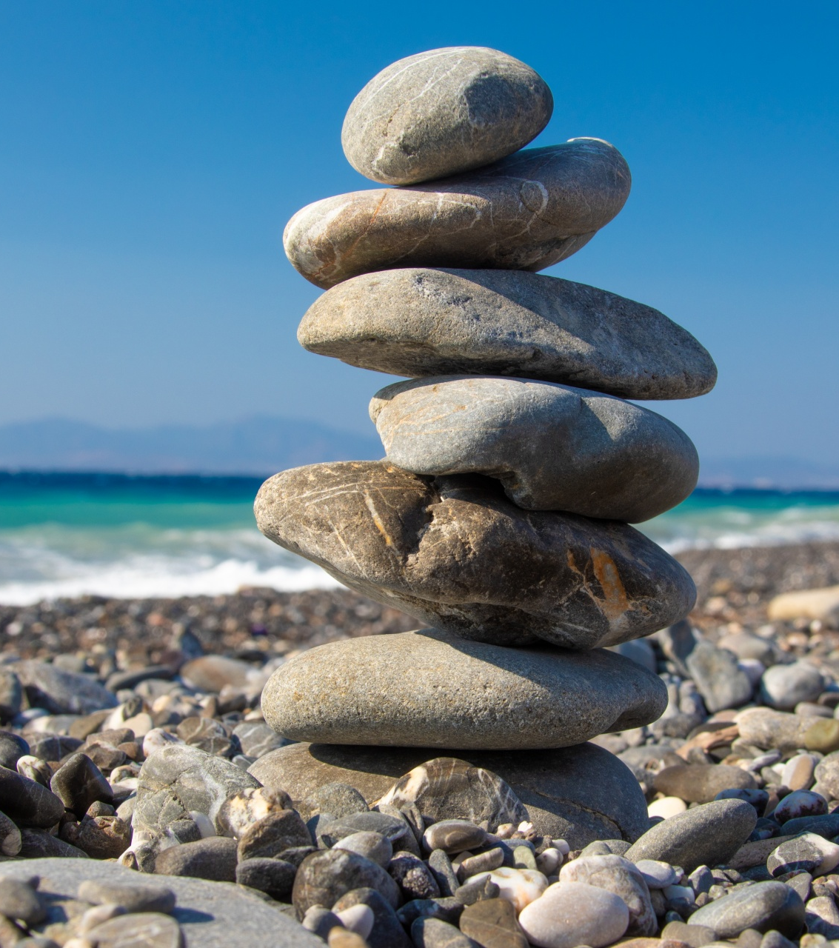
Rocks – Big things such as family, friends, passions, health Pebbles – Other important things such as home, school, exams, area we live Sand – Small stuff such as the latest shoes, how many likes on social media, messages pinging through on phone Water – There is always time to do the things you enjoy such as going for a walk, watching a movie, laughing!

Slide 61
Check Out

Slide 62
Session Six – Confidence and Motivation
Check in & Pledge review
Group game/ icebreaker
Letter to a stranger
Power poses
What motivates us?
Gratitude jars
Positive affirmations
Check out

Slide 63
Pledge follow up
How did you do?
Was it easy/ difficult?
Will you continue to make this change every week?
Has it made you feel better?

Slide 64
Letter to a Stranger
7 billion in the whole world – and there is no one quite like you!
Tell your stranger all about you!
Include your personal skills and qualities, what you are good at, things you enjoy doing and what type of person you are.
The stranger is only interested in how you are as a person, not what you look like!

Slide 65
Rate your confidence

Slide 66
Confidence – Power Poses

Slide 67
Now hold a high power pose, turn around to the person on your right and say one positive thing about yourself!

Slide 68
Rate your confidence now

Slide 69
What motivates us?

Slide 70
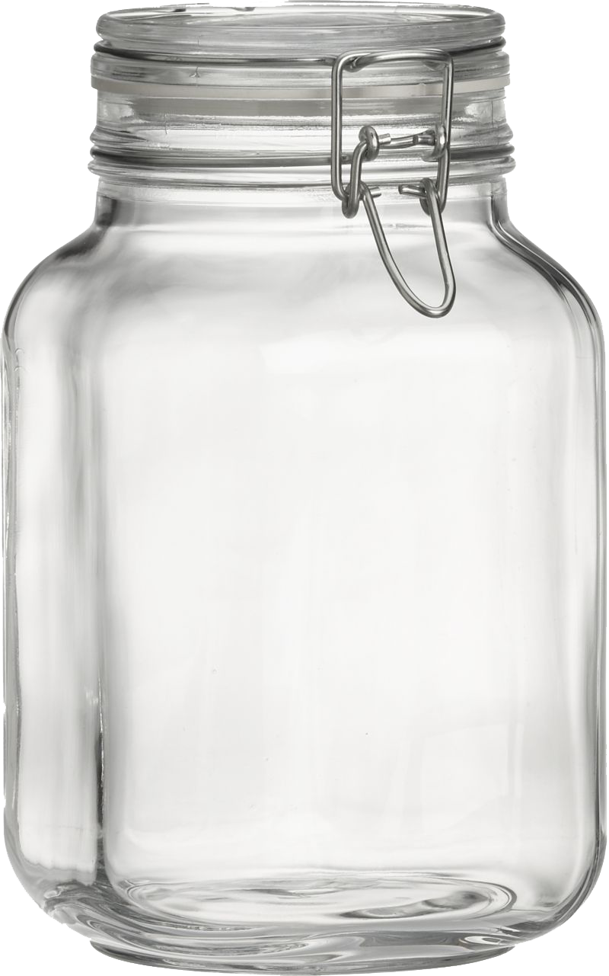
Time to say thank you!
Reminding ourselves of what we are grateful for, helps boost our self-confidence and self-esteem
It allows us to recognize all the good things in our lives
It reminds us to focus on the positive things!

Slide 71
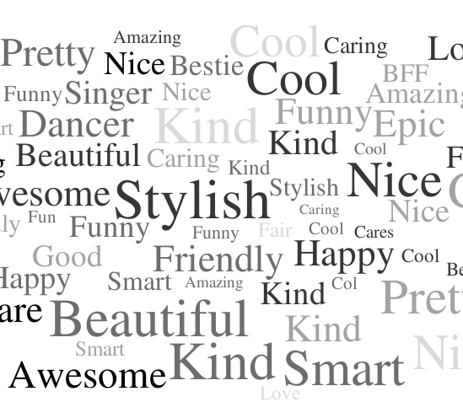
Positive affirmations
Draw around your hand
Write your name on your palm
Pass your handprint to the person on your left
As you receive each person’s handprint write one positive comment/ word about that person
When you get your handprint back – SMILE!!
These are all the positive things that make you – YOU!

Slide 72
Check Out

Slide 73
Session Seven – Body Confidence
Check in
Group game/ icebreaker
Our amazing bodies!
Media influence on body image
Brainstorm questions
Feel good tips!
Check out

Slide 74
If you are 100% confident with your body!

Slide 75
If you have ever heard someone saying one or more of the following:
My belly is so fat
My legs are too skinny
I wish I had a six-pack
My skin is so bad
I wish I was more tan
I hate my nose
I wish I had blue eyes
I hate curly hair
I wish I was smaller
My hips are too big
I wish I had curves
I wish I was taller
I hate my body!

Slide 76
What my body does for me
What I love about my body
What is unique about me
What I can do to help my body be strong and healthy

Slide 77
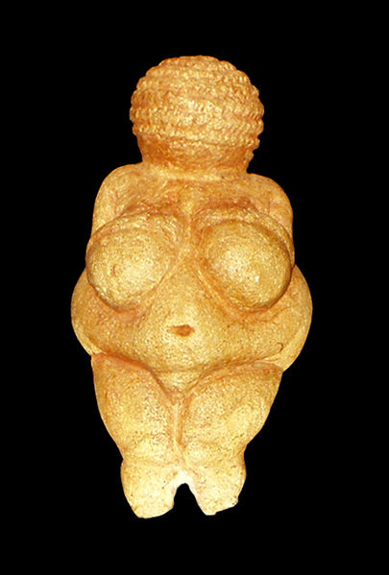
The ‘Venus of Willendorf’ figurine dates to about 25,000 BC and is considered a masterpiece of the Paleolithic era. Some historians point to the 4-inch statuette as a representation of idealized female beauty at the time.

Slide 78
What is considered as the ideal body now? Is this different for men? Why?

Slide 79
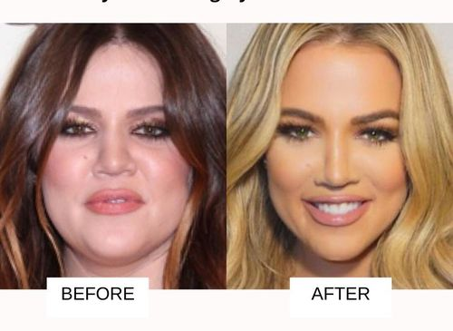
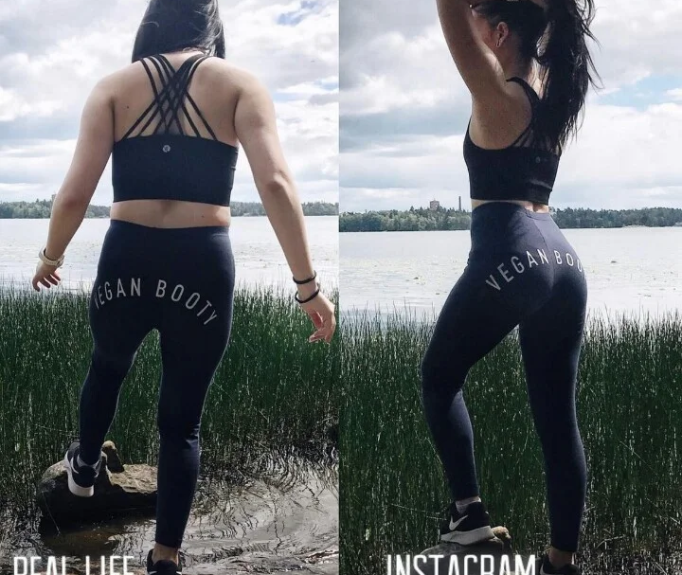
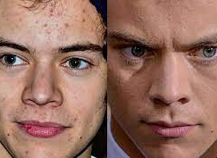
Is celebrity/ Instragram Culture to blame?

Slide 80
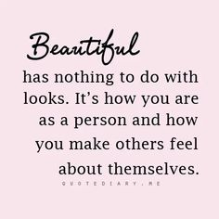
Remember…
What we see online is not always real
We should NEVER compare ourselves to people we see online –they have likely spent a lot of time to get that ‘perfect’ shot! Think about lighting, camera angles, poses and use of photoshop/filters!
Young people today are bombarded with approximately 5,000 digitally enhanced images a week that suggest how they should look.
Take a break from social media if you find yourself comparing yourself to others.
Finally…
Surround yourself with people who love you for who you are!
As always, seek support from a trusted adult if you are struggling!

Slide 81
Brainstorm
Group 1 - Think about situations where your physical appearance was more important than who you are as a person?
Group 2 – Think about your best friend/ someone special to you. What do you admire or respect about them?

Slide 82
Basic tips to help our bodies be strong and healthy! Practising these will help you feel good about yourself!
Hygiene
Balanced diet
Exercise
Sleep

Slide 83
Basic hygiene rules
Washing hands with soap after toilet/ as often as needed
Daily showers
Brushing and flossing teeth morning and night
Brushing hair every morning
Wearing clean clothes & changing underwear every day
Removing make-up before bed
Trimming hair and nails regularly

Slide 84
Balanced Diet – Food can be both fuel and fun!

Slide 85
Exercise - 60 minutes physical activity per day (walking, sports, taking the stairs, gym etc.)
Sleep – 8-10 hours sleep per night

Slide 86
Advice Column!
You are editor in chief of the advice column in a teen magazine! Young people want advice on the following:
How we can feel comfortable and confident in who we are
How can we celebrate our differences, rather than wanting to confirm and look a certain way
How can we reduce the stress and anxiety around body image that social media might cause?
How can we use social media to take pride in our uniqueness?

Slide 87
Check Out

Slide 88
Session Eight – Tools & Techniques for Coping
Tools and techniques we use to cope
Let’s practice these!
Notice how we feel!
Check Out

Slide 89
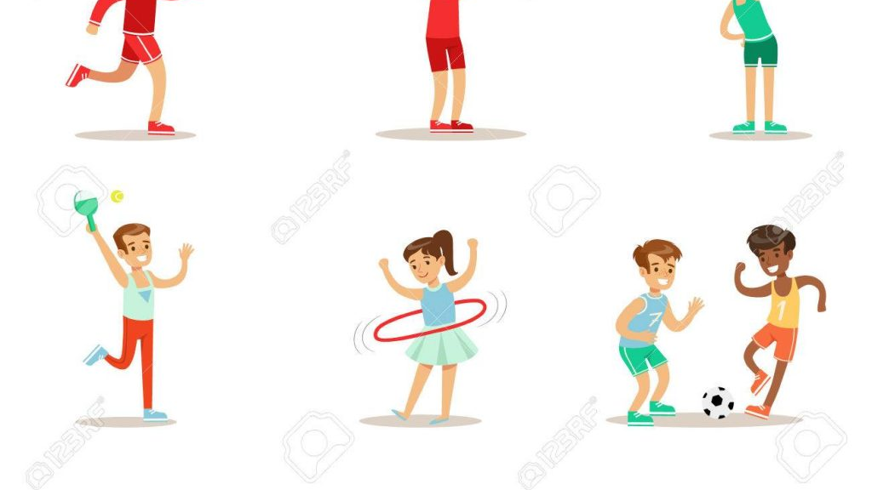
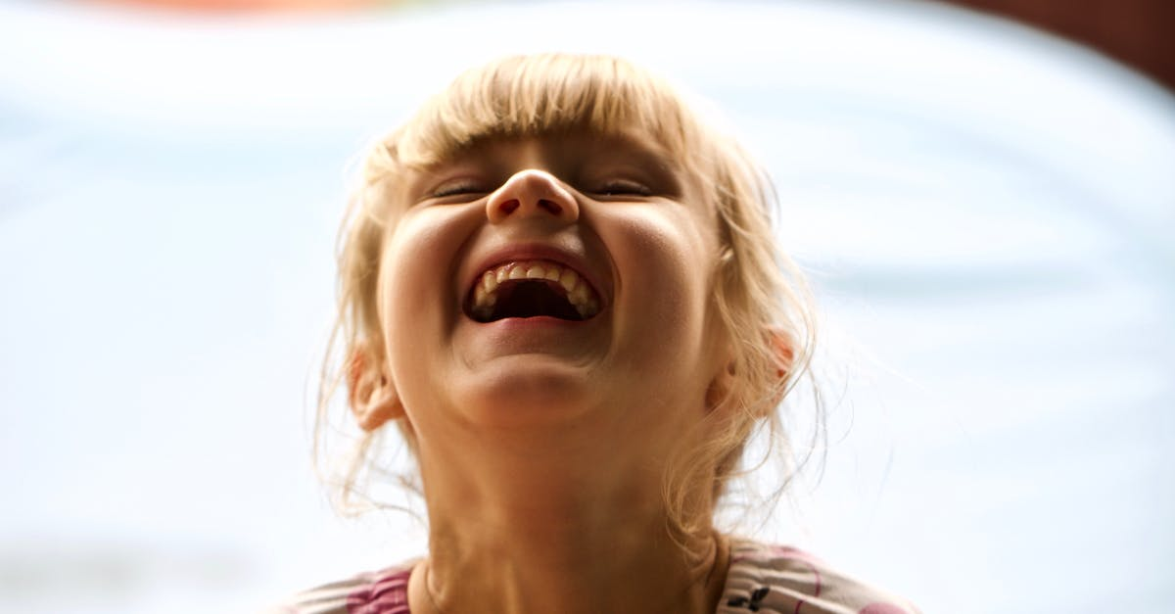
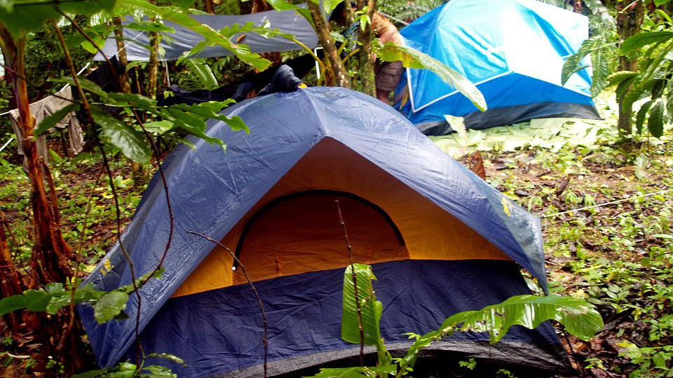
Managing stress in our bodies

Slide 90
Check Out

Slide 91
Session Nine – Money management for a better future
Check In
Essential vs Non-essential
Brain teaser
Group task – saving and spending!
Small sacrifices, big savings!
Saving tips
Traffic lights
Check out

Slide 92
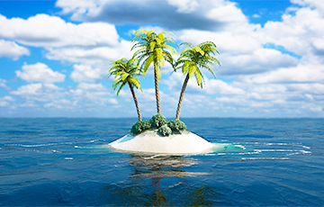
Desert Island
You are stranded on a desert island. You can only choose three items to bring with you.
What will you bring?
Why?

Slide 93
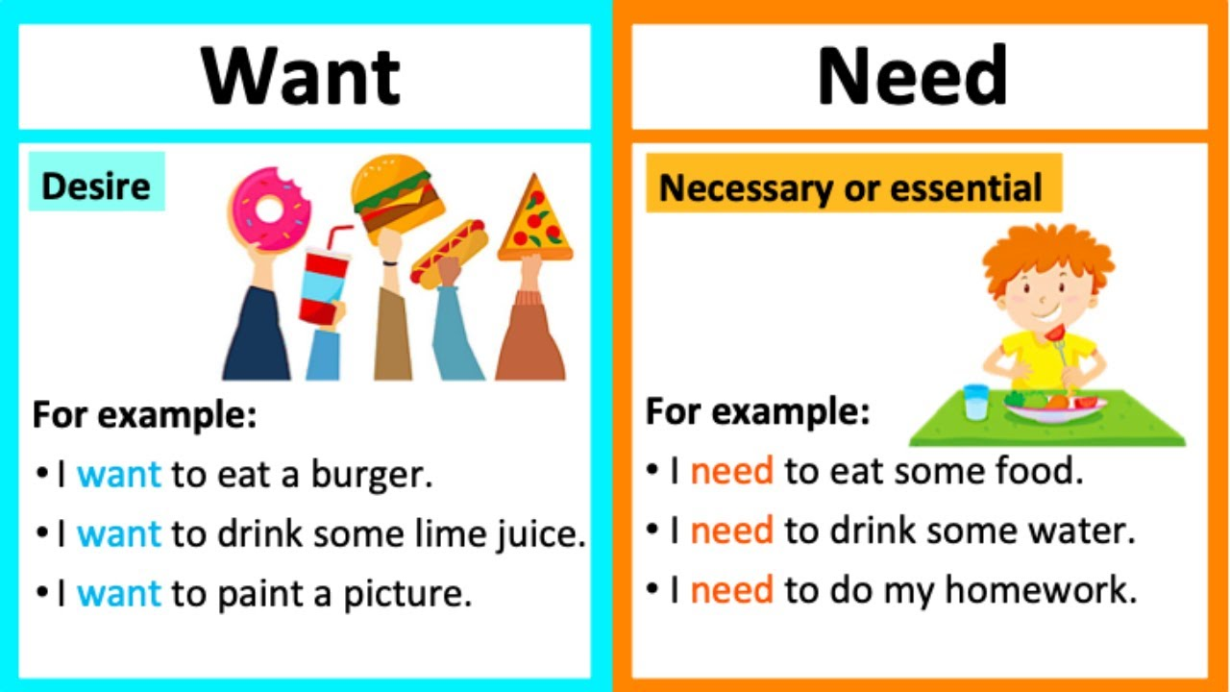
Did you pick essential or non-essential items?

Slide 94
Individual reflection
Think about last non-food item you bought or asked someone else to buy you.
How did it make you feel when you got it?
How often have you used it?
Did you really NEED it/ was it ESSENTIAL?
Do you feel pressure to buy certain things?

Slide 95
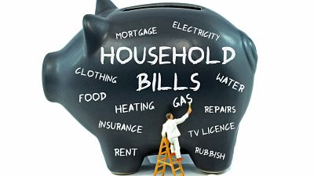
Brain Teaser
How much does the average family in NI spend per week on essential household costs?

Slide 96
£486.40 per week (2020 figures)
Notes:
Use up-to-date figures

Slide 97
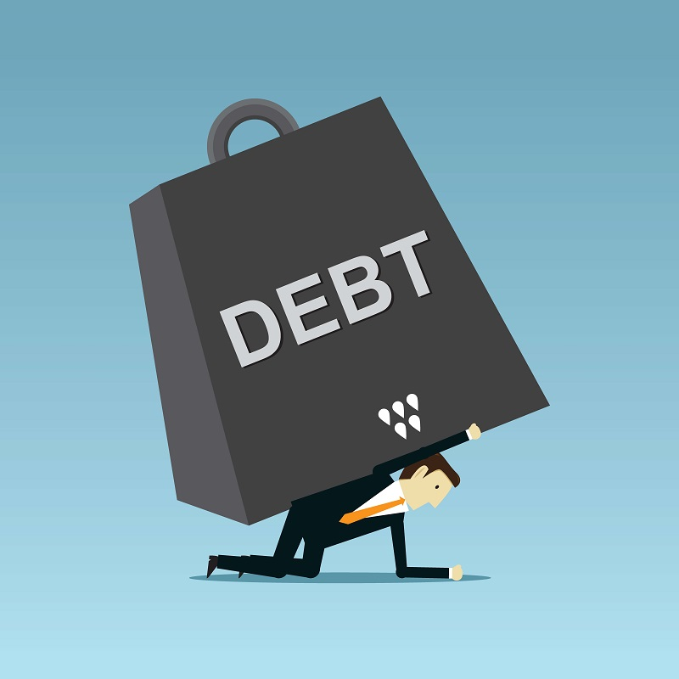
Average income of people in NI - £485.25 per week (2020 figures)
Average person has £1.15 to spend on non-essential items per week (2020 figures)
This has the potential to lead to poverty and increasing debt.
Notes:
Use up-to-date figures

Slide 98
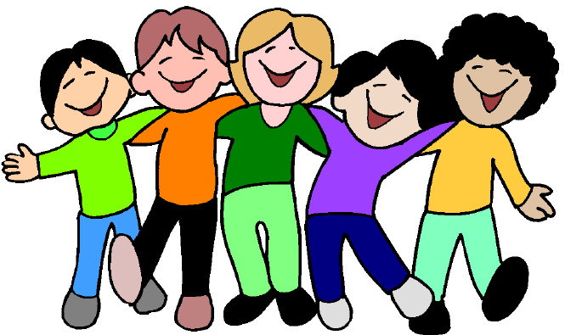
Group task – Saving and spending!
Organise a family or friends day out
Your budget is £60.00 (you don’t have to spend all this!)
Must be fun for all
Think about food, transport, entrance and other essential costs

Slide 99
Saving tips!

Slide 100
Red – One thing you will stop doing Amber – One thing you will find out more about Green – One thing you will start doing

Slide 101
Check Out

Slide 102
Session Ten – Looking ahead to the future
Check In
All about you!
Dream Job
Journey to employment
In the hot seat
Check out

Slide 103
All about you!
Palm – Name
Thumb – Personal quality
Index finger – Skill
Middle finger – Something you would like to improve
Ring finger – Something you are passionate about
Little finger – Describe yourself in one word!

Slide 104
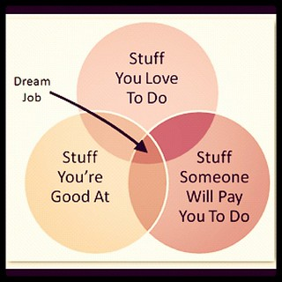
Your dream job!

Slide 105
Your journey to employment
Think about:
Choices/ decisions you will have to make
Skills/ experience you might need to develop
Obstacles/ challenges/ opportunities that may present themselves along the way

Slide 106
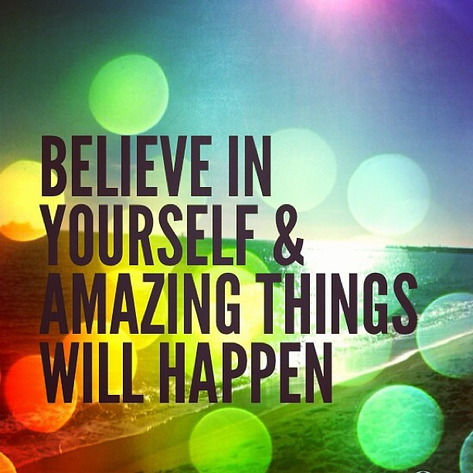
In the hot seat!
Think about how you enter the room, your body language, eye contact, and your tone and pace of voice.
The interviewers will be looking for someone who is confident, communicates well, dependable and trustworthy.
Be yourself!

Slide 107
Overall Evaluation & Check Out

